Slide 1
Reseacher
patient
Frontend layer
Patient dashboard
Researcher dashboard
Local storage
Backend layer
API gateway
Auth service
Trial & issue manangement
Issue service
Protocol analysis engine
Matching & scoring service
Patient data aggregator
Reporting & analytics engine
Campus DB

Slide 2
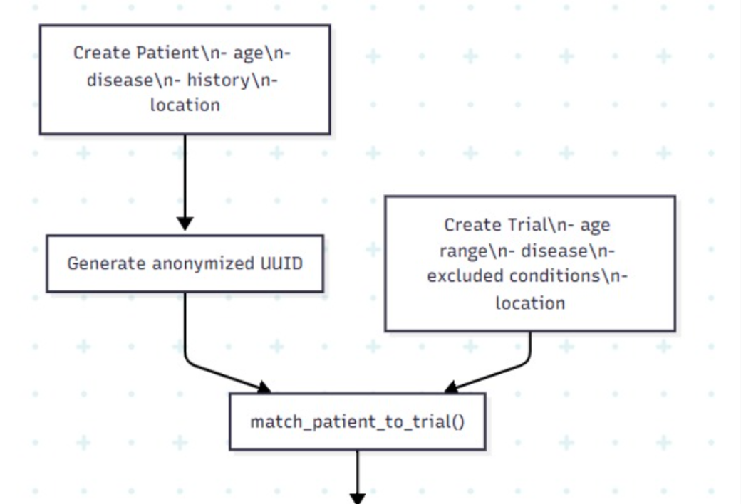

Slide 3
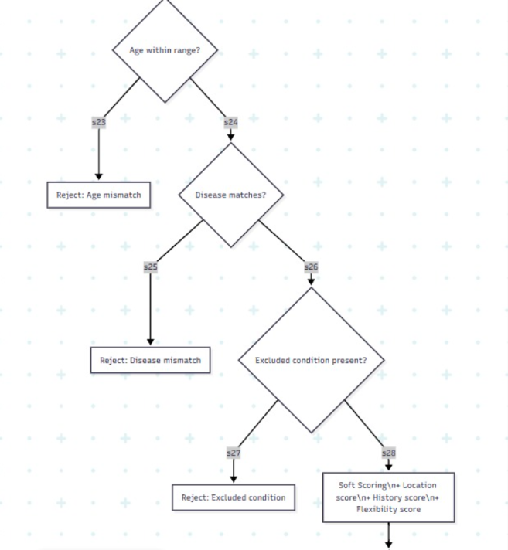

Slide 4
