Slide 1

Title: Currency Exchange Rate Calculator Tool
Student Name: Panapakam Hasini
Student ID: 2520030282
Cluster: 2
Section: 6
Under the Guidance
of
Supervisor Name:
Assistant Professor
Department of CSE

Slide 2
ABSTRACT
The Currency Converter Project is designed to provide users with a simple, efficient, and visually appealing platform to convert values between multiple currencies. Built using Core Java and enhanced with a graphical user interface (GUI), the application integrates both static conversion logic and live exchange rate API to ensure accurate and real-time results.A reliable converter helps users quickly calculate values across different currencies without manual effort. This project, Smart Global Currency Converter Tool, is designed to provide accurate, real-time conversions through a user-friendly interface. It combines Core Java programming concepts with API integration and a graphical user interface (GUI) to deliver technical robustness.

Slide 3
Existing System
Currency Converter Plus – Offline mode with updated rates.
Easy Currency Converter – Supports 200+ currencies, includes charts and historical data.
Revolut App – Banking + currency exchange with competitive rates.
XE Currency Converter – Widely used by travelers and individuals for quick conversions.
OANDA Currency Converter – Offers live rates and historical data, popular among traders.
Google Currency Converter – Built into Google Search for instant conversions.
Yahoo Finance Converter – Provides exchange rates alongside financial market data.

Slide 4
Proposed System
1. Hybrid Conversion Logic
2. User-Friendly GUI
3. Accuracy & Transparency
4. Multi-Currency Support
5. Performance & Reliability

Slide 5
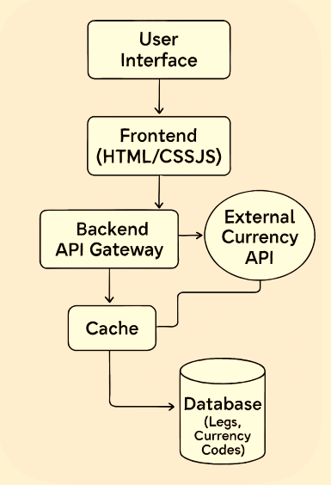
System Architecture

Slide 6
Project Modules
1. User Interface Module
2.Currency Conversion Module
3.Exchange Rate API Module
4.Rate Management Module

Slide 7
Objectives
Provide Accurate Conversions
Support Multi-Currency Operations
Ensure Accessibility & Reliability
Enhance User Experience
Educational & Technical Value

Slide 8
Co’s Attainments
CO-1: Internet Fundamentals & CSS Basics
This section establishes the web client-server foundation and core styling.
1.1 HTML Document Structure
1.2 Core CSS Styling
CO-2: HTML Forms, Semantic Tags & Layouts
Focuses on structured content, advanced layouts, and responsive design.
2.1 Forms & Semantic Content
2.2 Comprehensive Layouts & Animation

Slide 9
Co’s Attainments
CO-3: JavaScript Programming Essentials
Focuses on the core logic and data structures of the application.
3.1 JavaScript Fundamentals
CO-4: JavaScript Interactivity, DOM & Async
Covers how the app responds to users and interacts with browser storage.
4.1 DOM Manipulation & Events
4.2 Storage & Async Programming
CO-5: Advanced Web Development
Highlights integration with external services and robust error handling.
5.1 API Integration & Exception Handling

Slide 10
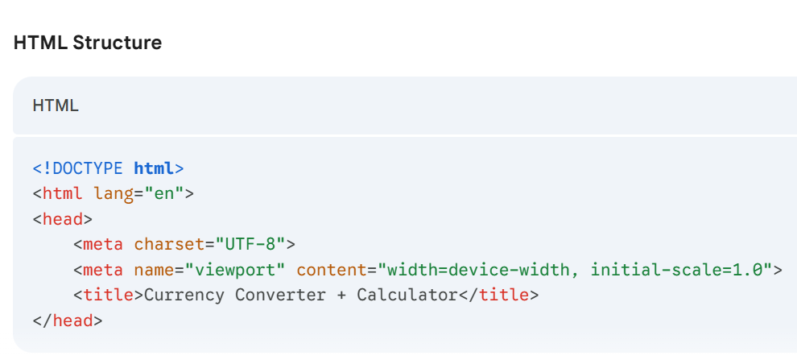
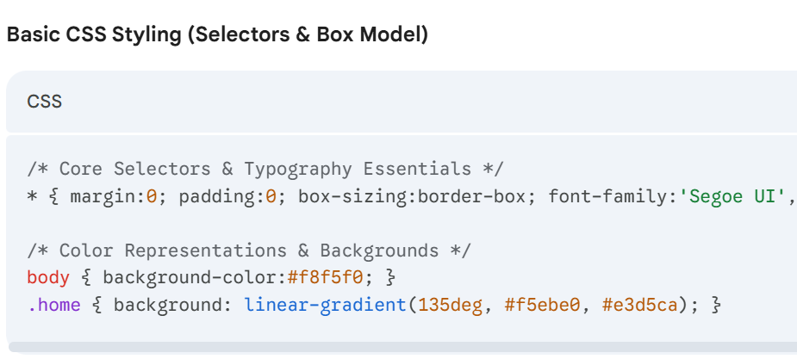
Screenshots for FWD & DSA
CO-1: Internet Fundamentals & CSS Basics

Slide 11
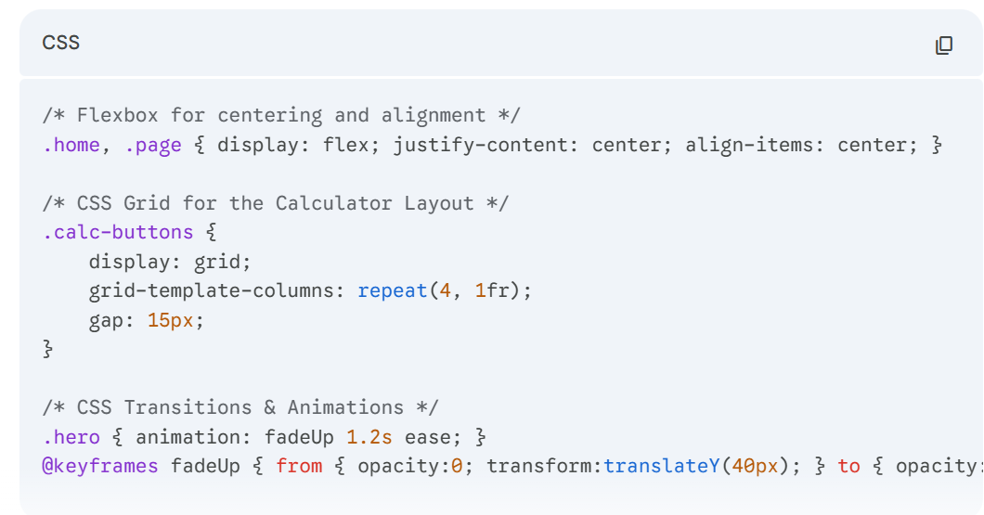
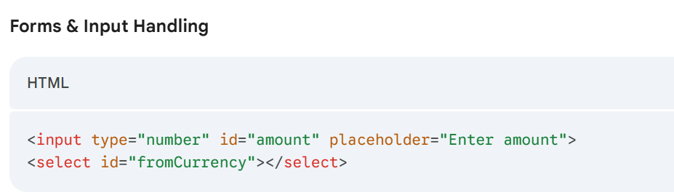
CO-2: HTML Forms, Semantic Tags & Layouts

Slide 12
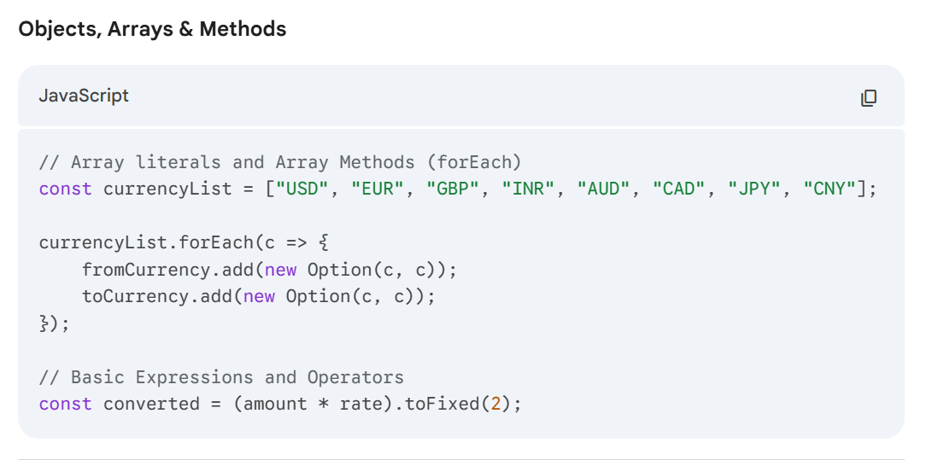
CO-3: JavaScript Programming Essentials

Slide 13
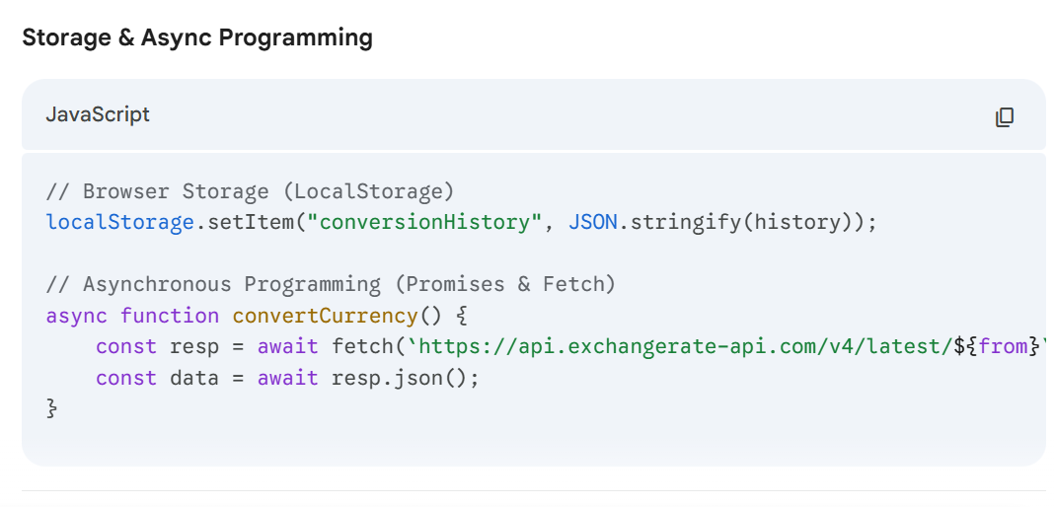
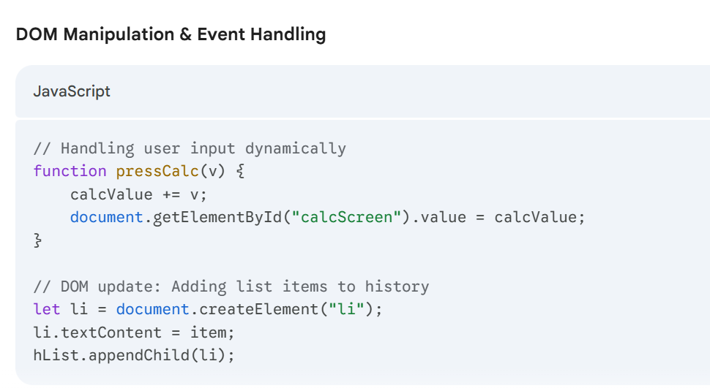
CO-4: JS Interactivity, DOM & Async

Slide 14
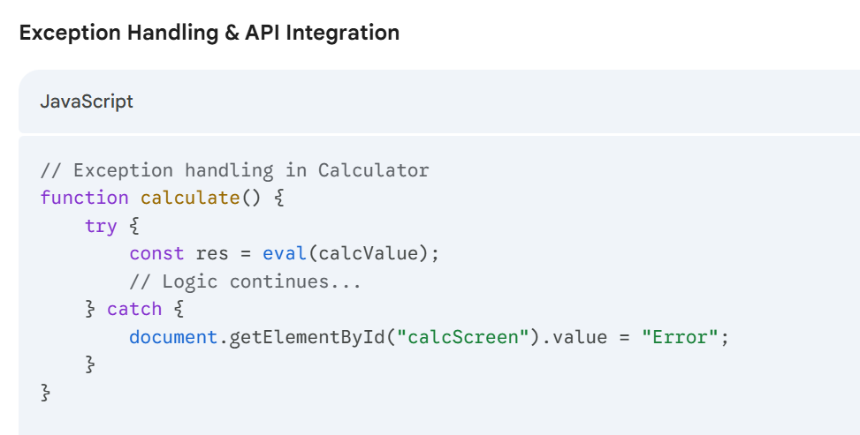
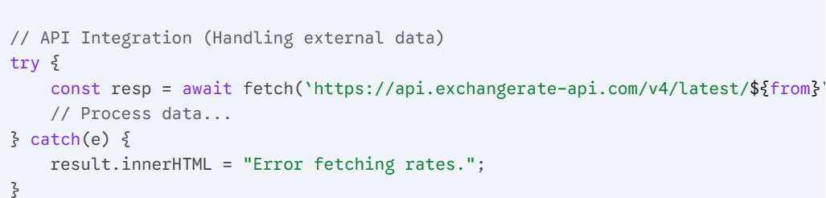
CO-5: Advanced Web Development & Deployment

Slide 15
Conclusion
This project successfully addresses the limitations of existing systems by combining static conversion logic with live exchange rate API integration.
This hybrid approach ensures both accuracy and reliability, even in offline scenarios.
With its user-friendly graphical interface, the system simplifies complex calculations, making currency conversion accessible to all users.

Slide 16
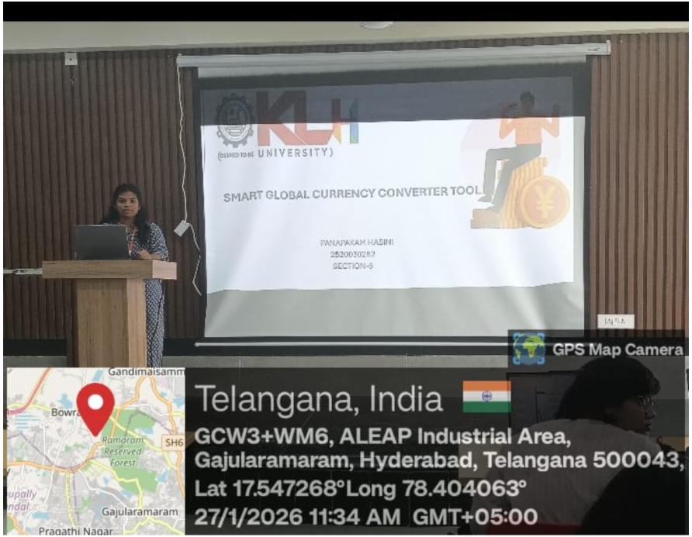
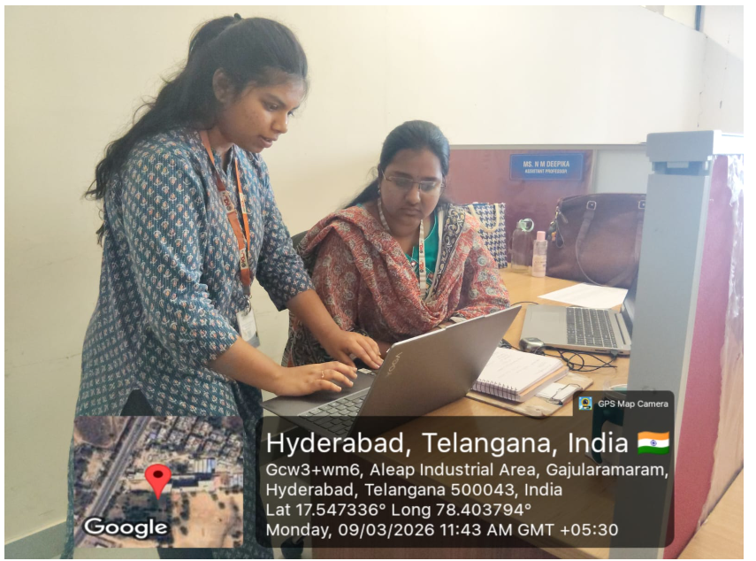
Geo- Tag Photos

Slide 17
THANK YOU

