Slide 1
DBSE&DBD PROJECT
Vehicle Parking Finder
& Booking App
Team No. 25 · Section 08
Student Name | Roll Number
Cherukuri Hamsini | 2520030016
Hasini Reddy | 2520030116

Slide 2
INTRODUCTION
Introduction to the Project
A smart application that helps vehicle owners find, check and book available parking spaces quickly and conveniently
Addresses the everyday difficulty of locating vacant parking in busy areas
Users can search nearby parking, compare options and reserve a slot in advance instead of arriving uninformed
Aimed at high-footfall locations: shopping malls, colleges, offices, hospitals and commercial areas
Core purpose: make finding and reserving a parking space simple, reliable and stress-free
WHERE IT'S NEEDED
M
Shopping Malls
C
Colleges
O
Offices
H
Hospitals
A
Commercial Areas

Slide 3
PROJECT ABSTRACT
Abstract
The Vehicle Parking Finder & Booking App is a smart parking management system designed to help vehicle owners find, check, and book available parking spaces quickly and conveniently. It addresses the difficulty of finding parking in busy locations such as shopping malls, colleges, offices, hospitals, and commercial areas. Users can search for nearby parking areas, view availability, location, pricing, capacity, and operating hours, select a suitable parking slot, choose a duration, and book the slot in advance. The system updates parking availability whenever a slot is reserved or released. Parking administrators can add and manage parking locations, monitor available and occupied slots, update parking charges, and manage bookings. A structured database stores user information, parking locations, slot details, and booking records. The application can also provide booking confirmation and maintain reservation history.

Slide 4
THE CHALLENGE
Problem Statement
Finding a vacant parking space in busy areas is time-consuming
Users often have to drive around searching for available spaces
This causes unnecessary delays for people trying to reach their destination
Repeated searching for parking adds to local traffic congestion
It also results in avoidable fuel wastage
Users rarely know availability, pricing or operating hours before arriving at a location
There is a clear need for a centralized system to check and reserve parking in advance
!
The proposed system aims to reduce the uncertainty and time involved in finding parking by providing a centralized parking discovery and booking platform.
Delayed arrival · Traffic congestion · Fuel wastage · Uncertainty · No advance booking

Slide 5
COMPARISON
Existing System vs Proposed System
EXISTING SYSTEM
PROPOSED SYSTEM
Apps such as Park+ allow users to search for parking and book a parking space in advance.
They provide parking discovery based on location and allow users to select booking time/date.
However, parking availability and pricing can depend heavily on the coverage and accuracy of the parking inventory.
Some third-party reviews report inconsistencies in availability/pricing information and note that bookable parking coverage is concentrated in certain cities.
Park+ is also an all-in-one vehicle services app, combining parking with FASTag, challans, insurance, vehicle information, loans and other services.
This can make the parking experience less focused because parking is only one part of a much larger application.
Centralized digital parking platform
Users search for nearby parking areas
Displays real-time availability and slot information
Shows location, pricing, capacity and operating hours
Users select a slot and book it in advance
Availability updates on reservation / release
Admin manages locations, slots, charges and bookings

Slide 6
SYSTEM DESIGN
Proposed System Architecture
User / Admin
React.js Frontend
UI Layer
Google Maps API
Parking location display & navigation
Node.js + Express.js Backend
Postman
REST APIs
Backend REST API testing
MySQL Database
Users · Parking · Slots · Bookings
USER FLOW
Search Parking → View Availability → Select Slot → Choose Duration → Book Slot → DB Updated
ADMIN FLOW
Manage Locations → Manage Slots → Update Charges → Monitor Bookings / Availability

Slide 7
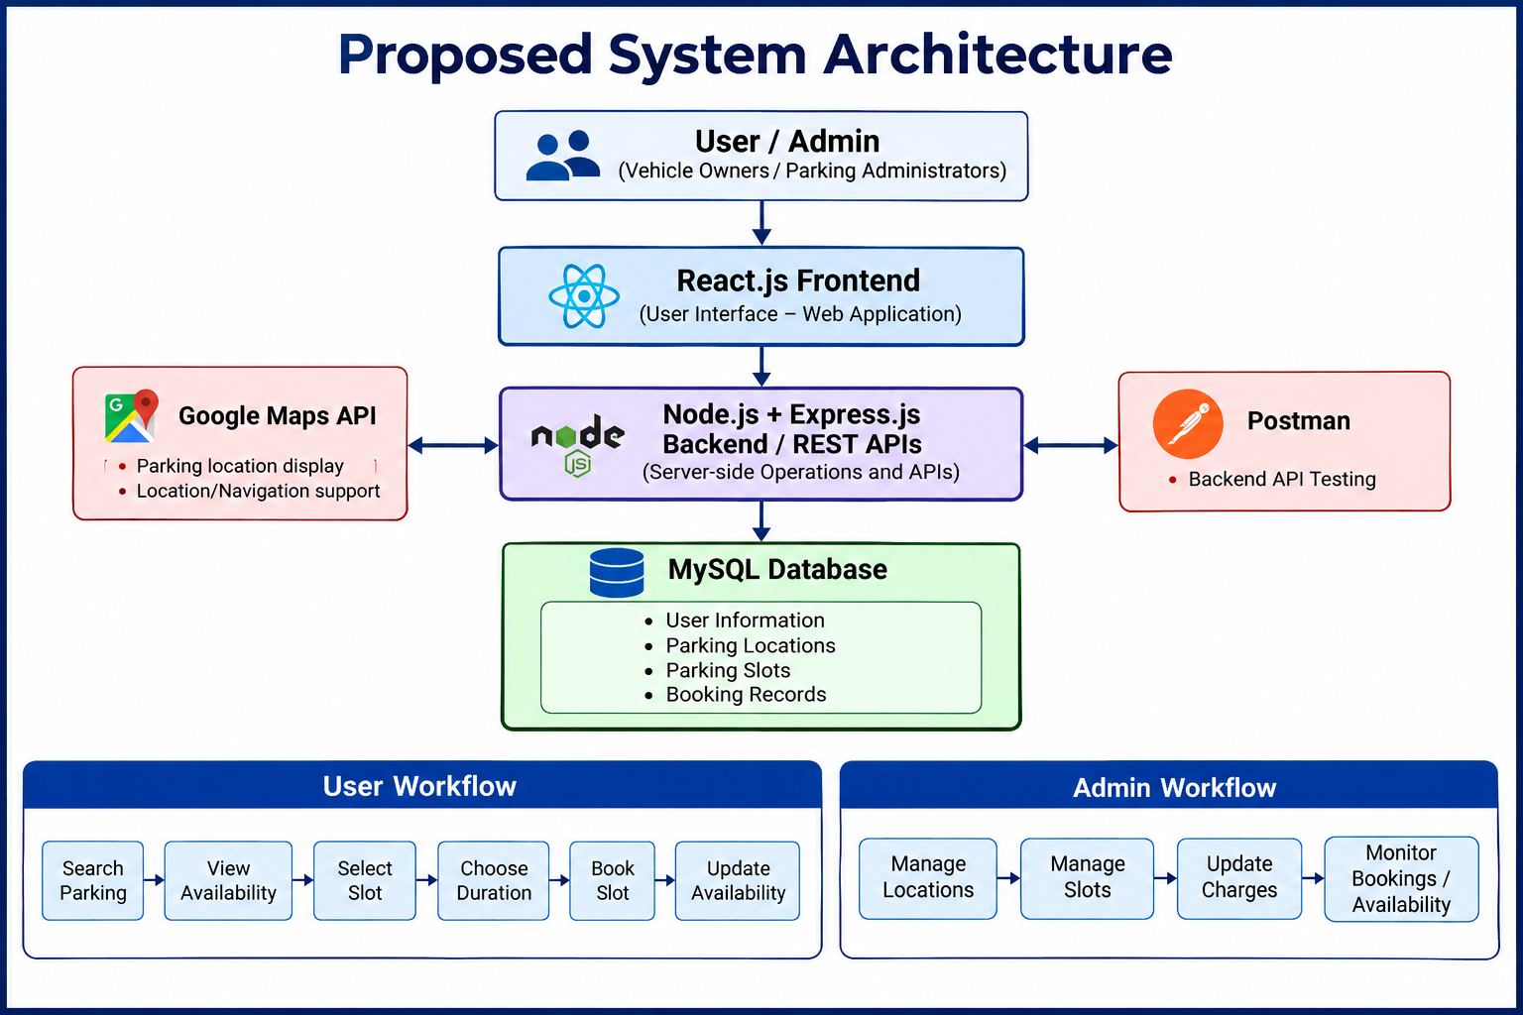
SYSTEM DESIGN​
Proposed System Architecture​

Slide 8
TECH STACK
Tools and Technologies Used
FRONTEND
BACKEND
DATABASE
HTML / CSS / JavaScript
Node.js
MySQL
Structure & styling
Server-side operations
Users, parking, slots & bookings
React.js
Express.js
Interactive user interface
REST APIs
DEV & VERSION CONTROL
TESTING & MAPS
DESIGN & BROWSER
VS Code
Postman
Figma
Development environment
Backend API testing
Interface design & prototyping
Git & GitHub
Google Maps API
Google Chrome
Code management & tracking
Locations & navigation
Running & testing the app

Slide 9
THANK YOU
Vehicle Parking Finder & Booking App

