Slide 1
PrODUCt SALES ANALYSIS
By
Hasini Thalla (2319751)

Slide 2
CONTENTS
Objectives
Requirements
Architecture diagram
Pipeline structure
Pipeline
Databricks Notebook
Outputs
I
Portfolio Build Up
Areas Of Focus
Summary

Slide 3
OBJECTIVES
Build a real-world data pipeline in Azure Data Factory (ADF) to analyze the product sales analysis using Azure cloud data services.​
Ingest data from flat files into Azure Data Lake Gen2 and from http source using ADF ​
Transform data using Azure Data bricks
Setting an email configuration upon success/failure of pipeline

Slide 4
REQUIR EMENTS
Problem statement: Fetch data from source url & load in staging raw layer as zip file & processed or clean data that has been arrived in last 24 hrs from source & load into ADLS refined container in parquet file as delta table while following below instruction:
The two requirements of the project are
Step 1 - Data preparation (use ADF):-
Fetch data from Source url & load in raw layer.
Unzip file with help of ADF/ADB under refined<participant_name>/Unzippeddata/file.
Fetch data that has been processed in last 24 hrs from source & load into ADLS refined container in parquet file while following below instruction:
Check if the file is available in the path. If it’s not available, there should be timeout after 10 minute.

Slide 5
REQUIR EMENTS
Step 2 - Data transformation(ADB):
for sourceorderheader file give the schema of column as per below
SalesOrderID,RevisionNumber,OrderDate,DueDate,ShipDate,Status,OnlineOrderFlag,SalesOrderNumber,PurchaseOrderNumber,AccountNumber,CustomerID,ShipToAddressID,BillToAddressID,ShipMethod,CreditCardApprovalCode,SubTotal,TaxAmt,Freight,TotalDue,Comment,rowguid,ModifiedDate
Drop all entries where color is null in product table.
From product file under column Name remove color & size only keep value before ‘-‘. Eg: HL Road Frame - Black, 58 à HL Road Frame
Check which product is mostly purchased.
Load final data on delta tables under adls processed container

Slide 6




ARCHItecture diagram
Azure Data Factory
Unzipping the files and performing checks
Azure DataBricks
Transforming the data
http://
From git repo
(http connector)
SalesOrderHeader
Ingest
Azure Data Lake Gen2
Raw Layer
Cohort3data.zip
Salesorderheader.zip
Azure Data Lake Gen2
Refined Layer
Cohort3data—2files
Product.csv
Salesorderdetail.csv
Salesorderheader.csv
Azure Data Lake Gen2
Presented Layer
Parquet files(delta tables)
POWER BI
Analyze and Visulize using powerBI
Cohort 3.zip
(Azure DataLake Gen2)

Slide 7
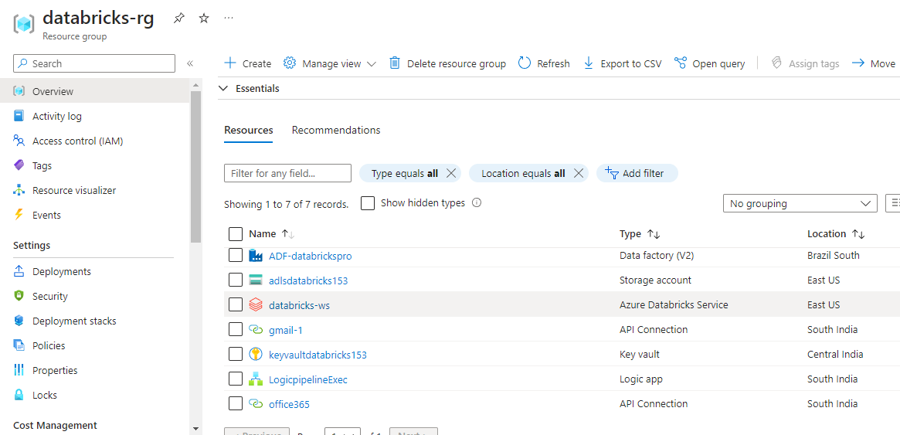
Resources Used
All the Azure services used
Azure Data Lake Gen2
Azure Data Factory
Azure Databricks
Azure KeyVault
Azure Logic App

Slide 8
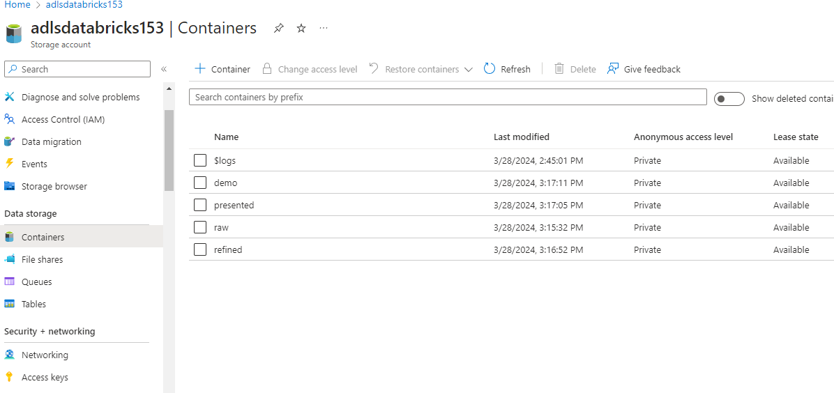
Containers in Azure DataLAKE

Slide 9
Containers in Azure DataLAKE

Slide 10
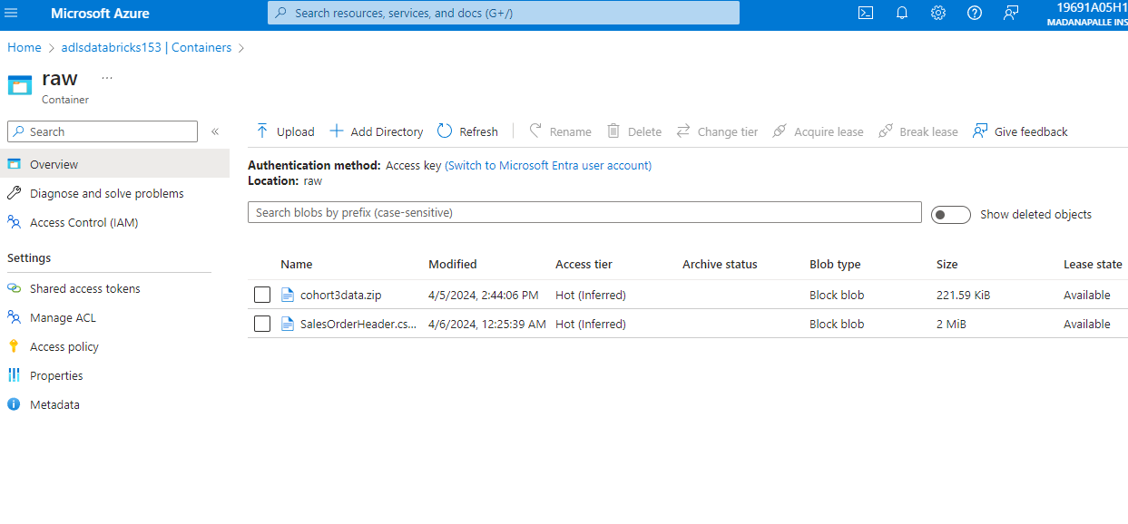
RAW Container in Azure DataLAKE

Slide 11
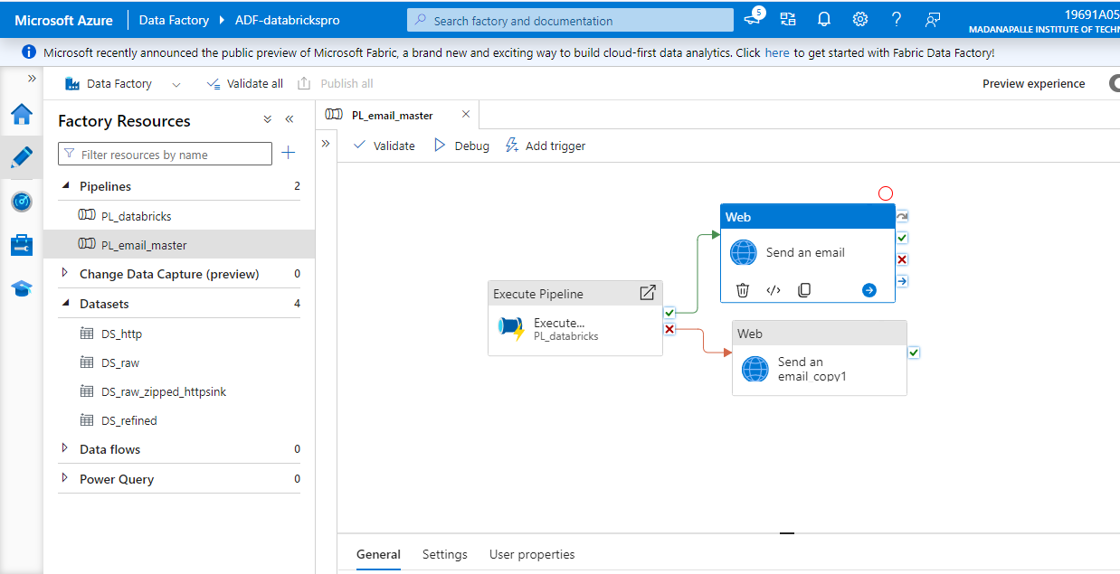
ADF MASTER PIPELINE

Slide 12
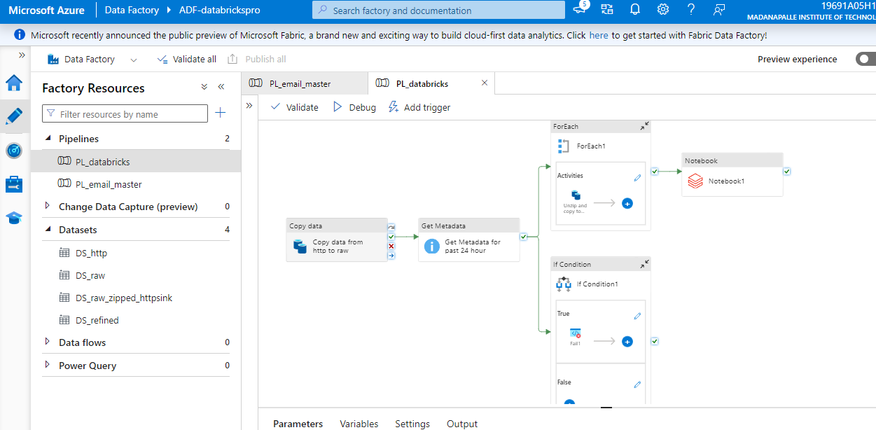
ADF CHILD PIPELINE

Slide 13
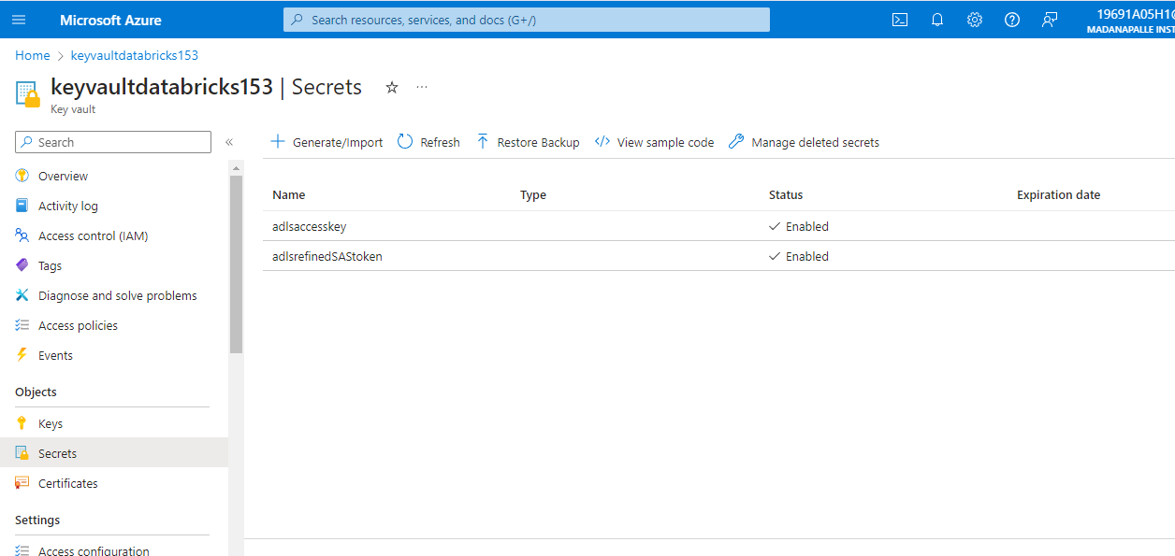
ADF KEYVAULT

Slide 14
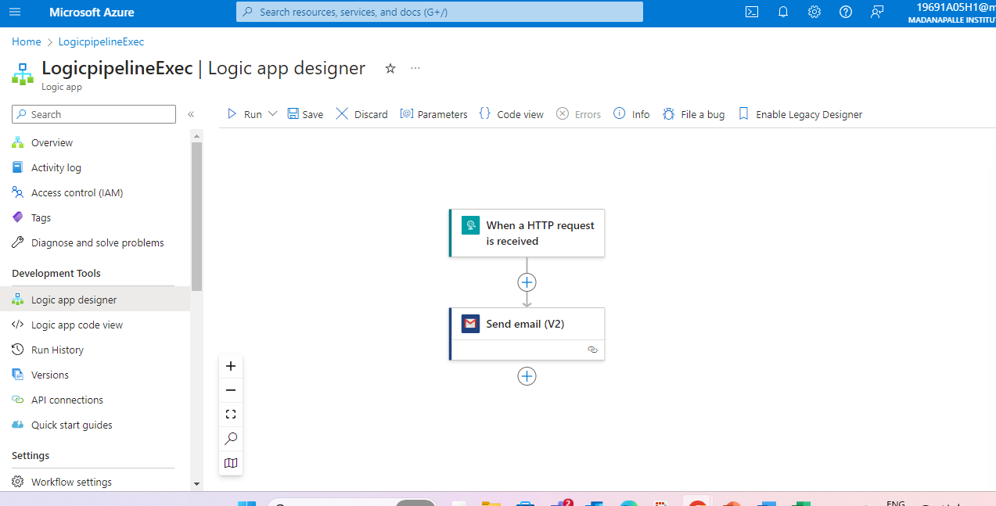
ADF logic app

Slide 15
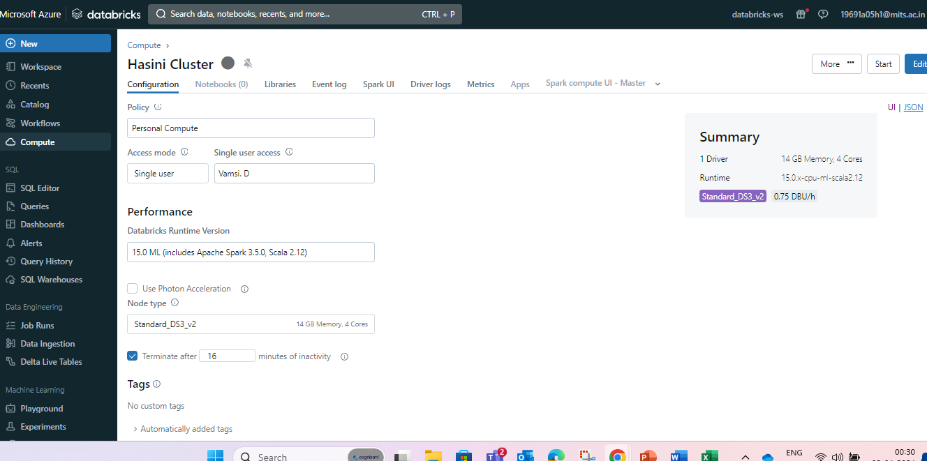
Databricks-Cluster

Slide 16
Databricks-Cluster

Slide 17
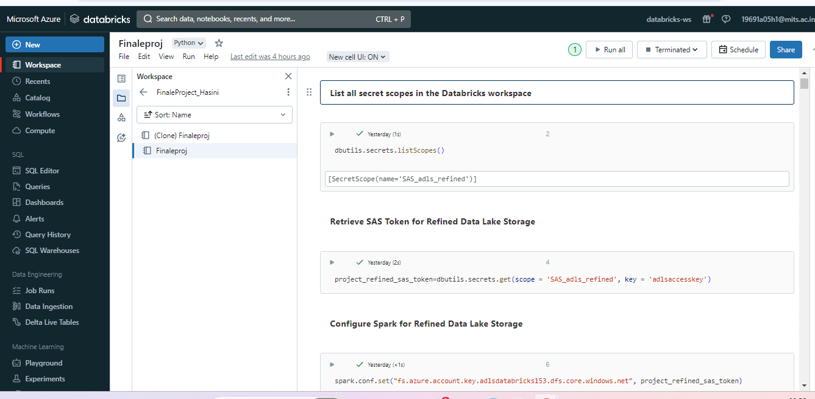
Databricks-NOTEBOOK

Slide 18
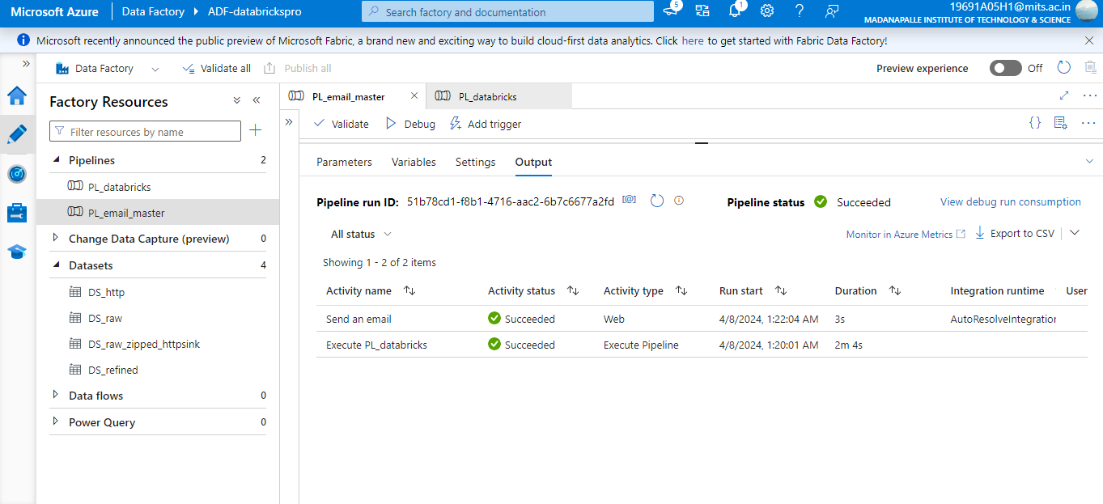
OUTPUTS-ADF MASTER PIPELINE

Slide 19
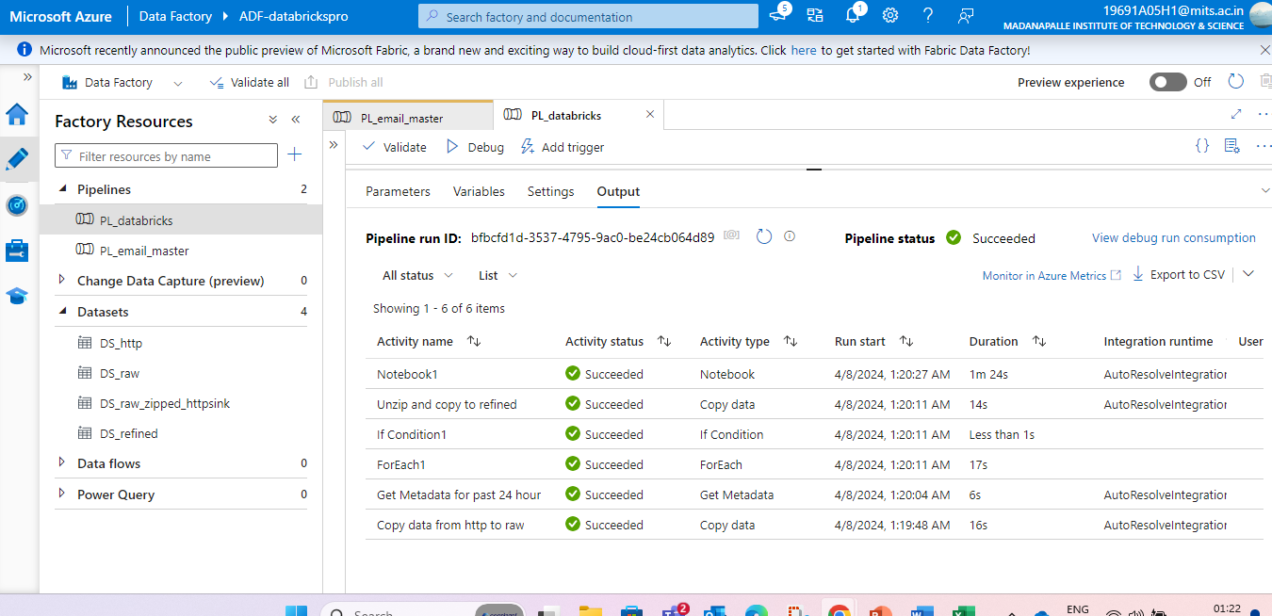
OUTPUTS-ADF CHILD PIPELINE

Slide 20
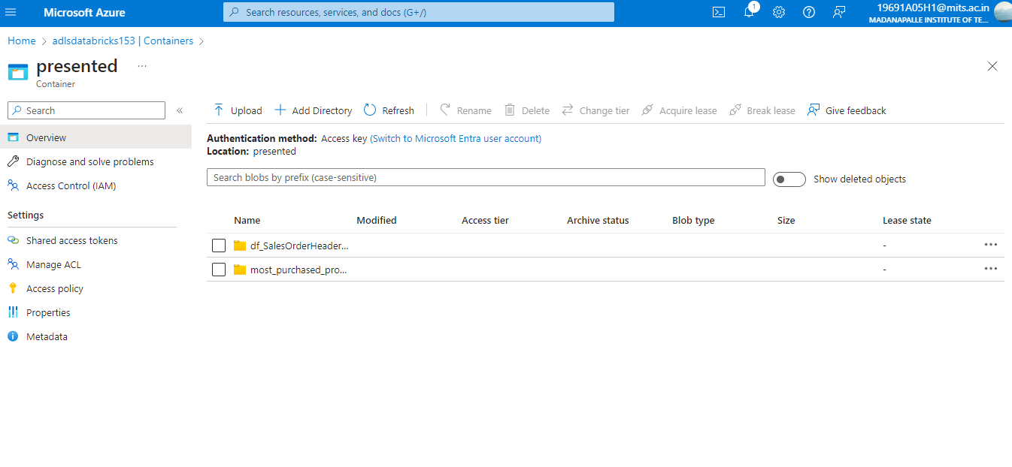
OUTPUTS-ADLS Presented container

Slide 21
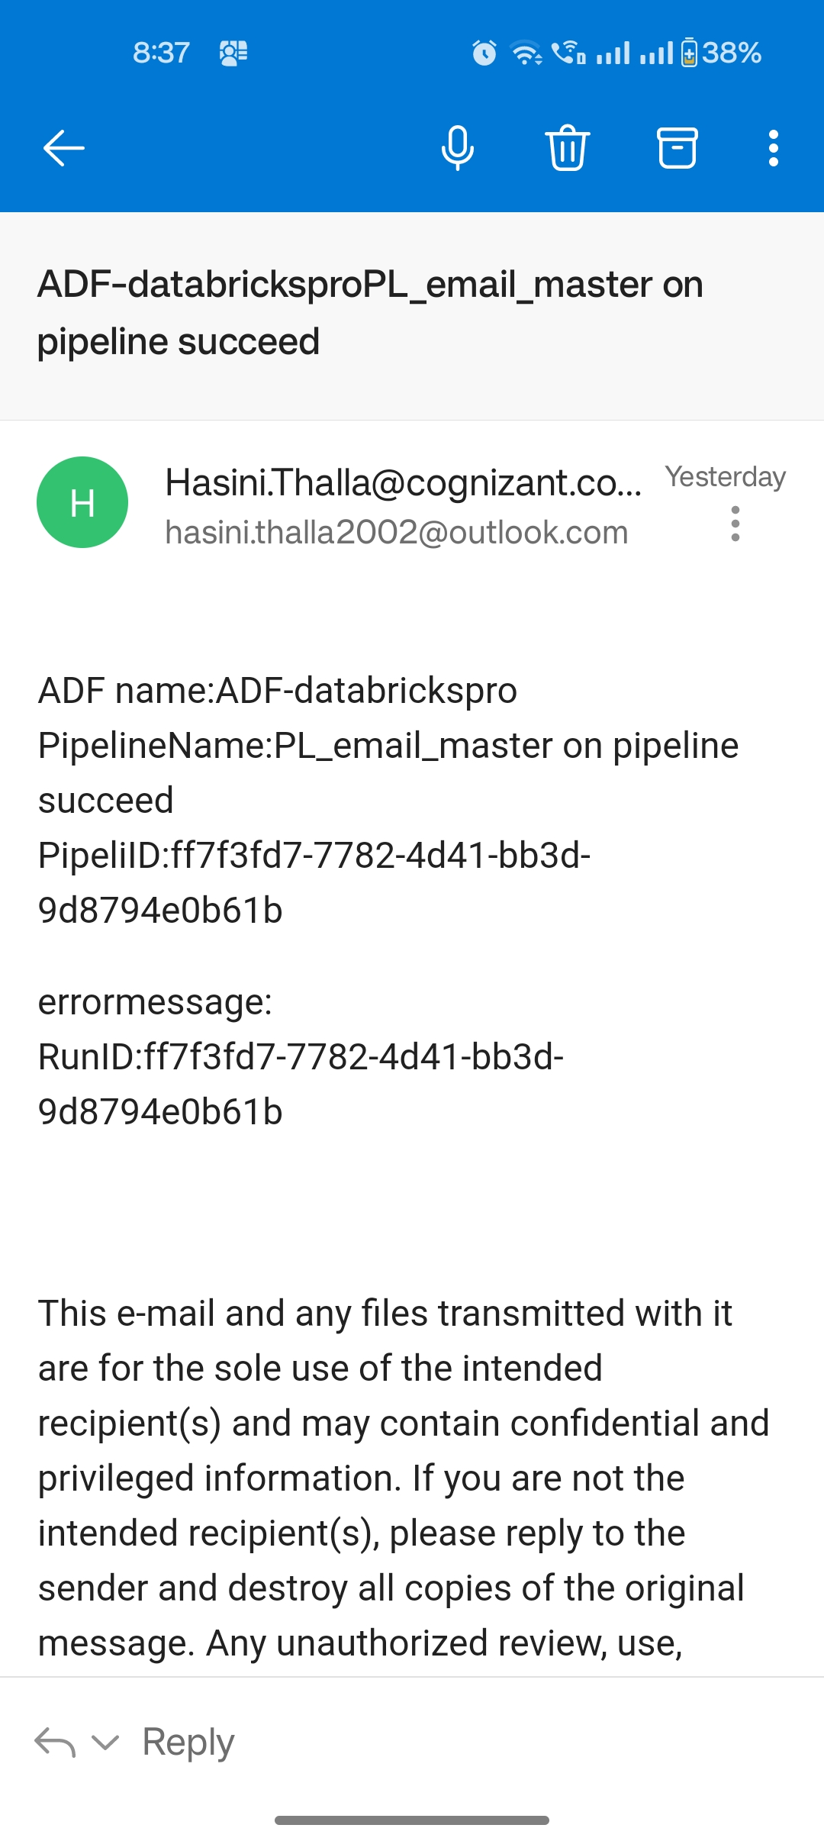
OUTPUTS-email notification

Slide 22
THANK YOU
Hasini Thalla
2319751@cognizant.com

