Slide 1
Clothes-Changing Person Re-Identification on PRCC
A comparison of a ResNet-50 baseline, TransReID and CAL under one training protocol
[Your name] | November 2026
Notes:
Today I compare three person re-identification models on the same task: finding a person in another camera when they wear different clothes.

Slide 2
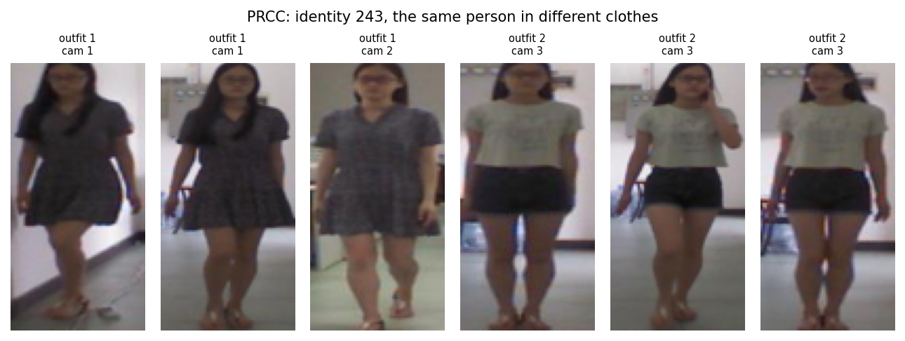
The task: find the same person in new clothes
Re-identification ranks gallery images so the same person comes first
Most models learn to match people by their clothes
In PRCC, camera C shows each person on another day in different clothes
The model has to use body shape, hair, face and posture instead
One training identity in its two outfits (cameras A and B against camera C)

Slide 3
Why the earlier numbers could not be compared
In the first stage each paper was reproduced with its own settings. They matched the papers, but they were trained differently:
Setting | CAL and baseline (own) | TransReID (own) | Common protocol
Input size | 384 x 192 | 256 x 128 | 256 x 128
Batch | 4 people x 8 images | 16 people x 4 images | 16 people x 4 images
Epochs | 60 | 120 | 60
Flip at test | yes | no | yes
Reported epoch | best on test set | best on test set | last
Goal: one task, one dataset, one protocol, and all three models trained again from scratch.
Notes:
Any difference in the old numbers could come from the settings instead of the methods. So the supervisor asked for one fixed task and retraining.

Slide 4
Three models, one task
1
Baseline
2
TransReID
3
CAL
ResNet-50
ViT-B/16, ICCV 2021
ResNet-50, CVPR 2022
Same network as CAL
Identity loss only
Shows what the CAL loss adds
Transformer over image patches
Camera embedding (SIE)
Jigsaw patch branch (JPM)
Clothes classifier per outfit
Adversarial loss hides outfits
Switched on at epoch 26
Notes:
The baseline is the CAL network without the clothes losses, so comparing those two isolates the CAL loss.

Slide 5
The common protocol
Same for all three
Kept from each paper
17,896 PRCC training images
256 x 128 input
Batch of 16 people x 4 images
Flip, pad and crop, random erasing
60 epochs
Flip at test, cosine distance
Report the last epoch
Backbone and pre-trained weights
Loss functions
Optimiser and learning-rate schedule
Input normalisation
Why: changing a method's own loss or optimiser would test a different method.
Notes:
Reporting the last epoch matters: picking the best epoch on the test set favours models whose score jumps around.

Slide 6
First check: the reproduction matches the papers
95.07
54.93
45.70
TransReID Rank-1, Market-1501
CAL mAP, PRCC clothes-changing
Baseline Rank-1, PRCC clothes-changing
paper 95.2
paper 55.8
paper 45.6
All three are within about two points of the published numbers, so the data loading, training code and evaluation are correct.

Slide 7
Main result: the baseline ends on top
Baseline: 51.0 Rank-1, 51.7 mAP
TransReID and CAL end about 3.5 mAP lower and almost tied
Same clothes: all three above 99.7 Rank-1
Notes:
When clothes stay the same, all three models are nearly perfect. All the difficulty is in the clothes-changing setting.

Slide 8
CAL wins for a while, then fades
Epoch 26: CAL loss switched on
Epoch 30: CAL is best, 51.45 mAP
Epoch 60: CAL down to 48.04, baseline still climbing
TransReID: flat at about 48 from epoch 10

Slide 9
The training setup changes the ranking
+8.67
CAL minus baseline, own settings
-3.63
CAL minus baseline, common protocol
Notes:
The baseline and CAL share the same network and optimiser, so this shows that the benefit of the CAL loss depends on the training setup.

Slide 10
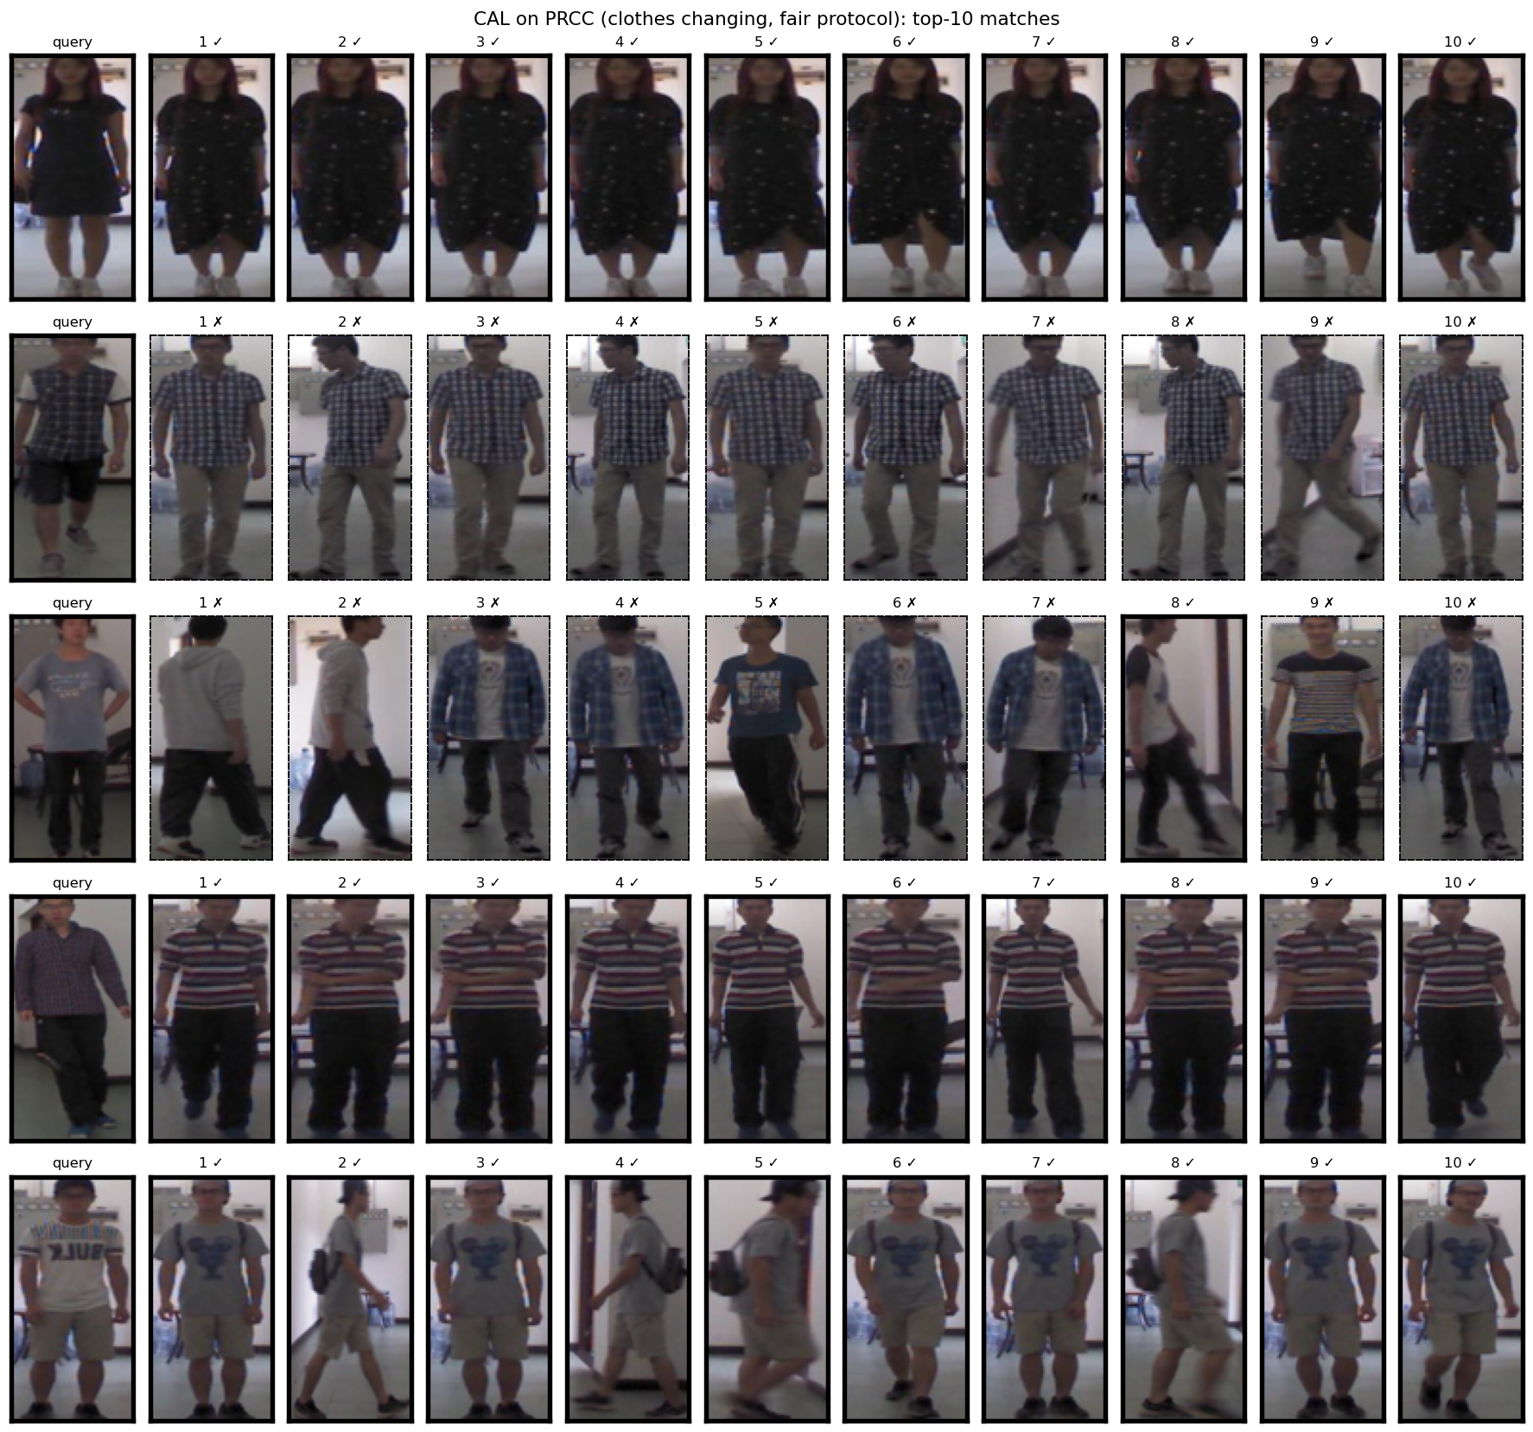
Retrieval examples (CAL)
Five clothes-changing queries, top ten matches
Solid frame and tick: correct person
Dashed frame and cross: wrong person
Some queries are found in new clothes, others match a stranger in similar clothes

Slide 11
Why did the baseline end on top?
Possible explanations, not yet tested one by one:
1
Smaller images
2
Batch structure
Without clothes, CAL needs hair, face and shoes, which are harder to see at 256 x 128
4 images per person means a batch less often holds both outfits of one person
3
Unstable after the switch
4
A stronger baseline
The adversarial contest drifts over time; reporting the last epoch shows the drift
The baseline itself gained 6 mAP from the new settings

Slide 12
Limitations and next steps
Limitations
Next steps
One run per model (seed 0)
Gaps between models are close to the run-to-run swing
One protocol and one dataset
No separate validation set in PRCC
1
Run seeds 1 and 2, report mean and spread
2
Repeat with CAL's own settings for all three
3
Try the CAL loss on the TransReID backbone

Slide 13
Conclusion
Under one protocol, the plain baseline gave the best final result (51.7 mAP).
CAL helps right after it switches on, but with these settings the gain does not last.
A bigger transformer backbone alone does not solve clothes changes.
More seeds are needed before firm conclusions.

