Slide 1
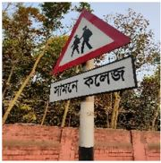

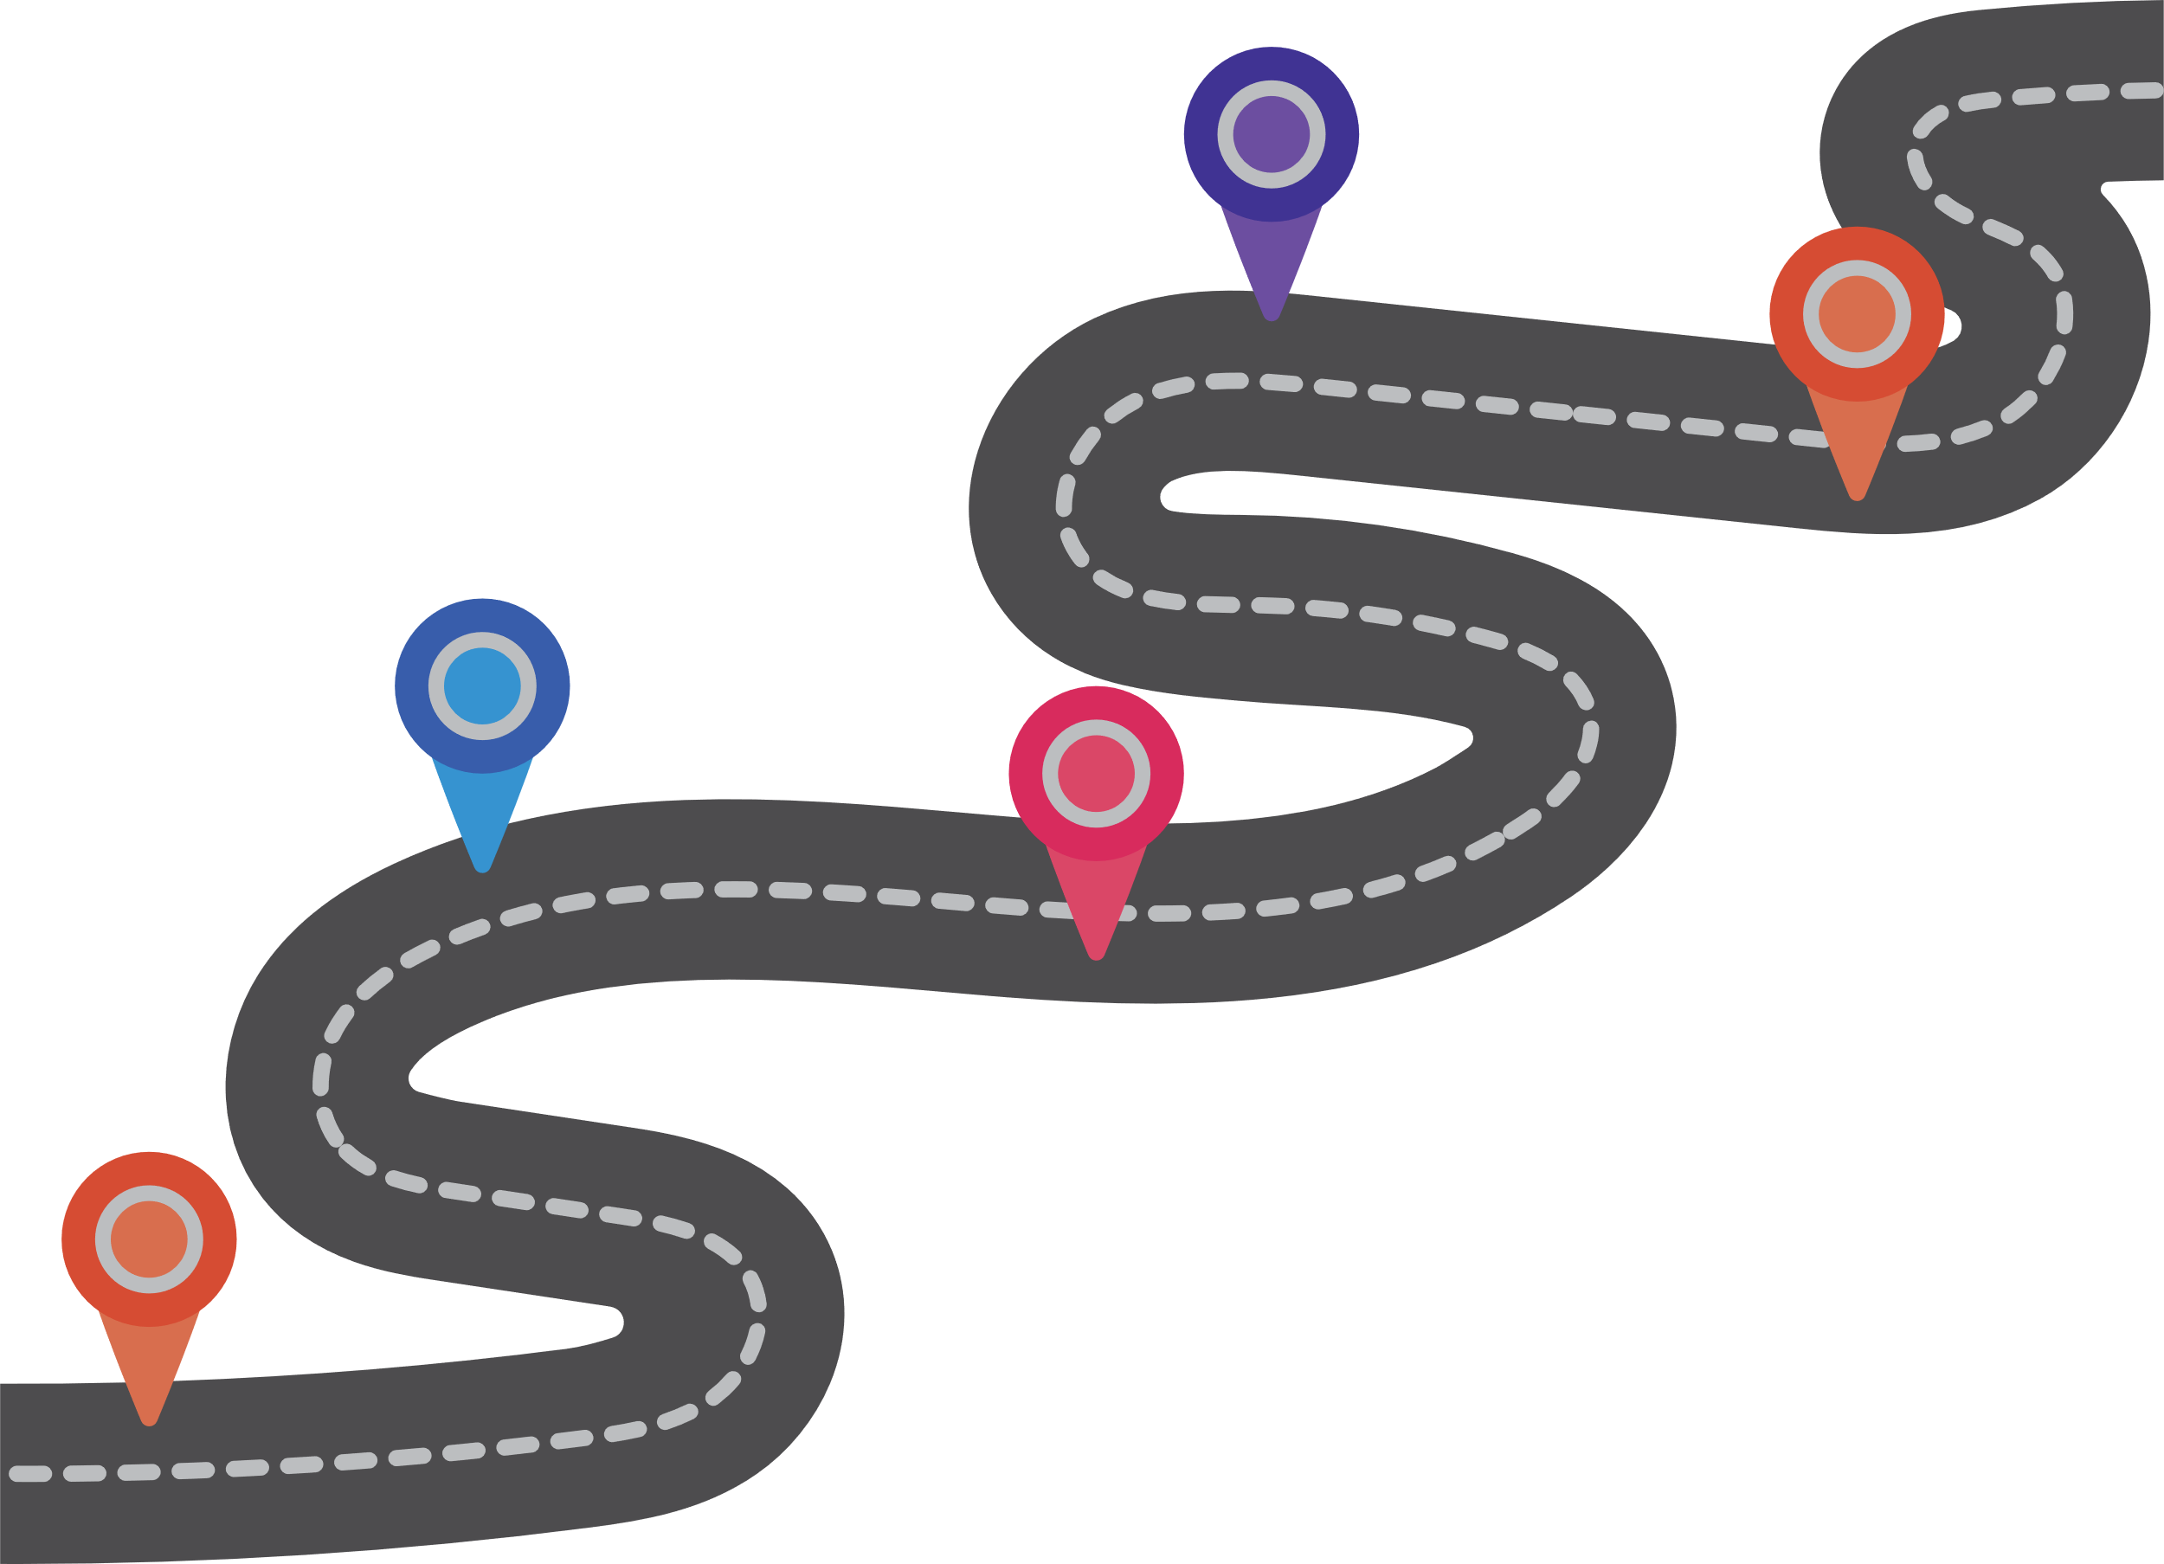
A Hybrid MobileNet–CNN Architecture for Robust
Traffic Sign Recognition in Bangladeshi Road
Environments
Name: Mst. Hasina Khatun
Department: Information and Communication Technology Islamic University | Kushtia - 7003,Bangladesh

Slide 2

Table of Content
Introduction
Result Comparison
Motivation
Evaluation Matrices
Objectives
Accuracy Plots & Curves
Methodology
Discussion
Proposed Model Architecture
Future Directions

Slide 3





Introduction
Traffic sign recognition for road safety and ITS(Intelligent Transportation Systems )
Challenges in Bangladesh: occlusion, blur, poor lighting, imbalance
Challenges with Current deep learning models
Project Goals and Impact

Slide 4




Motivation
1.
CNNs: capture local details but limited global understanding
2.
MobileNet: efficient, pretrained, but may lose fine details
3.
Hybrid = MobileNetV2 (global) + CNN (local) → accuracy + efficiency

Slide 5





Objectives
Design a hybrid MobileNet–CNN model
Train and evaluate on Bangladeshi Traffic Sign dataset
Evaluate with accuracy, precision, recall, F1, ROC-AUC
Compare with baseline CNN-only and MobileNet-only models
Use the Bangladeshi Traffic Sign dataset as benchmark

Slide 6








Methodology
Data Collection and Preprocessing
Data Sourcing
Data Preprocessing
Data Augmentation
Models
Training and Evaluation
Proposed Model

Slide 7





Proposed Model: Hybrid MobileNet–CNN Architecture
Branch 1 – MobileNetV2 (Global Features)
Input Layer
Branch 2 – Custom CNN (Local Features)
Fusion Layer
Classification Head
01
02
03
04
05

Slide 8
Result: Experimental Results & Comparison
Table 2: Precision, Recall, and F1-Score Comparison of Different Models on the Bangladeshi Traffic Sign Dataset
Model | Training Accuracy (%) | Validation Accuracy (%) | Testing Accuracy (%)
CNN | 71.70 | 86.42 | 88.62
MobileNetV2 | 89.71 | 94.20 | 94.60
InceptionV3 | 82.81 | 90.80 | 91.55
Proposed Hybrid CNN-MobileNetV2) | 99.28 | 99.70 | 99.88

Slide 9




Evaluation Metrics
01
02
03
04
05
Confusion Matrix
Accuracy
Precision
Recall
F1 Score

Slide 10
Result: Evaluation Metrics
Table1: Accuracy Comparison of Different Models
Model | Precision (%) | Recall (%) | F1-score (%)
CNN | 88.74 | 88.62 | 88.50
MobileNetV2 | 94.74 | 94.60 | 94.51
InceptionV3 | 91.83 | 91.55 | 91.44
Proposed Hybrid CNN-MobileNetV2) | 99.88 | 99.88 | 99.88

Slide 11
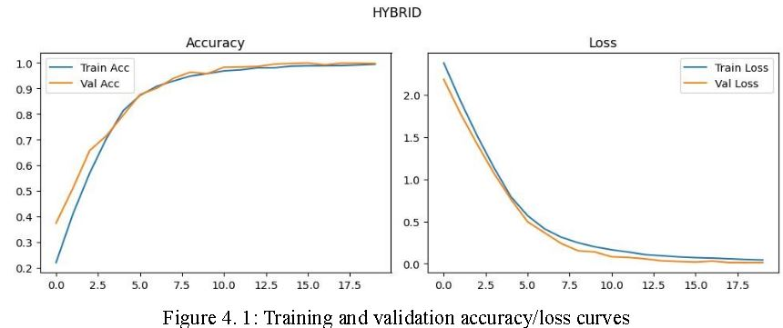
Accuracy Plot

Slide 12
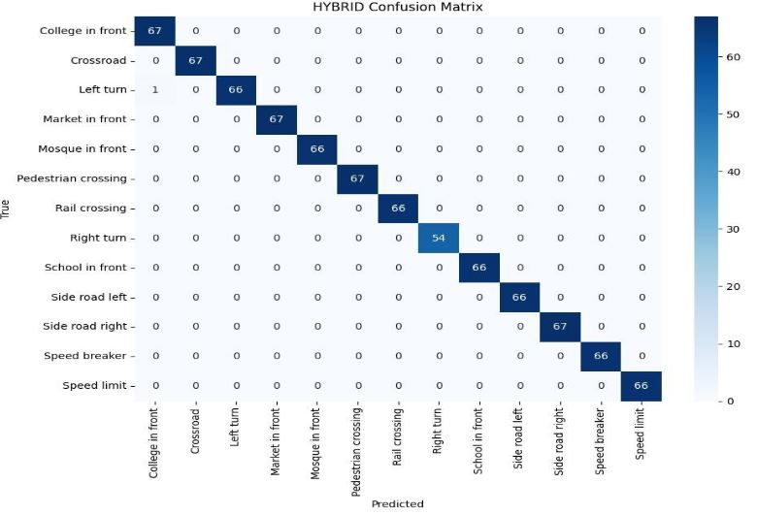
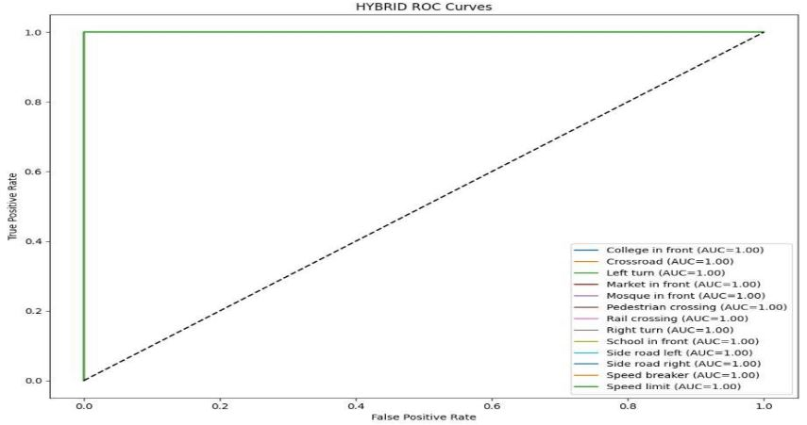
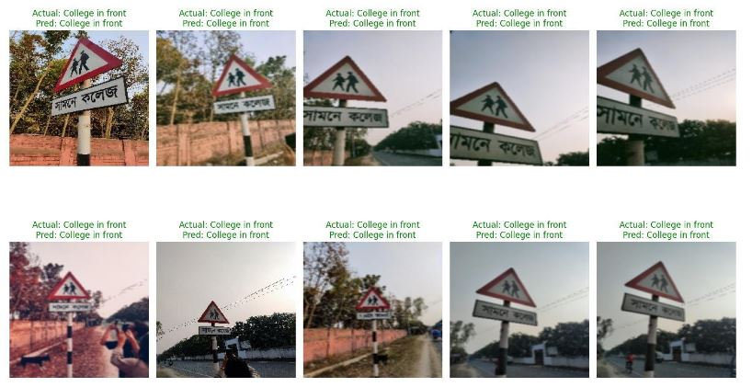
Confusion Matrix, Roc Curve & Qualitative Result Visualization Experimental Results & Comparison

Slide 13






Discussion
Hybrid outperformed baselines on all metrics
Improved recognition of visually similar classes (e.g., speed limits)
Advanced Technical Capabilities under blur, low-light, occlusion
Limitations: dataset imbalance, cropped-only images, low-light recall drop

Slide 14
Future Directions
1
Integration of Advanced AI Techniques
2
Enhanced Real-time Processing
3
Cross-Platform Scalability
4
Improved Robustness to Environmental Factors
5
01
02
03
04
05
Expanding Dataset Diversity

Slide 15
Thank You

