Slide 2
Sql/plsql Performance tuning
Tips and tricks
Hasith perera

Slide 3
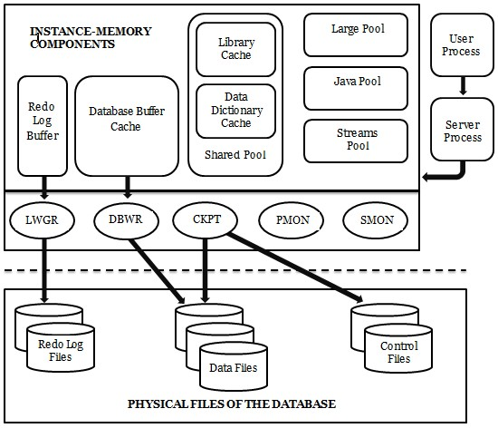
Oracle dbms architecture

Slide 4
Things should know before tuning
Database query performance tuning tools
Performance tuning flow
Parameters, settings should care about

Slide 5
Sql/plsql tools
In oracle there 2 major types to profile and optimize
SQL statements - DML
PL/SQL blocks
Have different types of tools to measure, optimize performance
2 major tools easy to use and easily available
SQL Trace tool = SQL Statements
Profiler tool = PL/SQL blocks

Slide 6
Start performance issue investigation
Starts in a fresh mind – problem can be somewhere else
First – Identify whether problem is visible in other forms
Narrow down the issue – Find the bottleneck
Use tools available to find the bottleneck
Categorize the issue
PL/SQL issue (e.g. some method cause the performance issue)
SQL issue (e.g. some select statement or cursor having a problem)

Slide 7
Interpret tkprof output
Real world example from SAAB shop floor workbench

Slide 8
Interpret tkprof output
Cont…
Query shop floor workbench with some conditions
Tkprof Output sorted based on the execution time.
Tkprof tool allow to sort based on different criteria.

Slide 9
