Slide 2
IFS Applications™ 2004
IFS/Sales Configurator
Product Presentation
Notes:
This is an extract from the IFS Sales & Support, product presentation.

Slide 3
Sales Configurator 1(2)
Summary
Guides the seller and customer
smoothly and conveniently through
process
  Selection of products
  Product characteristics
  Accessories
Use as an online background rule engine
or for offline client configurations
Products and related information can be
visualized through use of pictures, videos,
drawings, and similar media
  Marketing Encyclopedia
Used for configuring, proposing, and quoting customer-specific products or services
Notes:
Things to say: The IFS/Sales Configurator guides the seller and customer smoothly and conveniently thorough the selection of products, product characteristics and accessories, i.e., used for configuring, proposing, and quoting customer-specific products or services.
Use as an online background rule engine or for offline client configurations.
Products and related information can be visualized through use of pictures, videos, drawings, and similar media.
Marketing Encyclopedia

Slide 4
Sales Configurator 2(2)
Summary
The customer input drives the configuration process
  Configurations are built step by step
    Guiding questions
    Drag-and-drop techniques
  You can generate several quotations and
  compare products
  Cross-sell/up-sell your entire product/service
  portfolio effectively
Customers receive the optimum alternative with respect to
  Requirements
  Properties
  Prices
Notes:
Things to say: The customer input drives the configuration process. Configurations are built incrementally, either by guiding questions or by using drag-and-drop techniques. You can generate several quotations and compare products. Cross-sell/up-sell your entire product/service portfolio effectively.
Customers receive the optimum alternative with respect to such as requirements, properties and prices.
The Sales Configurator is tightly integrated with the IFS Configure-to-Order solution and with the IFS/Customer Orders component.
Integrates with IFS/Connect—Uses SOAP/XML for transferring data.

Slide 5



Sale Configurator
Process Overview
Sales Configurator
client
IFS/Customer Orders and quotations
Internet orders
Sales rules
Back-office configurator
Manufactured part
Vehicle for entering customer orders and sales quotations
Determines manufacturing structures and routings
Ensures that configurations can be produced
Notes:
Purpose of slide: Provides an overview of the process and explains the role of each component in the sales configurator process. Detail descriptions of the sales configurator client, sales rules, and back-office configurator can be found in the slides as follows. However, you can also hide the detail description slides and use them as speaker text for this slide. This slide contains animations on mouse-clicks.
Things to say:
Sales Configurator Client: The vehicle for entering configured customer orders and sales quotations. Provides an easy-to-use interface.
Sales Rules: The sales rules are invoked by the sales configurator client to ensure that the entered configuration can be produced.
Back-Office Configurator: The back-office configurator uses the characteristics and values entered in the sales configurator client to create the manufacturing structure and routings required to produce the configured product.

Slide 6
Sales Configurator
Sales Configurator Client
Sales Configurator
Client
Vehicle for entering configured customer
orders and sales quotations
The easy-to-use interface includes:
  Graphics
  Pictures and documents
  Drag-and-drop
  Product Advisor (Guided Questions)
  Product Catalog
Internet Orders
Sales Rules
IFS Customer Orders and Quotations
Back-Office Configurator
Manufactured Part
Notes:
Purpose of slide: Details the role and included features in the Sales Configurator Client. This slide can be hidden and used as speaker text to the process overview.
Things to say: The sales configurator client is the vehicle for entering configured customer orders and sales quotations. The easy-to-use interface includes graphics, pictures and documents, and the drag-and-drop feature. There is also a guided help feature which guides the user to the appropriate item by questions. It is possible to use the system as a product catalog to browse through the different items and characteristics available.

Slide 7
Sales Configurator
Sales Rules
Sales Configurator
Client
Used by the Sales Configurator client
to ensure that the entered configuration
can be produced
This is done by:
  Checking permitted combinations of
  characteristics and options
  Checking that dimensions are within
  predefined constraints
  Defining default characteristic values or
  selecting characteristic values based on
  entered values
Internet Orders
Sales Rules
IFS Customer Orders and Quotations
Back-Office Configurator
Manufactured Part
Notes:
Purpose of slide: Details the role and included features of the sales rules. This slide can be hidden and used as speaker text to the process overview.
Things to say: The sales rules are invoked by the sales configurator client to ensure that the entered configuration can be produced. This is done by checking for permitted combinations of characteristics and values. The sales rules also assure that entered dimensions are within predefined constraints. It is in the sales rules you can define default characteristic values or select characteristic values based on existing values.

Slide 8
Sales Configurator
Back-Office Configurator
Sales Configurator
Client
Uses options and values entered in the
Sales Configurator client
  Creates manufacturing structures
  and routings based on predefined
  rules and formulas in CTO
  Determines the final cost of the
  configuration
Internet Orders
Sales Rules
IFS Customer Orders and Quotations
Back-Office Configurator
Manufactured Part
Notes:
Purpose of slide: Details the role and included features in the Back-Office Configurator. This slide can be hidden and used as speaker text to the process overview.
Things to say: The back-office configurator uses the characteristics and values entered in the sales configurator client to create the manufacturing structure and routings required to produce the configured product. It uses formulae and rules to determine the shop order components and operations based on configuration structures and routings. The entire indented structure can be generated using Dynamic Order Processing (DOP).

Slide 9
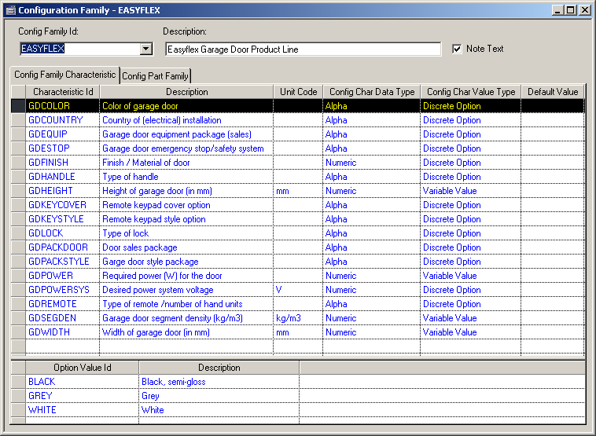
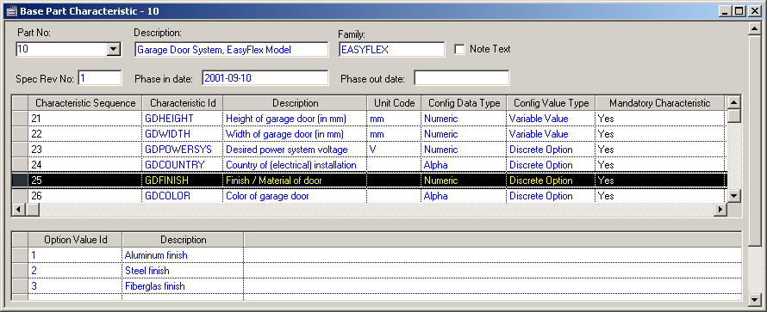
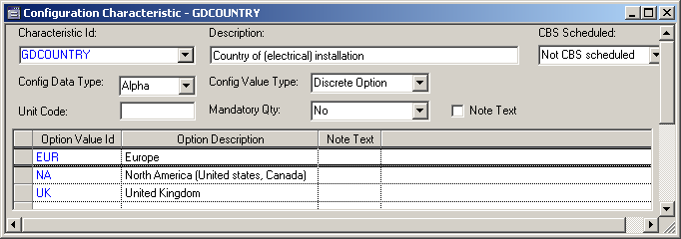
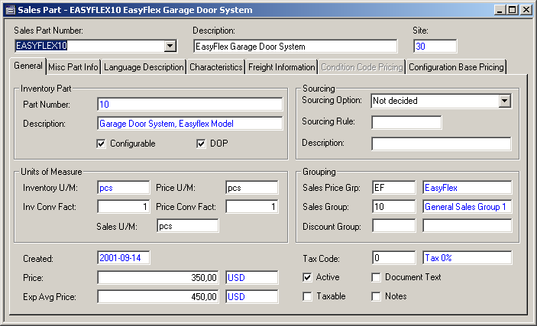
Sales Configurator
Configuration Data Integration 1(2)
Configuration Family
Base Part
Characteristics
Sales Part
Notes:
Purpose of slide: Shows the automatic update of parts, characteristics, and option values from IFS Applications to the Sales Configurator. The content continues on the next slide.
Things to say: To prepare the sales configurator client with basic data on which the rules are defined, the above described IFS basic data must be fulfilled. When these criteria is fulfilled, the necessary data is automatically provided in the workshop tool and it is possible to start defining appropriate rules immediately with no double entry of information.

Slide 10
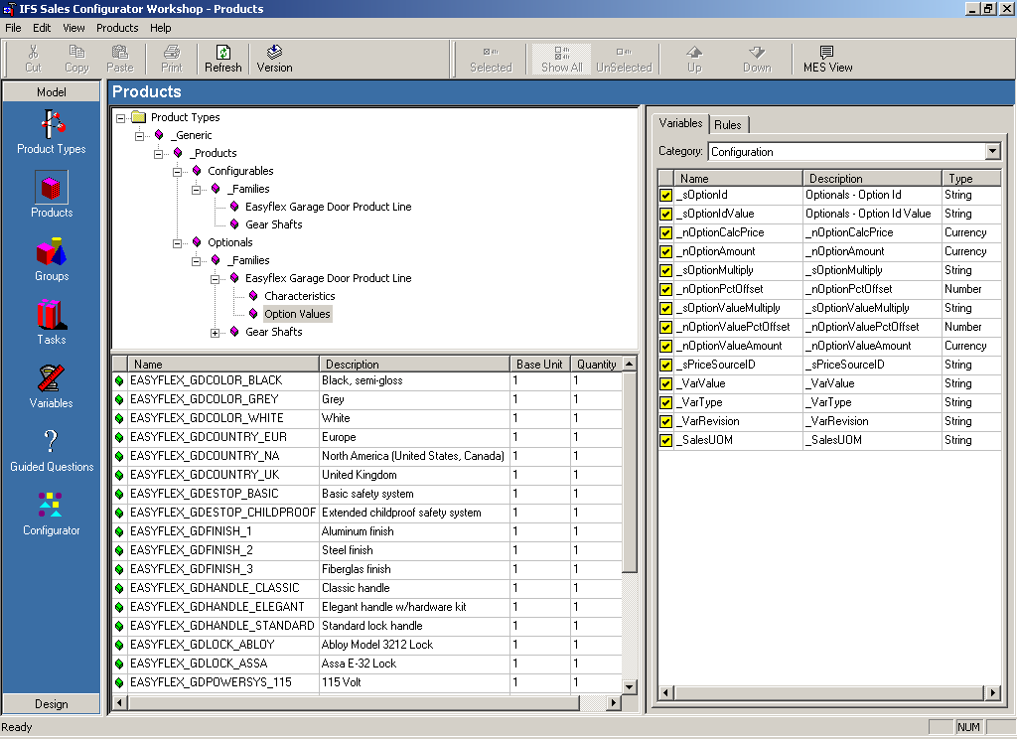
Sales Configurator
Configuration Data Integration 2(2)
Config. Family
Product Types
Products
Base Part
Groups
Char’s
Tasks
Variables
Sales Part
Guided
Questions
Configuration
Notes:
Purpose of slide: Shows the automatic update of parts, characteristics, and option values from IFS Applications to the Sales Configurator. The content continues from the previous slide. When clicking, the navigator is magnified and the background is grayed-out.
Things to say: (This may be considered before mention since it may be confusing for the audience). The nomenclature differs a bit (for historical reasons) between IFS back office and the Sales Configurator Workshop.
In general the following applies:
Config. Family = Product Type/Catalog
Sales Parts = Product/Configurables
Characteristics = Products/Optionals
Characteristics = Variables/Option Values = Discretes

Slide 11
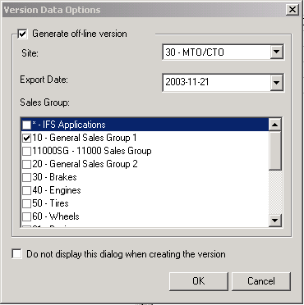
Sales Configurator
Configuration Data Integration 3(4)
Config. Family
Base Part
Char’s
Sales Part
Notes:
Purpose of slide: This slide contains animations on mouse-clicks. Click, the Version button is magnified and the Version Data Options dialog box is displayed.
Things to say: To be able to either distribute a Version or store it in the database one have to decide this by the use of the Generate offline version check box.
If the offline is to be used a Site should be decided for which it is valid. Data will be taken from this Site. This goes also for the chosen Sales Groups and Export Date.
The latter conforms to the validity of prices. If always it is to be used in Online mode it is possible to not display this screen by clicking the check box in the lower part of the screen.

Slide 12
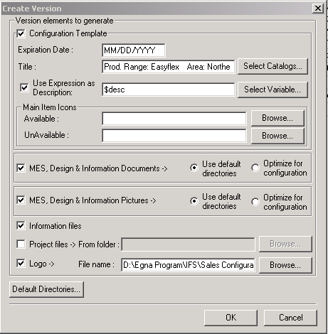
Sales Configurator
Configuration Data Integration 4(4)
.xcf
Notes:
Purpose of slide: To show the following Create Version screen.
Things to say: This screen follows directly after the user has finished the screen on the previous slide. The important thing here is not to forget to choose a Catalog from the Select Catalog function. MES and Information files are for the use and display of pictures and graphics. If not checked one cannot view any such things. When clicking OK either a Version file will be created or a storage in the database will be made if Online mode is chosen.

Slide 13
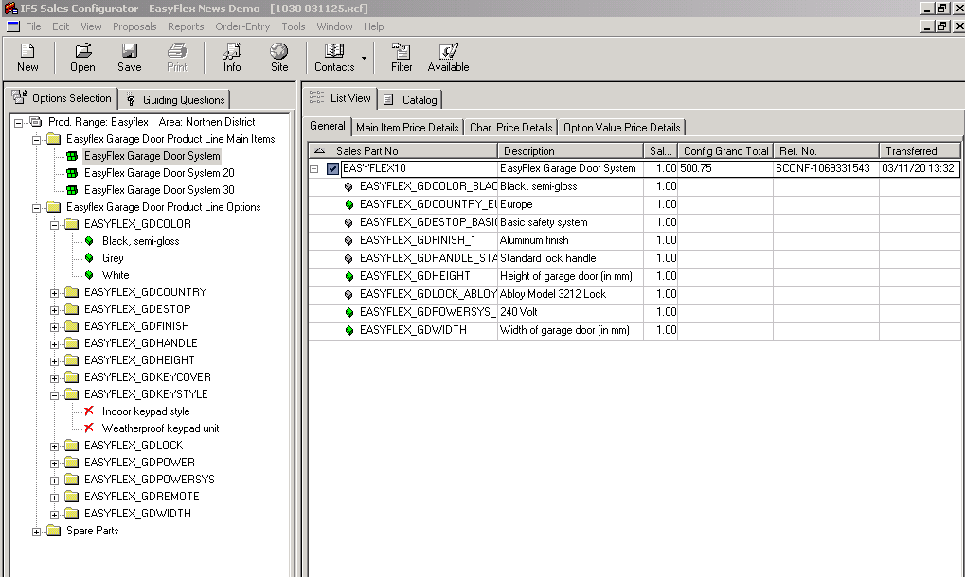
Sales Configurator
The Client View
.xcf
IFS Sales Configurator – EasyFlex News Demo – [1030 031125.xcf
Notes:
Purpose of slide: The offline .xcf file is then exported and opened by the client end-user.
Things to say: This is the client view look when opening an offline xcf file. The opened xcf file is shown in the upper bar of the screen.

Slide 14
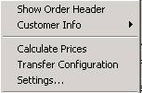
Sales Configurator
The Client View—Show Order Header 1(2)
Notes:
Purpose of slide: The Tools menu bar.
Things to say: The Order header is mostly populated firstly when the order is created and the user fills in appropriate customer and other data.
If wanting to show this later one have to go to Tools – Show Order header.

Slide 15
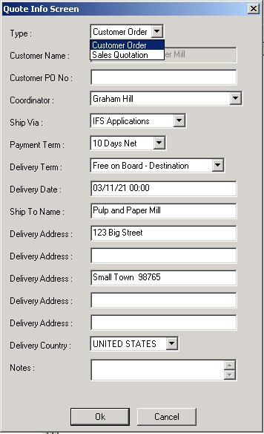
Sales Configurator
The Client View—Show Order Header 2(2)
  Order or Sales Quotation?
Notes:
Purpose of slide: The Order Header is in this case called Quote Info Screen.
Things to say: In this screen the user chooses whether the created configuration should be imported to IFS as a Customer Order or as a Sales Quotation. The rest of the fields are changeable and will be taken as a single occurrence address in IFS if changed.

Slide 16
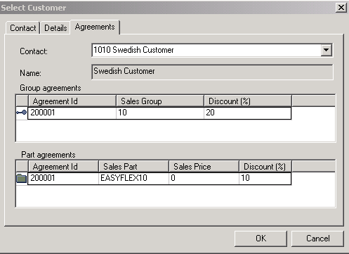
Sales Configurator
The Client View—Contacts/Customers
Notes:
Purpose of slide: Customers in the Sales Configurator.
Things to say: The menu choice Contacts displays all Customers flagged in IFS as for export to Sales Configurator.
Different details can be viewed but in our case it is important to see that pricing agreements follows the customer and can be used when calculating the price later.

Slide 17
Sales Configurator
The Client View—Calculate Prices 1(3)
Notes:
Purpose of slide: Calculate prices function
Things to say: The Calculate function should be used if wanting to fetch and summarize the prices of what has been configured.
Price logics are stored in Sales Configurator and is not fetched from IFS. Remember to recalculate prices if changes are made to the configuration.
This is decided to be done manually since it is not mandatory to choose a customer to a configuration and likewise it is very difficult to know exactly when to calculate.

Slide 18
Sales Configurator
The Client View—Calculate Prices 2(3)
Notes:
Purpose of slide: The General tab and the Main Item tab price display.
Things to say: The General tab displays the Grand total price of the whole configuration only.
To view details of the main item one goes to the Main Item tab where important pricing values are shown. One can see the Price list used for the main item calculation
as well as the main item Part Price, discounts in amount and percentage, the sum of underlying characteristical prices as well as the Cost. Attribute can be chosen to be not shown by each user or by the system administrator who delivers the Version xcf file. The Cost field may therefore be hided if not wanted.

Slide 19
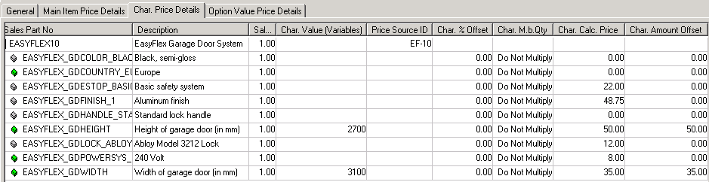
Sales Configurator
The Client View—Calculate Prices 3(3)
Notes:
Purpose of slide: Characteristics detail tabs.
Things to say: Two tabs exists and displays almost the same things but the Char Price detail tab is intended for the Variables while the Option Value Price detail tab is intended for Discrete characteristics price info.

Slide 20
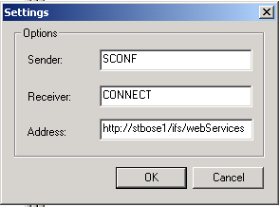
Sales Configurator
The Client View—Settings
Notes:
Purpose of slide: Settings.
Things to say: To be able to transfer a finished configuration one have to set up the connection to the Extended Server. This is done in the Address field and can be supplied by the Administrator. Sender and Receiver conforms to settings in Connect and is equal to settings for EDI transfers.

Slide 21
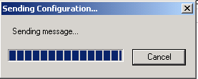
Sales Configurator
The Client View—Transfer Configuration 1(2)
Notes:
Purpose of slide: To transfer a configuration.
Things to say: When pressing the Transfer Configuration function the active configuration will be transferred if the user is online on the net.

Slide 22
Sales Configurator
The Client View—Transfer Configuration 2(2)
Notes:
Purpose of slide: Created transfers
Things to say: If the transfer succeeds the user will receive an identification automatically as well as a transfer date.

Slide 23
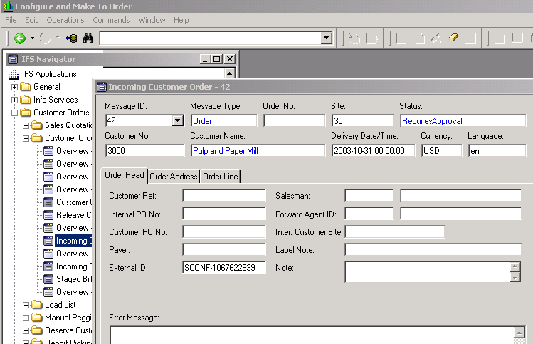
Sales Configurator
IFS Distribution—Incoming Customer Orders
Notes:
Purpose of slide: Received configuration
Things to say: If the transfer succeeds it will pop up as an incoming customer order. In the External ID field the configurations transfer id will be shown which makes it backwards traceable. Very important. In this case it then have to be manually approved but this can be set up as automatically create an order or quotation.

Slide 24
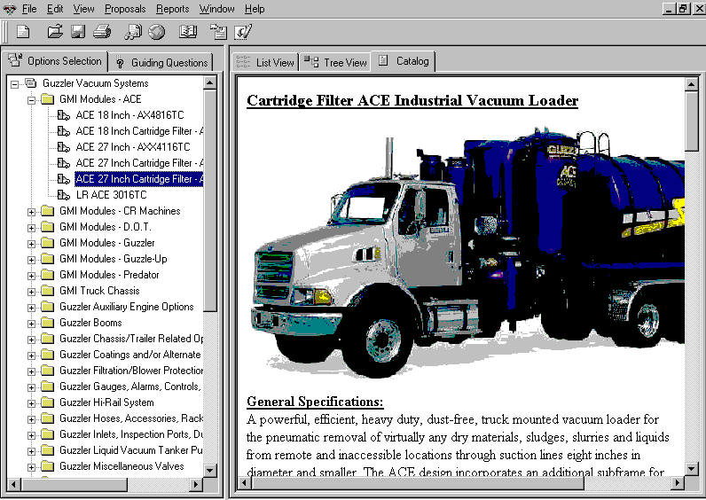

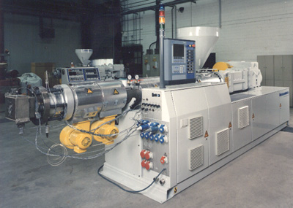
Sales Configurator
Marketing Encyclopedia
Information
Visual
Audio
Configurator
Photos
Documents
Web Sites
Notes:
Things to say: The Marketing Encyclopedia accesses any HTML-supported files, such as product specifications, pictures, diagrams, animation (.gif), videos (.avi, QuickTime), dynamic links to web sites. Can be used as an online repository of current product information, sales training, knowledge database, or company policy management. One of the benefits is that all information are gathered in one place.

Slide 25
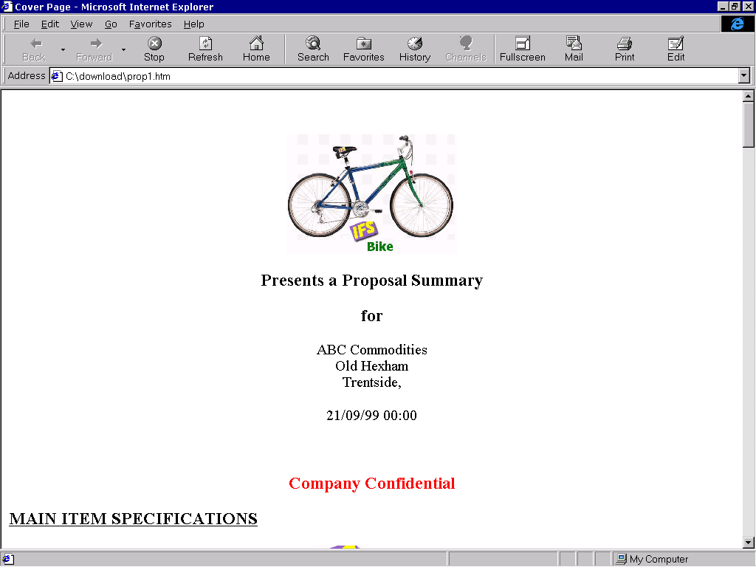
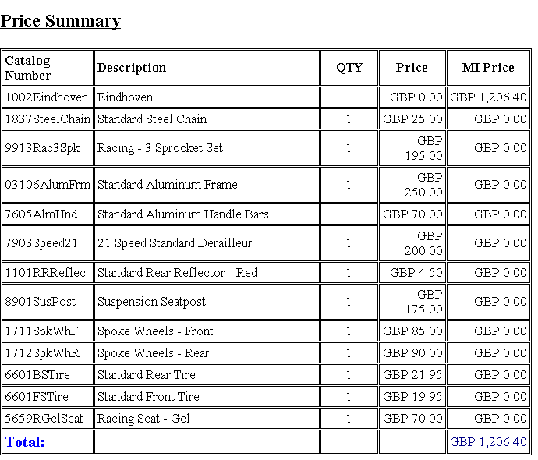
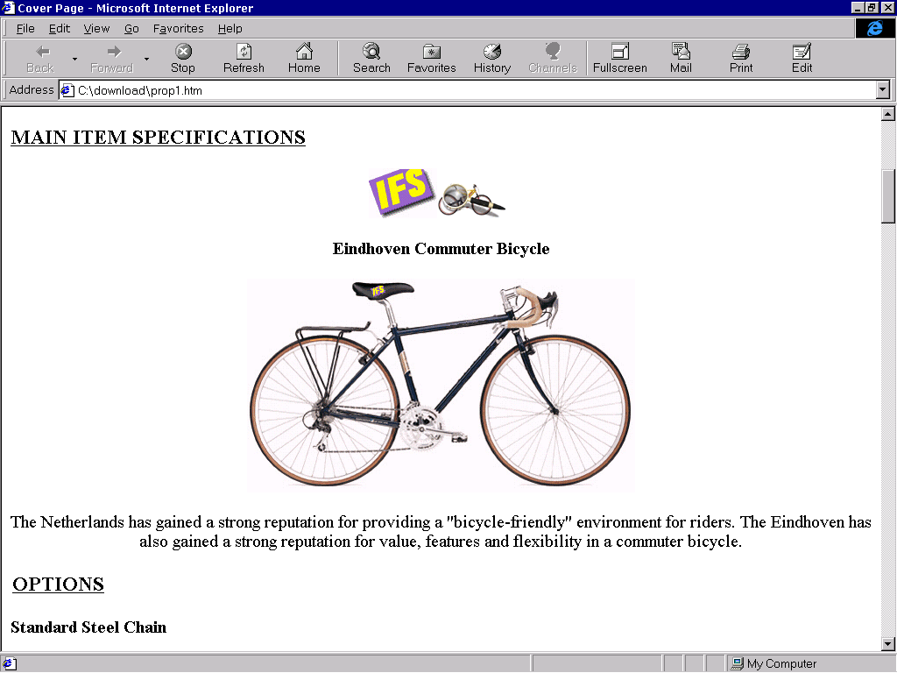
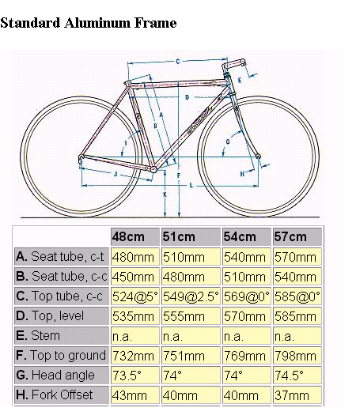
Sales Configurator
Proposal Generator
Notes:
Things to say:
Generate any configuration-specific output
Proposals, quotes, orders, reports, contracts, terms, bill-of-materials
Multiple ways of publishing special quotes
Rules or other logic can vary output
Unlimited user-defined formats included in HTML
Supports queries and printed reports

