Slide 1
Enhancing the Security of OLSR Protocol using Deep Reinforcement Learning
CDAP Prototype Presentation
16J – 008

Slide 2
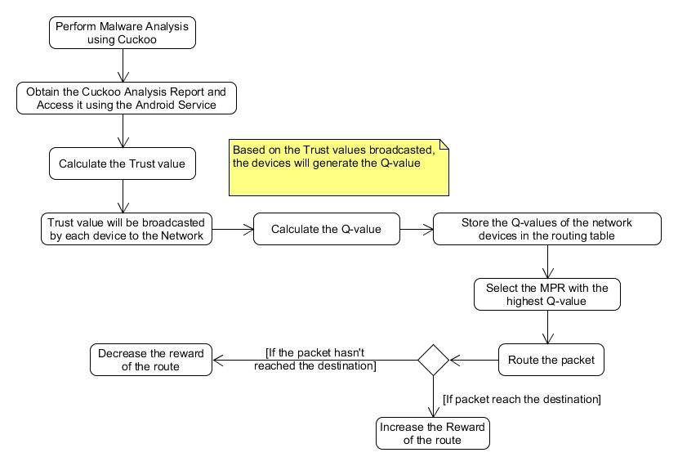
Methodology

Slide 3
Literature
Paper 1 – Trust based security for OLSR Routing Protocol
A Rule based approach and a trust language is used
To improve the integrity of the information provided by the neighbors – Provable Identity

Slide 4
Literature
Paper 2 – Enhancing the Security of Batman-Advanced Protocol
Device MAC Address is used to encrypt and decrypt the message.

Slide 5
Literature
Paper 3 – Secure OLSR
A signature is generated for each OLSR control message.
The signature is sent along with the message.
The signatures have a timestamp to indicate how fresh a message is.

Slide 6
Literature – Q-Learning
Paper 4 – Self- Adaptive Trust based ABR protocol for MANETS using Q-Learning
Proposed for reactive ABR Protocol
Reward is based on Associativity ticks and Trust Value.

Slide 7
Literature – Q-Learning
Paper 5 – K-Shortest Paths Q-Routing: A new QoS Routing Algorithm in Telecommunication Networks
Q-Routing is used to:
Improve the Average Packet Delivery Time
Reduce the time taken to find the best path without any loops

Slide 8
How Android Device Trust is Determined
Malware Analysis – Cuckoo Sandbox
CuckooDroid
Cuckoo analysis system has the ability to extract following features
Calls performed by Malware
Files created, deleted and downloaded by malware
Memory dumps
Network traffic in pcap format

Slide 9
Device Trust
How a trust is determined in each node is shown below:
$T_{device}=1 −\left(\frac{Infected files+Files created+Files downloaded}{Total files}\right)$-$\left(\frac{No.Malicious URL}{no.Total URL}\right)$

Slide 10
The OLSR Protocol
Proactive – Table Based
Based on Link state algorithm
For Mobile Ad-hoc networks
Periodic message exchange to share topology information
Ideal for large Ad-hoc Networks
MPR (Multi Point Relays) are selected for each node

Slide 11
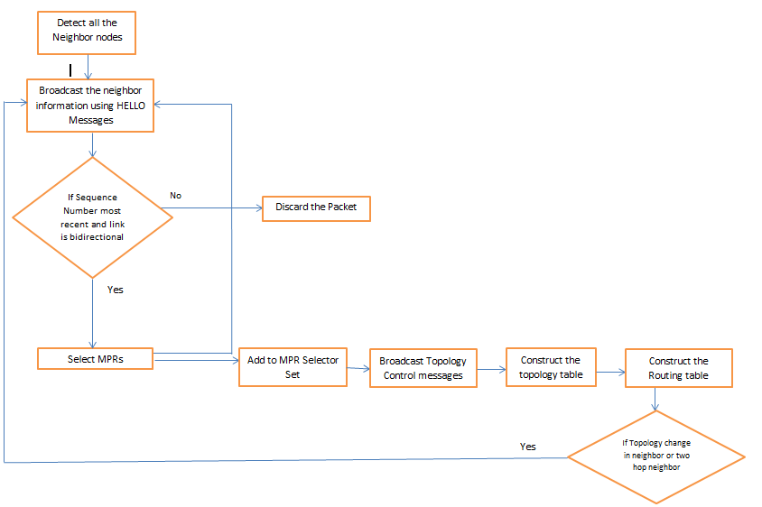
How OLSR Protocol Works

Slide 12
Why OLSR Protocol?
Optimization over traditional Link State Routing
Suitable for large MANETS
Reduce Flooding – Multi Point Relays
Reduce Traffic – Smaller Message size

Slide 13
Vulnerabilities in OLSR Protocol
Lack of a mechanism to verify the integrity of the MPR nodes

Slide 14
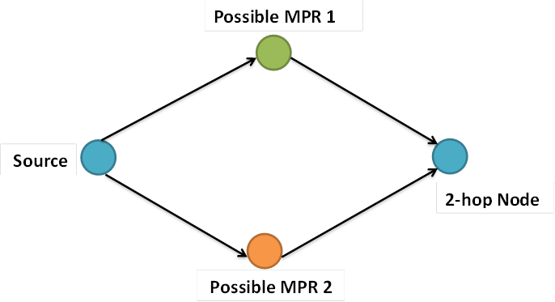
What are Multi Point Relays?

Slide 15
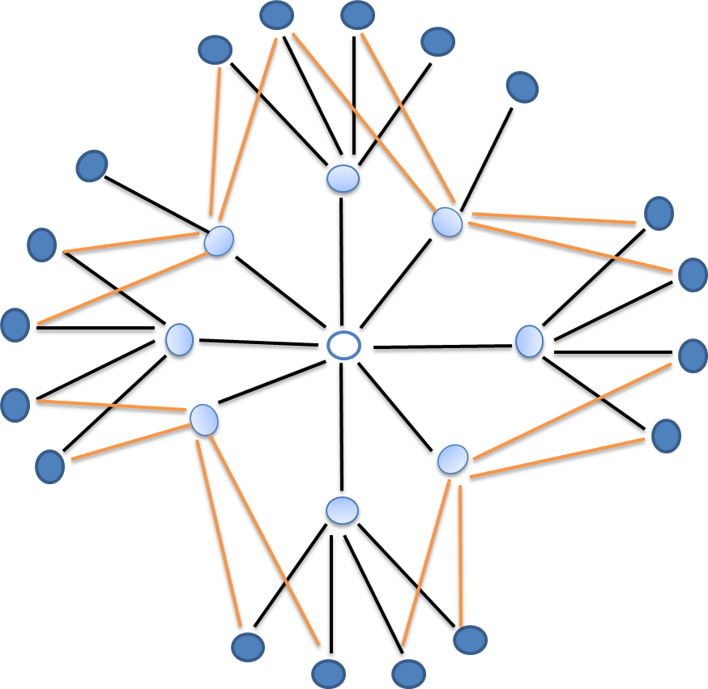
Multi Point Relays

Slide 16

MPR Set 1

Slide 17
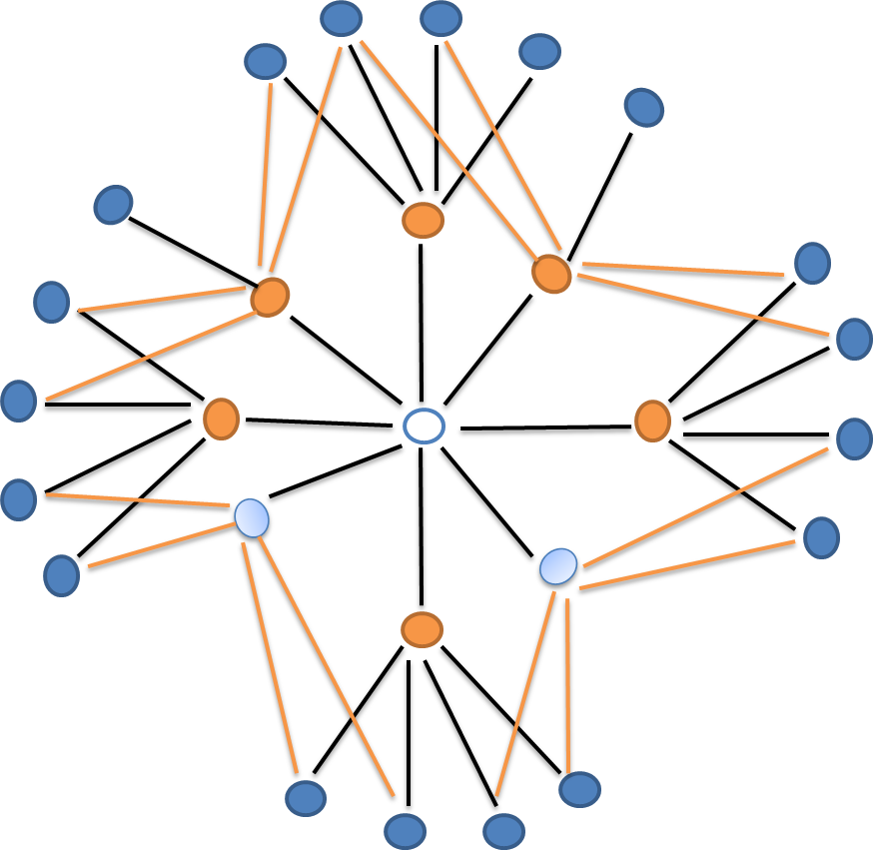
MPR Set 2

Slide 18
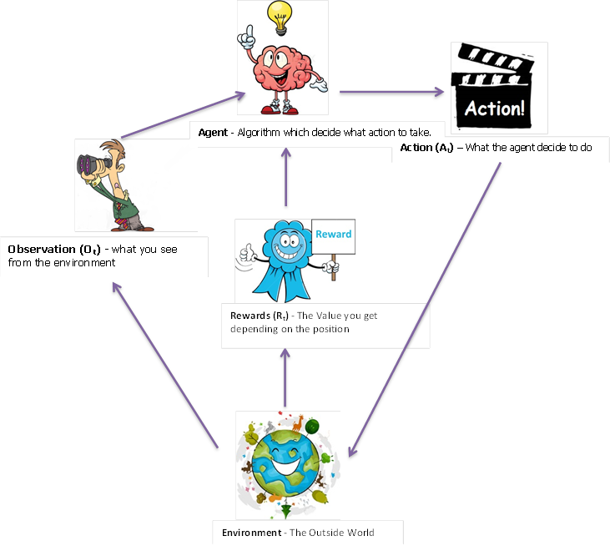
RL Model

Slide 19
Our RL Model
Environment – MANET
Agent – every node in the network is considered as an agent
Action – Choosing the appropriate MPR Set
Reward – if the packet reach the destination = 1
if the packet didn’t reach the destination = -1

Slide 20
State
A state is described by the following features
Trust of MPR set A
Trust of MPR set B
Number of neighbors connected

Slide 21
Demo
Environment
Model

Slide 22
Thank You.

