Slide 1

Data Representation and Analysis
Session 3: Cleaning Data and Simple Analysis
Hasitha Pramuditha

Slide 2

Welcome Back to Session 3!
Last time, we learned about DataFrames (our data tables in Python).
We used Pandas to load data from CSV files.
We explored data using head(), info(), describe(), and by selecting columns.

Slide 3

Today's Journey: Making Data Sparkle!
Learning Objectives:
Find and fix simple data problems.
Sort and filter data to find specific information.
Calculate basic statistics and summaries.
Create new information from existing data.

Slide 4

Why Data Isn't Perfect?
Data is often collected by humans, machines, or from different sources.
Mistakes happen! (Typos, missed entries, sensor errors).
Cleaning data is a crucial step in data analysis – it's normal!
Our goal is to make the data reliable for analysis.

Slide 5
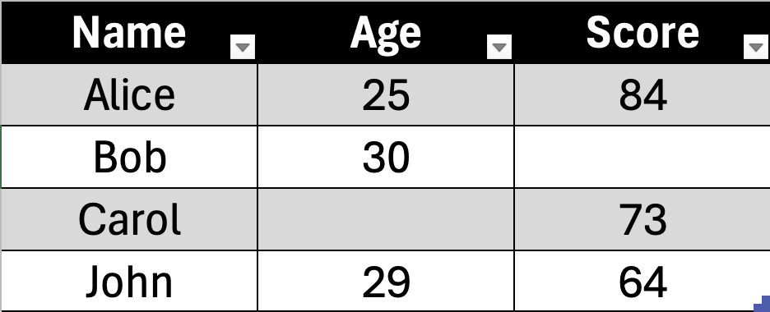
Common Data Problems: Missing Information
Sometimes, cells are just empty! (Represented as NaN or blank).
Why it happens: A field wasn't filled out, data wasn't available, sensor malfunction.
Problem: Missing data can cause errors in calculations or charts.

Slide 6
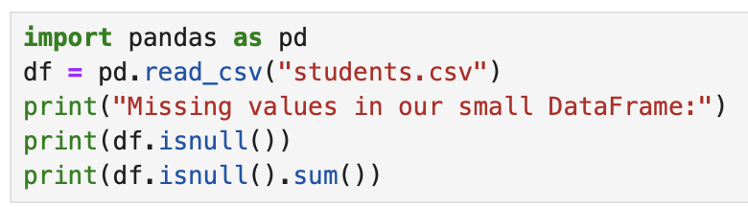
Finding Missing Data: df.isnull().sum()
df.isnull() checks every cell: Is it missing? (True/False)
.sum() then counts how many True values (missing) there are for each column.
It's your first step to diagnose missing data!

Slide 7
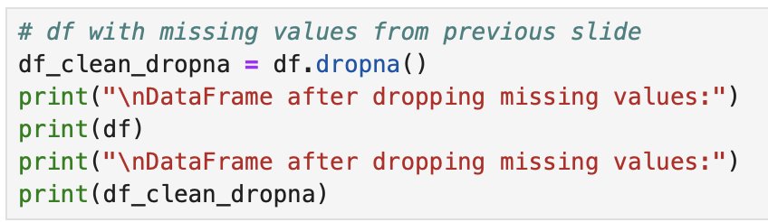
Simple Solution for Missing Data: Removing Rows
One option is to remove rows that have any missing data.
Use df.dropna() (drop Not Available).
Use with caution! You might lose valuable information if many rows have missing data.

Slide 8
Simple Solution for Missing Data: Filling Numbers
If a numerical column has missing values, we can fill them in.
Commonly, we fill with the average (mean) or median of that column.
Use df['Column'].fillna(value)

Slide 9
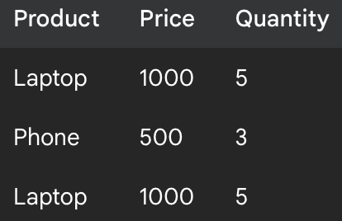
Common Data Problems: Duplicate Records
Sometimes, you have the exact same row of data twice (or more!).
Why it happens: Data entry error, merging data from different sources.
Problem: Duplicates can skew your counts, sums, and averages.

Slide 10
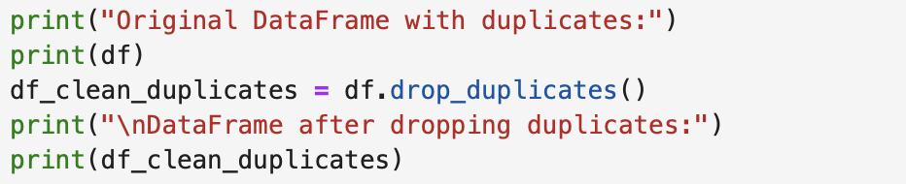
Simple Solution for Duplicates: df.drop_duplicates()
This function finds and removes identical rows.
It keeps only the first occurrence by default.
Very straightforward to use!

Slide 11

Common Data Problems: Wrong Format
Numbers might be stored as text (e.g., '25' instead of 25).
Dates might be text, not actual dates.
Why it happens: Data entry, mixed data types in a column.
Problem: You can't do math on text! ('5' + '5' gives '55', not 10).

Slide 12
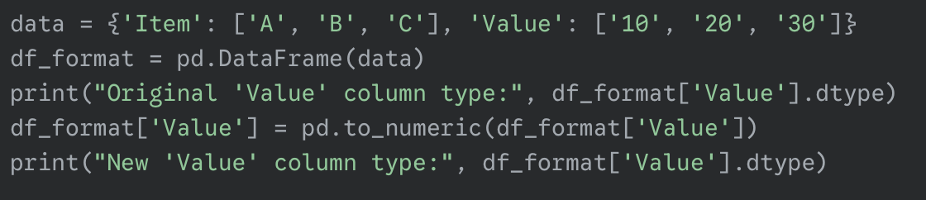
Simple Solution for Wrong Format: pd.to_numeric()
Use pd.to_numeric(df['Column']) to convert a column to numbers.
This is essential before doing any calculations!
Important: If there's text that can't be converted (like "hello"), it will cause an error unless you tell it what to do (e.g., errors='coerce' to turn them into missing values).

Slide 13

Sorting, Filtering, and Calculating

Slide 14
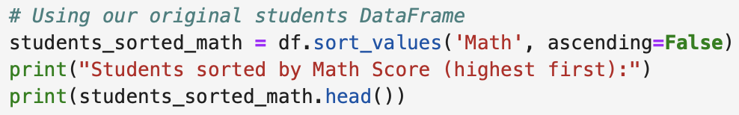
Organizing Your Data: Sorting
Putting your data in a specific order.
You can sort by any column (e.g., by Name A-Z, by Score highest-lowest).
Use df.sort_values('Column Name', ascending=False/True).

Slide 15

Filtering Data: Finding Specific Information
Filtering means picking out only the rows that meet certain conditions.
Like searching in Excel!
Examples: Students with scores > 80, sales from 'Store A', products named 'Laptop’.
We use square brackets and a condition inside: df[df['Column'] > value]

Slide 16
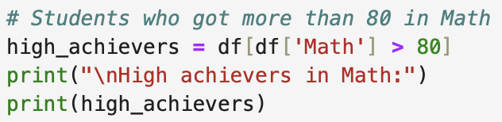
Filtering Data: Examples
High Scores: df[df['Score'] > 80]
Specific Name: df[df['Name'] == 'Alice’]
Multiple Conditions (AND):
df[(df['Age'] > 16) & (df['Subject'] =='Math’)]
(use & for AND, | for OR)

Slide 17
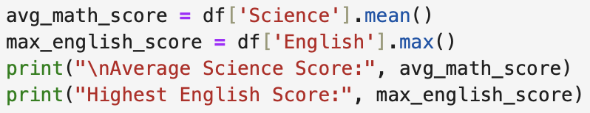
Basic Calculations: Column Statistics
Now that our data is clean, we can calculate meaningful numbers!
Average (Mean): df['Column'].mean()
Maximum: df['Column'].max()
Minimum: df['Column'].min()
Sum: df['Column'].sum()
These are powerful one-liners!

Slide 18

Creating New Columns: Adding Information
Often, you need to combine or transform existing data to get new insights.
You can create a new column by performing operations on existing columns.
Example: Calculate a 'Total' from 'Math’, ‘Science’ and 'English'.

Slide 19
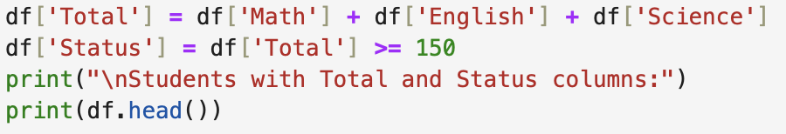
Creating New Columns: Examples
Total Score:
df['Total'] = df['Math'] + df['English’] + df[Science’]
Pass/Fail Status:
df['Status'] = df['Total '] >= 150
(This gives True/False values!)

Slide 20
Tasks:
Task 1: Load and Inspect Data
Load the dataset into a Pandas DataFrame.
Print the first 5 rows.
Print DataFrame info to check column types and missing values.
Output: First 5 rows and DataFrame info.
Task 2: Check for Missing Values
Count missing values in each column.
Print the results with the label "Missing values in each column:".
Output: Missing value counts (e.g., Price: 1, Quantity_Sold: 1).

Slide 21
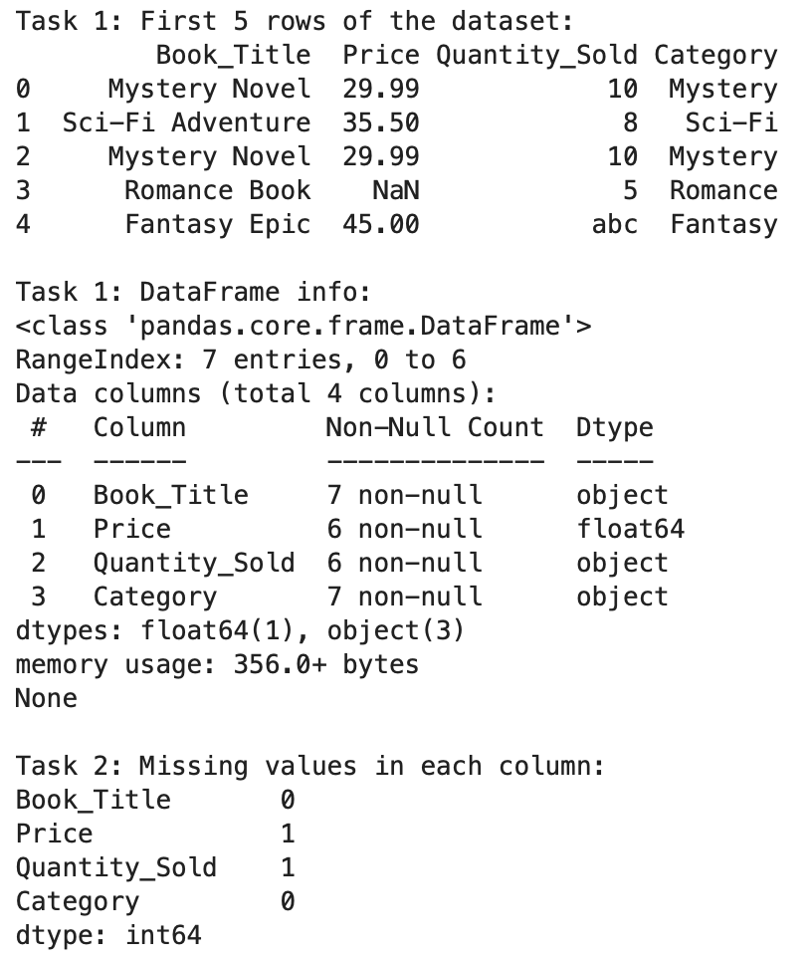
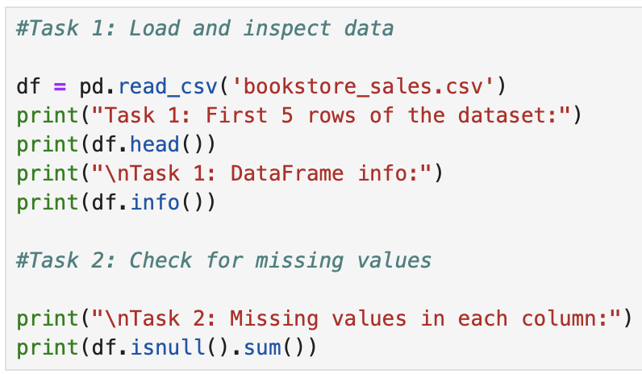
Task 1 and 2 Code:

Slide 22
Tasks:
Task 3: Handle Missing Values in Price
Calculate the mean of the Price column.
Fill missing Price values with the mean.
Print the updated DataFrame.
Output: DataFrame with no missing Price values (missing price filled with mean, ~33.998).
Task 4: Handle Missing Values in Quantity_Sold
Remove rows with missing Quantity_Sold using df.dropna(subset=['Quantity_Sold']).
Assign the result back to df.
Print the updated DataFrame.
Output: DataFrame with no missing Quantity_Sold (one row removed).

Slide 23
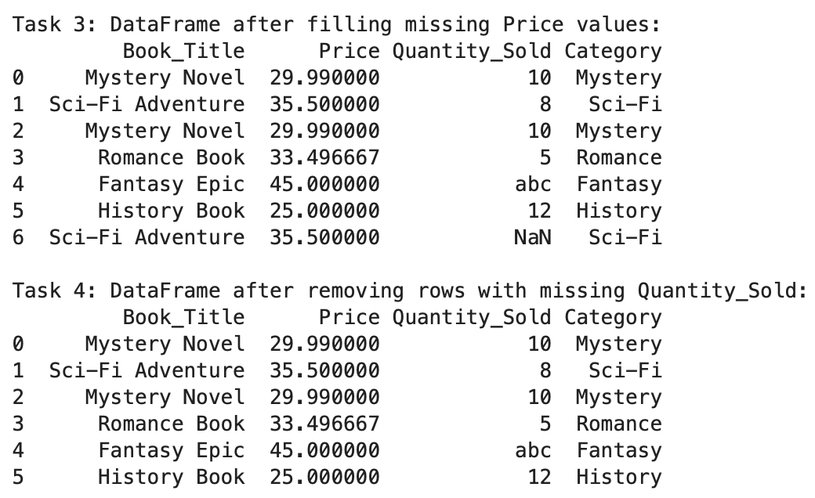
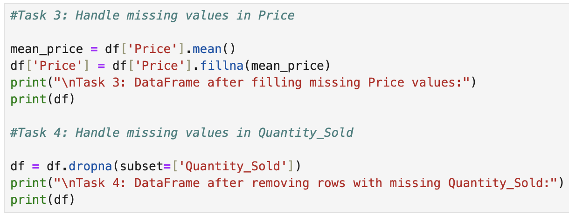
Task 3 and 4 Code:

Slide 24
Tasks:
Task 5: Remove Duplicate Rows
Remove duplicate rows by keeping the first occurrence.
Assign the result back to df.
Print the updated DataFrame.
Output: DataFrame with no duplicates (e.g., only one "Mystery Novel" row).
Task 6: Fix Wrong Format in Quantity_Sold
Convert Quantity_Sold to numeric using pd.to_numeric(df['Quantity_Sold'], errors='coerce') to turn invalid values (e.g., "abc") into NaN.
Remove rows with NaN in Quantity_Sold using df.dropna(subset=['Quantity_Sold']).
Assign the results back to df.
Print the updated DataFrame and Quantity_Sold data type using df['Quantity_Sold'].dtype.
Output: DataFrame with no invalid values in Quantity_Sold and confirmation of numeric type (e.g., int64).

Slide 25
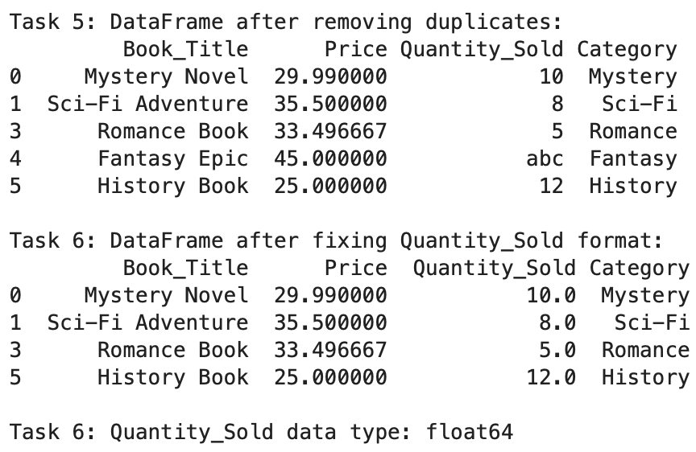
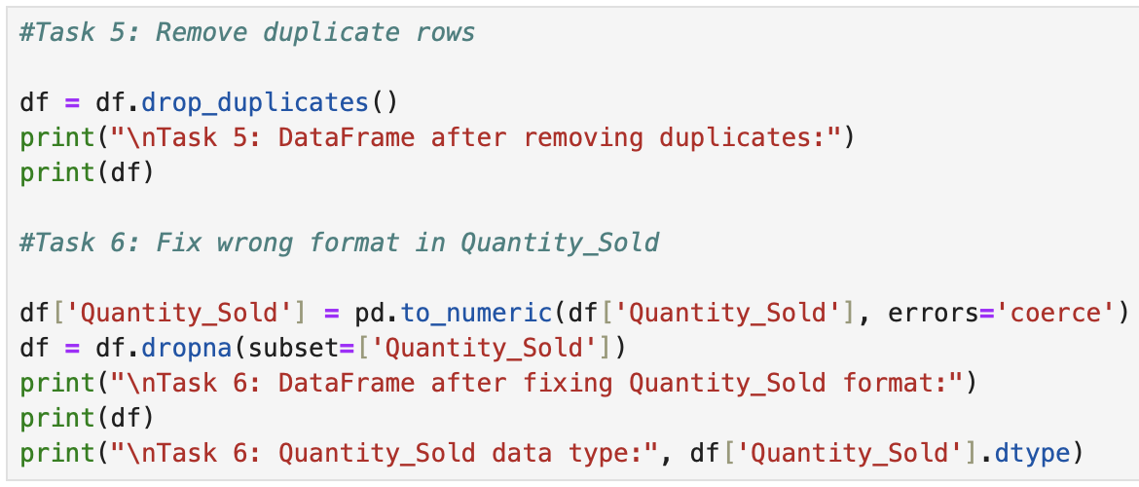
Task 5 and 6 Code:

Slide 26
Tasks:
Task 7: Sort the Data
Sort the DataFrame by Price in descending order using df.sort_values('Price', ascending=False).
Print the sorted DataFrame.
Output: DataFrame sorted by Price (highest to lowest).
Task 8: Filter the Data
Filter for books in "Mystery" or "Sci-Fi" categories using df['Category'].isin(['Mystery', 'Sci-Fi']).
Print the filtered DataFrame.
Output: Only rows where Category is "Mystery" or "Sci-Fi".

Slide 27
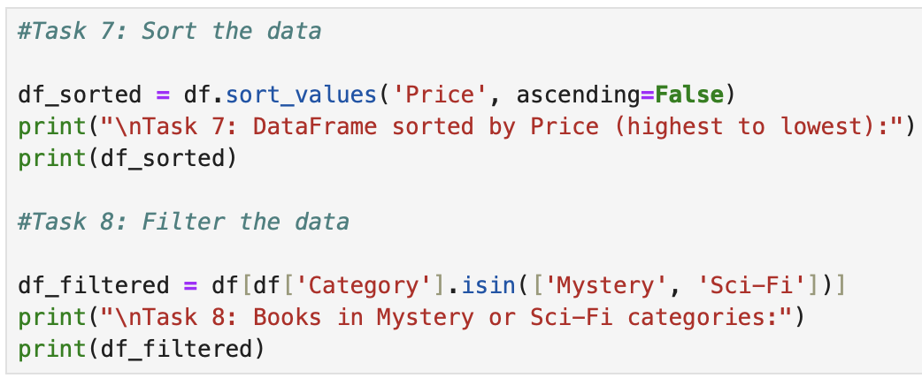
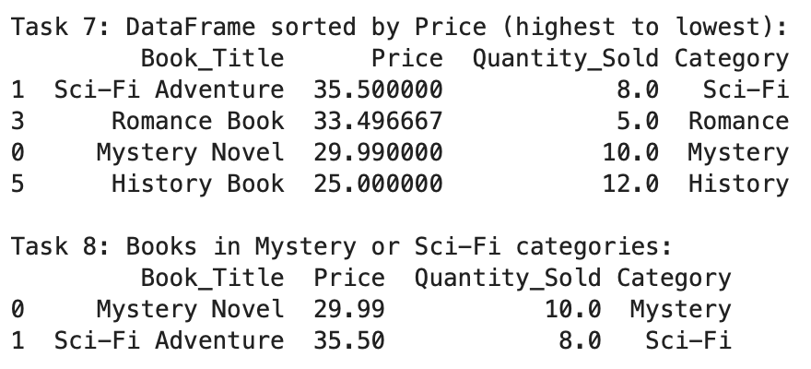
Task 7 and 8 Code:

Slide 28
Tasks:
Task 9: Calculate Basic Statistics
Calculate the average Price using df['Price'].mean().
Calculate the maximum Quantity_Sold using df['Quantity_Sold'].max().
Print both with clear labels.
Output: Average Price and maximum Quantity_Sold.
Task 10: Create a New Column
Create a Total_Revenue column by multiplying Price and Quantity_Sold.
Print the final DataFrame with the new column.
Output: DataFrame with Total_Revenue.

Slide 29
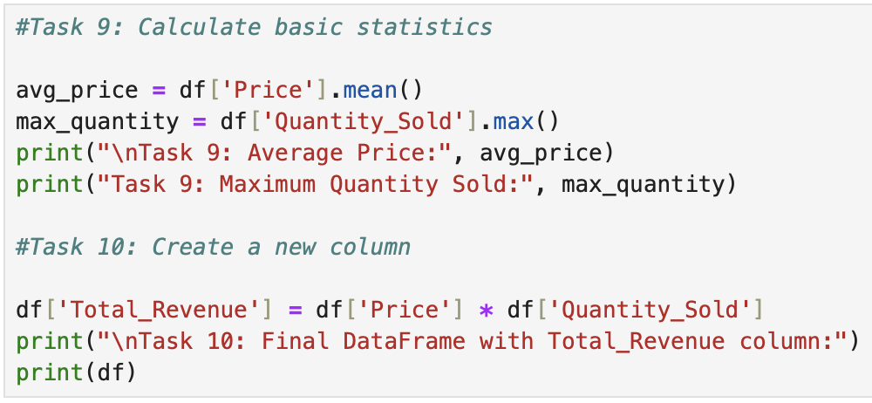
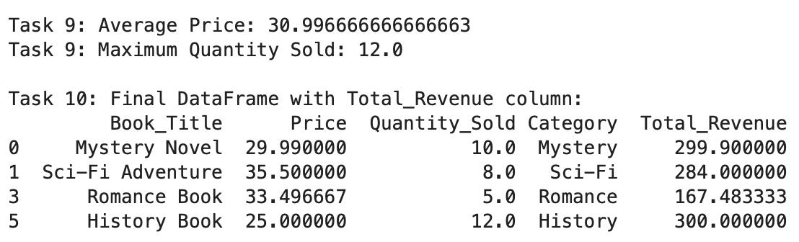
Task 9 and 10 Code:

Slide 30
Q & A

