Slide 1
Numerical Calculation of Spectral Problems
in SP3 Approximation by FEM
SCTEMM 19
Speaker: Alexander Vasilev^{1,2}
Alexander Avvakumov³, Valery Strizhov², Petr Vabishchevich²
1North-Eastern Federal University, Yakutsk
2Nuclear Safety Institute, Russian Academy of Sciences, Moscow
3National Research Center «Kurchatov Institute», Moscow
2019, June 19-21, Moscow

Slide 2
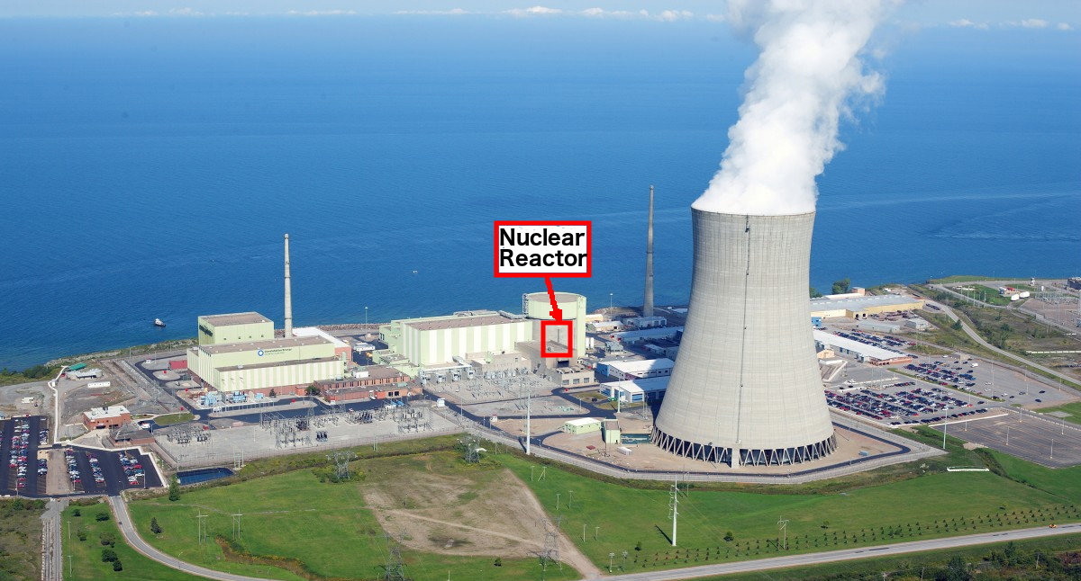
Motivation

Slide 3
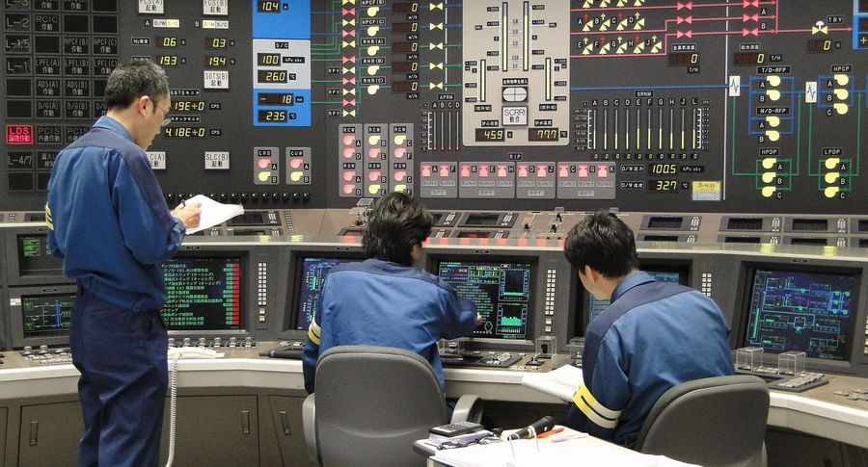
Math modeling
Neutron transport equation
time, energy, spatial and angular variables (7 unknowns)
Diffusion approximation
SP3 approximation

Slide 4
Equations
Diffusion approximation
$$\frac{1}{v_{g}}\frac{∂ϕ_{g}}{∂t}-∇⋅D_{g}∇ϕ_{g}+Σ_{rg}ϕ_{g}=(1-β)χ_{g}S_{n}+S_{s,g}+{\overset{˜}{χ}}_{g}S_{d},$$
$$S_{n}=\overset{G}{\underset{g^{′}=1}{∑}}νΣ_{f,g^{′}}ϕ_{g^{′}},S_{s,g}=\overset{G}{\underset{g≠g^{′}=1}{∑}}Σ_{s,g^{′}→g}ϕ_{g^{′}},S_{d}=\overset{M}{\underset{m=1}{∑}}λ_{m}c_{m}.$$
SP3 approximation
$$ϕ_{0,g}=ϕ_{g}+2ϕ_{2,g}$$
$$\frac{1}{v_{g}}\frac{∂ϕ_{0,g}}{∂t}-\frac{2}{v_{g}}\frac{∂ϕ_{2,g}}{∂t}-∇⋅D_{0,g}∇ϕ_{0,g}+Σ_{r,g}ϕ_{0,g}-2Σ_{r,g}ϕ_{2,g}=(1-β)χ_{n,g}S_{n}+S_{s,g}+χ_{d,g}S_{d},$$
$$-\frac{2}{v_{g}}\frac{∂ϕ_{0,g}}{∂t}+\frac{9}{v_{g}}\frac{∂ϕ_{2,g}}{∂t}-∇⋅D_{2,g}∇ϕ_{2,g}+(5Σ_{t,g}+4Σ_{r,g})ϕ_{2,g}-2Σ_{r,g}ϕ_{0,g}=-2(1-β)χ_{n,g}S_{n}-2S_{s,g}-2χ_{d,g}S_{d},$$
Delayed neutron source
$$\frac{∂c_{m}}{∂t}+λ_{m}c_{m}=β_{m}S_{n},m=1,2,...,M,G=1,2,...,G$$

Slide 5
Operator notation
Diffusion approximation
$$u=\{ϕ_{1},ϕ_{2},...,ϕ_{G}\},c=\{c_{1},c_{2},...,c_{M}\}$$
$$V\frac{∂u}{dt}+Au=(1-β)Fu+Ec,$$
$$\frac{∂c}{dt}+Λc=Qu.$$
SP3 approximation
$$u_{1}=\{ϕ_{0,1},ϕ_{0,2},⋯,ϕ_{0,G}\},u_{2}=\{ϕ_{2,1},ϕ_{2,2},⋯,ϕ_{2,G}\}.$$
$$V(\frac{∂u_{1}}{∂t}-2\frac{∂u_{2}}{∂t})+A_{1}u_{1}+Bu_{2}=(1-β)F(u_{1}-2u_{2})+Ec,$$
$$\frac{∂c}{dt}+Λc=Q(u_{1}-2u_{2}).$$
$$V(-2\frac{∂u_{1}}{∂t}+9\frac{∂u_{2}}{∂t})+A_{2}u_{2}+Bu_{1}=-2(1-β)F(u_{1}-2u_{2})-2Ec,$$

Slide 6
Spectral problems
Diffusion approximation
SP3 approximation
Lambda-
$$Ay=λ^{(k)}Fy$$
$$Lφ=λ^{(k)}Mφ$$
Alpha-
$$Ay-(1-β)Fy-Es=λ^{(α)}Vy$$
$$Lφ-(1-β)Mφ-Is=λ^{(α)}Wφ,$$
$$Λs-Qy=λ^{(α)}y$$
$$Λs-Rφ=λ^{(α)}s.$$
$$φ=\{y_{1},y_{2}\},L=\left(\begin{matrix}A_{1} & B \\ B & A_{2}\end{matrix}\right),M=\left(\begin{matrix}F & -2F \\ -2F & 4F\end{matrix}\right),I=\left(\begin{aligned}E \\ -2E\end{aligned}\right),R=\left(\begin{matrix}Q & -2Q\end{matrix}\right),W=\left(\begin{matrix}V & -2V \\ -2V & 9V\end{matrix}\right)$$

Slide 7




Software

Slide 8
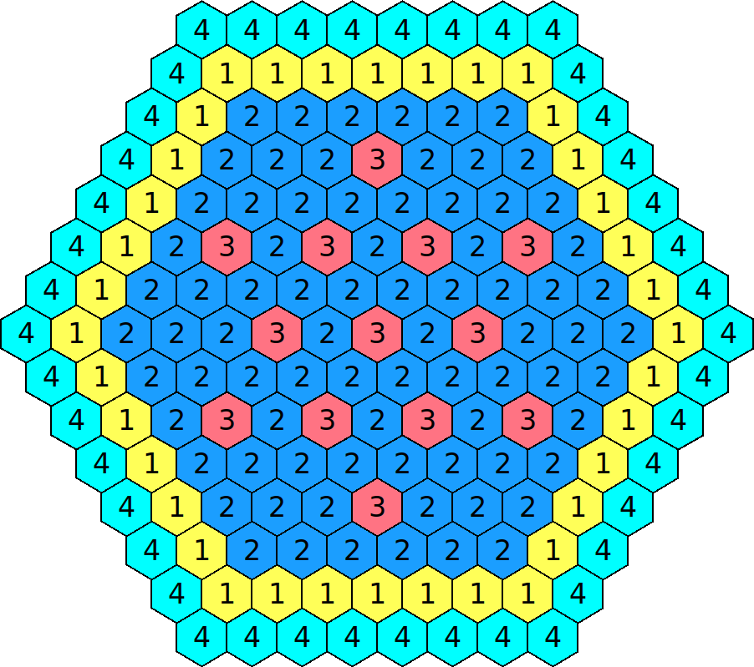
IAEA-2D with reflector
2 groups of instantaneous (G=2) and
1 group of delayed (M=1) neutrons
Lambda- and alpha- spectral problems
Varied:
n - number of triangles per assembly
p - order of finite element

Slide 9
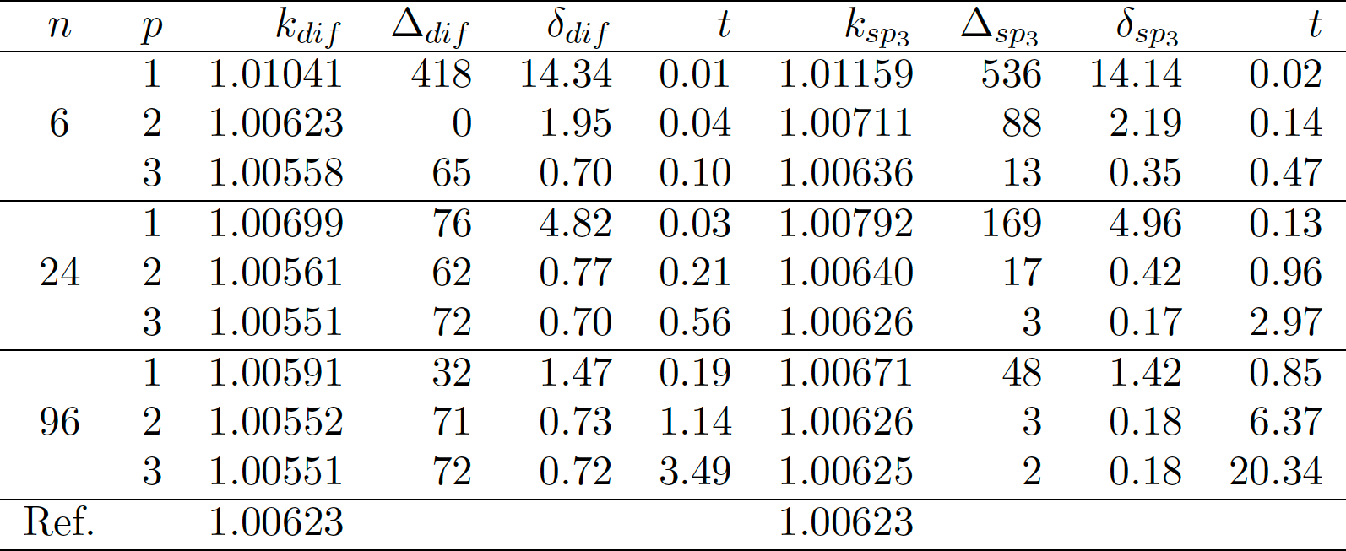
Solution of lambda modes spectral problem
Table: The effective multiplication factor
Ref: MCNP4C code (Bahabadi M.H. at el 2016 Annals of Nuclear Energy 98 74-80)

Slide 10
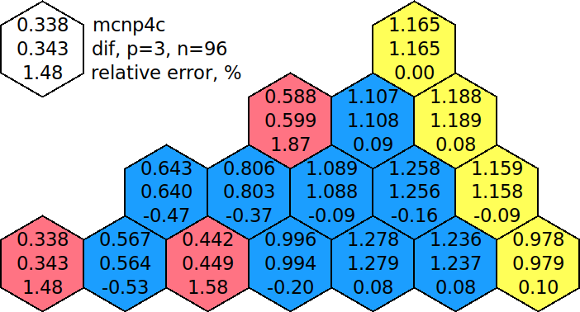

Solution of lambda modes spectral problem
Fig: Power and error distributions using diffusion and SP3 models

Slide 11
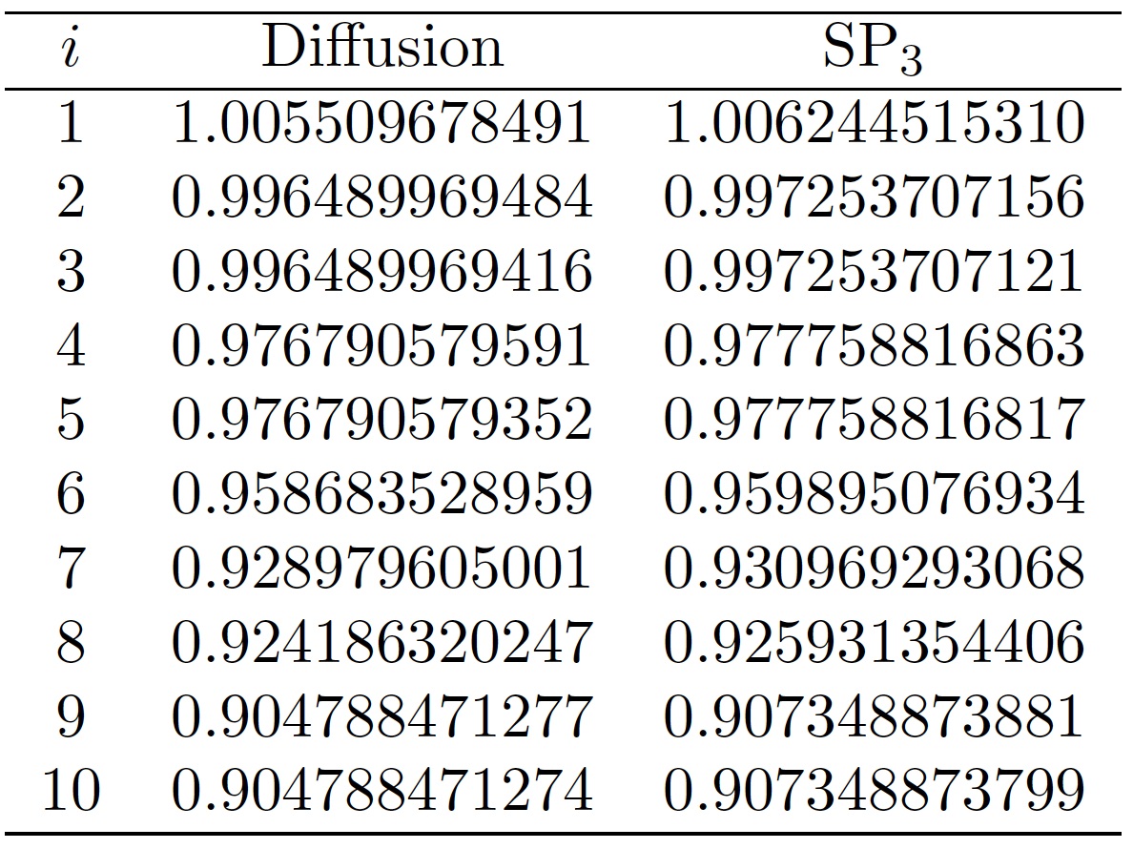
Solution of lambda modes spectral problem
Table: The first 10 eigenvalues for p=3, n=96

Slide 12
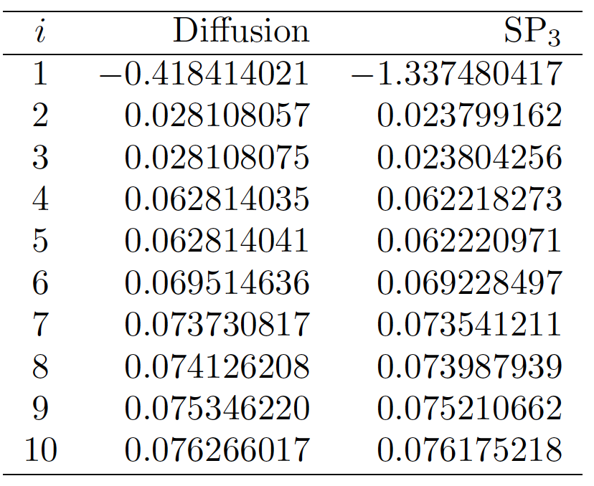
Solution of alpha modes spectral problem
Table: The first 10 eigenvalues for p=3, n=96

Slide 13
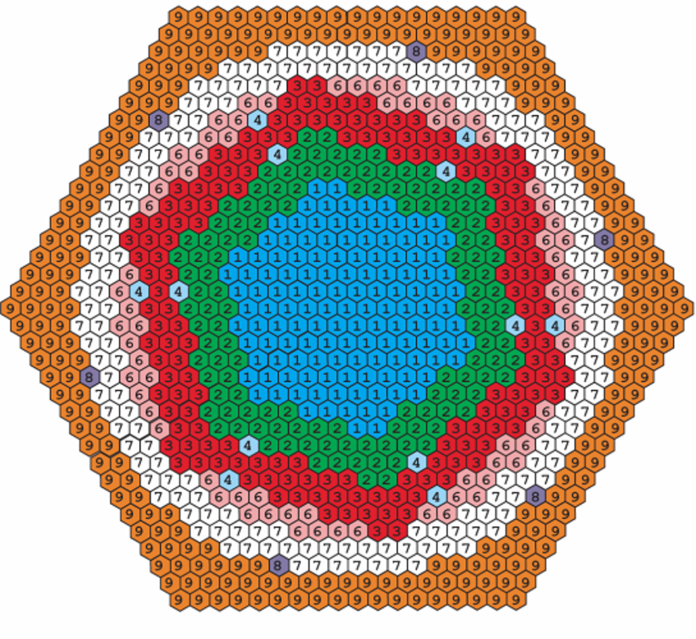
HWR test problem
2 groups of instantaneous (G=2) neutrons
Lambda- and alpha- spectral problems
Varied:
n - number of triangles per assembly
p - order of finite element

Slide 14
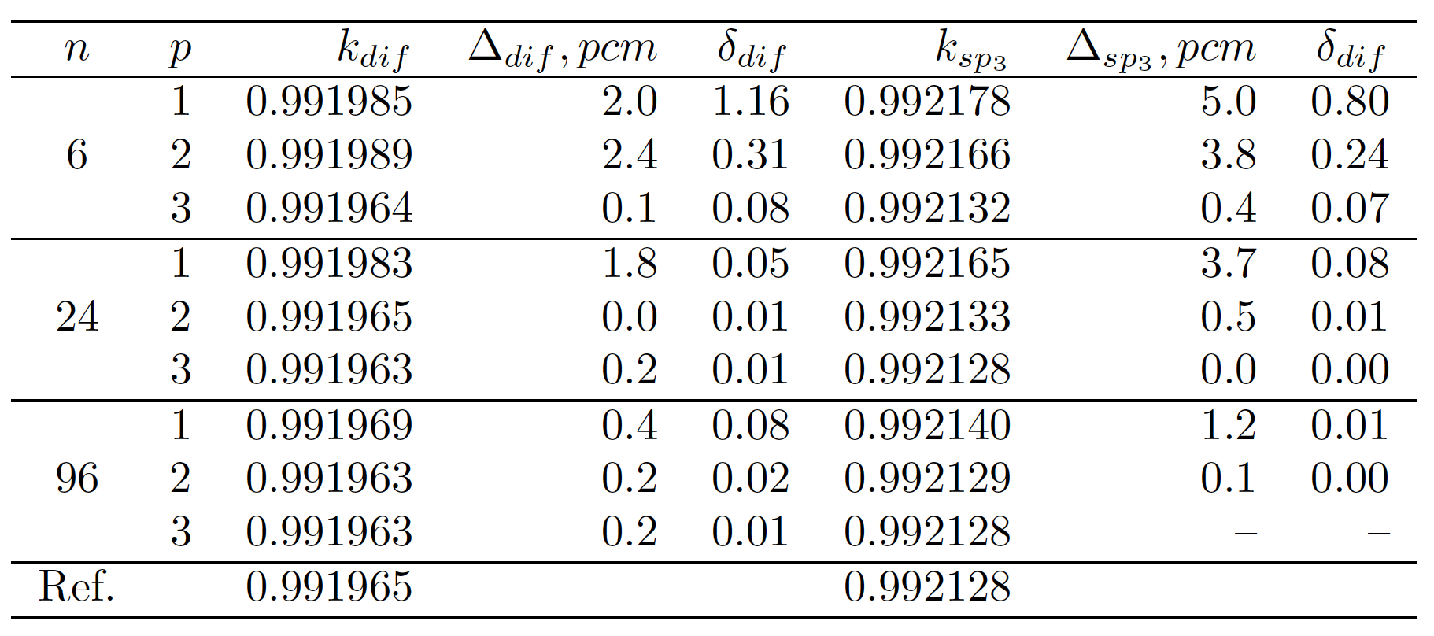
Solution of lambda modes spectral problem
Table: The effective multiplication factor

Slide 15
Solution of lambda modes spectral problem
Table: The first 10 eigenvalues for p=3, n=96

Slide 16
Solution of alpha modes spectral problem
Table: The first 10 eigenvalues for p=3, n=96

Slide 17
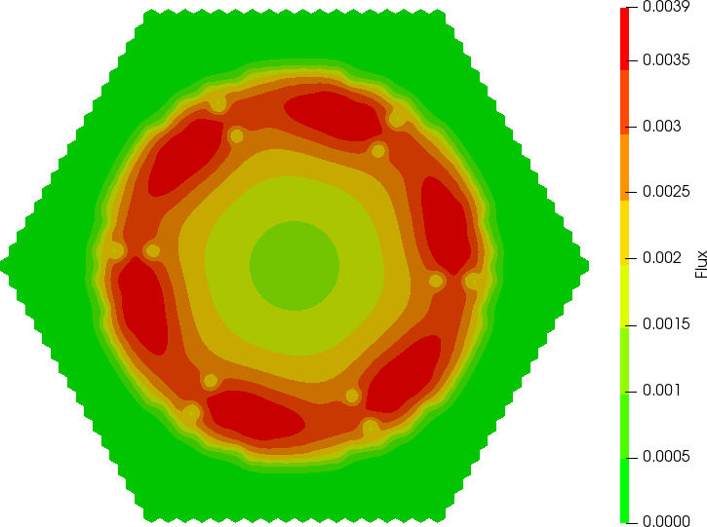
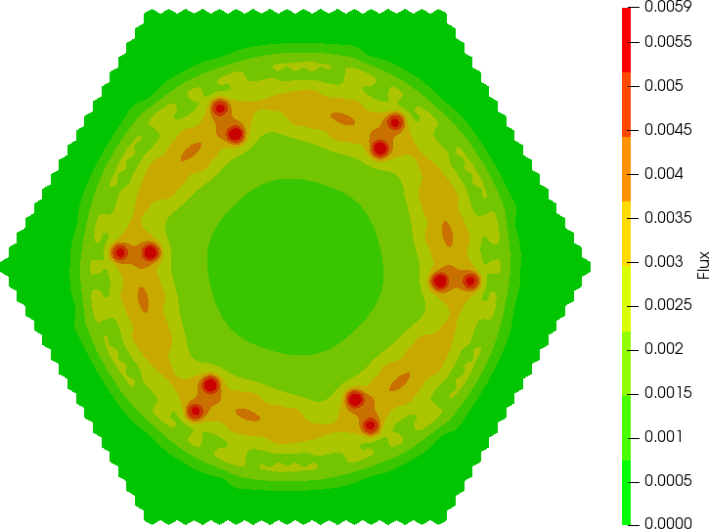
Solution of alpha modes spectral problem
Fig: The eigenfunctions
$$ϕ_{1}^{(1)},ϕ_{2}^{(1)}$$

Slide 18
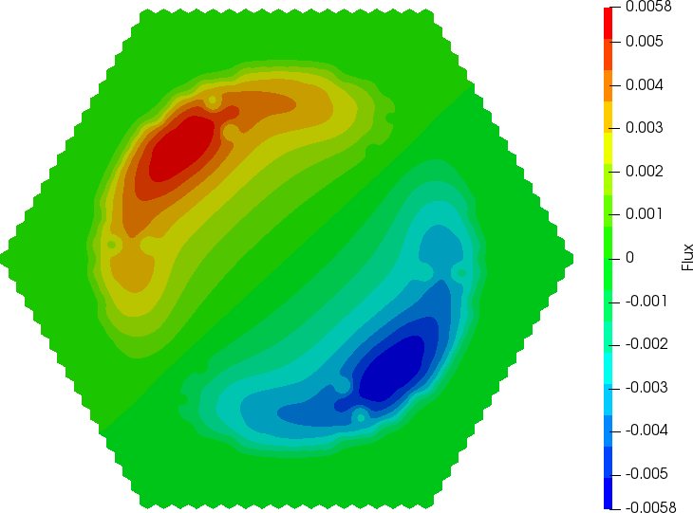
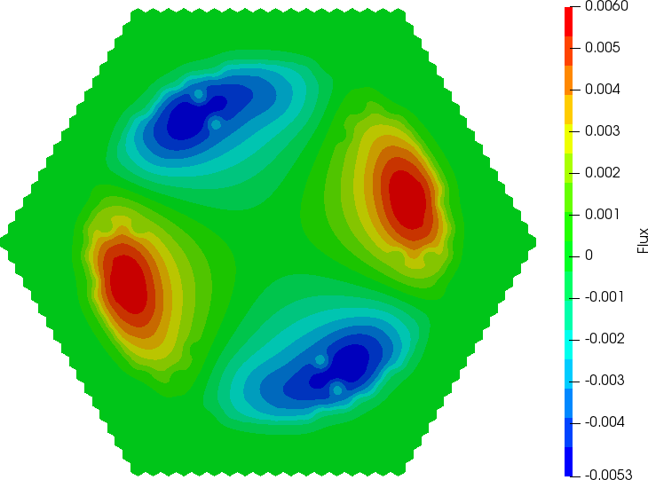
Solution of alpha modes spectral problem
Fig: Real part of eigenfunctions and
$$ϕ_{1}^{(4)},ϕ_{2}^{(5)}$$
$$ϕ_{1}^{(2)},ϕ_{2}^{(3)}$$

Slide 19
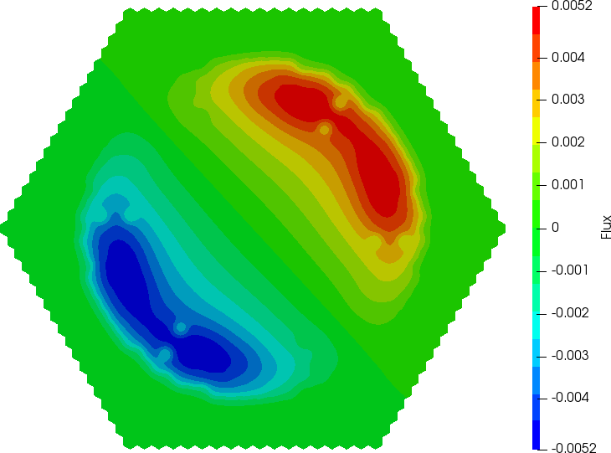
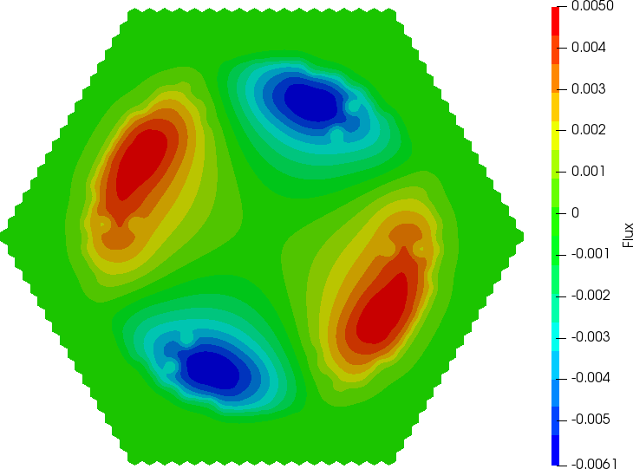
Solution of alpha modes spectral problem
Fig: imaginary part of eigenfunctions and
$$ϕ_{1}^{(4)},-ϕ_{2}^{(5)}$$
$$ϕ_{1}^{(2)},-ϕ_{2}^{(3)}$$

Slide 20
Conclusion
Compared the spectral parameters and non-stationary solutions, calculated by both the diffusion and SP3 options using the FEM.
Solution of the lambda- and alpha- spectral problems has been tested for the IAEA-2D with reflector and HWR reactor benchmark test.
Of particular interest is the problem associated with appearance of complex eigenvalues and eigenfunctions. It was found that this tendency occurs for both the diffusion and SP3 solutions of the HWR reactor test.

Slide 21
Thank you for your attention!

