Slide 1
Automatic Time Step Selection for Numerical Solution of Neutron Diffusion Problems
II International conference
Multiscale methods and Large-scale Scientific Computing
Petr Vabishchevich^{1,2} Aleksandr Vasilev^{1,2}
¹Nuclear Safety Institute, Russian Academy of Sciences, Moscow
²North-Eastern Federal University, Yakutsk
2018, August 15-17, Moscow

Slide 2
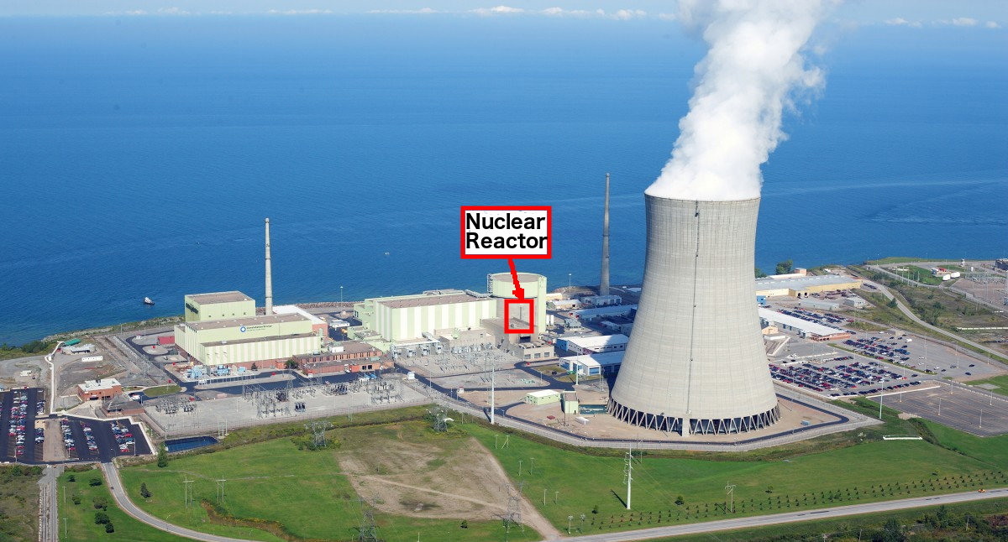
Nuclear power station
Nuclear reactor
Steam turbine
Generator
Cooling system
Other systems

Slide 3
Nuclear power station

Slide 4
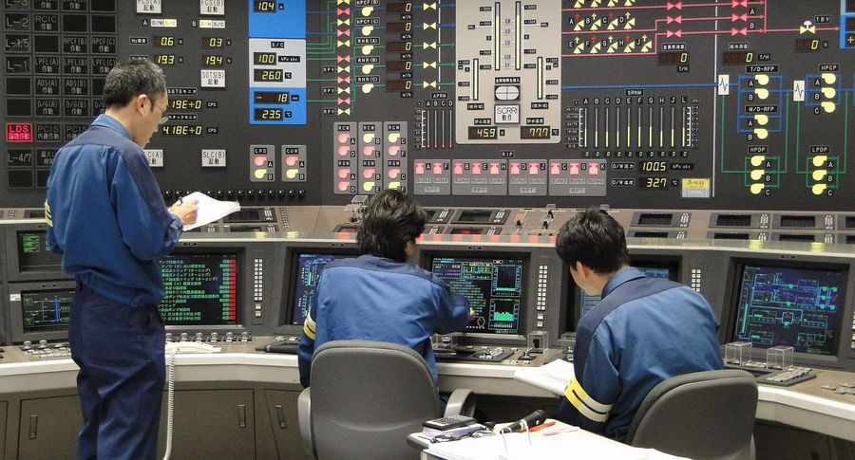
Math modeling
Neutron transport equation (time, energy, spatial and angular variables)
Mutigroup diffusion equation

Slide 5
Time step control
Cauchy problem
The problem of the time step control is relatively well developed for the Cauchy problem solution of differential equations systems (Ascher 1998, Gear 1971, Hairer 1987). The basic approach is to use additional calculations at a new time step to estimate the approximate solution.
Additional calculation
Additional calculations for estimating the error of the approximate solution can be carried out in different ways. The best-known strategy is connected with the solution of the problem on a separate time interval using the given step (the first solution) and with a step two times smaller (the second solution)
A posteriori
This way of selecting the time step is related to the class of a posteriori accuracy estimation methods. The decision as to suitable the time step or the re-calculation is accepted only after the calculation is completed.

Slide 6
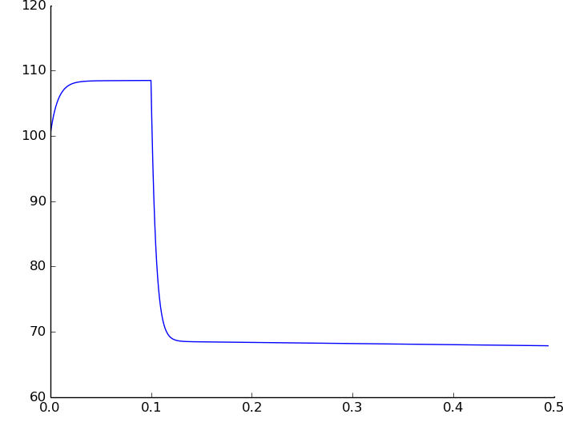
Motivation
Instability due to
initial data
Power
time

Slide 7
Motivation
Fast change
of solution
Instability due to
initial data
Power
time

Slide 8




Algorithm
${\tilde{τ}}^{n+1}$ = $γτ^{n}$, $γ=1.5$
$${\tilde{τ}}^{n+1}$$
Explicit scheme
$$t^{n}$$
$${\tilde{y}}^{n+1}$$

Slide 9

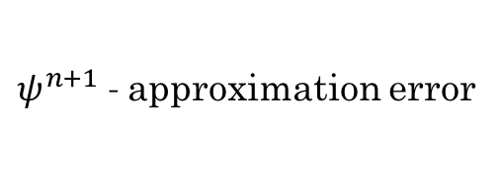
Algorithm
$ψ^{n+1}$- approximation error
$${\tilde{τ}}^{n+1}$$
Explicit scheme
$$t^{n}$$
$${\tilde{y}}^{n+1}$$
Implicit scheme
$$ψ^{n+1}$$

Slide 10



Algorithm
$δ$- error parameter
$${\tilde{τ}}^{n+1}$$
Explicit scheme
$$t^{n}$$
$${\tilde{y}}^{n+1}$$
Implicit scheme
$$τ^{n+1}$$
$$ψ^{n+1}$$
$$\left\|ψ^{n+1}\right\|≈δ$$

Slide 11


Algorithm
$$y^{n+1},{t^{n+1}=t^{n}+τ}^{n+1}$$
$${\tilde{τ}}^{n+1}$$
Explicit scheme
$$t^{n}$$
$${\tilde{y}}^{n+1}$$
Implicit scheme
Implicit scheme
$$y^{n+1}$$
$$τ^{n+1}$$
$$ψ^{n+1}$$
$$\left\|ψ^{n+1}\right\|≈δ$$

Slide 12
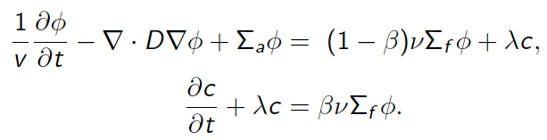


Neutron diffusion equation
Diffusion approximation
Boundary condition
Initial condition

Slide 13



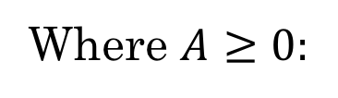
Calculated formulas
The needed time step
Calculated formula
Where $A≥0:$

Slide 14
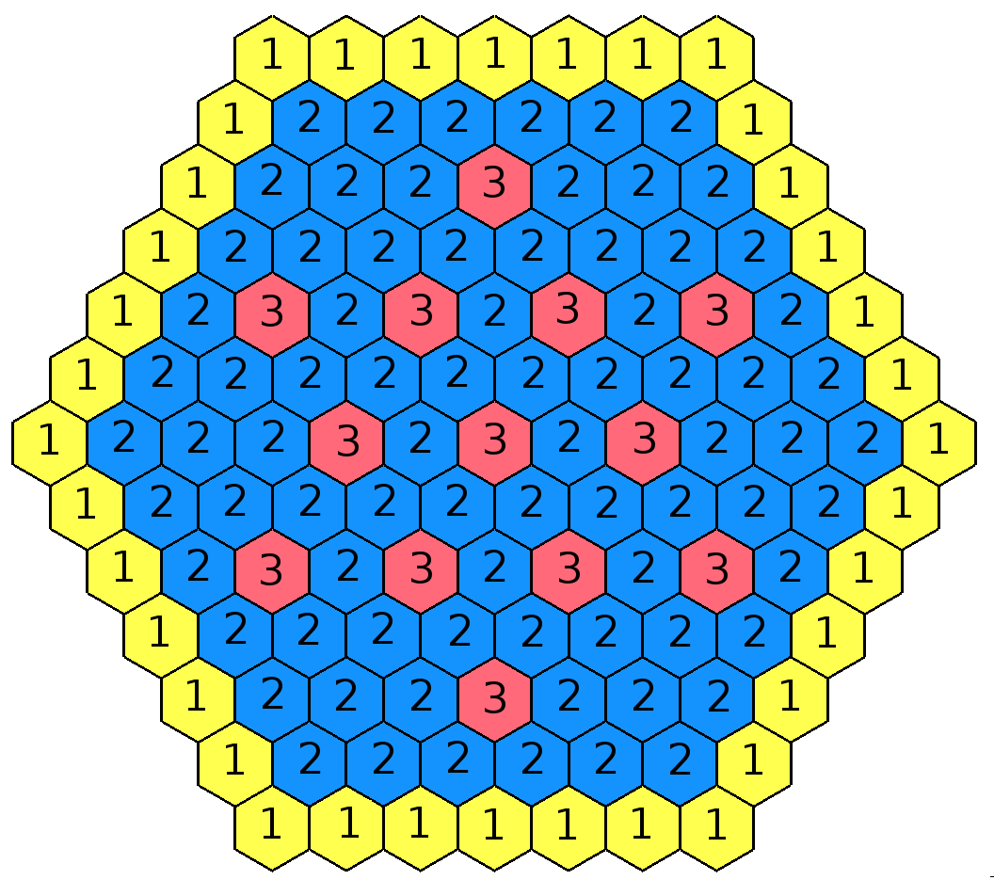
IAEA-2D benchmark
Without reflector
One group of instantaneous
and delayed neutrons
Modeling effect of immersion or
extraction of control rods

Slide 15
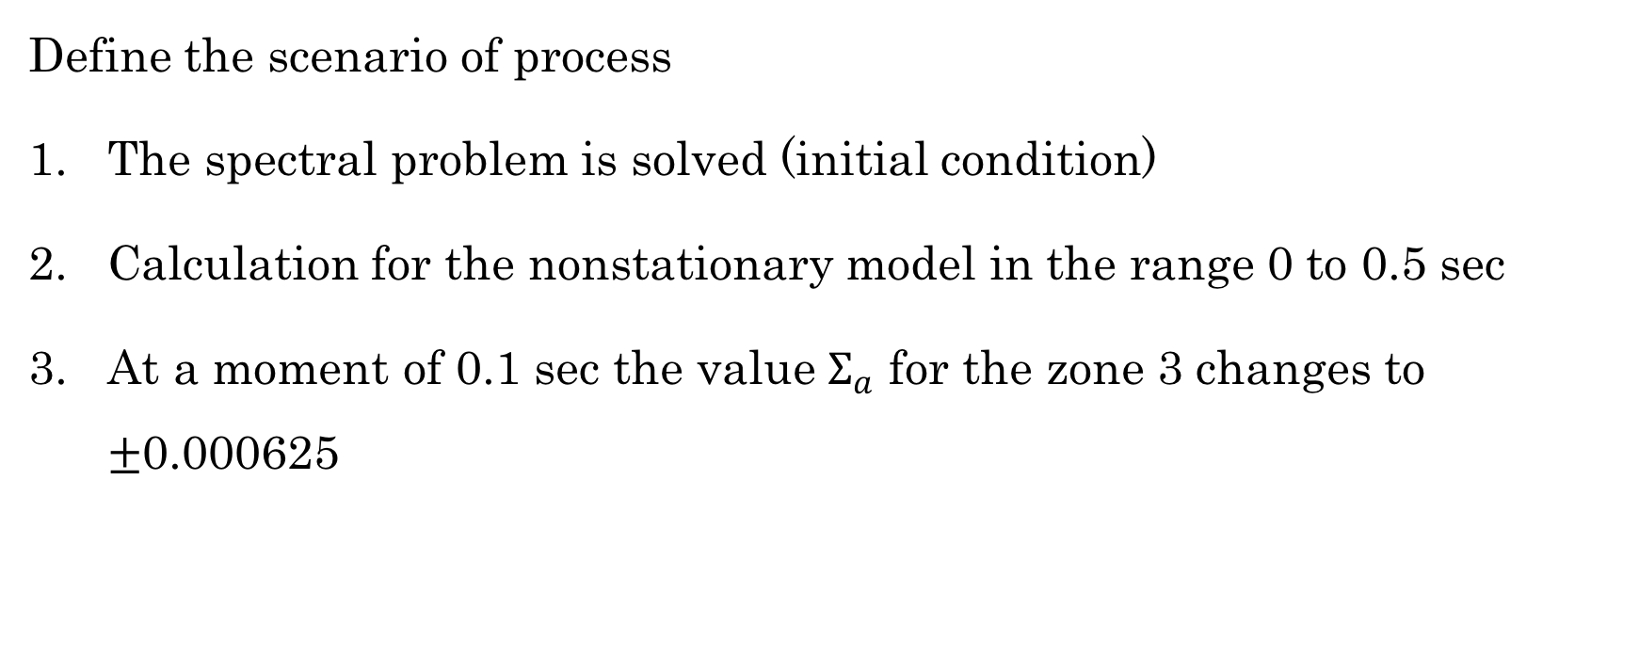
Scenario
Define the scenario of process
The spectral problem is solved (initial condition)
Calculation for the nonstationary model in the range 0 to 0.5 sec
At a moment of 0.1 sec the value $Σ_{a}$ for the zone 3 changes to $±$0.000625

Slide 16




Software

Slide 17
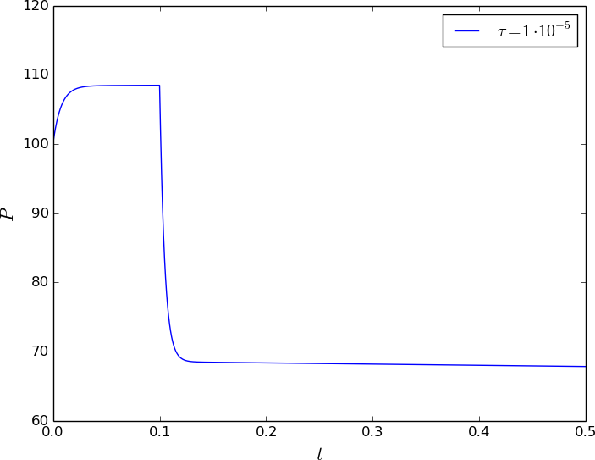
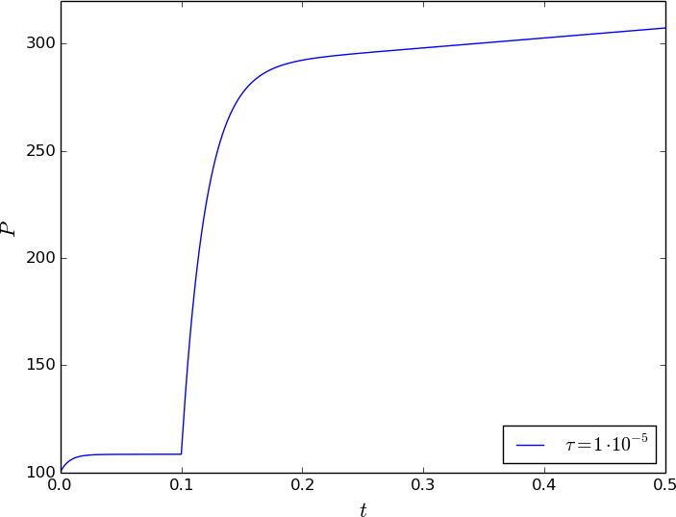
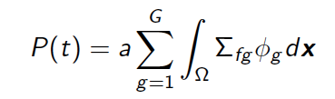
Nuclear power
Nuclear power for immersion (left) and extraction (right)

Slide 18
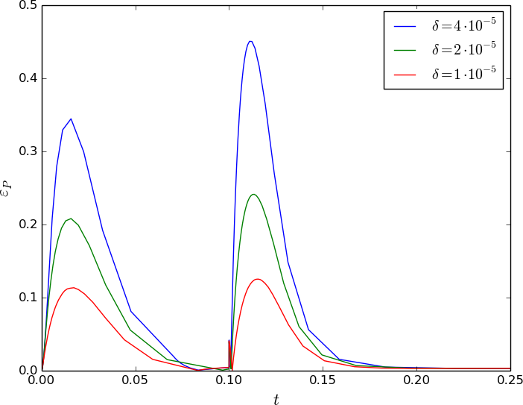
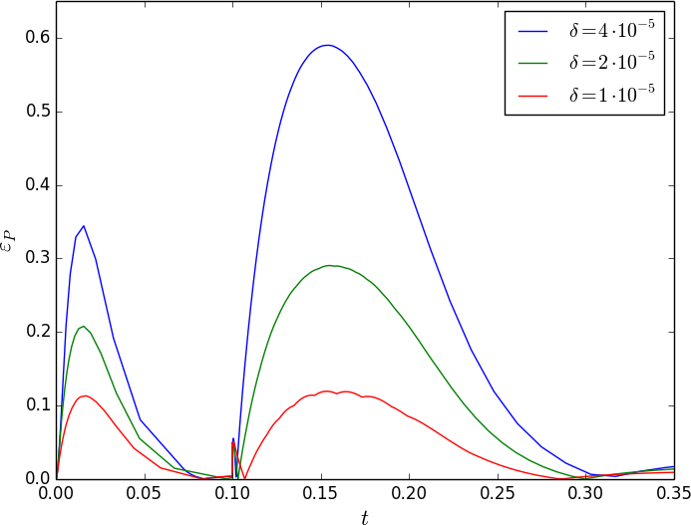

Error
Error for immersion (left) and extraction (right)

Slide 19
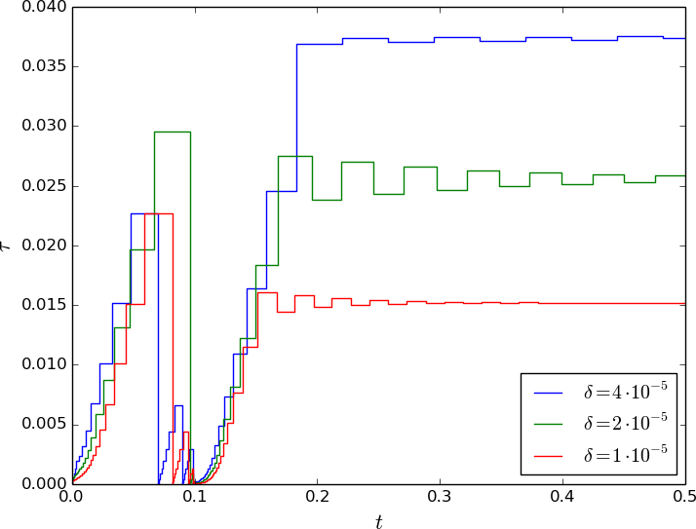
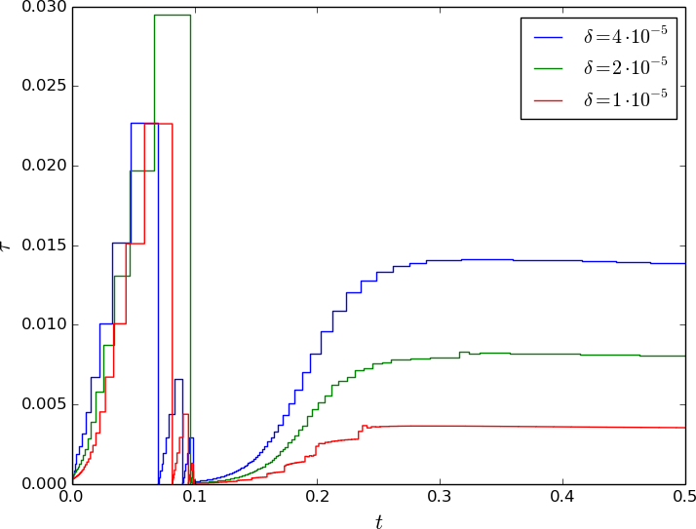
Time step
Time steps for immersion (left) and extraction (right)

Slide 20
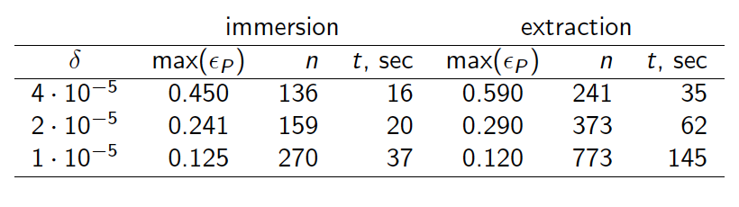
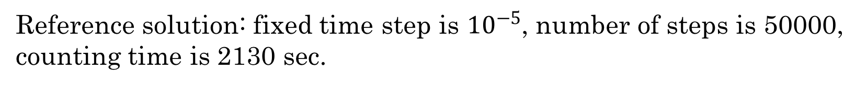
Counting time and number of steps
Reference solution: fixed time step is ${10}^{−5}$, number of steps is 50000,
counting time is 2130 sec.

Slide 21
Conclusion
An algorithm for automatic time step selection for numerical solution of neutron diffusion problems has been developed.
The solution is obtained using guaranteed stable implicit schemes, and the step choice is performed with the use of the solution obtained by an explicit scheme.
Calculation results obtained for a neutron diffusion problems demonstrate reliability of the proposed algorithm for time step choice.

Slide 22
Thank you for your attention!

