Slide 1

Maximizing Positive Business Impacts
The Breakfast Club - Group 03
Yasuhiro Arai Brin Harper
Katya Bondareva Harry Kaushal
Rajvir Grewal Riley Layton
Notes:
Introduce topic and team members

Slide 2
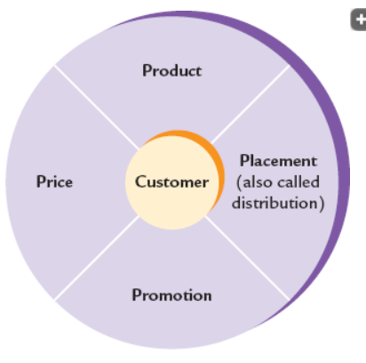
The Marketing Mix
Companies maximize positive business impacts by creating value and utility using the marketing mix
Marketing mix
Product
Promotion
Placement (distribution)
Price
Aka “the 4 Ps of marketing”
Designed to satisfy customers
Notes:
Companies maximize positive business impacts by creating value and utility using the marketing mix
Marketing mix
Product
Promotion
Placement (distribution)
Price.
Aka “the 4 Ps of marketing.” Designed to satisfy customers

Slide 3
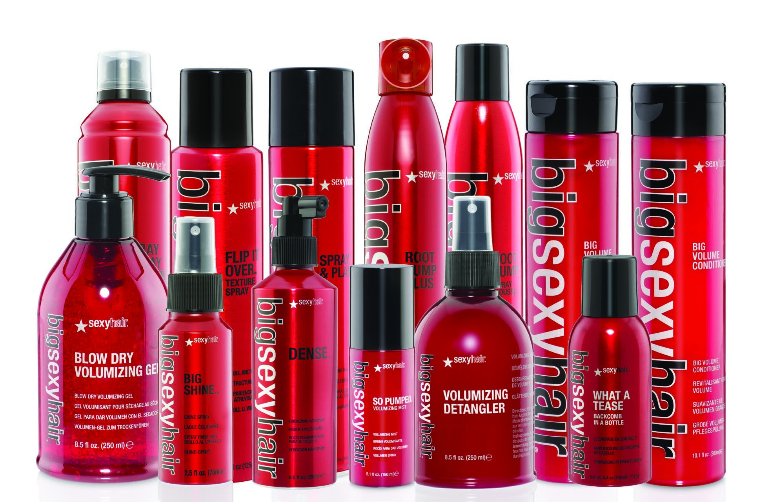
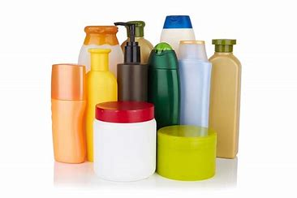
Product
Companies have a few important things to keep in mind when creating and selling a product such as design, features, brand name, packaging, warranties, ect. Basically anything with direct correlation to a product is included in the product aspect of the marketing mix. Products are affected by changing societies and are created with the main intent to cater to the consumers of the product.
Notes:
Companies have a few important things to keep in mind when creating and selling a product such as design, features, brand name, packaging, warranties, ect. Basically anything with direct correlation to the product is included in the product element of the marketing mix. Products are affected by changing societies and are created with the main intent to cater to the consumers of the product. Both are the same products but most people look at the top image first because it is more appealing and intriguing to potential buyers of the product. The bland and not very aesthetically pleasing products on the bottom will often get passed over without a second thought because people are not as intrigued by these products in relation to other products with better branding, logos and colourways.

Slide 4
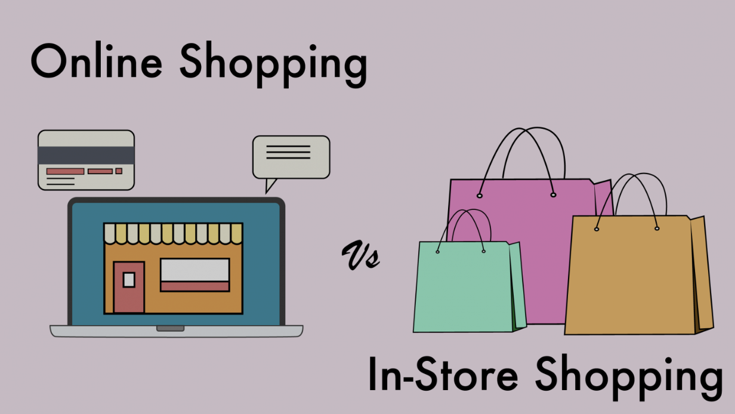
Place
This is where and how the product will be sold.
Online or in-store? Or both?
What is the consumer preference and what is the current situation indicating?
How will you plan your logistics? What are the attached costs and what is the cheapest and most efficient way?
Is customer service good this way?
Notes:
This is where and how you will sell your product. This is a crucial element of the process and must be executed in a proper manner. Will you sell your product online only? Or will you sell it in person at stores? Or will you combine both of these methods? These decisions will be based on consumer preference as well as the current situation. For example, many companies would have had to try and shift to online retailing during COVID as stores were closed. It also depends on whether consumers are more likely to go to the store or want the convenience of ordering online. After deciding this, the business must work out the logistics element. If you are in store, how will the product be transported to ensure enough stock is always available. If it is online, how will you transport your products? Will you give a contract to a third party or do it yourself? What is cheaper? All these elements must be taken into account when looking at the place element of the marketing mix, and will be crucial in determining the success of your product because if you cannot supply efficiently, customers may go to a competitor and this will have negative impacts upon your business.

Slide 5

Price
Setting the price that the customers will have to pay
Different pricing strategies to achieve goals - different for each company and for each stage of business
My company is a start up, so my primary main goal is to build a loyal customer base before I can gain profit. My strategy is to lower my price until my market share is greater, and then focus on profit next year
Our company is older and has a large market share. We suffered a large drop in profit over Covid-19, and in an attempt to fully recover we intend to increase our pricing in order to maximize our short-term profit.
Notes:
Setting the price that the customers will have to pay
Different pricing strategies to achieve goals - different for each company and for each stage of business

Slide 6

Promotion
PRODUCT ✅
PLACE ✅
PRICE ✅
Promotion
Billboards
Social media ads
What is the cost?
Is the method effective for the target market?
Is it unique from your competitors?
Notes:
You have the product, you have the place and you have the price. Now how will your customers know all this? This is where the promotion aspect comes into effect. You must effectively promote your product if you want your product to be successful. There are several different methods of doing this and the one which you will choose depends on your target market as well as your marketing budget. Will you use billboards on busy highways, or will you be using social media ads? What is the costs for this? Is this approach appropriate based on your intended market? Extensive research must be done on all this and more, before releasing an ad campaign, otherwise you may end up spending lots of money on an advertisement which reaches very few of your consumers. You must also be unique from your competitors to stand out from the rest. Promotion is an aspect that cannot be ignored by a business and must be carried out correctly to bring positive results.

Slide 7

Providing Value to the Customers
Companies focus on the marketing mix with the customers in mind
The customers have the following values satisfied:
Safe, useful, inclusive product
Fair price
Right place
Right time
Notes:
Companies focus on the marketing mix with the customers in mind
The customers have the following values satisfied:
Safe, useful, inclusive product
Fair price
Right place
Right time

Slide 8
Question #1
Which of these is not an aspect of the The Marketing Mix?
a) Distribution
b) Marketing
c) Customer Service
d) Creating Value for the Customer

Slide 9
Question #2
What specific course of action did the presentation outline that a startup could use to build a stronger customer base before shifting the focus to profit?
a) Focus on developing a more convenient product
b) Maximize ease of access so that customers are able to easily continue to get access to your product
c) Lower your price in the beginning to increase market share
d) Make a billboard with cute puppies and trendy teenagers

Slide 10
Question #3
If Jimmy decides to develop a new pesticide and sell it in a saturated market such as Canada, what would be important to keep in mind when introducing his product to consumers?
a) Place
b) Product
c) Promotion
d) Price
e) All of the above

