Slide 1
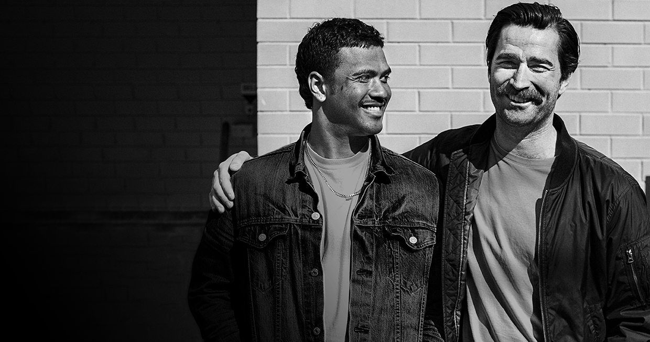

Title with Picture Layout
STOP MEN DYING TOO YOUNG
Subtitle
Notes:
To change the image on this slide, select the picture and delete it. Then click the Pictures icon in the placeholder to insert your own image.

Slide 2

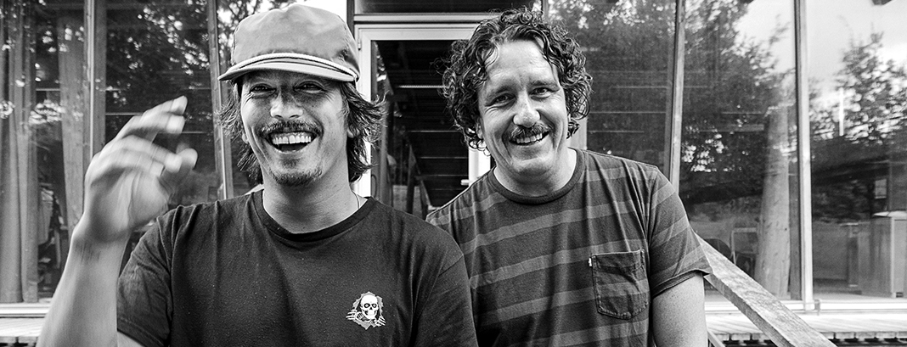
CHALLENGES
Year-round engagement
Increase awareness in the general public about our other causes
Collect, analyze, display and utilize customer data to increase engagement and retention

Slide 3
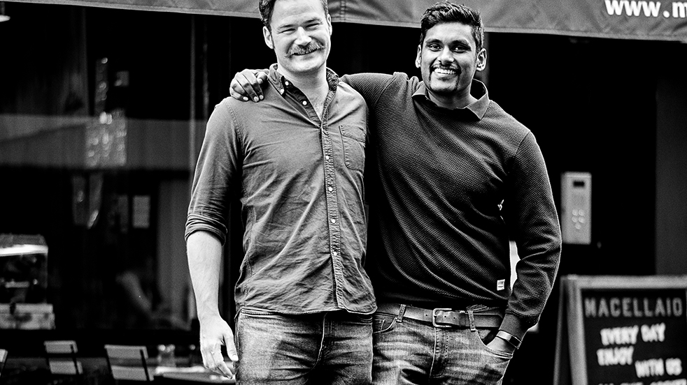
SOLUTIONS
SOLUTION
Provide a digital solution that allows fundraisers to connect to more people in their network and create sustainable engagement outside of November and beyond just prostate cancer.

Slide 4
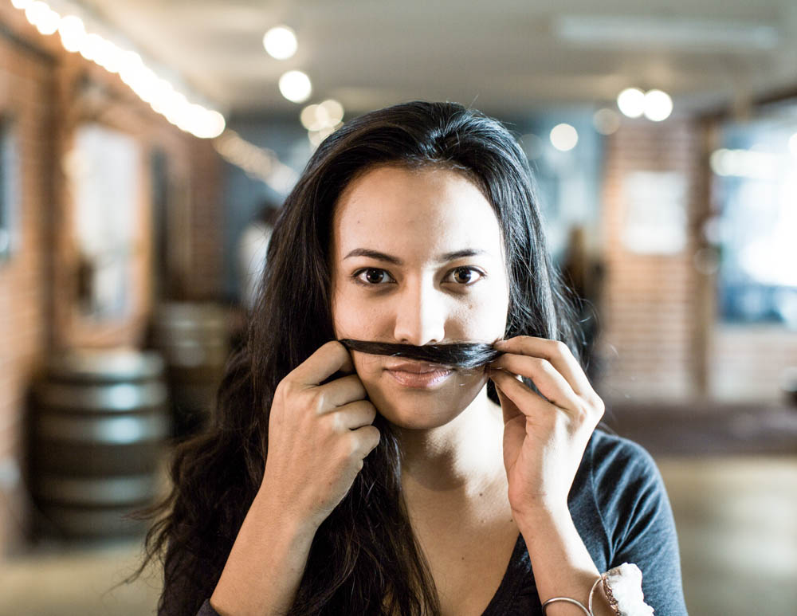
HYPOTHESIS
Highlighting other causes and events will increase opportunity for donations, outside of November.
Using data to highlight user impact will motivate them as they can see that their participation makes a difference.
By integrating better with social media we’ll create engagement and traction.

Slide 5
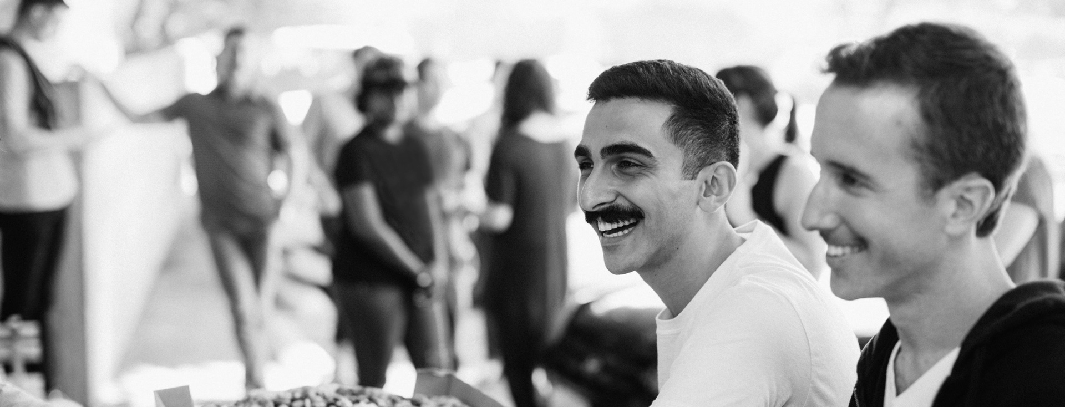
TESTING
MEASURING MO’IMPACT
KPI’S
A/B
Usability
Info Retention
Likelihood of reengagement
Number of new accounts
Increase Event attendees
Increase donations outside of November

Slide 6
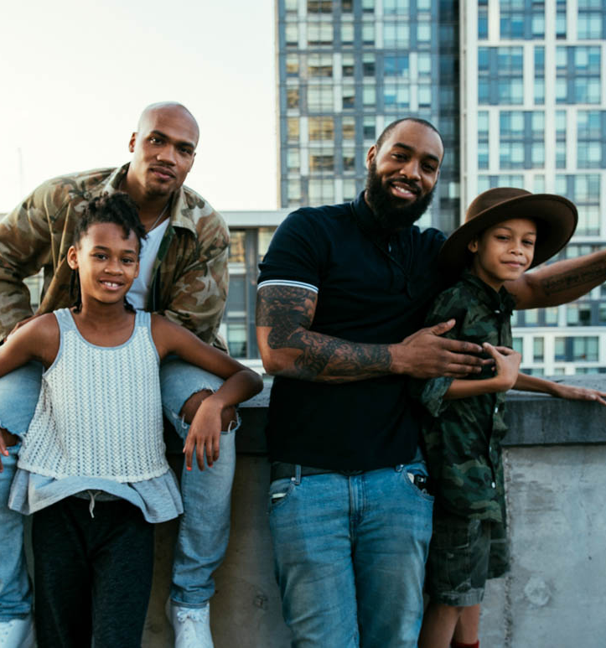

THE BIG PICTURE
Facebook arcade style game, “Stache Bros” (data), whichi includes:
Loading screen displays facts and info
After each level a share button is presented (social media)
Energy level to play – if low, share Mo page on social media or wait.
Advertisement revenue directly goes to donations.
2. Add-on to app: track sleeping, eating and running habits, if indicators of depression are detected it shows a pop-up with help-line information.

Slide 7
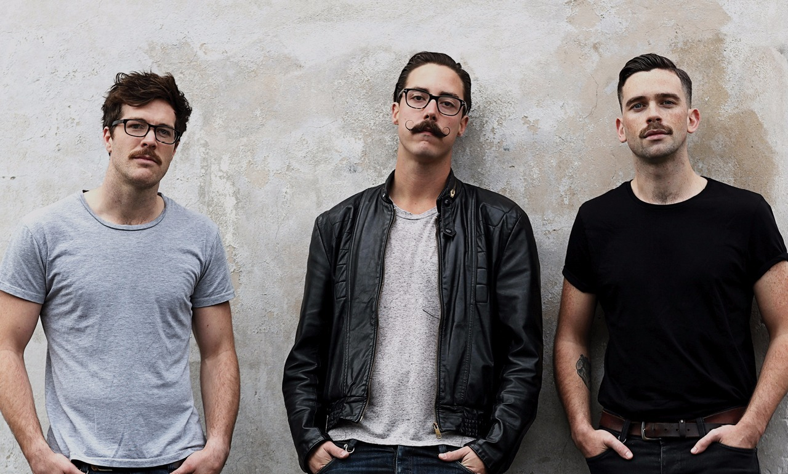
Questions?

Slide 8
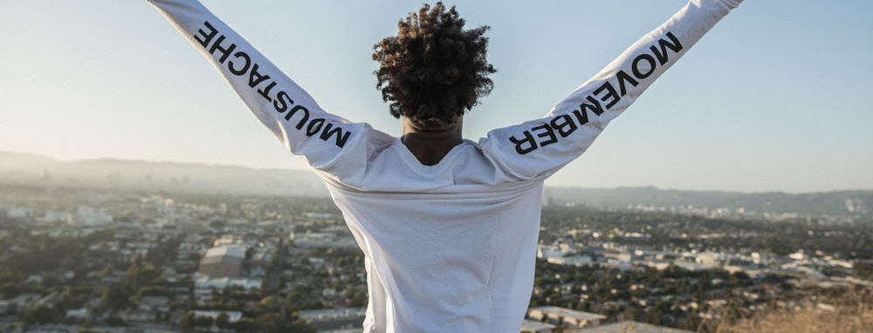
THANK YOU!

