Slide 1
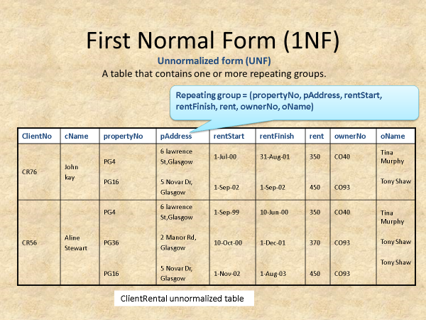
Normalize the below using the Functional dependency techniques

Slide 2
To transform an unnormalized table into 1NF, we ensure that is a single value in each row and column. This is achive by removing the repeating group.
clientNo | cName | PropertyNo | pAddress | rentStart | rentFinish | Rent | ownerNo | OName
CR76 | John kay | PG4 | 6 lawrence st.Glasgow | 1-Jul-00 | 31-Aug-01 | 350 | CO40 | Tina Murphy
CR76 | John kay | PG16 | 5 novar Dr, Glasgow | 1-Sep-02 | 1-Sep-02 | 450 | CO93 | Tony Show
CR56 | Aline stewart | PG4 | 6 lawrence st.Glasgow | 1-Sep-99 | 10-Jun-00 | 350 | CO40 | Tina Murphy
CR56 | Aline stewart | PG36 | 2 manor rd, Glasgow | 10-Oct-00 | 1-Dec-01 | 370 | CO93 | Tony Show
CR56 | Aline stewart | PG16 | 5 novar Dr, Glasgow | 1-Nov-02 | 1-Aug-03 | 450 | CO93 | Tony Show

Slide 3
Second Normal Form (2NF)
Note(1NF - > 2NF)
-If partial dependencies exist on the primary key remove them by placing them in a new relation with a copy of their values.
Client : (ClientNo, Cname)
PropertyRental : (clientNo, PropertyNo, rentStart, rentFinish)
Owner : (PropertyNo, pAddress, rent, ownerNO, oNAME)

Slide 4
Third Normal Form (3NF)
Note(2NF - > 3NF)
-If transitive dependencies exist on the primary key, remove them by placing them in a new relation
Client : (clientNo, cName)
Rental : (clientNo, PropertyNo, rentStart, rentFinish)
PropertyForRent : (PropertyNo, pAddress, rent, ownerNo*)
Owner : (ownerNo, oName)

