Slide 1
warriors Convert
Robots dominate the world.

Slide 2
Outlines:
01
Introduction
Introducing our project vision, mission, values and strategies.
02
Planning
Establishing and maintaining vision, mission, values and strategies.
03
Organizing
Identifying activities, departments and co-ordination.
04
Influencing
How it will affect the community positively.
05
Controlling
Get a modern PowerPoint Presentation that is beautifully designed. I hope and I believe that this Template will your Time.

Slide 3
Introduction

Slide 4
Warriors Convert
Introduction
The project is to make robots to help armies in wars.
They will be armed with all possible weapons .
They will be programmed to use these weapons well and when to use them.
This project will help to reduce human losses.
By these robots it will be the guerrilla soldiers who can attack the enemy’s camp.

Slide 5
Planning vision, Mission, Values, strategy

Slide 6
Vision:
Designing robots to be willing to face wars instead of soldiers.
Mission:
Designing different kinds of robots with different positions in the war.
Defining kinds of robots we will need in war.
Constructing software which will enable the robots to fight.
Applying a system for the soldiers to control the robots remotely.

Slide 7
Values:
Reducing the human loss due to the wars deaths.
investing the human resources in planning, organizing, monitoring and controlling rather than fighting.
promoting for the inner peace.

Slide 8
Strategy:
01
Initiating a team consisting of different specialists for making the outlines and setting up the software for the robots.
02
Communicating with the official authorities to approve the software.

Slide 9
03
Designing the different shapes and the structure of the robots:
We will use the best steel, iron and other machinery metals to be powerful enough to fight in the war.
We will insert cameras in their heads to remotely send a live full vision to the war where the human resources will control the situation.
In their hands, legs, knees will be inserted gun like machines which will be used to be multi shooting weapons.
In their feet we will put small wheels which will enable the robots not only to walk and run but to drive like a car for long distances.
We will use the best steel, iron and other machinery metals to be powerful enough to fight in the war.

Slide 10
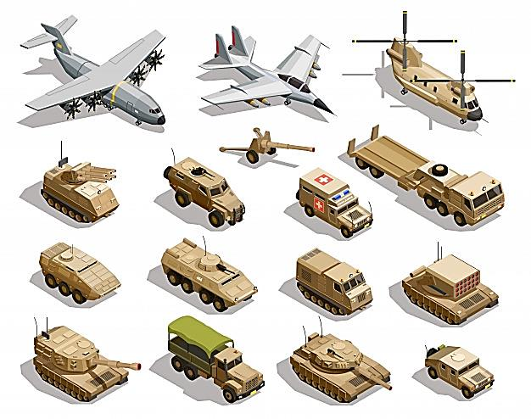
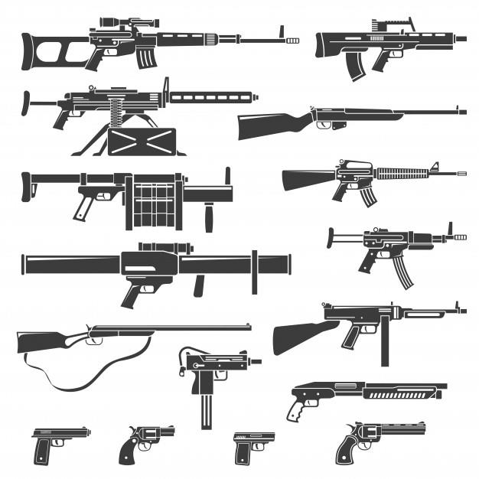
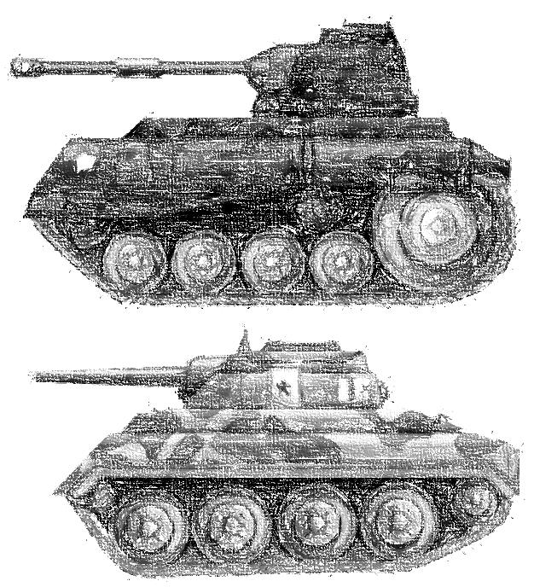
03
Designing the weapons and the training the robots on how to deal with the weapons will be a main target.
One of the main weapons designed for the robots are as shown.

Slide 11
Strategy:
04
After designing the robots we will co-ordinate with the official authorities for making the robots on reality.
05
After having the robots’ models we will split them into groups in order to have the following teams: Infantry, Artillery, Armored weapon, Snipers, Air Defense, rockets and Navy.

Slide 12
Strategy:
06
The previous feature will aid the human resources to control the robot with sensors.
07
We will work on updating our robots’ software after each war, in order not to lose the previously fought or the upcoming ones.

Slide 13
Organizing

Slide 14
Organizing
Departmentally organizing the activities : We need all departments are dependent like:
Development department to make the software of the robots.
Testing Department to test the software of the robot.
Engineering department to invent the shape of the robot.
Identification of activities:
Making kind of robots like soldier and Armored weapon.
01
02
Co-ordination between authority and responsibility:
Firstly making the robot by the engineering department , then software department will receive it to make the software of this robot , and finally testing department will receive it to test the software of this robot.
03

Slide 15
Influencing

Slide 16
Influencing
By these robots we will reduce the human loss, and this project will open the door to make robots do the difficult jobs which is danger to human, promoting for the world-wide peace by saving the human kind and investing their brains rather than their force powers.
Influencing the people to put in mind the importance of this kind of technology and to be later on used not only in wars but in houses, companies, hospitals etc…

Slide 17
Controlling

Slide 18
Controlling Classification
Standard Performance
This is the performance of the robots which is systimatically designed.
Actual Performance
This is the applied and monitored performance which is managed in war.
Types
Errors
Programming a robot especially for the first time to be used as a worrier is not an easy challenge; of course we will face some challenges. Errors will be our biggest fear.

Slide 19
Performances
Standard Performance:
The robots’ software is programed for fighting in wars, running, being the best snipers which will affect the result of the war and positively the loss of resources.
Best Design
During the war of course many of our robots will be affected negatively and may shutdown which will need to be fixed.
Accordingly our robots after the standard and the actual performances in the field after the war ends, they will collect our damaged robots, ship them to our base to be later fixed or used as spare parts.
Perfect
Robot
Actual Performance:
The applied software will enhance the fighting skills and being a worrier which requires not only applying a software but training the robots and monitoring their reactions and attitudes to control the consequences and fix any pop up situations and problems.

Slide 20
Controlling Errors
Software errors:
This kind of errors is the easiest to discover and fix.
As we will discover these errors in the beginning before even going to the war.
Technical errors:
Errors in finishing the robots in their hardware which will require further investigation and will unfortunately require Dismantling and regrouping.
This kind of errors is time consuming.
Connection errors:
This particular type of errors happens in the field during the war where the human resources lose their connections with the robots in the war and they become unable to hear, see or even act.
One of the solutions to such an error is to send a backup or connecting to a satellite which will give us the full vision and then we can act according to the situation.

Slide 21
Thank you for reaching this far
WIN IN PEACE…

