Slide 1
Agenda
1-Introduction to React
what is react?
diffrence between library and framework?
why we use them instead of traditional html,css,js?
SPA VS MPA
2- how react works?
virtual dom
component based architecture
3- Setting up environment
node js + npm +npx
how to create react project (react app + vite)
project structure
VScode extensions
4- Practical Part
JSX basics
components
styles
props

Slide 2
Introduction to React
React is a JavaScript library for building user interfaces.
Created by Facebook in 2013.
Used for building fast, interactive, single-page web apps.

Slide 3
Why React and Not Traditional HTML/CSS/JS?
- Traditional approach is static and not dynamic.
- No component reusability or efficient DOM updates.
- Harder to maintain and scale large applications.
→ React introduces reusability, virtual DOM, and stateful UIs.

Slide 4
Library vs Framework
- Library: Provides tools (e.g., React).
- Framework: Full structure & control (e.g., Angular).

Slide 5
SPA vs MPA vs CSR vs SSR
- SPA (Single Page Application): One HTML page, updates dynamically.
- MPA (Multi Page Application): Multiple HTML pages.
- CSR (Client Side Rendering): Rendered in browser.
- SSR (Server Side Rendering): Rendered on server, faster initial load.

Slide 6
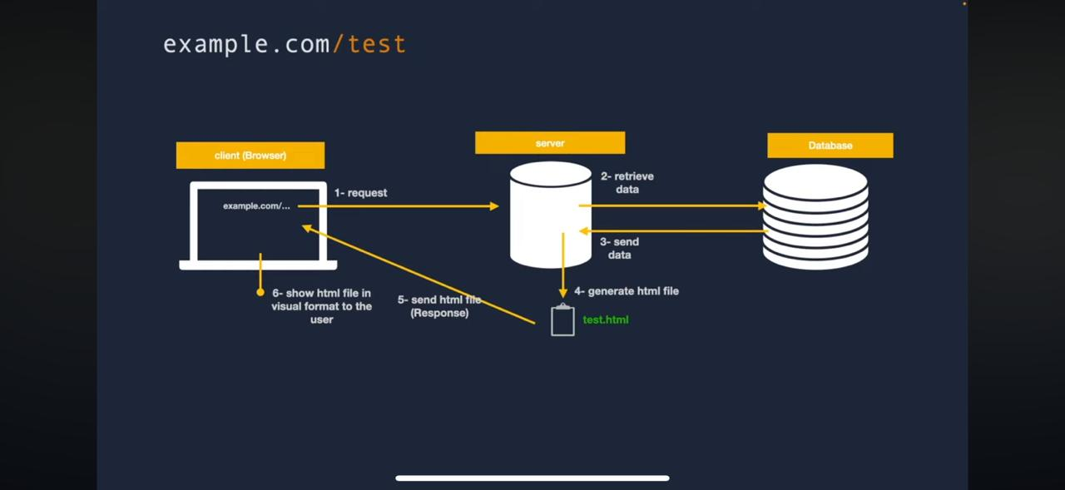
MPA

Slide 7
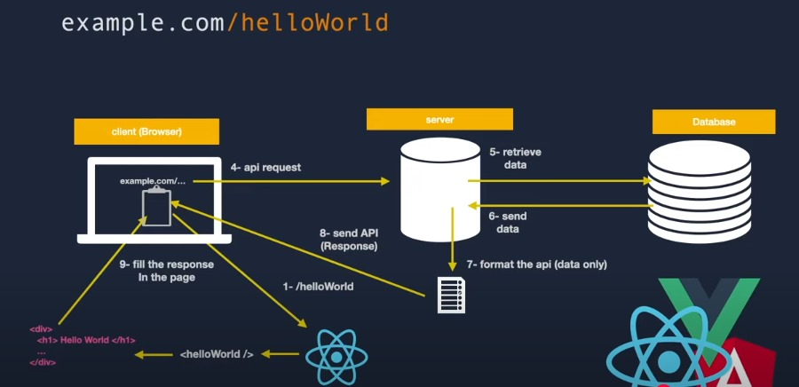
SPA

Slide 8
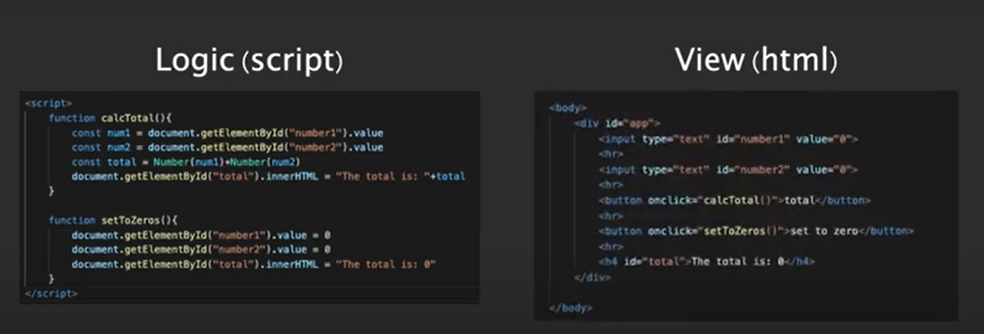
UI-State in traditional way

Slide 9
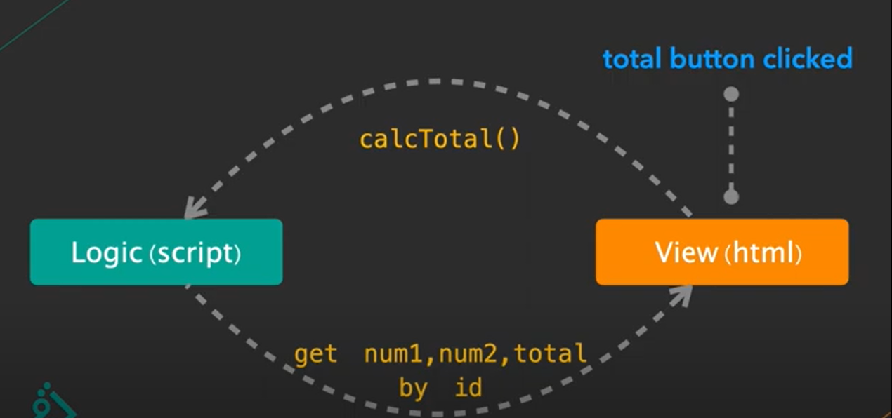

Slide 10
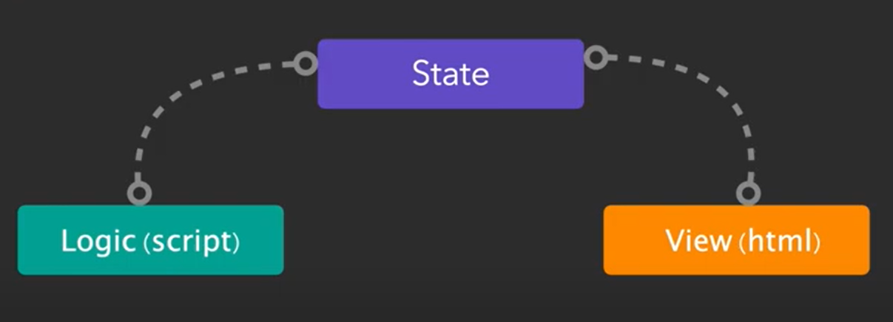
Two-way-binding

Slide 11

Virtual Dom

Slide 12
React Features & Why It's Fast
- Virtual DOM: Efficient re-rendering.
- Component-based architecture: Reusable and modular.
- Huge community: Lots of packages and support.
- Great for performance and maintainability.

Slide 13
React Setup Steps
1. Install Node.js and npm.
2. Run: npx create-react-app my-app
3. cd my-app && npm start
4. Open project in VS Code.

Slide 14
React Project Structure
- node_modules/: All packages
- public/: Static files like index.html
- src/: All React components and logic
- index.js: Entry point, renders App component
- App.js: Root component

Slide 15
What is JSX?
- JSX = JavaScript + XML
- Looks like HTML but it's JavaScript.
- Allows embedding expressions, props, and logic.
- Must return ONE root element.

Slide 16
React Components
- Functional Component: Simple JS function (modern and preferred).
- Class Component: ES6 class (legacy, rarely used).
- All components return JSX.
Example: const MyComponent = () => <h1>Hello</h1>

Slide 17
Props in React
- Props = Properties passed to components.
- Used to send data from parent to child component.
- Read-only and immutable.
Example: <Welcome name='Sara' /> → props.name = 'Sara'

