Slide 1

.NET & C#
By Hasna Haseeb K C

Slide 2

.NET FRAMEWORK
.Net is a software Framework
It runs primarily on Microsoft windows Platform
includes a large library and provides language interoperability across several programming languages like c#, vb, j#, c++,asp etc

Slide 3

History:
Microsoft started development on the .NET Framework in the late 1990s originally under the name of Next Generation Windows Services (NGWS)
By late 2000 the first beta versions of .NET 1.0 were released
  Available for Windows 98, ME, NT 4.0,2000, and XP
  Provides power of CTL,CLR,CLI
On 3 April 2003 Microsoft launched its .Net Framework Version 1.1
  the version that is shipped with any windows operating system (windows server 2003)

Slide 4

7 Nov. 2005
On 07th November 2005 Microsoft published .NET Framework version 2.0 with the Visual studios 2005, Microsoft SQL Server 2005
6 Nov. 2006
On 6 November 2006 .Net comes with its new .Net version 3.0 formerly this version is called WinFX.
19 Nov. 2007
On 19 November 2007. Microsoft introduced .Net Framework version 3.5 and include support for Ajax enabled websites and LINQ
12 Apr. 2010
On 12 April 2010 .Net framework version 4.0 was introduced .it includes support for visual basic
18 Apr. 2011
.NET Framework 4.0.1 was a fix for Windows Workflow Foundation and introduced on On 18 April 2011
19 Oct. 2011
NET Framework 4.0.2 was introduced as a support for Microsoft sql server on On 19 October 2011
4 Mar. 2012
.NET Framework 4.0.3 was released on 4 March 2012 includes dynamic language runtime and managed Extensibility Framework
15 Aug. 2012
On 15 August 2012 .Net Framework version 4.5 was launched

Slide 5
17 Oct. 2013
The release of .NET Framework 4.5.1 was announced on 17 October 2013 along Visual Studio 2013.
This version requires Windows Vista SP2 and later and is included with Windows 8.1 and Windows Server 2012 R2.
5 May 2014
The release of .NET Framework 4.5.2 was announced on 5 May 2014.
This version requires Windows Vista SP2 and later
For Windows Forms applications, improvements were made for high DPI scenarios.
For ASP.NET, higher reliability HTTP header inspection and modification methods are available

Slide 6
12 Nov. 2014
.NET Framework 4.6 was announced on 12 November 2014.
It was released on 20 July 2015.
It supports a new just-in-time compiler (JIT) for 64-bit systems called RyuJIT.
WPF and Windows Forms both have received updates for high DPI scenarios.
This version requires Windows Vista SP2 or later
30 Nov. 2015
The release of .NET Framework 4.6.1 was announced on 30 November 2015.
This version requires Windows 7 SP1 or later

Slide 7
30 Mar. 2016
The preview of .NET Framework 4.6.2 was announced on 30 March 2016.
It was released on 2 August 2016.
This version requires Windows 7 SP1 or later.
5 Apr. 2017
On 5 April 2017, Microsoft announced that .NET Framework 4.7 was integrated into Windows 10 Creators Update, promising a standalone installer for other Windows versions.
An update for Visual Studio 2017 was released on this date to add support for targeting .NET Framework 4.7The promised standalone installer for Windows 7 and later was released on 2 May 2017

Slide 8

17 Oct. 2017
.NET Framework 4.7.1 was released on 17 October 2017.
Amongst the fixes and new features, it corrects a d3dcompiler dependency issue
It also adds compatibility with the .NET Standard 2.0 out of the box.
.NET Framework 4.7.1 is also shipped as a Windows container image.
30 Apr. 2018
.NET Framework 4.7.2 was released on 30 April 2018.
Amongst the changes are improvements to ASP.NET, BCL, CLR, ClickOnce, Networking, SQL, WCF, Windows Forms, Workflow and WPF.
This version is included with Server 2019.[5]
.NET Framework 4.7.2 is also shipped as a Windows container image.

Slide 9
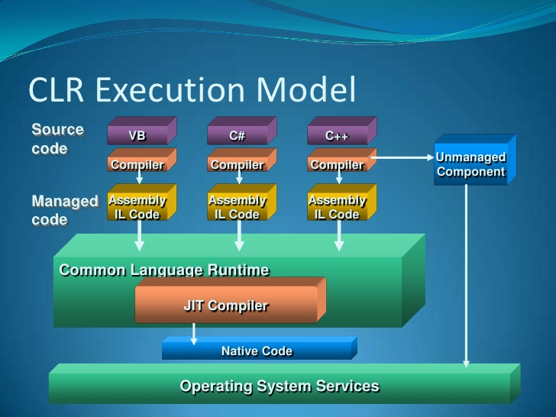
.NET Framework 4.8 was released on 18 April 2019.
  It was the final version of .NET Framework, all future work going into the .NET Core platform that will eventually become .NET 5 and onwards
  This release included JIT enhancements ported from .NET Core 2.1, High DPI enhancements for WPF applications, accessibility improvements, performance updates, and security enhancements.
  It supported Windows 7, Server 2008 R2, Server 2012, 8.1, Server 2012 R2, 10, Server 2016 and Server 2019 and also shipped as a Windows container image.
  The most-recent release is 4.8.0 Build 4115, with an offline installer size of 115 MB and a digital signature date of May 1, 2021.

Slide 10
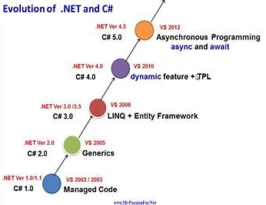
C# Version History
C# 1.0
  .NET Framework 1.0/1.1
  Visual Studio .NET 2002
  First release of C#
C# 2.0
  .NET Framework 2.0
  Visual Studio 2005
  Generics, Partial types, Anonymous methods, Nullable types, Iterators, Covariance and contravariance
C# 3.0
  .NET Framework 3.0\3.5
  Visual Studio 2008
  Auto-implemented properties, Anonymous types, Query expressions, Lambda expression, Expression trees, Extension methods
C# 4.0
  .NET Framework 4.0
  Visual Studio 2010
  Dynamic binding, Named/optional arguments, Generic covariant and contravariant, Embedded interop types

Slide 11
C# 5.0
  .NET Framework 4.5
  Visual Studio 2012/2013
  Asynchronous members, Caller info attributes
C# 6.0
  .NET Framework 4.6
  Visual Studio 2013/2015
  Static imports, Exception filters, Property initializers, Expression bodied members, Null propagator, String interpolation, nameof operator, Dictionary initializer
C# 7.0
  .NET Core
  Visual Studio 2017
  Improved performance and productivity, Azure Support, AI Support, Game development, Cross platform, Mobile App Development,Window App Development

Slide 12
THANK YOU

