Slide 1

Bridging the Generalizability Gap in Diabetes Prediction
Organization: Silicon Global Tech Gilgit
Presenter: Hasnain Alam
Organization: Silicon Global Tech
Department: Artificial Intelligence and Data Science
Supervisor: Mr. Hafizuddin

Slide 2
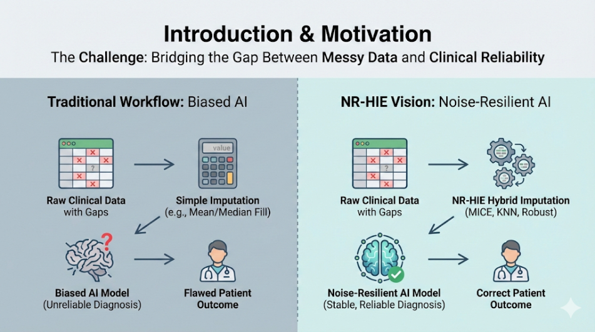
Introduction and Motivation
The Global Health Crisis: Diabetes Mellitus has escalated into a worldwide emergency, with millions undiagnosed and at risk of irreversible complications.
The Shift to Preventative Care: Moving from reactive treatment to proactive AI-driven risk identification.
The "Dirty Data" Challenge: Clinical datasets are sparse and plagued by MNAR (Missing Not At Random) gaps
The Problem of Bias: Traditional imputation methods, like filling gaps with simple averages, introduce massive bias and distort a patient's true clinical picture.
Motivation for NR-HIE: There is an urgent need for noise-resilient algorithms that can handle "Missing Not At Random" (MNAR) data without sacrificing diagnostic accuracy.

Slide 3
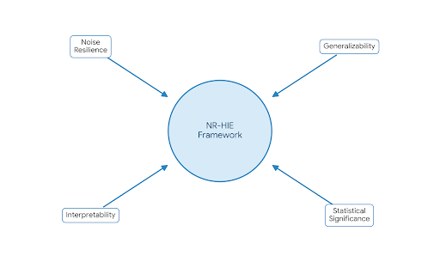
Project Aim and Objectives
Core Goal: Engineer the Noise-Resilient Hybrid Imputation–Ensemble (NR-HIE) framework.
Noise Resilience: Actively learn from missing data patterns rather than deleting them
Redefine Imputation as Learning: Shift from treating preprocessing as a separate cleaning step to treating imputation as an integral part of the learning process itself.
Generate multiple "views" of data (MICE, KNN, Robust) to prevent information loss and capture both global and local data structures.
Bridge the Generalizability Gap: Validate performance on an unseen external cohort (DiaBD) to prevent overfitting..
Interpretability: Ensure "Black Box" transparency using SHAP.
Statistical Rigor: Target significant improvements in F1-Score and Calibration (Brier Score).

Slide 4
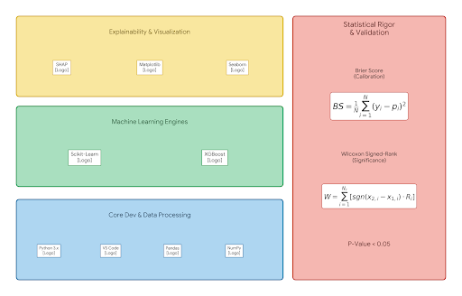
Tools & Technologies
Core: Python 3.x, VS Code, Pandas, NumPy.
Machine Learning: Scikit-Learn (Imputation/Base Models)
XGBoost (Gradient Boosting).
Statistical Validation:
Brier Score: For probabilistic calibration
Wilcoxon Signed-Rank Test: For statistical significance (p < 0.05).
Explainability: SHAP (Shapley Additive exPlanations)
.

Slide 5
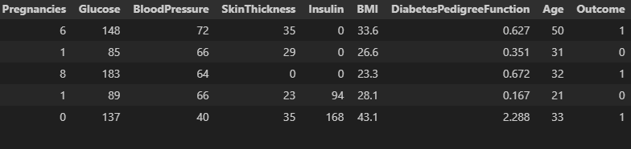
Methodology
Source: https://www.kaggle.com/datasets/uciml/pima-indians-diabetes-database
Dataset Description:
Primary Dataset: Pima Indians Diabetes Database (PIDD).
Demographics: 768 female patient records.
Diagnostic Features (8): Pregnancies, Glucose, BloodPressure, SkinThickness, Insulin, BMI, DiabetesPedigreeFunction, Age.
Target: Outcome (0: Non-Diabetic, 1: Diabetic).

Slide 6
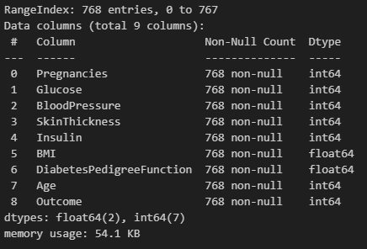
Exploratory Data Analysis (EDA
Loaded the Pima Indian Diabetes dataset into a Pandas DataFrame.
Check shape and structure to
understand the data.
Found 768 rows and 8 columns
Analyzed “Outcome” as target vector.

Slide 7
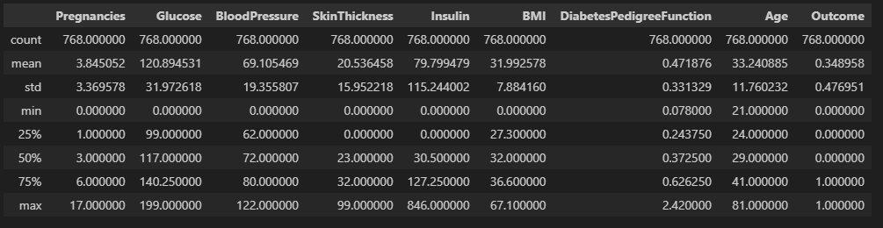
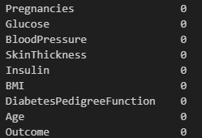
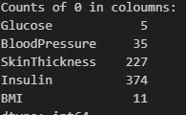
Exploratory Data Analysis (EDA
Analyzed statistical summary to check the dispersion and detect anomalies.
Analyzed missing values but found no missing values
Captured zeroes as missing values
Revealed massive "Hidden Missingness." Insulin was missing in 48% of cases; SkinThickness in 29%

Slide 8
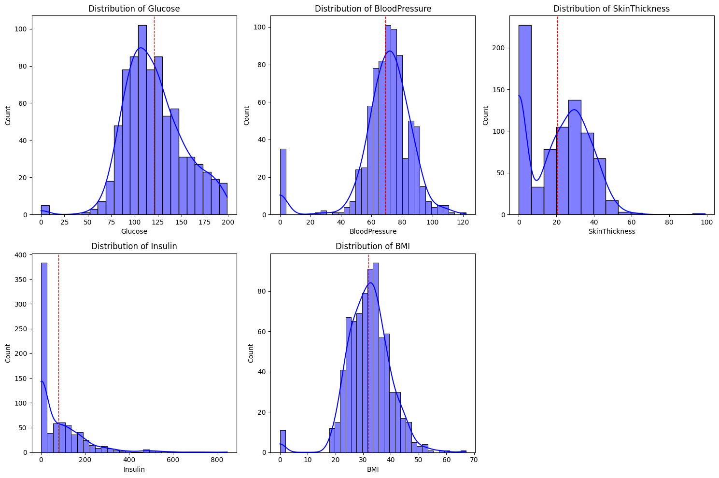
Feature Distribution Analysis
Feature Distribution:
Normal-Like: Glucose, BloodPressure.
Right-Skewed: Insulin, SkinThickness, DiabetesPedigreeFunction
BMI showed slightly right skewed distribution.

Slide 9
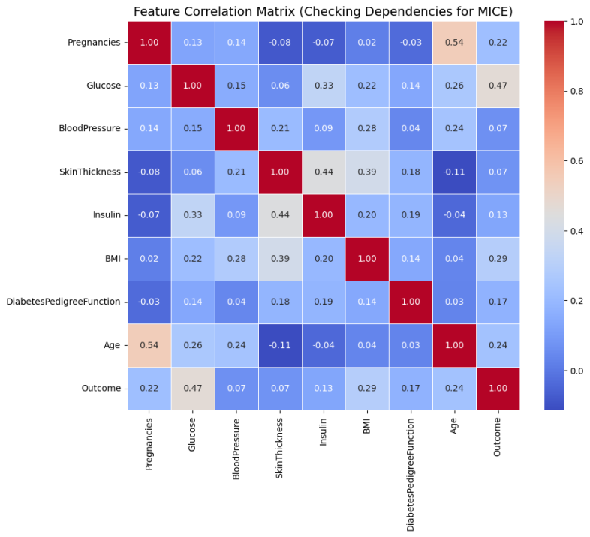
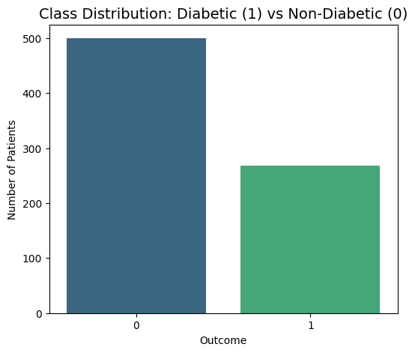
Class Imbalance:
65.1% Non-Diabetic vs. 34.9% Diabetic
Created a Correlation Matrix to identify predictive signals and multicollinearity.
Glucose showed the strongest correlation with the target. Strong multicollinearity found between Age and Pregnancies.

Slide 10
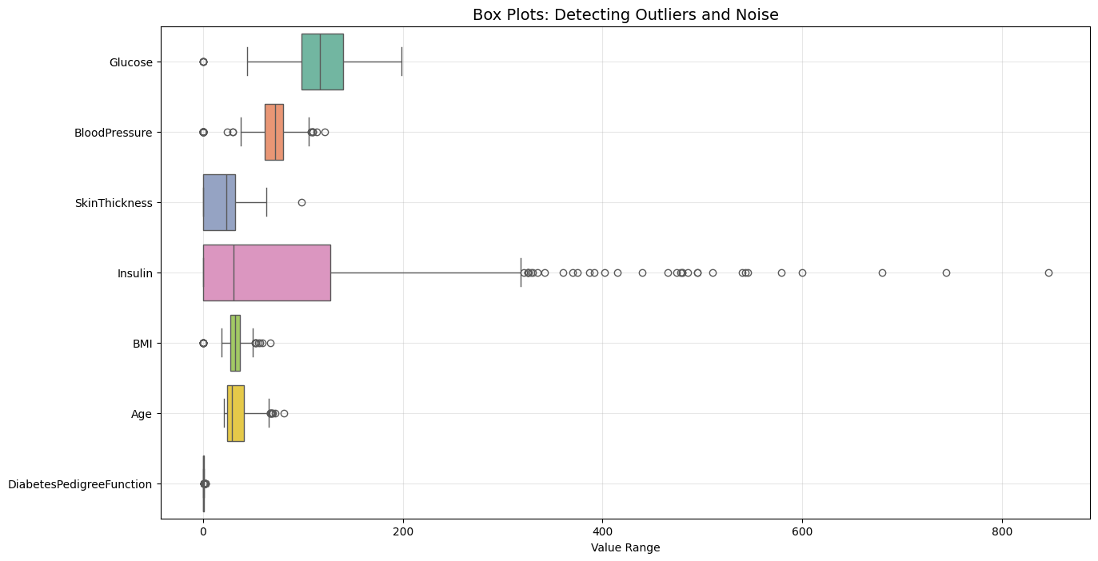
Outlier Detection
Insulin: Extreme outliers detected (Max value: 846 µU/ml).
DiabetesPedigreeFunction: Showed outliers representing patients with a very strong genetic history
The Problem: Standard scaling (Min-Max) would compress the useful data range to accommodate these few extremes.
The Solution: Applied RobustScaler (IQR-based) to mitigate outlier influence.
Mechanism: Scales data based on the Interquartile Range (IQR) (25th to 75th percentile), effectively rendering the model resilient to these extreme outliers.

Slide 11
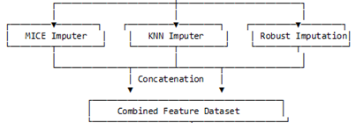
Preprocessing
Solving the "Missing Not At Random" (MNAR) Problem
Implemented the proposed Noise-Resilient Hybrid Imputation(NRHIE) framework
First data was split into 80% Training and 20% Test set with a random state of 42.
Instead of relying on a single imputation method (which introduces bias), we engineered a Triple-Stream Approach to maximize information retention.
1: MICE (Multivariate Imputation by Chained Equations)
Captures correlations between features (e.g., Age vs. Insulin).
2: KNN (K-Nearest Neighbors)
Preserves patient similarity clusters (k=5).
3: Robust Statistics (Constant/Median)
Fills gaps with constants to allow trees to split on "missingness.“
Leakage Prevention Protocol:
  Crucially, all imputers are fitted strictly on the Training Set. The Test Set is transformed using these "frozen" parameters to prevent data leakage.

Slide 12
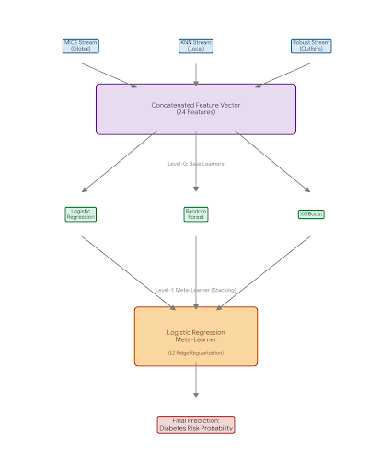
Feature Engineering & Stacking Architecture
Feature Space Expansion (Concatenation):
Merged streams into a rich 24-feature vector..
Level-0: Base Learners :
Logistic Regression: For linear decision boundaries.
Random Forest: For variance reduction.
XGBoost: For bias reduction.
Level-1: The Meta-Learner:
Algorithm: Logistic Regression with L2 Ridge Regularization.
Role: Dynamically weights the most reliable imputation stream for each patient.

Slide 13
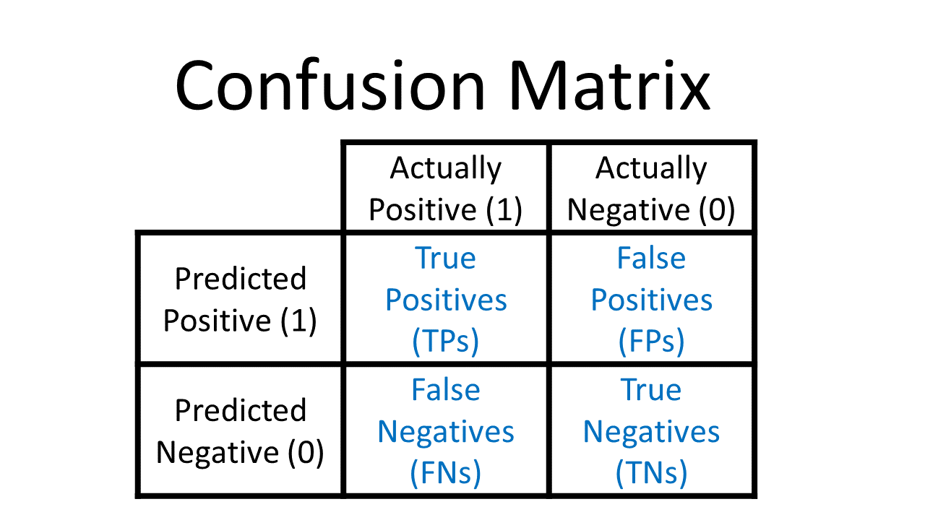
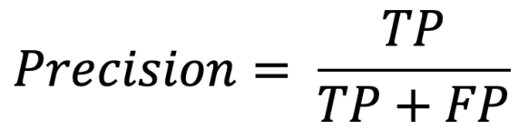
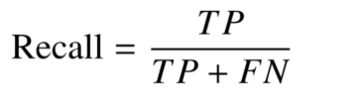
Comprehensive Evaluation Framework
  Standard accuracy is insufficient for medical screening where the cost of missing a disease is high.
  Selected a multi-dimensional metric set to evaluate safety, stability, and reliability
  Key Evaluation Metrics:
  Confusion Matrix : To explicitly quantify False Negatives, minimizing the risk of missing diabetic patients.
Precision:
  Recall:
  to minimize False Negatives.

Slide 14

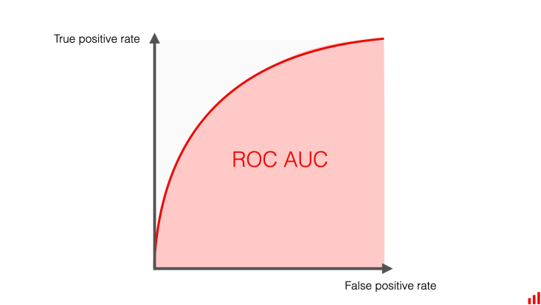

Comprehensive Evaluation Framework
  F1-Score: Used to balance Precision and Recall, ensuring the model doesn't just predict the majority class (Non-Diabetic).
  ROC-AUC: Benchmarks the model's global ability to rank a random diabetic patient higher than a healthy one, independent of threshold.
Probabilistic Reliability (The Brier Score):
To assess "Calibration“ how close the predicted probability (e.g., 85% risk) is to the actual outcome.
Mean Squared Difference between predicted probability and actual outcome. A lower score indicates higher trust.

Slide 15
External Validation Protocol
Testing Generalizability on Unseen Populations
Objective: To rigorously test if the model can handle Dataset Shift—a common failure mode where AI fails on new patient demographics.
The External Dataset (DiaBD):
Utilized the DiaBD (Bangladesh) cohort containing 5,288 patient records.
Demographic Alignment: Filtered the Features alignment as the Pima training set.

Slide 16
External Validation Protocol
Strict "Frozen" Protocol:
No Retraining: The model was not retrained on the Bangladesh data.
Pipeline Reuse: The exact preprocessing pipeline (RobustScaler, Imputers) fitted on Pima data was applied to transform the DiaBD data.
Significance: This replicates a real-world scenario where a deployed model encounters entirely new patients.

Slide 17
Explainable AI (XAI) Strategy
Bridging the "Black Box" Trust Gap
The Interpretability Challenge:
Ensemble models (Stacking) are complex "Black Boxes." Clinicians cannot blindly trust a probability score without understanding the "Why".
The Solution: SHAP (Shapley Additive exPlanations):
Adopted a game-theoretic approach to assign a "contribution value" to each feature for every prediction.
Analysis Levels:
Global Interpretability: Used Summary Plots to rank features (e.g., Glucose, BMI) across the entire population to verify biological validity.
Clinical Validation: Checked if the model's top predictors aligned with established medical literature (e.g., verifying that Glucose is the #1 predictor).

Slide 18
Results and Discussions
Baseline Performance & Optimization
Three base learners (Logistic Regression, Random Forest, XGBoost) were initially trained with default hyperparameters.
Finding: Without tuning, models prioritized "overall correctness" over detecting the disease, leading to high False Negative rates (Type II Errors).
Baseline Accuracy: Random Forest led with 75.32%.
Model | Accuracy | Precision (Weighted) | Recall (Weighted) | F1-Score
Logistic Regression | 72.08% | 0.72 | 0.72 | 0.6504
Random Forest | 75.32% | 0.75 | 0.75 | 0.6780
XGBoost | 74.68% | 0.74 | 0.75 | 0.6723

Slide 19
Results and Discussions
Hyperparameter Tuning Impact:
Strategy: Grid Search CV optimization of n_estimators, max_depth, and C.
Quantitative Gain: Tuning yielded a statistically meaningful improvement of 1.5% to 2.0% across all models.
Result: Tuned Random Forest accuracy rose to 77.27%
XGBoost rose to 76.62%
Model | Baseline Accuracy | Tuned Accuracy | Improvement | Tuned F1-Score
Logistic Regression | 72.08% | 73.38% | +1.30% | 0.6612
Random Forest | 75.32% | 77.27% | +1.95% | 0.6957
XGBoost | 74.68% | 76.62% | +1.94% | 0.6604

Slide 20
Internal Validation (NR-HIE Ensemble)
NR-HIE Stacking Performance:
The NR-HIE Stacking Ensemble achieved an internal accuracy of 77.27%, numerically identical to the single best Random Forest model.
Metric | Tuned Single Best (RF) | NR-HIE Meta-Learner
Accuracy | 77.27% | 77.27% (More Robust)
F1-Score | 0.6957 | 0.6729
Precision (Class 1) | 0.68 | 0.69
Recall (Class 1) | 0.64 | 0.65

Slide 21
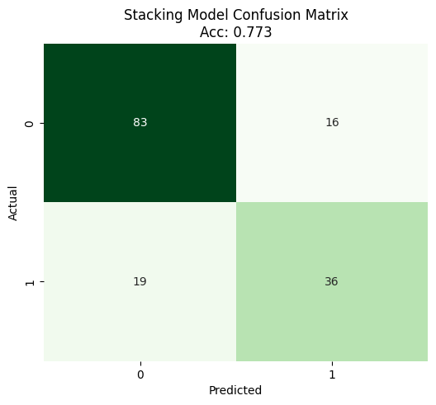
Internal Validation (NR-HIE Ensemble)
Confusion Matrix Deep Dive (Safety Check):
True Negatives (TN): 83 – Healthy patients correctly cleared.
True Positives (TP): 36 – Diabetic patients correctly flagged.
False Negatives (FN): 19 – Minimized to reduce the risk of missed diagnoses.
False Positives (FP): 16.

Slide 22
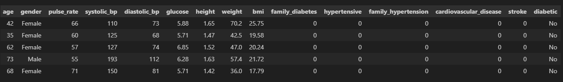
External Validation (The Generalizability Test)
Source: https://data.mendeley.com/datasets/m8cgwxs9s6/2
External validation dataset:
For external validation the DaiBD (A Diabetes Dataset for Enhanced Risk Analysis and Research in Bangladesh) dataset was employed. This dataset contains 5,288 patient records and 14 Features. Key features include age, gender, pulse rate, blood pressure (systolic and diastolic), glucose level, BMI, and family history of diabetes, hypertension, and cardiovascular disease.

Slide 23
External Validation (The Generalizability Test)
The "Generalizability Surge":
Contrary to the typical performance drop seen in cross-demographic testing, the NR-HIE framework's performance improved.
Random Forest Accuracy: 80.26%.
NR-HIE Stacking Accuracy: 81.62%.
F1-Score dropped to 0.29 due to prevalence shift, but ROC-AUC (0.767) confirms robust ranking.
Metric | Best Single Model (Random Forest) | NR-HIE Stacking Ensemble
Accuracy | 80.26% | 81.62%
F1-Score | 0.2658 | 0.2905
AUC-ROC | 0.7495 | 0.7669
Brier Score (Calibration) | 0.1302 | 0.1273

Slide 24
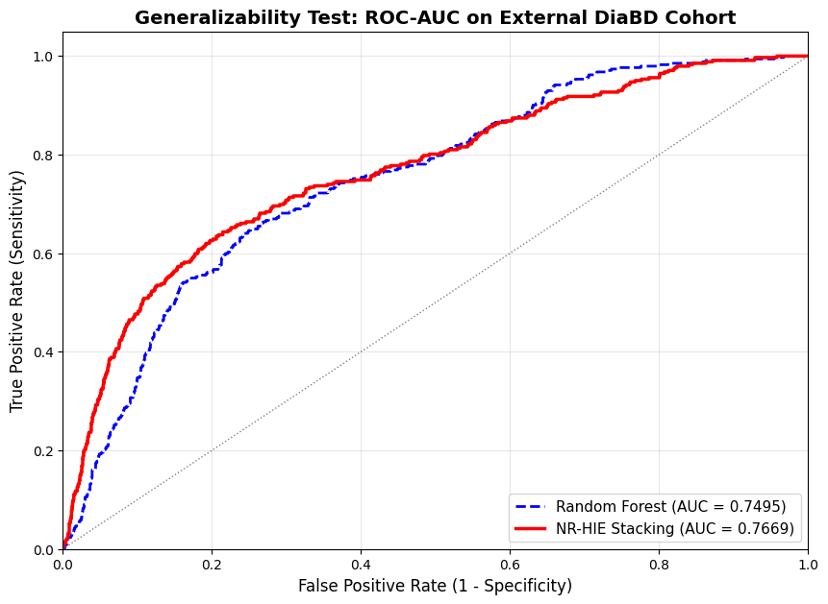
External Validation (The Generalizability Test)
Metric Variance Analysis:
F1-Score Shift: Dropped to 0.2905 on external data.
Reason: This is due to the drastic difference in class prevalence between the Pima and Bangladesh datasets, not model failure.
Stability: The superior ROC-AUC (0.7669) and Calibration scores confirm the model remains robust despite this demographic shift.

Slide 25
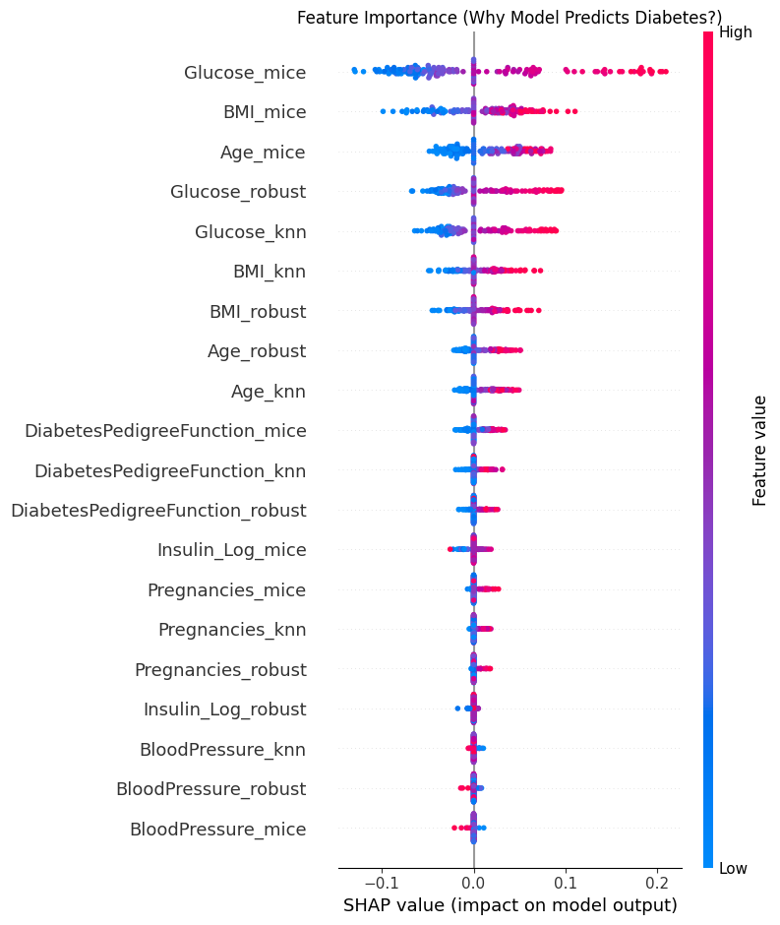
Explainability & Clinical Trust
Validating Biological Relevance with SHAP
Objective:
To verify that the high accuracy is driven by genuine physiological patterns, not data artifacts.
Global Interpretability:
Glucose: #1 Predictor (Biologically validated).
BMI & Age: Strong secondary predictors..
Age: Consistently predictive across the population.
Low-Impact Features:
Features like SkinThickness had lower impact, confirming the model correctly prioritized stronger biomarkers.
Trust: Low impact of noise features confirms the model is learning valid physiology, not artifacts

Slide 26
Conclusion
Bridging the Gap Between Theory and Practice
Proof of Concept:
The study successfully validated that the NR-HIE Framework mitigates performance degradation when transferring models between medical populations.
Key Technical Achievements:
Data Reconstruction: Hybrid Imputation successfully restored the distribution of missing markers like Insulin and Skin Thickness.
Optimization Gains: Hyperparameter tuning delivered a consistent 1.5% - 2% accuracy boost.

Slide 27
Conclusion
The "Generalizability" Breakthrough:
Achieved superior generalizability (81.62% on external data).
This counter-intuitive success proves the Meta-Learner filtered out dataset-specific noise.
Clinical Safety:
The low Brier Score (0.1273) confirms the model provides well-calibrated, realistic risk probabilities.
SHAP Analysis verified reliance on medically valid features (Glucose, BMI).
Key Takeaway:
"The NR-HIE framework proves that how you handle missing data is just as critical as which classifier you use."

Slide 28
Limitations
Boundaries of the Current Implementation
Demographic Bias:
The primary training data (Pima Indians) consists exclusively of female patients.
Impact: The current model is recommended strictly for female patient populations; application to males requires retraining.
Dataset Scalability:
Internal validation relied on a small sample size (n=768).
Impact: Restricted the use of deep learning architectures (like LSTMs) which require massive data to converge.

Slide 29
Future Work
The Roadmap to Global Deployment
Longitudinal: Integrate LSTMs for time-series risk prediction.
Global Model: Retrain on diverse male/female datasets
Multimodal Learning: Integrate unstructured data like Retinal Images (for diabetic retinopathy) alongside tabular data.

Slide 30
Thank You
Presenter: Hasnain Alam
Contact: alamhasnain457@gmail.com
Phone: 92-355-4286542

