Slide 1
End-to-end Learning Model for Autonomous Vehicles
M. Hasnain Naeem – Deep Learning, Group 1

Slide 2
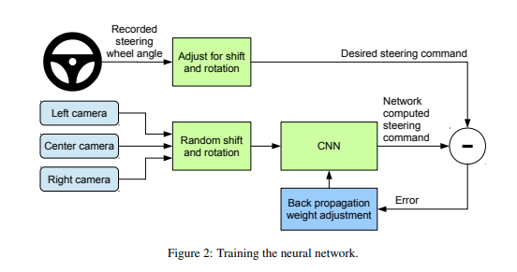
Introduction
Autonomous vehicles use computer vision based models to predict the steering angles.
End-to-end learning approaches map raw pixels directly to steering commands.

Slide 3
Problem Statement
Creation of an end-to-end model with an input of video frames to predict steering angle for autonomous vehicles

Slide 4
Related Projects
Relevant projects include opensource implementations of various relevant papers. Most relevant papers are:
Bojarski, Mariusz, et al. "End to end learning for self-driving cars." arXiv preprint arXiv:1604.07316 (2016).” End to End Learning for Self-Driving Cars | Papers With Code
Hou, Yuenan, et al. "Learning to steer by mimicking features from heterogeneous auxiliary networks." Proceedings of the AAAI Conference on Artificial Intelligence. Vol. 33. No. 01. 2019.

Slide 5
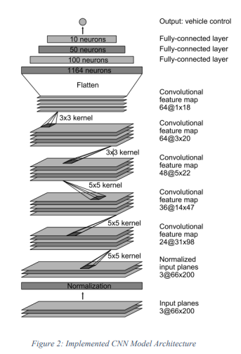
Network

Slide 6
Project Structure
Folders
driving_dataset
images: default folder for training images.
videos: default folder for test videos.
data.txt: contains image names and corresponding steering angles.
logs: contains logs to be plotted and visualized in the TensorBoard.
save: contains model checkpoints.
assets: contains assets used by the software such as the steering wheel image.
Scripts
model.py: code for CNN model.
run.py: script to test the model on real-time video feed.
run_dataset.py: script to test the model on images in the driving_dataset/images folder.
run_video: script to run the model on a video.
train.py: script to train the model.

Slide 7
Tech Stack
Language: Python 3.x Frameworks:
TensorFlow (1.x or 2.x)/TensorFlow GPU (1.x or 2.x
OpenCV
NumPy
Gooey

Slide 8
Data
Dataset videos were recorded by driving around Rancho Palos Verdes and San Pendro California.
Dataset size is 3.1 GB and it contains 63,000 images, sampled from the videos with a frame rate of 20 frames/second.

Slide 9
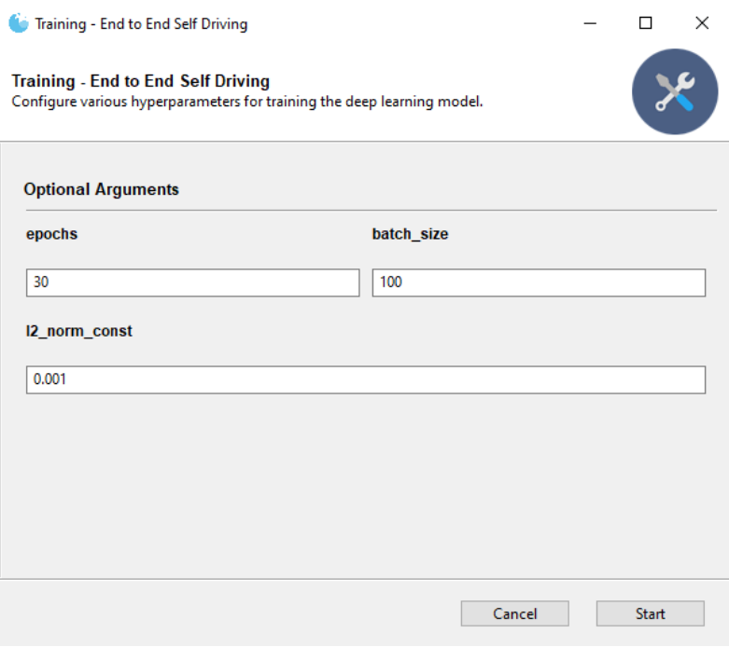
Usage – Training

Slide 10
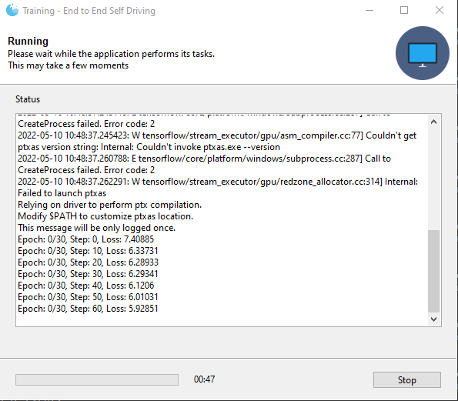
Usage – Training

Slide 11
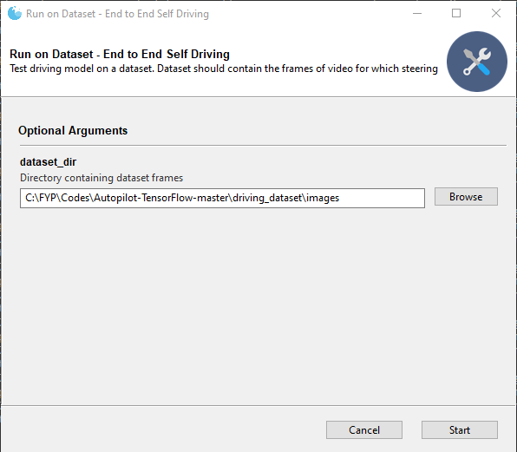
Usage – Testing on Dataset

Slide 12
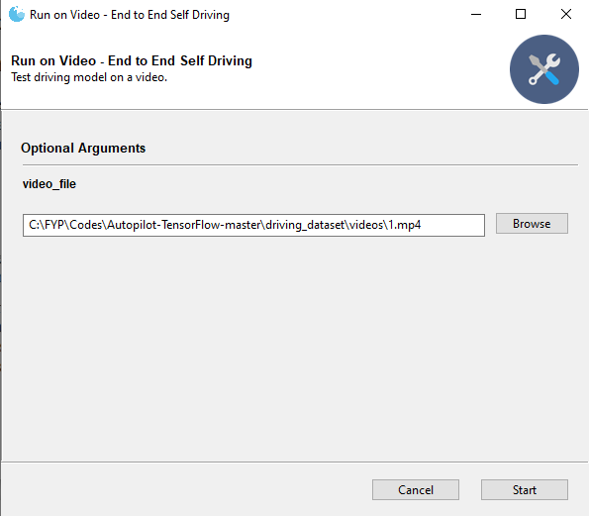
Usage – Testing on Video

Slide 13
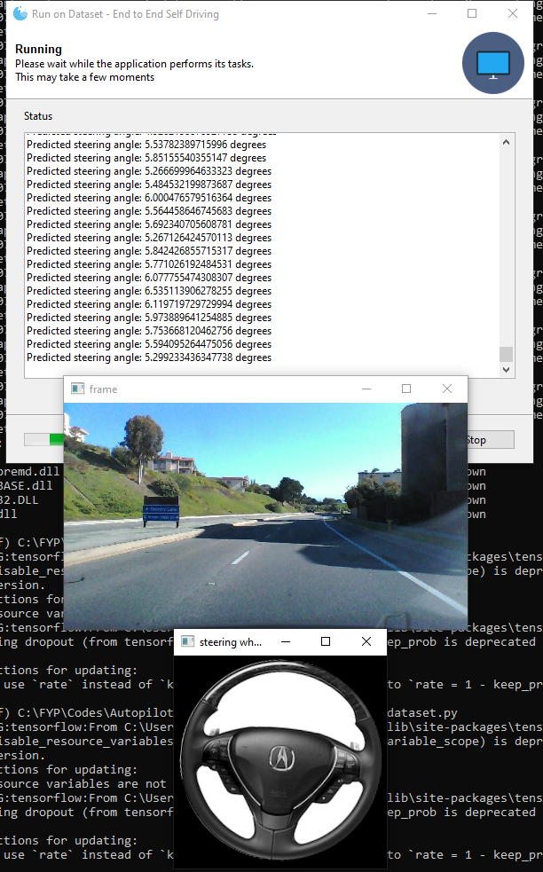
Usage – Model in Action

Slide 14
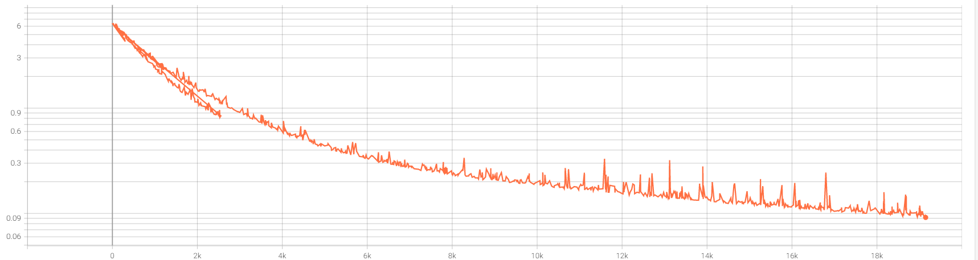
Loss
Goal: minimize mean square error (MSE) between the predicted steering
angle and the ground truth.
Loss
Epochs

Slide 15
Future Work
Data Augmentation
Data augmentation techniques can be applied to simulate different light and weather conditions.
GANs can be used to change the environmental conditions without introducing any changes to the symmetry of the road.
2. Better Architecture
Obvious step: use deeper CNN network
A promising direction: two-stream CNNs along with LSTM layers. Using two CNN models in parallel will capture the local-temporal features and the following LSTM layers will capture the global-temporal features. This approach will especially help with navigating through the moving entities, for instance cars and humans.

Slide 16
Conclusion
An end-to-end learning approach for self-driving introduced, by Nvidia team, was reproduced in this project. A well-documented and modular code with both CLI and GUI support has been delivered.
In this project, using relatively small amount of data from less than hundred hours of driving, without manual breakdown into road or lane marking detection, semantic abstraction, path planning, and control, we have empirically proven that CNNs can learn the entire task of lane and road following.

