Slide 1
Todo Application in Meteor.js

Slide 2
Features
User authentication
Add tasks
Public/private
Delete tasks
Mark tasks complete/incomplete
Progress bar showing completed tasks

Slide 3
Technologies Used
Meteor.js to connect frontend/backend/server
React for components
Bootstrap for layout

Slide 4
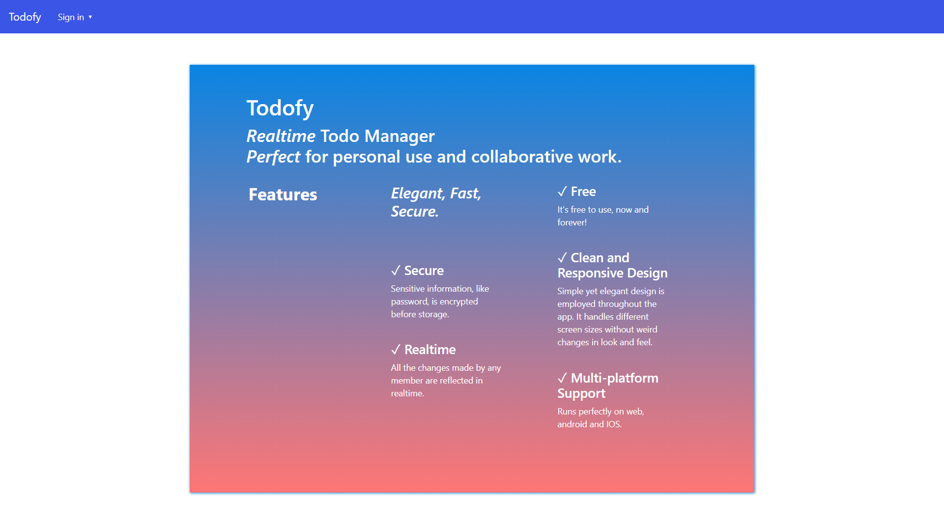
Homepage

Slide 5
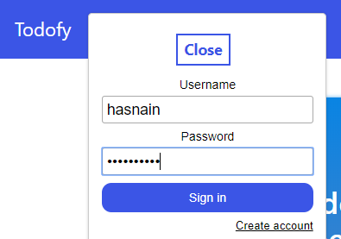
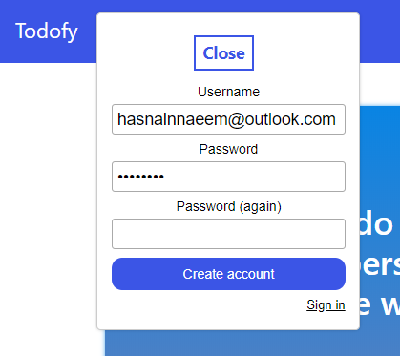
Sign in / Sign up

Slide 6
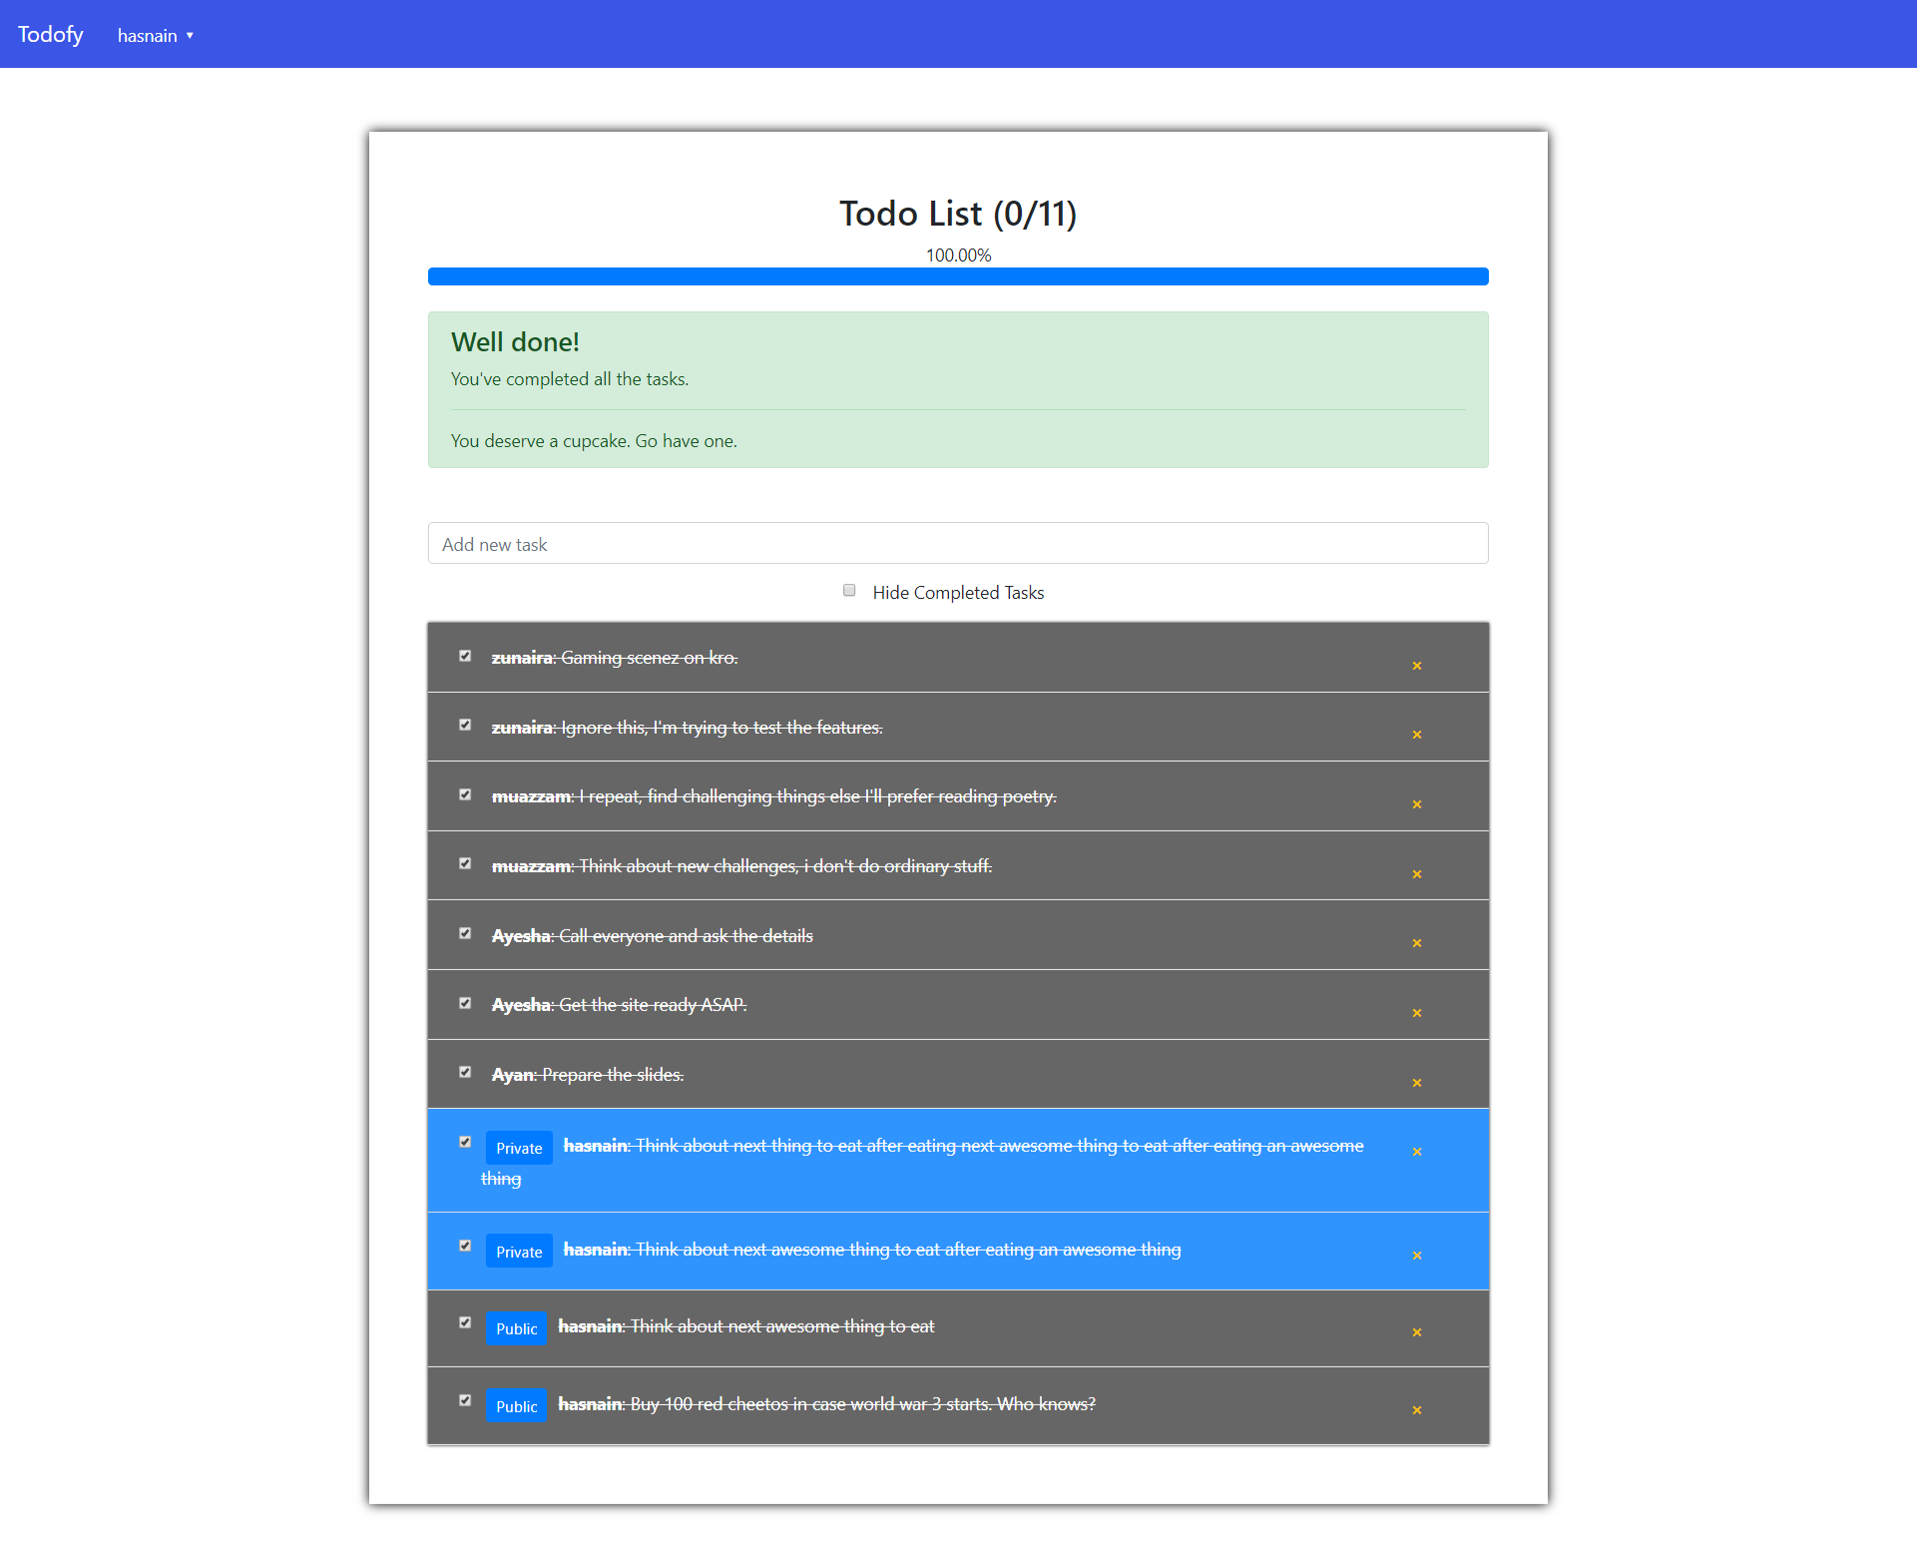
App

Slide 7
End

