Slide 1

Password Strength Checker
What it is, how to use it, and how it works inside.
Notes:
This deck covers three things: how to use the website, what message it is trying to give you, and how it is built and works behind the scenes.

Slide 2
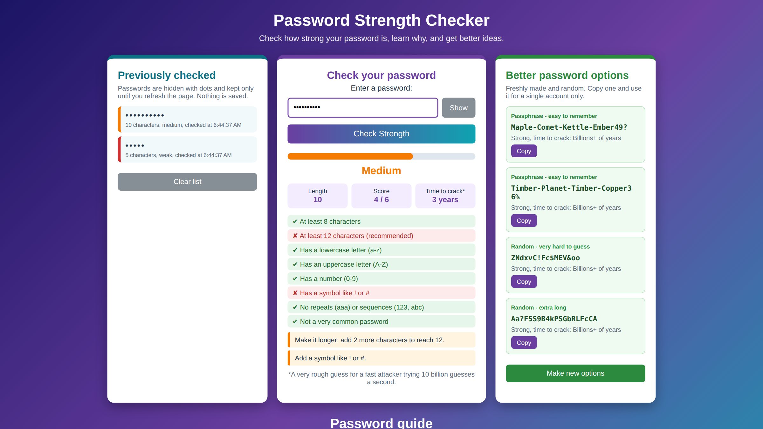
Notes:
The website exactly as it looks in the browser, after checking hello and then Summer2024.

Slide 3



What is this website?
Check
A free page that tells you how strong a password is, explains why, and gives you better ones to use.
Rates any password as Weak, Medium or Strong.
Learn
Shows which rules passed and what to fix.
Improve
Makes four stronger options you can copy.
Notes:
Three jobs: check, learn, improve.

Slide 4
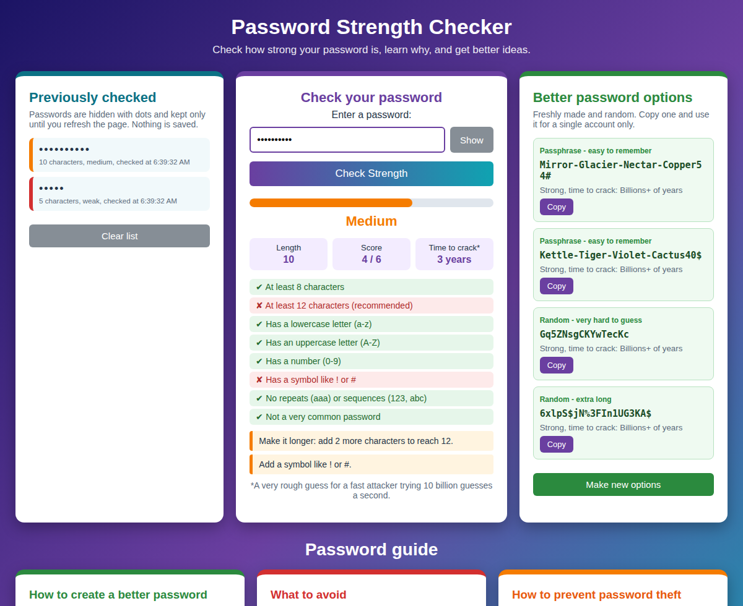
How to use it
1
Type a password
Click the box and type. Press Show to see what you typed.
2
Press Check Strength
Or just press the Enter key.
3
Read the results
See the bar, rating, score and crack time.
4
Make it better
Follow the orange tips, or copy a stronger option.
Notes:
Walk through the four steps using the screenshot on the left.

Slide 5
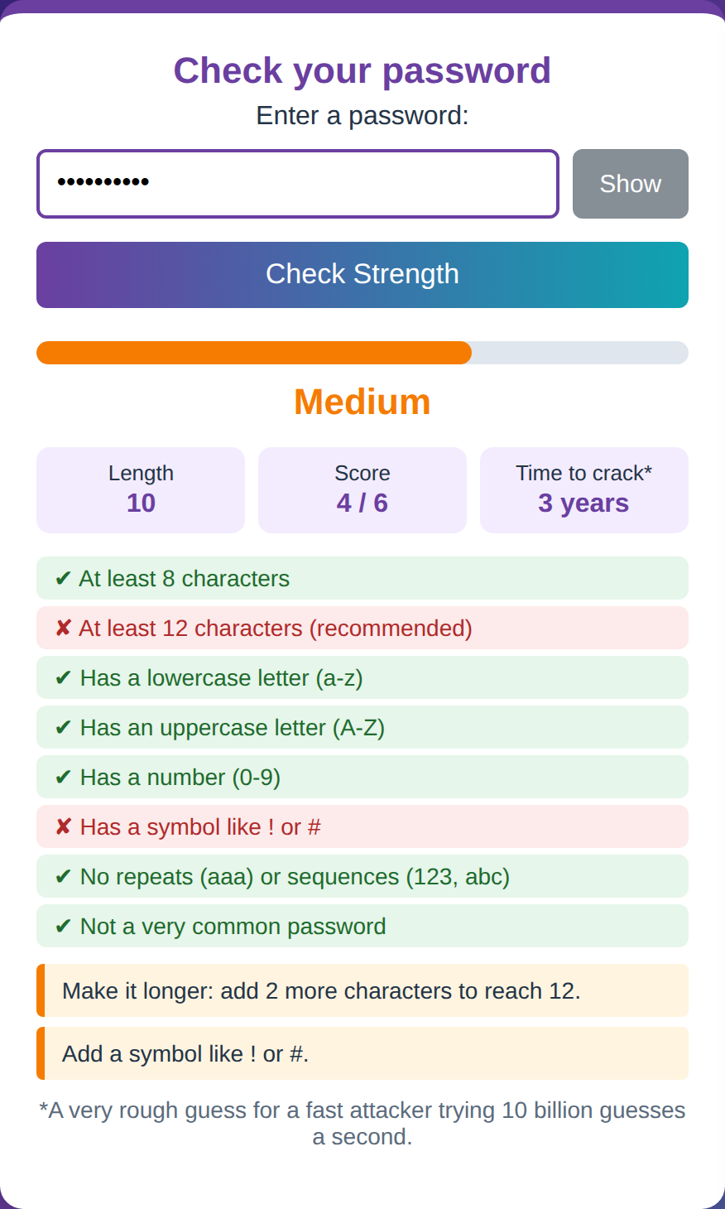
Reading your results
Bar and rating
Fills up and turns red, orange or green.
Length and score
How many characters, and points out of 6.
Time to crack
A rough guess for a fast attacker.
Ticks and crosses
Green means passed. Red means needs work.
Orange tips
Plain steps to make it stronger.
Notes:
Each part of the middle panel tells you something different. Colours match the meaning: red is weak, orange is medium, green is strong.

Slide 6
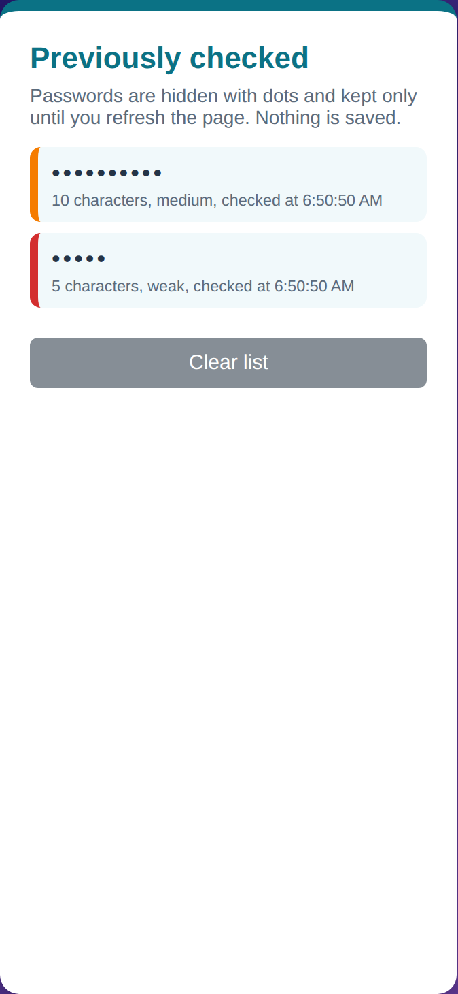
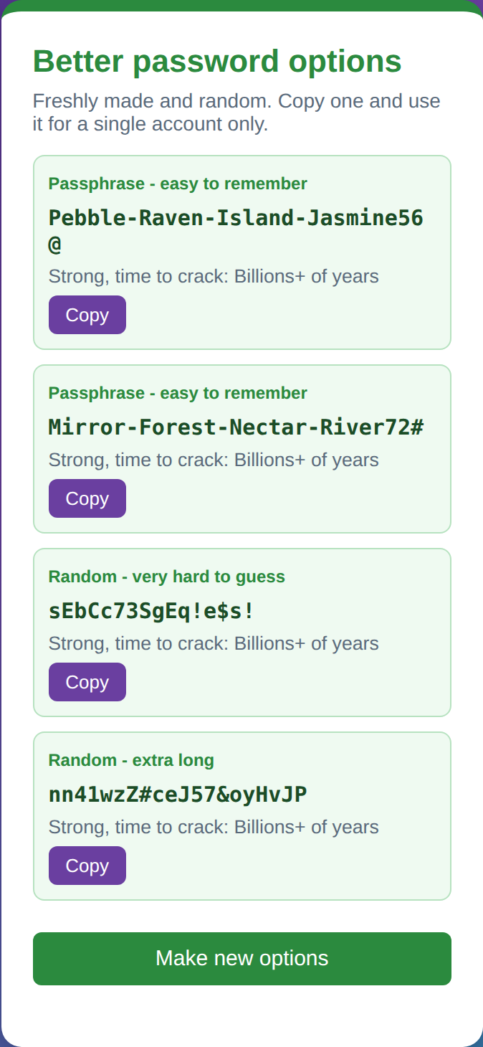
The three panels
Previously checked
Check your password
Better password options
Your checks as dots. Never saved.
Type, check and read the results.
Four stronger ideas. Copy one.
Notes:
Left: history of what you checked, shown as dots only. Middle: the main checker. Right: freshly made password options.

Slide 7



What is it trying to tell you?
Longer is stronger
Avoid the obvious
Never reuse one
Every extra character makes guessing far harder.
Names, 123456 and p@ssw0rd swaps are tried first.
One leaked password opens every account that shares it.
Aim for 12 or more.
Patterns lose points.
Use each for one account.
The message: make it long, make it unusual, and use a different one for every account.
Notes:
Everything on the page, from the tips to the guide, repeats these three ideas.

Slide 8
Why length matters
Same mix of letters, numbers and symbols, same fast attacker. Only the length changes.
118 trillion years
13 billion years
1.5 million years
171 years
7 days
8 characters
10 characters
12 characters
14 characters
16 characters
Bar heights are not to scale. The real gaps are far bigger.
Notes:
This uses the same formula as the website: possible characters to the power of length, divided by 10 billion guesses per second. It is a rough guess, not a promise.

Slide 9



What it is built from
HTML
CSS
JavaScript
Structure
Style
Brain
Title and header
Three panels
Guide and footer
Three-column layout
Colours and rounded cards
Fits on a phone too
Scores the password
Makes new options
Runs every button
Notes:
HTML builds the page, CSS makes it look good, JavaScript makes it do things. The whole site is one file.

Slide 10





What happens when you press Check
1. Read
Grabs the text from the box.
2. Analyse
Tests six rules, looks for repeats and runs like 123, and checks a list of common passwords.
3. Score
Counts the points and picks Weak, Medium or Strong.
4. Show
Draws the bar, rating, ticks, crosses, tips and crack time.
5. Remember
Adds a dots-only entry to Previously checked.
Notes:
This is the JavaScript at work. If you check the same password twice, it shows a note instead of adding it to the history again.

Slide 11

How it decides the score
Six rules, one point each
Then it adjusts
8 or more characters
12 or more characters
Patterns lose 1 point
aaa, 123, abc or keyboard rows like qwerty
A lowercase letter
An uppercase letter
Common passwords are Weak
A list of 20, such as password and 123456
A number
A symbol like ! or #
0-2 Weak, 3-4 Medium, 5-6 Strong
The final rating bands
Notes:
The score starts as the number of rules passed. Patterns take one point off. A very common password is always Weak with a score of 0.

Slide 12

Guessing time and new passwords
Crack time guess
Better options
Adds up the character types used: 26 + 26 + 10 + 32
Time = possible characters ^ length, divided by 10 billion a second
Patterns make it 1000 times quicker
Picks 4 words from a list of 46, plus a 2-digit number and a symbol
Also makes random 16 and 20 character strings
Uses the browser's secure random tool and retries until Strong
Notes:
Left: how the time estimate is made. Right: how the right-hand panel creates passphrases and random passwords.

Slide 13



Safe by design
Stays local
Dots only
Plain text only
No password is sent anywhere. It all runs on your own device.
History shows dots and a length, and is gone when you refresh.
Anything typed is displayed as text, so it can't run as code.
Notes:
The page practices what it preaches: nothing is saved or uploaded.

Slide 14


Putting it all together
You type
JavaScript checks
The page shows
You choose better
HTML draws it, CSS styles it, JavaScript does the thinking. The result: a safer password.
Notes:
Wrap up: try the checker with your own passwords, but never type a real password you use anywhere into an unfamiliar site.

