Slide 1
University of Koblenz
Master Thesis Progress Update
Benchmarking Holistic vs Sentence-Level RLAIF
for Factual Summarization via
Granular Credit Assignment (GCA)
AI feedback granularity
for factual summarization
Biweekly meeting • 21 April 2026
holistic labels vs sentence-level labels + GCA
Student
Muhammad Hasnat
Supervisors
Dr. Zeyd Boukhers
Prof. Dr. Frank Hopfgartner
Mentor
Lingxiao Kong
Topic • progress • next steps • risks
Notes:
[Sources] - Master_Thesis_Proposal_RLAIF_GCA.pdf, title page and thesis title. - README for 21-04-2026 on GitHub: meeting date and current update context (https://github.com/hasnat23/master-thesis-rlaif-gca/tree/main/progress-updates/21-04-2026).

Slide 2
Thesis topic and controlled comparison
The core question is whether more granular AI feedback improves factual reliability in long-form summarization.
Research question
Experimental setup
For long news summaries, are holistic A/B AI preferences enough, or does sentence-level supervision aggregated via GCA lead to more factually consistent outputs under the same DPO setup?
Holistic RLAIF
Sentence-level + GCA
Judge compares full Summary A vs Summary B and emits one overall preference.
Judge compares aligned sentence pairs, then aggregates local wins into one summary-level preference.
Why it matters
What stays fixed
What changes
A few factual mistakes can dominate the quality of an otherwise fluent summary.
Base model, candidate pool, DPO recipe, compute budget.
Only the feedback granularity: holistic labels vs sentence-level labels + GCA.
Cheaper signal, but coarse.
Denser signal and easier diagnosis.
Main outputs: factuality metrics, judge reliability, human audit agreement, and error analysis by error type.
Notes:
[Sources] - Proposal pages 3–8: problem statement, research gap, novelty, research questions, and methodology. - Specifically the proposal states that only feedback granularity changes while model, candidate pool, DPO recipe, and compute budget are held constant.

Slide 3
Current status at a glance
The project has moved from proposal to an executable research pipeline.
Phase 1
Phase 2
Infrastructure
Phase 3
Phase 4
Setup & baselines
Judge formats & GCA prototype
MOGON GPU access and runs
Preference labeling at scale
DPO fine-tuning + full evaluation
Complete
Implemented
Working
Next
Upcoming
What is already in place
Execution milestone
Runnable prototype covering preprocessing, sentence splitting, candidate construction, and baseline ROUGE.
Holistic judging format and sentence-level judging format are designed around preference, rationale, and confidence.
Semantic sentence alignment and majority-based GCA prototype are implemented.
Human audit plan and sampling logic are defined.
MOGON is accessible and the thesis workflow already ran end to end on university GPU resources.
20
200
1
pilot samples
selected subset
running job
Notes:
[Sources] - Phase1_Phase2_Progress_Update.pdf: prototype pipeline, alignment, GCA, reliability controls, human audit preparation. - Biweekly_Progress_Update (Master Thesis).pdf: MOGON access working and 20-sample baseline run. - GitHub README 21-04-2026: 200-sample subset confirmed; candidate generation job running.

Slide 4
What has already been done
Progress combines methodology setup, code implementation, and infrastructure validation.
Pipeline foundations
Judging and GCA
Infrastructure and measurable outputs
Deterministic subset selection and preprocessing.
Consistent sentence segmentation for both comparison regimes.
Candidate generation pipeline prepared for fixed A/B pools.
Baseline evaluation with ROUGE already reproducible.
YAML-configured scripts and dataclass-based data flow in the repo.
Holistic A/B judge prompt defined with rationale and confidence.
Sentence-level pair judging implemented after alignment.
Reliability controls prepared: confidence gating, A/B swap, rationale validation.
Aggregation logic implemented; current repo version uses a confidence-aware GCA score.
Human audit design is ready for execution.
Pilot baseline metrics
(20-sample run)
ROUGE-1 0.3278
ROUGE-2 0.1201
ROUGE-L 0.2341
BERTScore F1 0.8612
Important context
These are baseline comparison numbers before preference training, not final thesis results.
Notes:
[Sources] - GitHub README 21-04-2026 lines 270–301: codebase modules, subset, and pilot baseline metrics. - Earlier progress update PDF: prototype preprocessing, candidate generation, ROUGE evaluation, judge formats, alignment, GCA, and audit preparation.

Slide 5
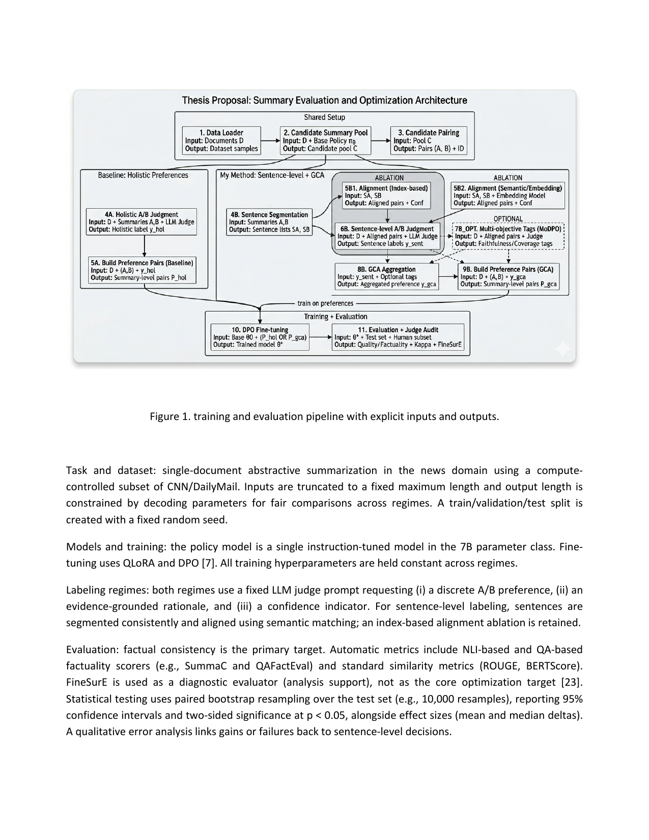
Methodology and pipeline overview
The thesis compares two preference-labeling regimes under the same training objective.
Design choices
Task — Single-document news summarization on a controlled CNN/DailyMail subset.
Model — Instruction-tuned 7B model; current MOGON setup uses Mistral-7B-Instruct-v0.3.
Training — Offline preference optimization with DPO and QLoRA.
Judging — Holistic full-summary A/B preference vs sentence-level aligned pair judgments.
Reliability — Confidence gating, order randomization, rationale validation, and human audit.
Evaluation — ROUGE and BERTScore now; SummaC, QAFactEval, and human agreement next.
Pipeline figure from the proposal
Current GCA idea in the repo: aggregate sentence judgments into one summary preference while penalizing weak local sentences.
Notes:
[Sources] - Proposal pages 7–10, especially the pipeline diagram on page 9 and the methodology text on pages 7–9. - GitHub README 21-04-2026 lines 271–283 and lines 375–382 for the implemented code modules and current GCA scoring formula.

Slide 6
Today's meeting update from the repo
This is the most current operational view for 21 April 2026.
Live status
Operational details
Immediate blockers
Phase 1 is complete. Phase 2 infrastructure is implemented. The 200-sample candidate generation job is running on MOGON NHR A100.
Cluster — MOGON NHR / partition a100dl
OpenAI API key on MOGON
Needed for Phase 3 judging, not for current candidate generation.
GPU — NVIDIA A100-SXM4-40GB
Model — Mistral-7B-Instruct-v0.3
Sentence alignment noise
Smoke test passed
Will be quantified with semantic vs index-based ablation.
Job 1068925 validated conda activation, GPU detection, dataset loading, model loading, and generation.
Subset — 200 articles with SHA256 IDs
5 samples • opt-125m • exit code 0:0
Output target — 400 candidate summaries
Factuality metrics pending
SummaC and QAFactEval depend on generated candidate file.
Status — No crash after model load; generation in progress
Bug fixes already handled
transformers 5.x / bitsandbytes issue fixed; switched to bfloat16 and corrected rsync paths.
Notes:
[Sources] - GitHub README 21-04-2026 lines 264–267, 305–372, 395–412. - These lines cover the running job, the smoke test, the bug fix, the environment, and the current blockers.

Slide 7
What comes next
Immediate plan for moving from prototype execution to the main comparison experiment.
1
Finish stable baseline generation — Complete and verify the 200-sample candidate pool on MOGON.
2
Compute baseline metrics — Run ROUGE, BERTScore, then add SummaC and QAFactEval.
3
Start judge prompt tests — Run a small judge test with reliability checks and filtered outputs.
4
Build preference datasets — Construct holistic and sentence-level preference pairs from the same candidate pool.
5
Human audit + DPO training — Audit selected pairs, then fine-tune both models under identical settings.
Next meeting target — baseline generation finished, judge prompts validated, and a clear path to build both preference datasets from the same candidate pool.
Notes:
[Sources] - Proposal timeline and implementation plan on pages 10–11. - Earlier progress PDFs: immediate next steps. - GitHub README: upcoming Phase 2 → Phase 3 actions and dependencies.

Slide 8
Challenges, mitigations, and discussion
The thesis is designed to make both positive and negative results meaningful.
Judge noise / bias
Alignment noise
Compute and scaling
Metric limitations
AI-generated preferences may be unstable or prompt-sensitive.
Wrong sentence alignment can hide the value of GCA.
Generation, judging, and training must stay within budget.
ROUGE alone does not capture factual reliability.
Mitigation
Mitigation
Mitigation
Mitigation
Confidence gating, A/B swap checks, rationale validation, human audit.
Compare semantic vs index-based alignment and filter ambiguous cases.
Controlled subset, caching, QLoRA, and staged execution on MOGON.
Add factuality metrics and independent human checks before claiming gains.
Takeaway for today: the thesis question is clear, the prototype and infrastructure are working, and the next milestone is a stable candidate pool followed by reliable preference labeling.
Questions and supervisor feedback
Notes:
[Sources] - Proposal pages 7–11: reliability plan, threats to validity, mitigations, timeline, and expected outcomes. - GitHub README blockers / risks section for current operational risks.

