Slide 1
Benchmarking Holistic vs Sentence-Level Reward-Model
Preferences via Granular Credit Assignment (GCA)
Progress Update — 11 August 2026
Muhammad Hasnat
Supervisors: Prof. Dr. Frank Hopfgartner, Dr. Zeyd Boukhers | Mentor: Lingxiao Kong
Today: pipeline walkthrough + reward-model results at 3 dataset sizes

Slide 2
The Question
Does scoring a summary sentence-by-sentence give a better training
signal than scoring it as a whole?
Holistic
Judge reads the whole summary → one score
GCA (Granular Credit Assignment)
Judge scores each sentence, then we average the scores
Same judge. Same summaries. Same reward-model recipe.
The only thing that changes is how finely we look before deciding which summary is better.
2

Slide 3
Pipeline: What Goes In, What Comes Out
1. Load Data
CNN/DailyMail → 1k / 5k / 10k articles
2. Generate 2 Summaries
Mistral-7B, temperature 0.7 & 1.0
3. Pair A vs B
one A/B candidate pair per article
4. Score Whole Summary — HOLISTIC
AlignScore reads the full text → 1 score
4. Score Each Sentence — GCA
AlignScore scores every sentence separately
5. Decide Preference
higher score wins → chosen / rejected
5. Average → Decide
mean sentence score → chosen / rejected
6. Train Reward Model
holistic pairs → pairwise accuracy
6. Train Reward Model
GCA pairs → pairwise accuracy
7. Compare Accuracy
Holistic vs GCA — 20 independent runs × 3 dataset sizes
3

Slide 4
Experiment Setup
• Dataset: CNN/DailyMail news articles
• Candidate model: Mistral-7B-Instruct
• Judge: AlignScore (fixed, deterministic — not an LLM prompt)
• Reward model: RoBERTa-base, Bradley-Terry
• Evaluation: 5-fold cross-validation
• Repeats: 20 independent runs, at each of 3 sizes
Three dataset sizes tested
1,000 / 5,000 / 10,000 preference pairs — each run 20 times, independently seeded
→ 3 sizes × 2 conditions × 20 runs = 120 reward-model trainings in total
4

Slide 5
Results — 1,000 Training Examples
 | Holistic | GCA
Accuracy | 53.0% | 56.9%
Runs favouring | — | 20 / 20
+3.95 points
average GCA advantage Wilcoxon p < 0.001 Cohen's d = 2.22 (large)
GCA wins in every single run.
The gap is statistically significant
(p < 0.001).
With little training data, scoring sentence-by-sentence gives a clearly better signal.
5

Slide 6
Results — 5,000 and 10,000 Training Examples
Size | Holistic | GCA | Difference
5,000 | 58.4% | 58.2% | no difference
10,000 | 58.6% | 58.5% | no difference
The GCA advantage disappears once there is enough training data.
This is not just "no proof yet" — it's confirmed absent
Equivalence tests rule out any real difference bigger than about half a point, in either direction, at both dataset sizes (20 runs each, same rigor as the 1,000 result).
6

Slide 7
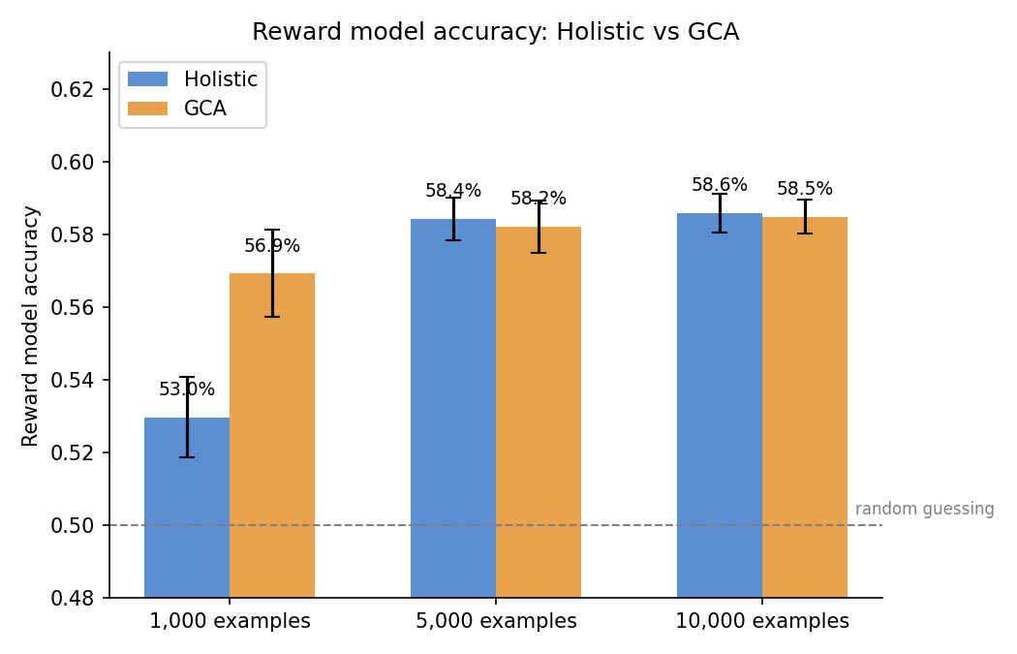
Accuracy Across All Three Scales
Both bars grow with more data — the gap between them (orange minus blue) shrinks to nothing.
7

Slide 8
Key Findings
• Small data (n=1,000): GCA gives a real, significant boost — all 20 runs agree (p < 0.001).
• Large data (n=5,000 / 10,000): the boost disappears — confirmed, not just unproven.
• Both reward models stay well below "reliable" (53–59% vs. 50% random guessing).
• Checked whether summary length secretly drove the results — it didn't.
• Likely reason: with little data, cleaner labels help most; with more data, the model averages out noisy labels on its own.
8

Slide 9
Status
Done
• AI-judge scoring, both holistic and GCA
• Reward-model training and evaluation at all 3 dataset sizes
• 20 independent runs per size (120 trainings total)
• Full statistical testing: significance, effect size, equivalence
Open (minor, not urgent)
• One side-experiment on article length is partly blocked by a cluster mirror outage — unrelated to the main question above
9

Slide 10
Questions for Today
• Does this fully answer the question about reward-model training and evaluation?
• Anything else you'd like to see before submission?
Thank you
10

