Slide 1

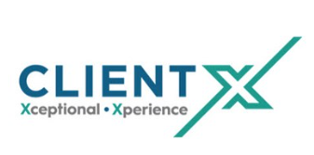






Welcome to the Client X Training Program
We are excited to offer this training program to help you onboard to Client X at Cargill. We believe that Client X will give us these benefits:
Loremipsum
Lesson 1
Why Client X Matters?
Because we’re so busy doing our job, it’s easy to forget who we’re helping. We have created a video that provides perspectives from three Cargill plan managers on how Global IT impacts their facility.
What is Customer Experience? (YouTube video)
Do you agree with the three dimensions of interaction?
How do you think this applies to Global IT?
Lesson 2
The Dimensions of Customer Experience
In order to really deliver on Client X, we need to understand “what makes a client experience good or bad?” We have an article here, read through it.
7 Ways to Create a Great Customer Experience Strategy
In addition to the points brought forth in the videos, are there other things make up a customer experience?
Describe a positive customer experience you’ve had using the dimensions of Success, Effort, and Emotion.

