Slide 1
Filtering AOI Data to Reveal Real Defects
Explaining the 4‑bucket logic with live data
Serial example: BSE2503696995

Slide 2
The Challenge
One PCB can generate hundreds of AOI log lines.
Operators and engineers waste time sifting through machine chatter.
Goal: Collapse the noise into crystal‑clear action lists.

Slide 3
Example Sample data from COGI
EventDate | LoopNumber | Ref_Id | DefectCode | ReworkStatus
7/21/2025 11:15 | 1 | P2002 | COPLANARITY | Reworkable
7/21/2025 11:15 | 1 | P2002 | OVERHANG | Reworkable
7/21/2025 11:16 | 2 | P2002 | COPLANARITY | Overridden
7/21/2025 11:16 | 2 | P2002 | COPLANARITY | False call
7/21/2025 11:16 | 2 | P2002 | OVERHANG | Overridden
7/21/2025 11:16 | 2 | P2002 | PADOVERHANG | Reworkable

Slide 4
Key Columns in the AOI Export
Column | Meaning
SerialNumber | Unique PCB barcode
Ref_Id | Component / pad reference
DefectCode | Type of failure (e.g. OVERHANG)
ReworkStatus | Disposition (Reworkable / Overridden / False call)
LoopNumber | 1st, 2nd, 3rd pass

Slide 5
Rules: Four Possible Outcomes
Outcome | Rule | Meaning
Real | Reworkable > 0 AND Overridden > 0 | Operator confirmed; still bad
Fixed | Reworkable = 0 AND Overridden > 0 | Repaired; AOI now silent
Suspect | Reworkable > 0 AND Overridden = 0 | Fresh hit; needs review
False | False call > 0 | Operator ruled 'no problem'

Slide 6
Step‑by‑Step Example (BSE2503696995)
Loop | ReworkStatus | DefectCode | Insight
1 | Reworkable | COPLANARITY | AOI spots issue
1 | Reworkable | OVERHANG | AOI spots issue
2 | False call | COPLANARITY | Operator rules false
2 | Overridden | COPLANARITY | Confirms good
2 | Overridden | OVERHANG | Confirms defect
2 | Reworkable | PADOVERHANG | New suspect

Slide 7
Final Status for Pad P2002
Only OVERHANG remains a true escape. PADOVERHANG waits for operator review.
DefectCode | Outcome
COPLANARITY | False
OVERHANG | Real
PADOVERHANG | Suspect

Slide 8
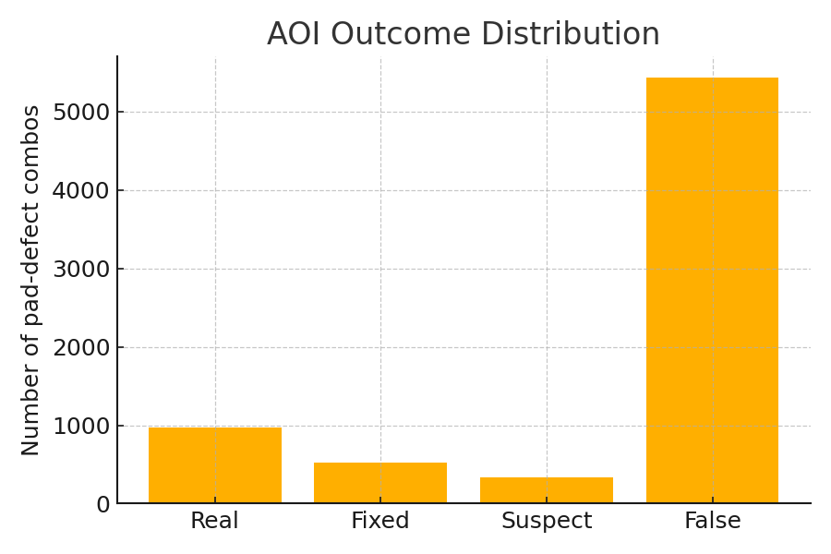
Outcome Distribution (Full July‑26 Export)
Outcome | Count
Real | 977
Fixed | 527
Suspect | 335
False | 5440

Slide 9
Who Uses Which Bucket?
Team | Focus Bucket | Reason
Rework Techs | Real | Actual repairs
Operators | Suspect | Review fresh hits
Process / NPI | False | Trim nuisance pads
Quality Eng. | Fixed | Proof of successful repair

Slide 10
Take‑aways
4‑bucket logic collapses 500+ lines into clear action lists.
Operators see only 'Suspects'; techs see only 'Real' defects.
Recipe engineers get a ready‑made Pareto of 'False' calls.
Quality team validates repairs via the 'Fixed' bucket.
Refresh is one click (or one script) for every new AOI export.

