Slide 1

WELCOME
Web Tool
COVID 19 WEBSITE PRESENTATION
follow
services
teams
timeline
about
DESIGNED BY GROUP A

Slide 2
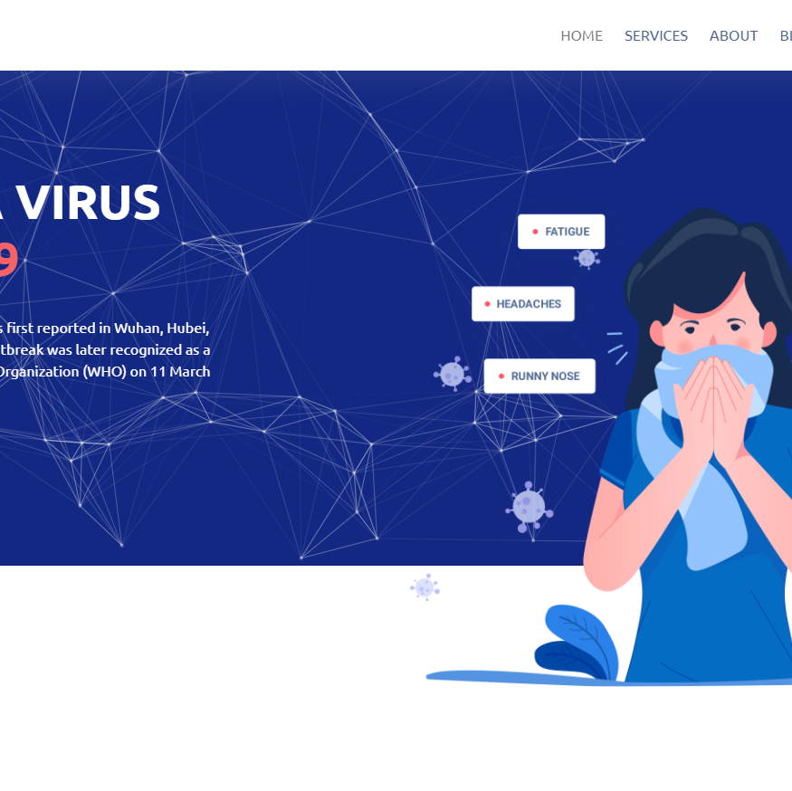
follow
teams
Web Tool
services
timeline
about
WWW.COVID19.COM
A BEST COVID INFORMATION WEB SITE IN BANGLADESH
COVID19-20
Covid 19 Website Provide All Covid Information and Best Emergency Service . Our service 24 hours and all Update news blog and Hospital Information.

Slide 3


HTML
CSS
JS
5
3
5
MARKUP LAN
STYLE SHEET
JAVASCRIPT
Web Tool
follow
services
teams
timeline
about
HTML 5 is a markup language used for structuring and presenting content.
Cascading style sheets is a style sheet
JS is a programming language that conforms to the ES5 specification

Slide 4



Remaining Work
BS
PHP
MYSQL
8
4.5
19
DATABASE
follow
BOOTSTRAP
DEVELOPMENT
Web Tool
services
teams
timeline
MYSQL is an open source relational database management system
about
CSS framework directed at responsive, mobile-first
Using php web framework Laravel, web app mvc pattern based

Slide 5
Web Tool
follow
timeline
services
teams
about
01-May-21
01-Jun-21
To Day
PHOTO TYPING
FONTEND DEVELOPE
CONTENT MANAGE
We are Start psd design and make web structure.
We are start coding make web page and fontend develop
We collect information and update all service

Slide 6
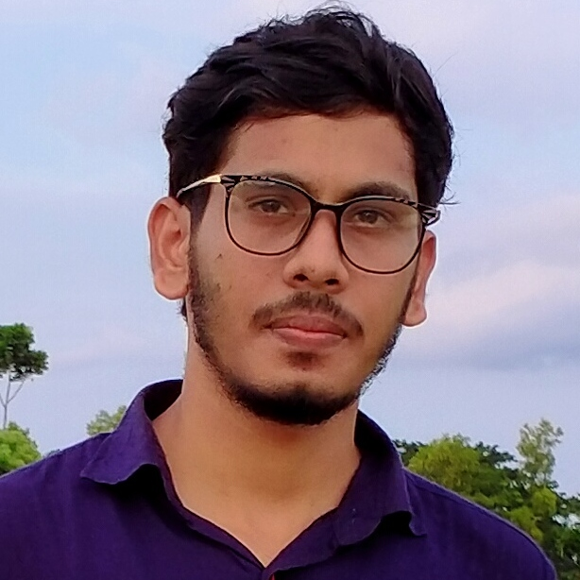

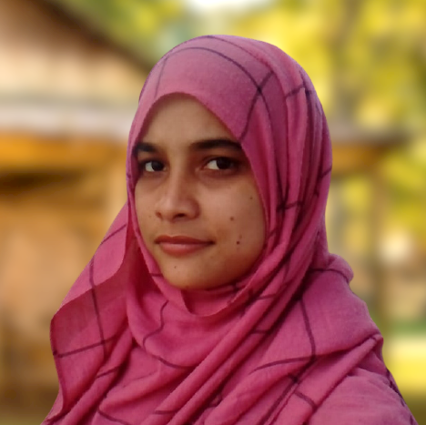
01
02
03
follow
Web Tool
services
teams
timeline
about
ABUL HASNAT
PALLOB BISWAS
MOYNA KHATUN
CEO, COVID 19
DM, COVID 19
CONTENT MANAGER
I am a Full Stack Web Developer With Experience Of More Then 4+ Years With Specializing in Web-Development Python, PHP, HTMl/CSS ,SQL
I am Fontend Developer With 3 Years Commercial Experience. I Use
I am a Professional Content Specialist, SEO Manger, and CS Graduate

Slide 7
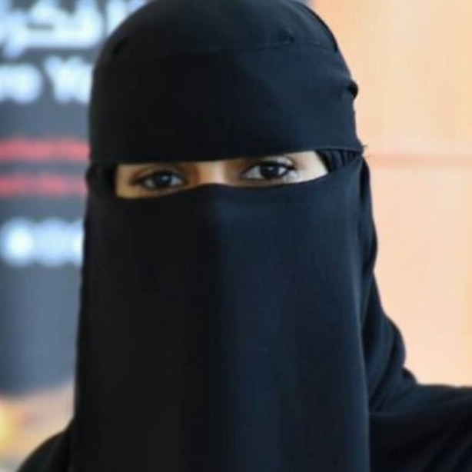
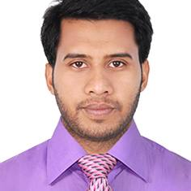
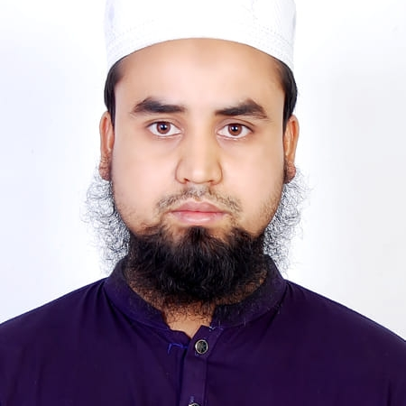
04
05
06
follow
Web Tool
services
teams
timeline
about
ARIFUN NAHAR
OBAIDUR ISLAM
OBAIDUR RAHMAN
DATA REASEARCHER
DATA SPECIALIST
GRAPHIC DESIGNER
I am a Data Entry and Web Search Expert. I’m also in social media research like Instagram, facebook, Twitter etc.
I am a data entry and Graphics Design Expert. I have over 5 years experience in data entry and 1Year in Graphic Design
I am a and Graphics Design Expert. I have over 5 years experience in data entry and 1Year in Graphic Design

Slide 8





Ambulance car
Oxygen
We Provide 24 hour ambulance, we are ready to take the patient to the hospital very fast, we provide ambulance in all the districts.
We are delivering oxygen 24 hours a day, we have enough oxygen, we are ready to deliver the oxygen cylinder to the specified location as soon as we order, in all the districts of Bangladesh.
Blood
Plasma
Web Tool
follow
services
teams
We are ready to supply blood 24 hours a day, you can take blood and plasma of any group if you want and donate your blood to humanity. Quickly communicate from any district of Bangladesh.
Here you need to add some brief about the service that your company is providing currently
timeline
about
ICU
Hospital
We are ready to supply icu bad 24 hours and quickly.
we get manage all covid hospital government and private hospital.

Slide 9
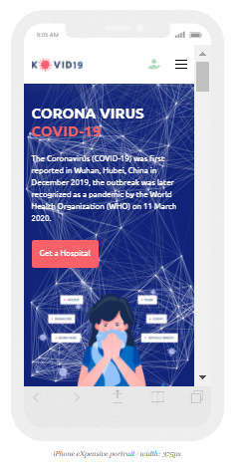
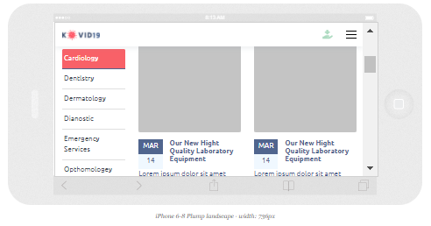

follow
teams
Web Tool
Responsive
timeline
about

Slide 10
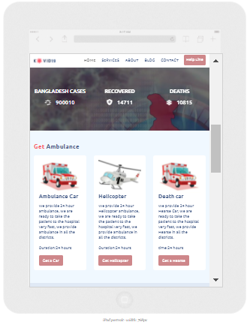
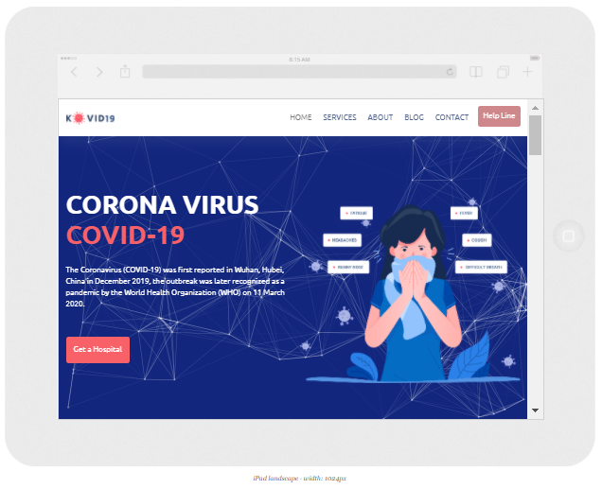
follow
teams
Web Tool
Responsive
timeline
about

Slide 11
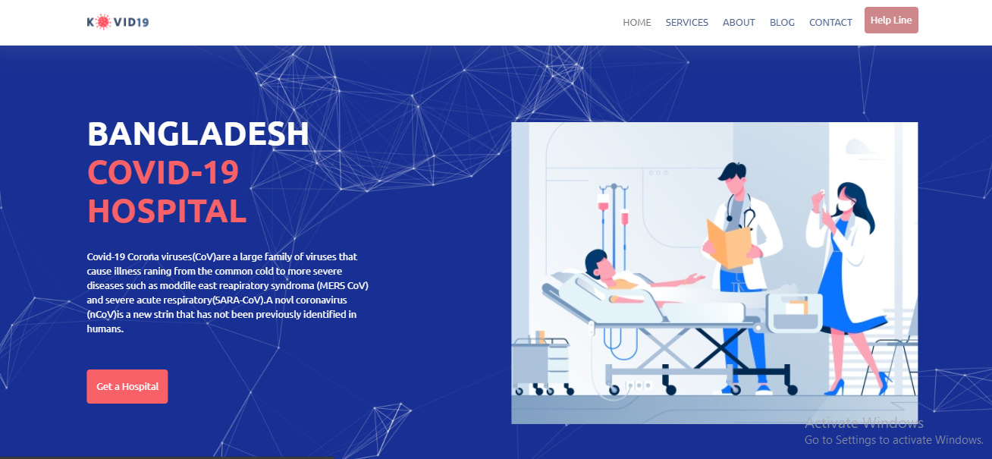
follow
teams
Web Tool
Responsive
timeline
about

Slide 12
Home page
Private
Hospital
Appointment
GOVT
Counter
API
follow
teams
Web Tool
Flow Chart
timeline
about
Ambulance
Contact
oxygen
Blood / oxygen
blood
ICU bad
Detail page

Slide 13
services
Dropdown
Service-1
Service-2
follow
teams
Web Tool
Flow Chart
timeline
about
Service-3

Slide 14
member1
About page
member2
member3
Team
member4
Future
member5
follow
teams
Web Tool
Flow Chart
timeline
about
Future all catagory

Slide 15
Blog Page
Post detials
post
post
post
Category list
follow
teams
Web Tool
Flow Chart
timeline
about
post
post
post
post
post
post

Slide 16
Contact
Location
Address
follow
teams
Web Tool
Flow Chart
timeline
about
Contact Forms

Slide 17

Thanks Everyone
follow
teams
Web Tool
Thanks
timeline
about
“Stay home stay safe. If you show symptoms of COVID-19, self isolate yourself, wear a mask around others and seek medical advice”

Slide 18



follow
Web Tool
services
teams
timeline
about
8M
6M
7M
https://www.facebook.com/coronavirus_info
https://www.pinstar.com/coronavirus_info
https://www.twitter.com/coronavirus_info

