Slide 1

ERP System
Web & Mobile Applications with smart Approvals

Slide 2
Modules
ERP
Forms
Mobile
Web
Finance & Accounting
Human Resources
Purchase
Contract
Training
Supply Chain
Inventory
Payroll
Project Services Resource Management

Slide 3
Introduction
Modern ERP for today's businesses
Unified Web & Mobile experience
Integrated Electronic Approval system
Technologies:
React.js & React Native (TS)
Material UI
Git & GitHub,
Express, RESTful APIs, GraphQL APIs, OAuth
Passport.js,Node.js

Slide 4
Why a New ERP System?
Need for fast, flexible, mobile-first solutions
Real-time electronic approvals essential
Enhance productivity and decision-making

Slide 5
Project Scope
Full ERP Modules: Finance, HR, Procurement, Inventory, Services
Web Application (React.js)
Mobile Application (React Native)
Real-time Notifications & Approvals
Integration with existing databases

Slide 6
Key Features
Modern, Responsive UI/UX Design (Web & Mobile - Android & iOS)
Fully adaptive interfaces for desktop, tablet, and mobile devices.
Native performance and experience using platform-specific best practices (Material Design for Android, Human Interface Guidelines for iOS).
User-centric design approach: intuitive navigation, clean layouts, and smooth interactions.
Light and Dark Mode support for better accessibility and user preference.
Optimized for high performance (fast loading, smooth transitions).

Slide 7
Key Features
Secure Authentication with Role-Based Access Control (RBAC)
Multi-layered security protocols including SSL/TLS encryption.
Secure login with options like email/password, OTP, biometric authentication (Face ID, fingerprint).
Role-based access ensures users only see and act on what they are authorized for.
Centralized user management for administrators to easily assign or change roles.
Session management and automatic logout for inactive users.

Slide 8
Key Features
Seamless Electronic Approval Workflow
Digital approval of all requests and transactions.
Configurable multi-level approval workflow based on department, role, or transaction type.
Audit trail and history for every approval action (who approved, when, and comments).
Ability to approve, reject, or delegate tasks.

Slide 9
Key Features
Real-Time Push Notifications for Approvals
Instant push notifications for pending approval requests, status updates.
Configurable notification settings based on user preferences (email, mobile push, in-app).
Interactive notifications: users can approve or reject directly from notification.
Notification batching and smart reminders to reduce notification overload.

Slide 10
Technology Stack
Frontend: React.js (Web), React Native (Mobile)
Backend: Node.js, Express.js
Database: SQL Server
APIs: RESTful APIs
Authentication: JWT / OAuth2
Deployment: Cloud Hosting

Slide 11
Electronic Approval Workflow
Transaction submission
Routing to approver
Notification to approver (Web & Mobile)
Approve/Reject with comments
Real-time status updates

Slide 12
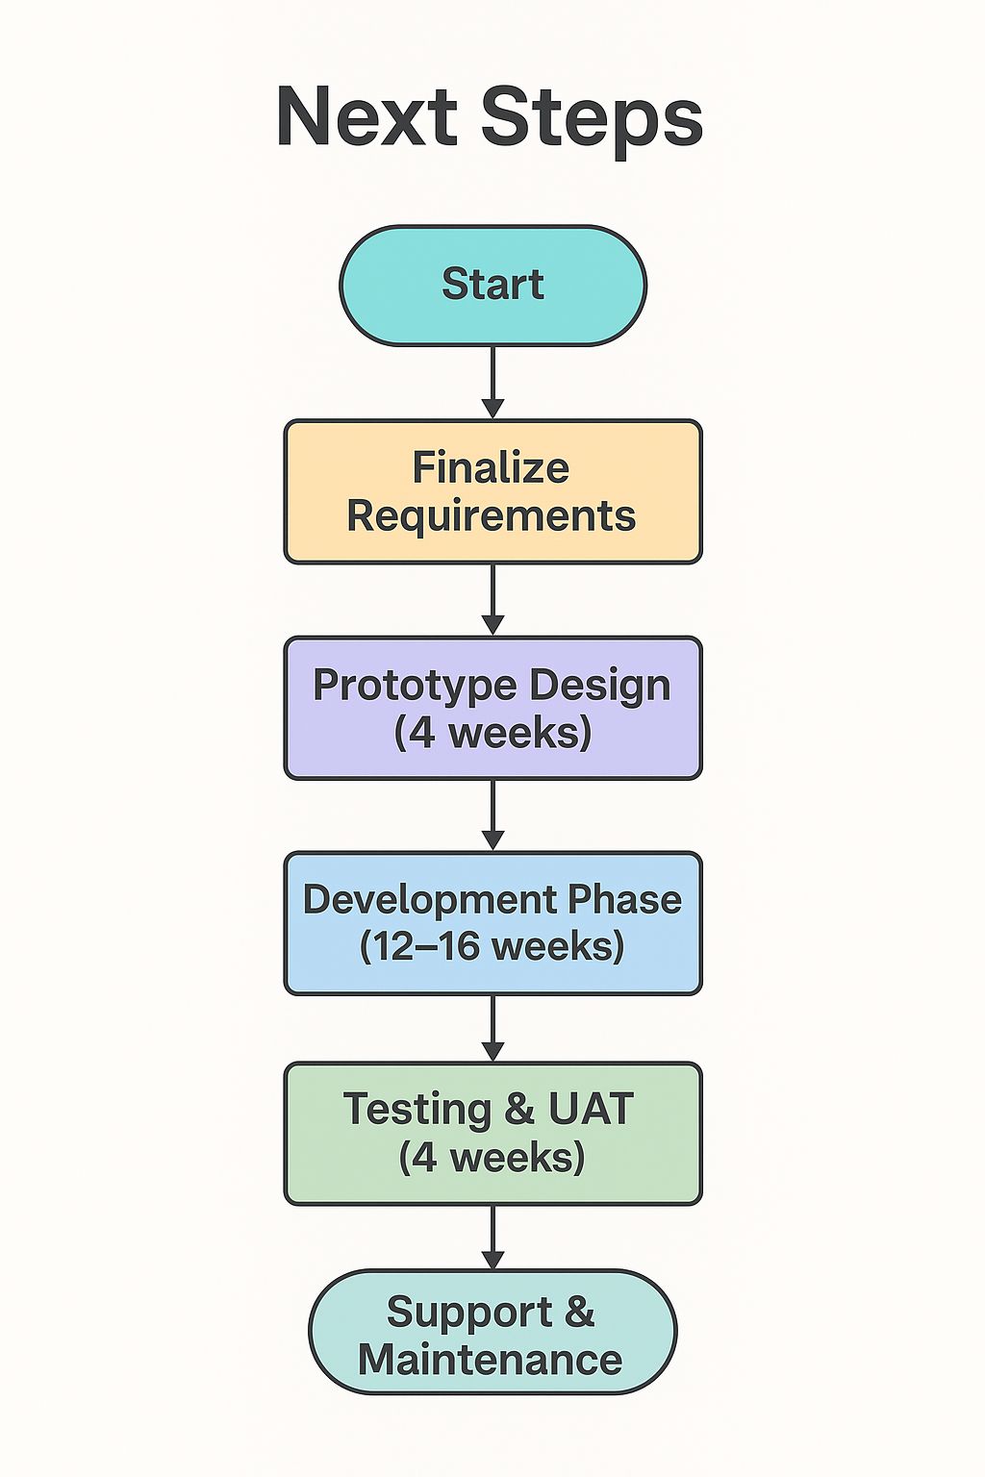
Next Steps & Timeline
Finalize requirements
Prototype design (4 weeks)
Development phase (16 weeks)
Testing & UAT (4 weeks)
Go-Live and Support

