Slide 1
The magic formula:
• Off-line value: a value function based on patterns and/or expert rules.
• On-line value: the average reward.
• Transient values: transients values are estimates of the quality of a move, based
on previous simulations including those which did not use this move in this situa-
tion; the most well known transient value is based on “Amaf” (all moves as first):
it’s a value function based on permutations of simulations [44, 112]; roughly, for
a max node, instead of the average of the rewards of simulations containing the
transition from a to b thanks to move m (as in the on-line version), we consider
the average reward of simulations crossing a and containing action m in any node
later than a. “Amaf” values within MCTS algorithms are termed “Rave” values
(Rapid Action Value Estimate).
The coefficients of these three terms verify the following property[152]:
• When nb and na are small, then the first term (off-line value) is the most impor-
tant;
• When nb increases, then transient values become more important;
• When nb → ∞, the on-line value has weight going to 1 and other values go to 0.
A typical formula might be
ˆ ˆ
maximize co f f lineVo f f line + ctransient V + conlineV + cexploration

Slide 2
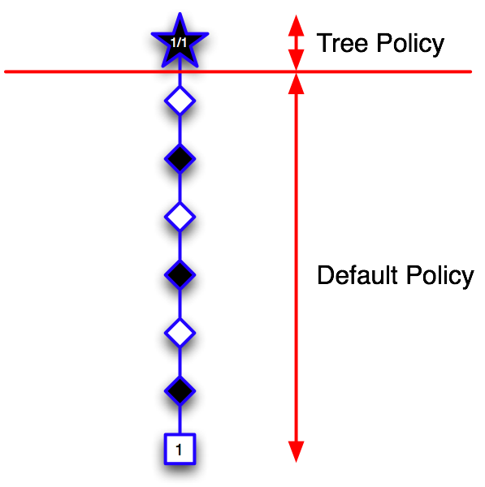

UCT (Upper Confidence Trees)
Coulom (06)
Chaslot, Saito & Bouzy (06)
Kocsis Szepesvari (06)
Notes:
The idea of the MCTS algorithm is to construct in
memory a subtreeT of the global tree T representing
the problem in its whole
The construction of the tree is done by the repetition of 3 successive steps:
while there is some
time left do:
1. descent,
2. evaluation,
3. growth.

Slide 3
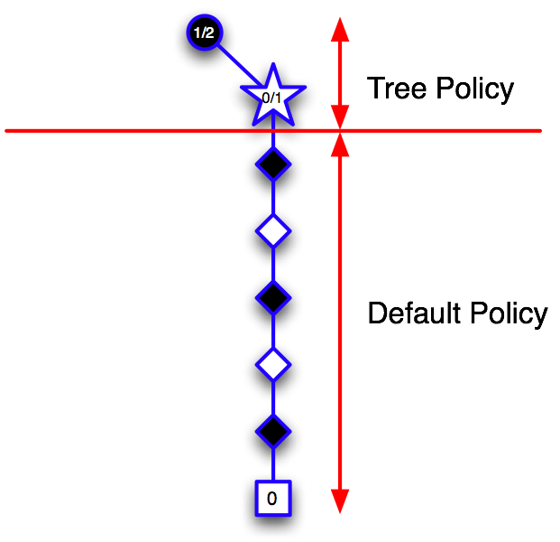
UCT
Notes:
Descent
The descent in T is done by considering that taking decision (choosing
a branch to follow) is a k-armed bandit problem. We use the formula presented previously
to solve this problem. In order to do that, we suppose that the necessary informations is stored for each node. Once a new node has been reached, we just repeat the same principle until we reached a situation S outside of T .

Slide 4
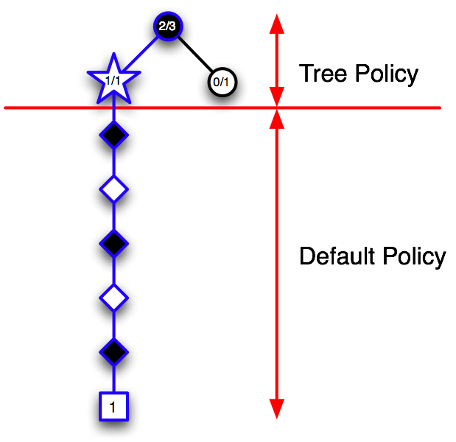
UCT
Notes:
Evaluation
Now that we have reached S and that we are outside of T^ , there is no more information available to take a decision. As we are not at a leaf of T ,we can not directly evaluate S. Instead, we use a Monte Carlo simulation to have a value for S.
Growth
We add the node S to T 1 . We update the information of S and of all the situations encountered during the descent with the value obtained with the Monte Carlo evaluation.

Slide 5
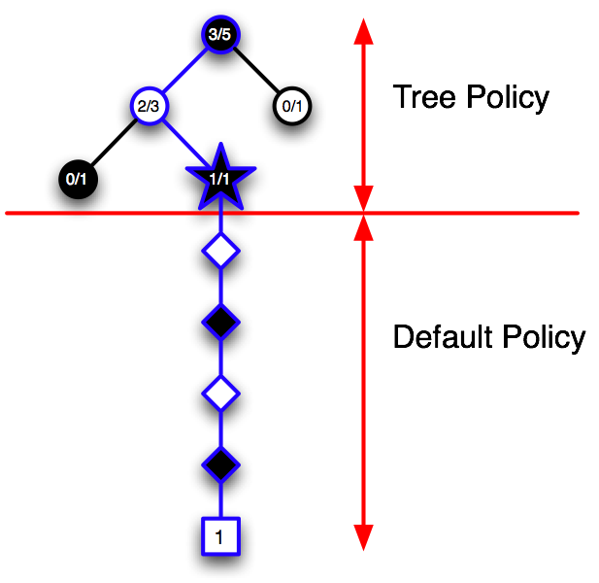
UCT
Notes:
And So forth until run out of time
We choose the most simulated node until that time

Slide 6
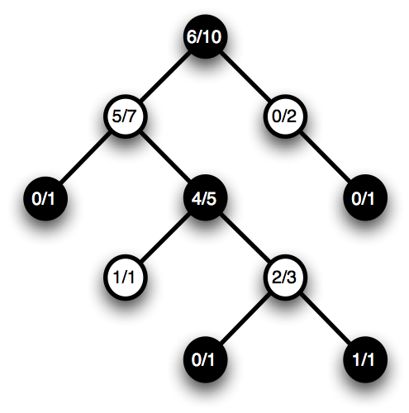
UCT
Kocsis & Szepesvari (06)
Notes:
Here only a small represenation of the hole tree constructed in memory
By the algorithm

Slide 7
Monte-Carlo Tree Search Heuristics
An extension: progressive unpruning / widening
Simulated move = argmax score
score(m) = nbWins(m)/nbSims(m)
+ c.sqrt( log(nbSims(father(m))) / nbSims(m))
argmax computed only among m1,...,mK
with K=nbSims(father(m))q
q=1/4 in theory (Munos,Audibert,Wang),
q=1/3.4 in some experiments
An extension: multi-scale learning
score(m) =
c1 . nbWins(m) / nbSims(m) <=== online learning
+c2 . nbWinsAmaf(m) / nbSimsAmaf(m) <=== transient learning
+c3 . offlineLearning(m) <=== offline learning
+c4 . expertRules(m) <=== rules from the ages
As a function of nbSims(m):
* c3+c4=1 at the beginning (c3/c4 depends on learning size);
* then c2 increases, c3+c4 goes to 0;
* later, c2 decreases to 0 also, c1 goes to 1.
==> beautiful
==> somewhat similar to human analysis in Go
An extension: “meta” level
1) Replace the random player by MoGo with huge thinking time.
2) Run the new (very slow) algorithm.
==> database of very good games
==> improves the learning
Also:
- diversification of the opponent (too much symetry) (?)
- human inoculation (add moves to be considered)
First idea: a random player.
Input: situation s
Output: a result (white wins or black wins)
Principle: a random player plays both as
black and white until the game is over.
Second idea: an adaptive random player.
Principle: a random player plays both as
black and white until the game is over.
- all situations are stored in memory
- if a situation is already stored, then:
choose move with
best empirical success rate
An extension: Amaf / Rave values
Idea: if most winning simulations have move m, then we should
explore m more strongly.
An extension: UCT
Simulated move = argmax score
score(m) = nbWins(m)/nbSims(m)
+ c.sqrt( log(nbSims(father(m))) / nbSims(m))
==> beautiful compromise exploration / exploitation
==> does not work in computer-Go (c<<1 optimal)
==> highly cited however as the explanation of MCTS successes
==> efficient for stochastic one-player games (imho)

Slide 8
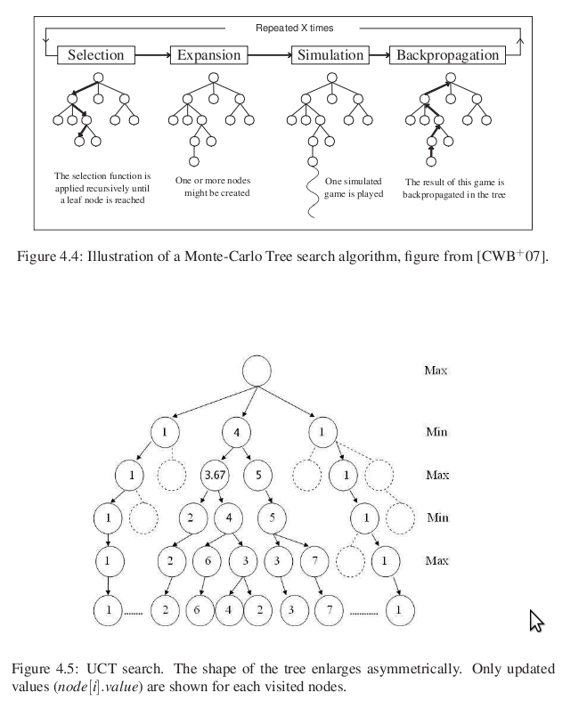
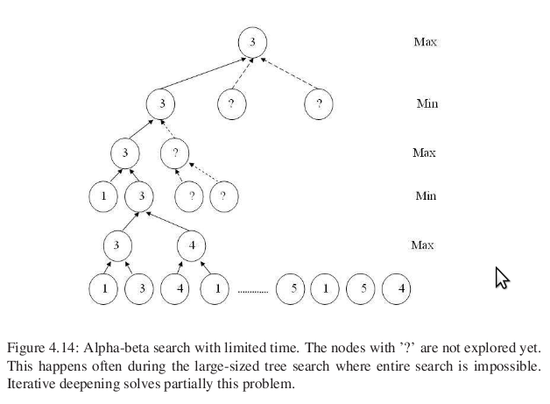
Illustration of the two parts of the algorithm, namely the tree search part and
the Monte-Carlo part. The root represents the analysed position. Each node represents a
position of the game, each branch leading from a position to another playing exactly one
move. The tree search part is done using the UCT algorithm. The Monte-Carlo evaluation
function consists in starting from the position and playing with a simulation policy until the
end of the game. Then the game is scored exactly simply using the rules.

Slide 9
APPENDIX
Branching factor:the branching factor is the number of children at each node. If this value is not uniform, an average branching factor can be calculated.
For example, in chess, if a "node" is considered to be a legal position, the average branching factor has been said to be about 35.[1] This means that, on average, a player has about 35 legal moves at his disposal at each turn.
Higher branching factors make works that follow every branch at every node, such as exhaustive brute force searches, computationally more expensive due to the exponentially increasing number of nodes, leading to combinatorial explosion.
For example, if the branching factor is 10, then there will be 10 nodes one level down from the current position, 102 (or 100) nodes two levels down, 103 (or 1,000) nodes three levels down, and so on. The higher the branching factor, the faster this "explosion" occurs. The branching factor can be cut down by a pruning algorithm.
Bandit:
The principle of this algorithm is based on the construction of a highly
unbalanced tree. The nodes represent situations and the branches represent
decisions. The nodes are evaluated by Monte Carlo simulations. The growth
of the tree is directed by a bandit formula. A very efficient improvement of
the algorithm is Rapid Action Value Estimation (RAVE).
The multi-armed bandit problem models an agent that simultaneously attempts to acquire new knowledge and to optimize its decisions based on existing knowledge. There are many practical applications:
* clinical trials investigating the effects of different experimental treatments while minimizing patient losses,[1][2] and
* adaptive routing efforts for minimizing delays in a network.

Slide 10
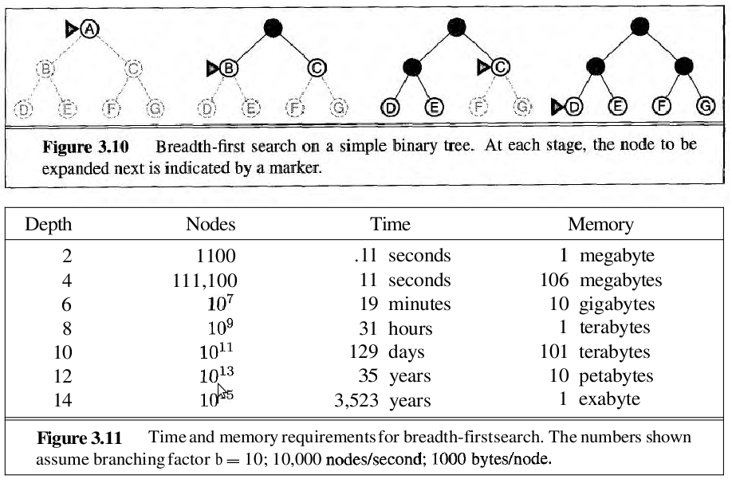

Slide 11
Size of the Game tree(minmax): determined by the number of available moves at each game state
Assume there are b moves valid at the initial game state;
Depth is d;
Number of available moves at each game state is:
Sum from i=1 to d of (b! / (b-i)!)
B=10; d=6 => 187.300
Consequences
This algorithm can rapidly become overwhelmed by the sheer number of game
states generated during the recursive search. In chess, where the average number of moves on a board is often considered to be 30 (Laramée, 2000), to look ahead
only five moves (i.e., b=30, d=5) requires evaluating up to 25,137,931 board posi-
tions. This value is determined by the expression:
MINIMAX can take advantage of symmetries in the game state (such as rotations
of the board or reflections) by caching past states viewed (and their respective
scores), but the savings are game-specific.

Slide 12
Astronomical numbers:
Common stucture: a state tree where the root node represents the initial state and edges represents potential moves that transform the state into a new state.
5 * 10 ^ 20 different board configurations for checker
For TicTacToe (3x3)
N(3x3=9) = 1 + 9x8 + 9x8x7 + … + 9x8x7... x3x2x1 = 986 410
N(4x4 = 16) = 82 619 585
Total number of positions in :
Go = 10 ^ 170
Tic Tac Toe = 10 ^ 6
Chess = 10 ^ 50
Branching factor (Number of branches under each node)
* Go (19x19) = 200 ~ 280
* Chess = 35 ~ 40
=> 5 moves ahead leeds to analysing 1.5 billion game states.
We need dozen moves in Go to get (hopefully) an accurate evaluation of the situation

Slide 13
Minimax
Given a specific position in a game tree from the perspective of an initial player, a search program must find a move that leads to the greatest chance of victory (or at
least a draw)
Input:The algorithm starts from an initial position in a game tree and assumes that it
can (a) iterate through all valid moves for a given player at a game state, and (b)
evaluate the game state to compute an integer representing the strength of the
game from a player’s perspective
Output:Return a move from among the valid moves that leads to the best future game
state for a specific player, as determined by the evaluation function.
Assumptions:
The program assumes there is an evaluation function score(state, player) that returns an integer representing the score of the game state from player’s perspective; smaller
integer numbers (which may be negative) reflect weaker positions.
The algorithm looks ahead a fixed number of moves, called the ply depth.
A deep first algorithm
The Complexity of Minimax
• For a given game with branching factor b,
searching to depth d require O(bd)
computation and storage
– chess has a branching factor of around 35
• A 1-move search tree for chess has 1225 leaves
• Say a typical chess game has 100 moves then the
number of leaves in the tree is 35100 = 10154
• Assuming a modern computer can process 1000000
board positions a second it will take 10140 years to search
the entire tree.
– go has a branching factor of 360 or more
Partial Search Tree
• In a real game, we can only look ahead a few ply!
• The depth of search is determined by the time
allowed per move.
• Suppose we can process 1000000 positions a
we can search 5 ply. second and we’re allowed one minute per move, then

Slide 14
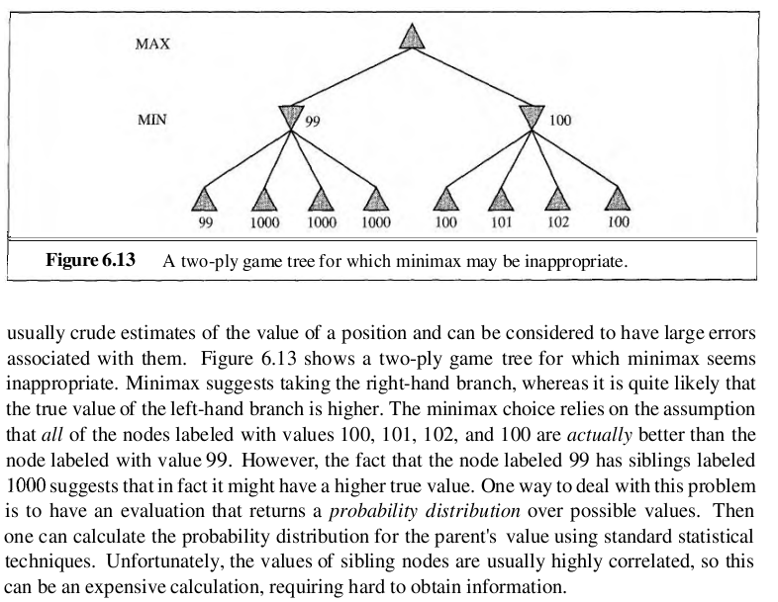
Minimax Cutoff
• Does it work in practice?
– Time complexity: O(bm)
• Chess:
– b = 35
– Suppose we limit our search to 1.5 million nodes
per move
– m=4
– 4-ply chess player is a lousy player!
– 4-ply = novice chess player
– 8-ply = typical PC, human master
– 12-ply = Deep Blue, Kasparov
The Evaluation Function
In MoGo ??
• If we do not reach the end of the game how do
we evaluate the payoff of the leaf states?
• Use a static evaluation function.
– A heuristic function that estimates the
utility of board positions.
– Desirable properties
• Must agree with the utility function
• Must not take too long to evaluate
• Must accurately reflect the chance of winning
• An ideal evaluation function can be applied directly to
the board position.
• It is better to apply it as many levels down
in the game tree as time permits.
• Example evaluation functions:
– Tic-Tac-Toe: # ways to win
– Chess: value of white pieces/value of black pieces

Slide 15
