Slide 1



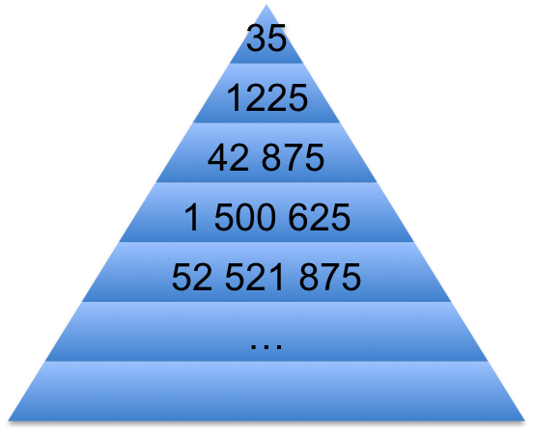

Minimax Algorithm: the brute force solution
For the MAX player
1. Generate the game to terminal states
2. Apply the utility function to the terminal
states
3. Back-up values
• At MIN ply assign minimum payoff move
• At MAX ply assign maximum payoff move
4. At root, MAX chooses the operator that
led to the highest payoff
3
MAX
MIN
3
2
MAX
7
3
2
6
MIN
7
2
3
6
2
Perfect play for deterministic, perfect-
information games
Assume that the opponent will select its best move choice and make no mistakes
Totally impractical
- Time complexity is O(b^{d})
- Space complexity is O(b^{d})
Search tree growing exponentially with the depth !

Slide 2



AlphaBeta: an improvement of Minimax
Algorithm : a MiniMax with pruning.
ALPHABETA takes advantage of the calculated states when determining whether to continue searching a particular subtree or prune it.
Pruning does not affect final result.
Good move ordering improves effectiveness of pruning.
Time complexity
• O(b^{d/2})
• means we go from an effective branching factor of b to sqrt(b)
(e.g. 35 -> 6 for chess).
3
MAX
3
2
MIN
7
3
6
MAX
2
MIN
7
2
3
6
2
ALPHABETA twice faster

Slide 3
Dynamic programming
Dynamic Programming is a method used to optimize the objective function in a planning problem.
Recursively decompose the problem into subproblems, solve subproblems and construct the global solution.
However, the algorithm is not anytime; if stopped before then, there is
no result.
Can be seen as one player game against a random player.
Finding the shortest path in a graph
3
B
2
E
A
4
5
2
1
C
g
6
6
3
F
D
4

Slide 4
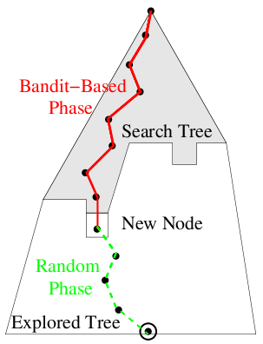
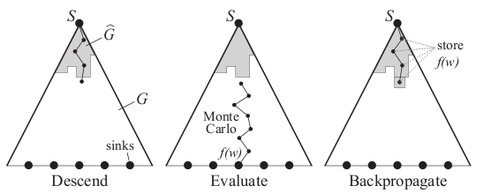
MCTS: how it works ?
Algorithms for taking decisions in uncertain environments.
Principles:
Iteratively growing unbalanced tree (choosing a decision
is seen as bandit problems – UCT).
Random simulations (Monte-Carlo simulations
as an evaluation function).
3 steps loop while time budget > 0

Slide 5
Monte-Carlo Tree Search: Algorithm sketch
Input: a situation s
Output: a (hopefully good) move m for situation s
Memory = empty; statistics = empty mapping
While (time left > 0)
s'=s, game = ()
While (s' in memory, not terminal)
s'= reachable situation such that nbWins(s') / nbSims(s') max
endwhile
s''=s'
While (s' not terminal)
s'= random reachable situation from s'
endwhile
result = result(s') memory = memory + s''
for all states in the simulation
statistics(s) = statistics(s) + statistics(game,result)
endfor
endwhile
Restart games
Choose move
to be explored
Using statistics
Choose move
to be explored
Update statistics

Slide 6

K-armed bandit problem
Problem Description :
p₁,...,p_{N} unknown probabilities ∈ [0,1]
At each time step t∈ {1,...,N}
  - Choose arm a_{t}∈ {1,...,N} (as a function of a_{j} and r_{t} j<t)
  - With probability p_{j,t}
    - win ( r_{t} = 1 )
    - loose ( r_{t} = 0 )
Goal: minimize a Regret: R_{N}=N max{p_{i}} - ∑ r_{t} (t<N)
Classical solution:
UCB: Choose arm j maximizing the compromise:
p_{j,t}:Empirical average for decision j
N :Total number of trials
n_{j,t}:number of trials with decision j
p_{j,t} + √(logN/n_{j,t})
(Lai et al; Auer et al)
Optimal regret O(log(n))

Slide 7
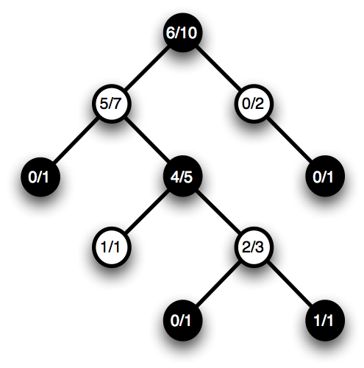

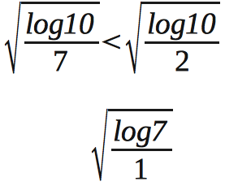
Exploitation vs Exploration dilema
p_{j,t}+√(logN/n_{j,t})
p_{j,t}+√(logN/n_{j,t})
_x0013_

Slide 8
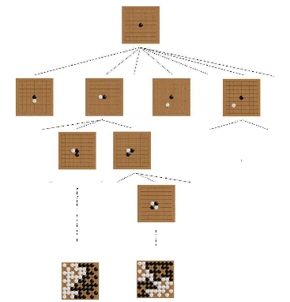
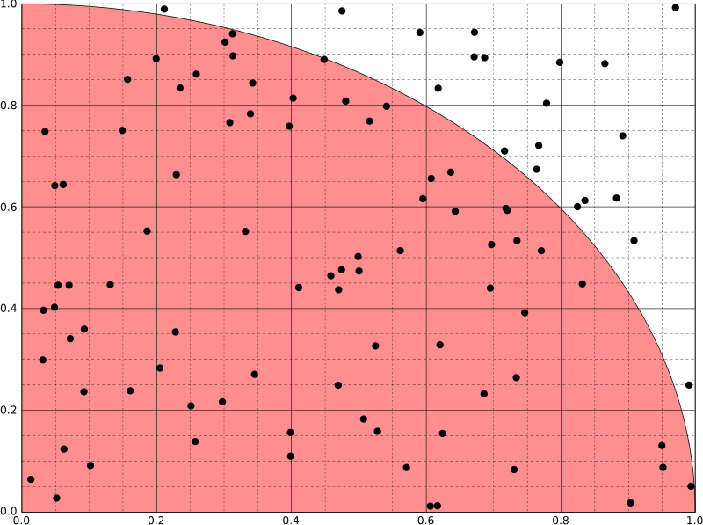
Monte-Carlo simulations
simulations to approximate pi
Simulations to find the optimal move
.....
double nbTotalPoints = 0;
double nbPointsInSquare = 0;
double PI;
int timeLeft = 10000; // time budget
double x, y;
srand(time(NULL));
cout << "Estimating PI by MC Simulations "<<endl;
while (timeLeft > 0) {
x = (double)(rand() % 10) / 10;
y = (double)(rand() % 10) /10;
nbTotalPoints ++;
if ((sqrt (x * x + y * y)) < 1) {
nbPointsInSquare ++;
}
timeLeft --;
}
PI = 4 * (nbPointsInSquare / nbTotalPoints);
...
Monte-Carlo evaluation function
consists in starting from the postion
and playing with a simulation policy
until the end of the game.

Slide 9
MoGo: record of achievement
2011 : First win against a pro (6D) H2 in 13x13 MoGoTW
2011 : First win against a pro (9P) H2.5 in 13x13 MoGoTW
2011 : First win against a pro in Blind-Go in 9x9 MoGoTW
2010 : Gold medalist in TAAI 2010 in three categories:
9x9 Go, 13x13 Go, 19x19 Go. MoGoTW
2007: win against a pro (5p) in 9x9 (blitz) MoGo
2008: win against a pro (5p) in 9x9 white MoGo
2009: win against a pro (5p) in 9x9 black MoGo
2009: win against a pro (9p) in 9x9 black MoGoTW
_x0016_
_x0016_
_x0016_
_x0016_
2008: win against a pro (8p) 19x19, H9 MoGo
2009: win against a pro (9p) 19x19, H7 MoGo
2009: win against a pro (1p) 19x19, H6 MoGo
MCTS = an efficient approach for taking
decisions under uncertainty

Slide 10

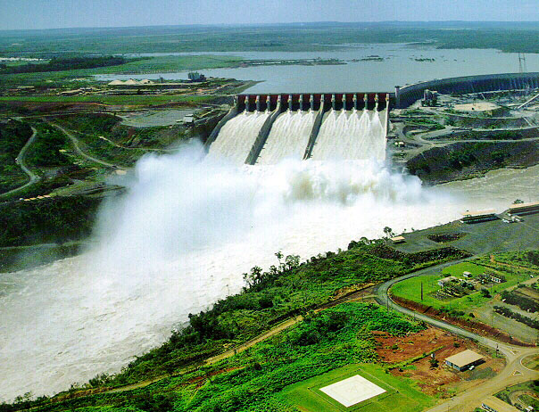
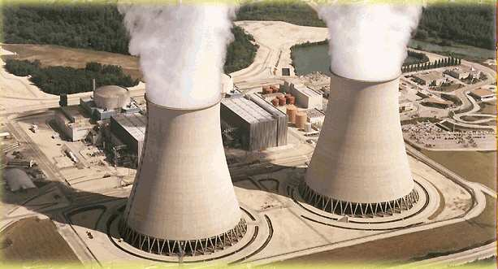
Application to energy
MCTS in the continious domain
Energy plant managment
Financial market
Application to partially observable problems

