Slide 1
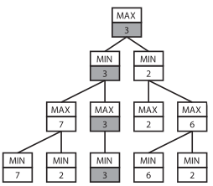
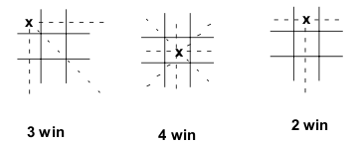
Recursion-backtracking-brute force
Minimax Algorithm
For the MAX player
1. Generate the game to terminal states
2. Apply the utility function to the terminal
states
3. Back-up values
• At MIN ply assign minimum payoff move
• At MAX ply assign maximum payoff move
4. At root, MAX chooses the operator that
led to the highest payoff
Minimax
• (+) Perfect play for deterministic, perfect-
information games
(-) The program must assume that the
opponent will select its best move choice and make no mistakes
• (-) Totally impractical since it generates the
whole tree
– Time complexity is O(b^d)!
– Space complexity is O(bd)
Search tree growing exponentially with the depth
Heuristic to reduce search tree in Tic-tac-toe
Most-Win Heuristics
35
1225
42 875
1 500 625
52 521 875
…...

Slide 2
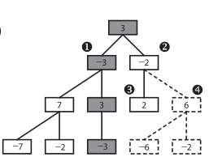
Recursion-backtracking-Heuristics
ALPHABETA 'twice better '
Algorithm : almost the same as MinMax
The primary distinction is that
ALPHABETA takes advantage of the calculated states when determining whether to continue searching a particular subtree or prune it..
Today versions of alphaBeta are more depth-first and anytime than older versions.
Alpha-beta pruning
• Pruning does not affect final result
• Alpha-beta pruning
– Good move ordering improves effectiveness of
pruning
– With “perfect ordering,” time complexity
• O(b^d/2)
• means we go from an effective branching factor of b to
sqrt(b) (e.g. 35 -> 6).

Slide 3
Dynamic programming
Dynamic Programming is a method used to optimize the objective function
in a planning problem.
An example of problem where this algorithm is efficient is the problem
of finding the shortest path in a graph
However, the algorithm is not anytime; if stopped before then, there is
no result.
Can be seen as one player game against a random player :
Max level and mean level (mean function is just for the example)

Slide 4
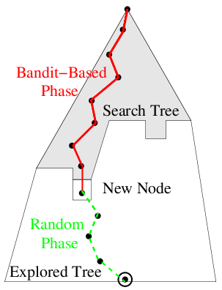
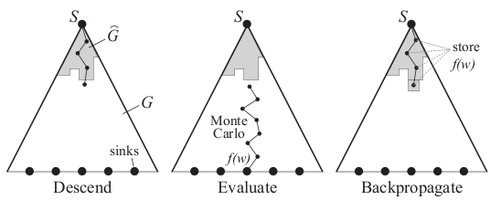
Recursion-Anytime-Heuristics
Monte-Carlo Tree Search (MCTS)
Algorithms for taking decisions in uncertain environments.
The principles are:
- iteratively growing unbalanced tree (choosing a decision
is seen as bandit problems - UCT);
- random simulations (Monte-Carlo simulations
as an evaluation function).
While TimeLeft > 0

Slide 5
Algorithm Sketch
Input: a situation s
Output: a (hopefully good) move m for situation s
Memory = empty; statistics = empty mapping
While (time left > 0)
s'=s, game = ()
While (s' in memory, not terminal)
s'= reachable situation such that nbWins(s') / nbSims(s') max
endwhile
s''=s'
While (s' not terminal)
s'= random reachable situation from s'
endwhile
result = result(s') memory = memory + s''
for all states in the simulation
statistics(s) = statistics(s) + statistics(game,result)
endfor
endwhile
Restart games
Choose move
to be explored
Using statistics
Choose move
to be explored
Update statistics

Slide 6
K-one-armed Bandit
Problem Description :
p1,...,pN unknown probabilities ∈ [0,1]
At each time step t∈ {1,...,N}
  Choose arm at∈ {1,...,N} (as a function of aj and rt j<t)
  With probability pj,t
    win ( rt=1 )
    loose ( rt=0 )
Minimize a Regret: RN=N max{pi} - ∑ rt (t<N)
=> a classical solution : UCB1: Choose arm j maximizing the compromise:
pj,t+√(logN/nj,t)
(Lai et al; Auer et al)
pj,t:Empirical average for decision j
N :Total number of trials
nj,t:number of trials with decision j
=> optimal regret O(log(n))

Slide 7
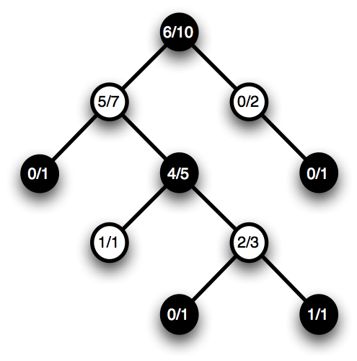

Exploitation vs Exploration dilema..
pj,t+√(logN/nj,t)
pj,t+√(logN/nj,t)

Slide 8
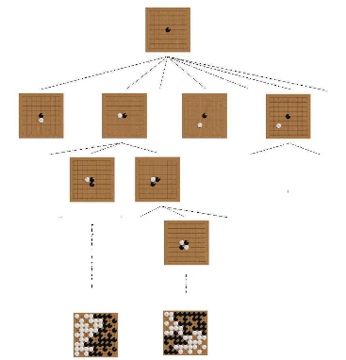
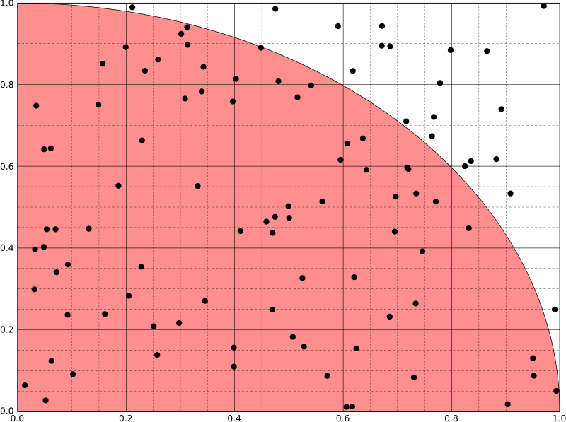
Monte Carlo Simulations
simulations to approximate pi
Simulations to find the optimal move
.....
double nbTotalPoints = 0;
double nbPointsInSquare = 0;
double PI;
int timeLeft = 10000;
double x, y;
srand(time(NULL));
cout <<"*** Estimating PI by Monte-Carlo Simulations ***"<<endl;
while (timeLeft > 0) {
x = (double)(rand() % 10) / 10;
y = (double)(rand() % 10) /10;
nbTotalPoints ++;
if ((sqrt (x * x + y * y)) < 1) {
nbPointsInSquare ++;
}
timeLeft --;
}
PI = 4 * (nbPointsInSquare / nbTotalPoints);
...
Illustration of the Monte-Carlo part. The root represents the analysed position. Each node represents a position in the game, and each branch leading from a position to another, playing exactly one move. The tree part is done using the UCT algorithm.The Monte-Carlo evaluation function consists in starting from the postion and playing with a simulation policy until the end of the game. Then the game is scored exactly simply using the rules.

Slide 9
Palmarès de MoGo
2011 : First win against a pro (6D) 13x13 MoGoTW
2011 : First win against a pro H2.5 in 13x13 MoGoTW
2011 : First win against a pro in Blind-Go in 9x9 MoGoTW
2010 : Gold medalist in TAAI 2010 in three categories: 9x9 Go, 13x13 Go, 19x19 Go.
In 9x9 board
2007: win against a pro (5p) (blitz) MoGo
2008: win against a pro (5p) white MoGo
2009: win against a pro (5p) black MoGo
2009: win against a pro (9p) black MoGoTW
In 19x19 board
2008: win against a pro (8p) 19x19, H9 MoGo
2009: win against a pro (9p) 19x19, H7 MoGo
2009: win against a pro (1p) 19x19, H6 MoGo
MCTS = the only efficient approach for taking decisions under uncertainty

Slide 10



Energy management applications : MCTS in the continious domain
Application to patially observable games

