Slide 1

Hasq Technology
Secure Ownership and Control of Digital Tokens, Hasq Chains, and Applications
Oleg Mazonka
CSE Research Rounds
27 Jan 2015

Slide 2
Hasq Technology
Harrys’ questions
What is Hasq?
Why should someone use it?
Where do we need it?
How it works?
Why is it safe?
What has been done?

Slide 3
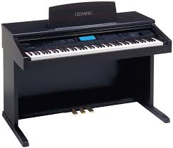
Hasq Technology
What is Ownership
<number>/28

Slide 4
Hasq Technology
What is Ownership
Ownership – state of possessing something
Possess – to own
<number>/28

Slide 5
Hasq Technology
What is Ownership
Ownership – state of possessing something
Possess – to own
Possess – to have control of
<number>/28

Slide 6

Hasq Technology
Ownership Types
<number>/28

Slide 7
Hasq Technology
Ownership Types
Ownership property | Real objects, money (cash) | Money (bank account) | Copyright | Authorship | ?
Can be lost against will | Yes | Yes | Yes | No | No
Can be transferred at will | Yes | Yes | Yes | No | Yes
<number>/28

Slide 8


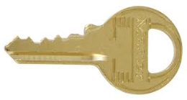
Hasq Technology
Owning a box
<number>/28

Slide 9

Hasq Technology
Padlock chain
<number>/28

Slide 10
Hasq Technology
Padlock chain
<number>/28

Slide 11
Hasq Technology
Padlock chain
<number>/28

Slide 12
Hasq Technology
Padlock chain
<number>/28

Slide 13

Hasq Technology
Hasq Chain
N is a sequence number for a particular S;
S is a hash of arbitrary nature digital data, S can be expressed as a string of hexadecimal characters – token;
K G O are hash strings: Key, Generator and Owner;
D is an optional textual Data field
<number>/28

Slide 14
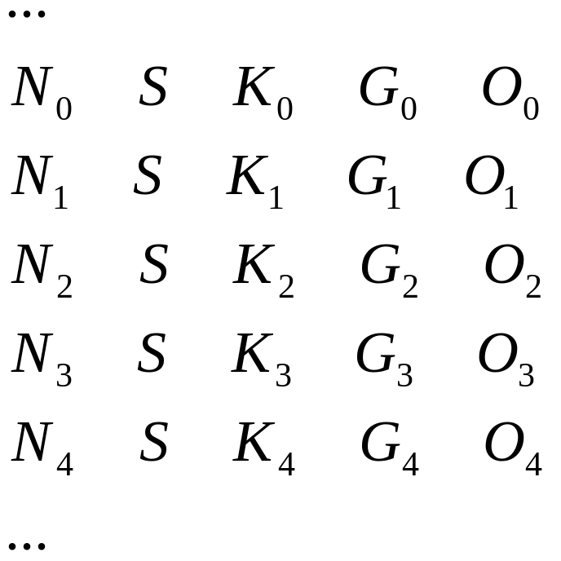
Hasq Technology
Hasq Chain
Ns are consecutive numbers for the chosen S
<number>/28

Slide 15
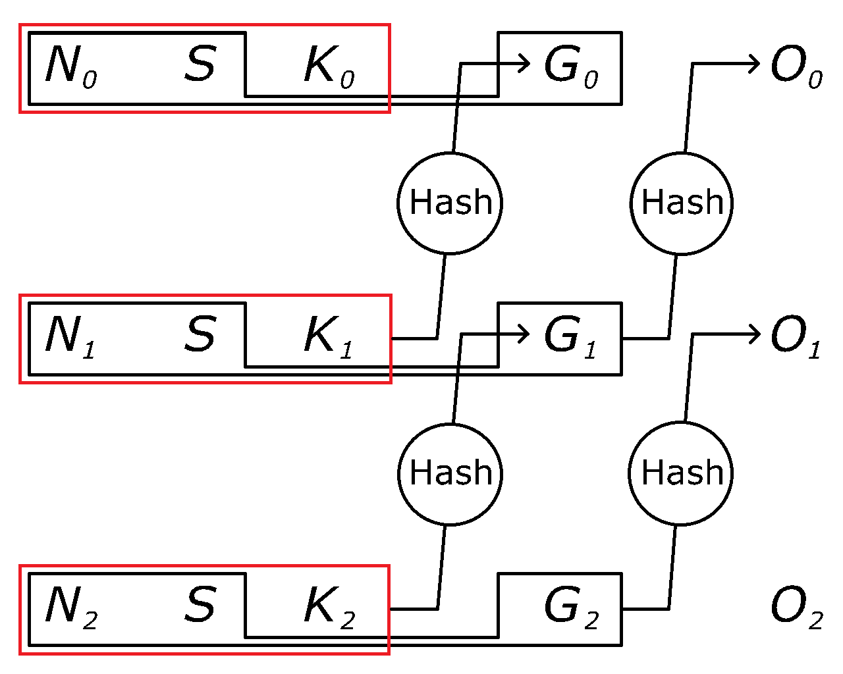
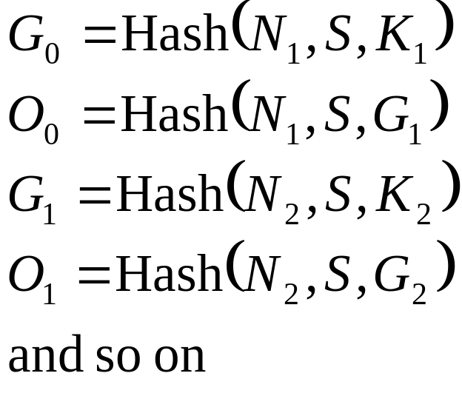

Hasq Technology
Hasq Chain
<number>/28

Slide 16
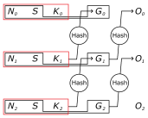
Hasq Technology
Servers and Distributed DBs
…
Internet
<number>/28

Slide 17
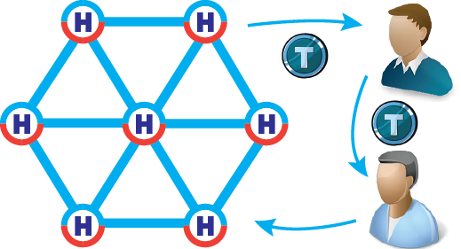
Hasq Technology
Servers and Distributed DBs
To own a token is equivalent to own an object or a promise
Tokens can be produced
Tokens can be assigned positive (obligation) or negative (debt) value
Tokens can be transferred
<number>/28

Slide 18
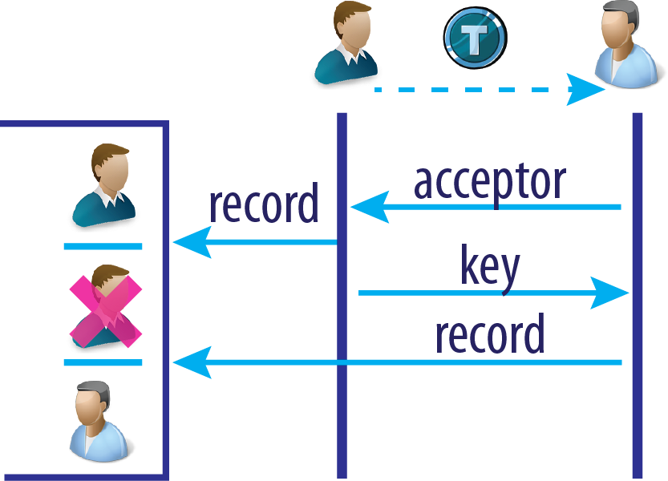
Hasq Technology
Transaction
Sender and recipient exchange with hashes calculated from records
1) sender gives the "token key" to recipient
2) recipient gives the "token acceptor" to sender
3) mixed when token may be locked in an intermediate state
<number>/28

Slide 19


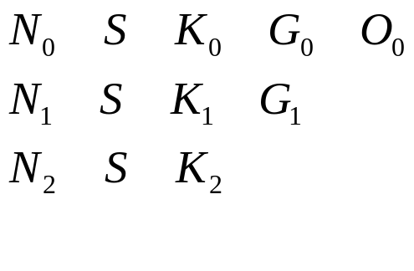
Hasq Technology
Locked State
c8cf7a6d75c1e81cb8d996fd23460551d1bc5da7
<number>/28

Slide 20
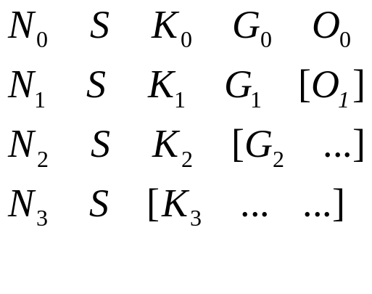
Hasq Technology
Locked State
c8cf7a6d75c1e81cb8d996fd23460551d1bc5da7
c8cf7a6d75c1e81cb8d996fd23460551d1bc5da7
<number>/28

Slide 21
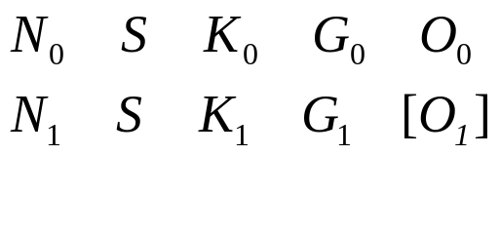
Hasq Technology
Locked State
c8cf7a6d75c1e81cb8d996fd23460551d1bc5da7
<number>/28

Slide 22
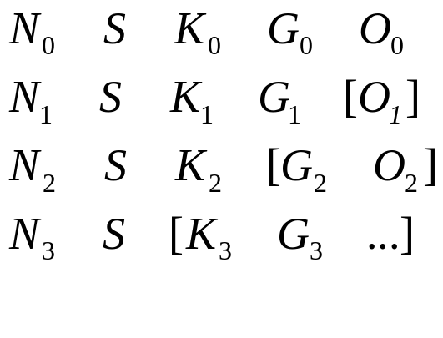
Hasq Technology
Locked State
c8cf7a6d75c1e81cb8d996fd23460551d1bc5da7
c8cf7a6d75c1e81cb8d996fd23460551d1bc5da7
<number>/28

Slide 23
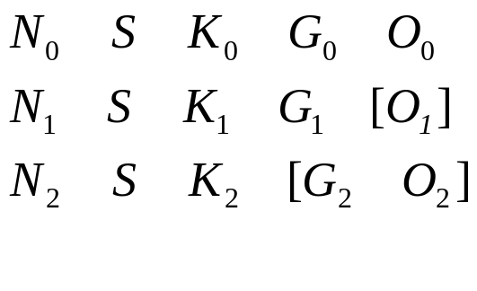
Hasq Technology
Locked State
c8cf7a6d75c1e81cb8d996fd23460551d1bc5da7
<number>/28

Slide 24
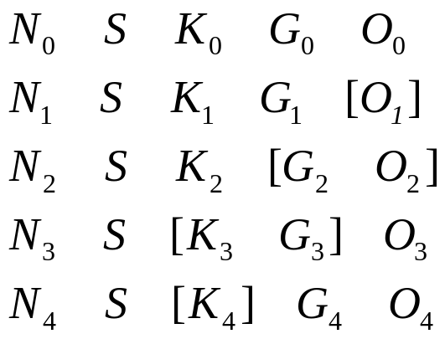
Hasq Technology
Locked State
c8cf7a6d75c1e81cb8d996fd23460551d1bc5da7
c8cf7a6d75c1e81cb8d996fd23460551d1bc5da7
c8cf7a6d75c1e81cb8d996fd23460551d1bc5da7
<number>/28

Slide 25
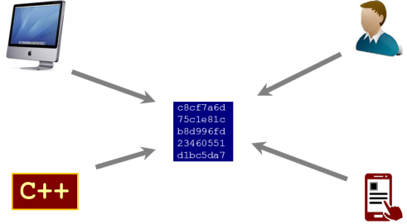
Hasq Technology
Some Properties
Issuer has full control over issue of tokens
Full spectrum of anonymity: complete, partial or none
Ultimately no client software required
Lost references to owned tokens can be restored
High transaction processing speed
No sensible motive to hack Hasq servers
No Public Key Cryptography
Locked state
Devices or software can own and control tokens
<number>/28

Slide 26
Hasq Technology
Debt tokens
A
B
Record – Debt – REF Accept
Record – Debt – REF Accept
Record – Debt – REF Release
<number>/28

Slide 27
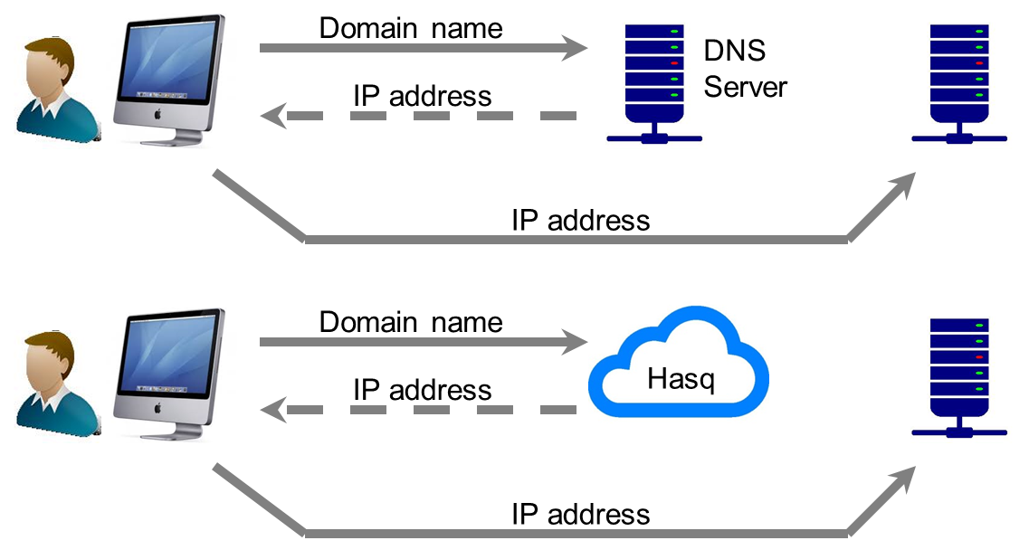
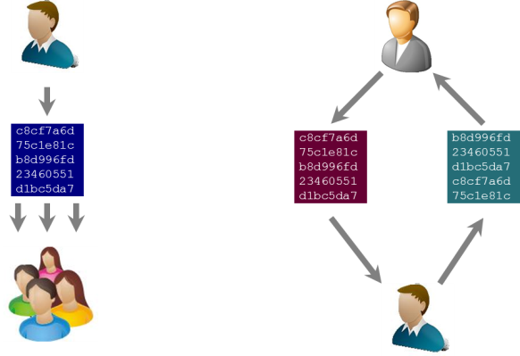
Hasq Technology
Applications
Financial Industry
  IOU, bonds, travelers cheques
  Money surrogates, gift cards, reward points
Shareholders Registry
Copyrighted Materials (i.e. music, photo, designs)
Software licensing
Messenger
Alternative DNS
<number>/28

Slide 28
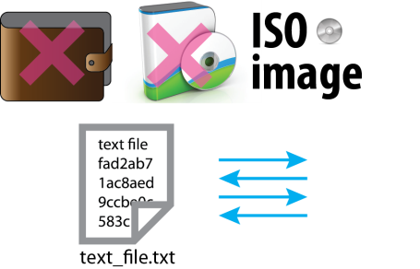

Hasq Technology
Summary
The token can:
  be passed electronically over the Internet or telephone
  be passed fully anonymously for either the sender or the recipient
  serve as a currency note
  serve as an obligation
  serve as a verifiable title for ownership
  serve as modifiable association with a particular piece of electronic data
Simple chain scheme
Small distribution
  Portable C++ source code, no 3rd party libraries
  OS + Hasq = 10 Mb bootable CD ISO image

