Slide 1
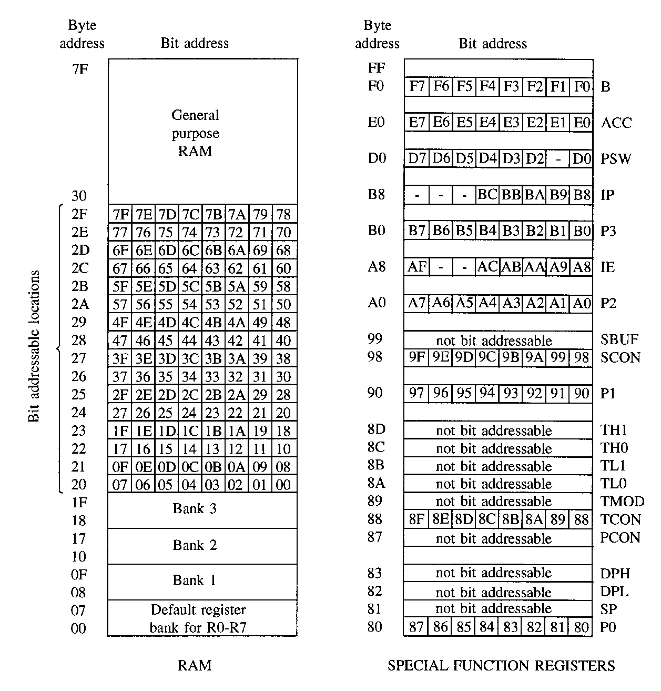
SFRs

Slide 2
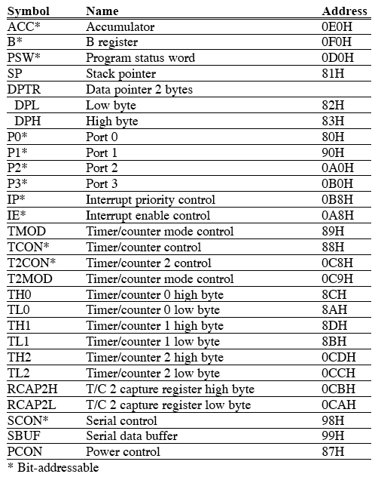

Slide 3
The ACC – Accumulator
Commonly used for move and arithmetic instructions.
Can be referred to in several ways:
Implicitly in op-codes.
Referred to as ACC (or A) for instructions that allow specifying a register.
By its SFR address 0E0H.
Operates in a similar manner to the 8085 accumulator.
Bit addressable.
ACC.2 means bit 2 of the ACC register.

Slide 4
The B Register
Commonly used as a temporary register, much like a 9th R register.
Used by two op-codes
MUL AB, div AB
B register holds the second operand and will hold part of the result
Upper 8 bits of the multiplication result
Remainder in case of division.
Can also be accessed through its SFR address of 0F0H.
Bit addressable.

Slide 5
The DPL and DPH Registers
2 8-bit registers that can be combined into a 16-bit DPTR – Data Pointer.
Used by commands that access external memory
Also used for storing 16bit values
mov DPTR, #data16
; setup DPTR with 16bit ext address
movx A, @DPTR
; copy mem[DPTR] to A
Can be accessed as 2 separate 8-bit registers if needed.
DPTR is useful for string operations and Look-Up-Table (LUT) operations.

Slide 6
The SP Register
SP is the stack pointer.
SP points to the last used location of the stack.
Push operation will first increment SP and then copy data.
Pop operation will first copy data and then decrement SP.
In 8051, stack grows upwards (from low memory to high memory) and can be in the internal RAM only.
On power-up, SP points to 07H.
Register banks 2,3,4 (08H to 1FH) form the default stack area.
Stack can be relocated by setting SP to the upper memory area in 30H to 7FH.
mov SP, #32H

Slide 7
The PSW Register
Program Status Word is a “bit addressable” 8-bit register that has all the flags.
MSB |  |  |  |  |  |  | LSB
CY | AC | F0 | RS1 | RS2 | OV | - | P
Symbol | Position | Function
CY | PSW.7 | Carry Flag
AC | PSW.6 | Auxiliary Carry Flag. For BCD Operations
F0 | PSW.5 | Flag 0. Available to the user for general purposes.
RS1 | PSW.4 | Register bank select bits. Set by software to determine which register bank is being used.
RS2 | PSW.3
OV | PSW.2 | Overflow Flag
- | PSW.1 | Not used
P | PSW.0 | Parity Flag. Even Parity. P=1 A contains an odd no. of 1’s

Slide 8
The P0, P1, P2, and P3 Registers
Port Latches.
Specify the value to be output on the specific output port or the value read from the specific input port.
Bit addressable.
First bit has the same address as the register.
Example: P1 has address 90H in the SFR, so
P1.7 or address 97H refer to the same bit.
Link: SFR address

Slide 9
The SBUF Register
Serial Port Data Buffer.
2 registers at the same location
One is read-only used for reading serial input data.
Serial Data Receive Buffer.
The other is write-only used for storing serial output data.
Serial Data Transmit Buffer.
Link: SFR address

Slide 10
Timer Registers – TH0 and TL0
The high and low bytes of the 16-bit counting register for timer/counter T0.
There is also a TH1 / TL1 pair for the T1 timer.
In the 8052, one more pair exists (TH2) / (TL2) for the T2 timer.
Link: SFR address

Slide 11
Control Registers
IP – Interrupt Priority.
IE – Interrupt Enable.
TMOD – Timer Mode.
TCON – Timer Control.
T2CON – Timer 2 Control (8052)
SCON – Serial Port Control.
PCON – Power Control (80C51).
Link: SFR address

Slide 12
8051 – Timer /counter

Slide 13
8051 – Timer / Counter
2 – 16 bit timer / counter
4 – 8 bit registers – or 2 16 bit registers
TL0, TH0 – Timer/ Counter 0 and
TL1, TH1 - Timer/ Counter 1
MOV TL0, #0FEH – instructions to load the counter
Can be used in 4 different modes
TMOD – Timer Mode selection register
TCON – timer control register
Timer operations can be controlled either by software or by hardware

Slide 14

TCON – special function register
TCON – is a dual purpose register
Higher 4 bits D7- D4 – are timer control
Lower 4 bits are for interrupt control

Slide 15
IE1 – external Interrupt 1 – edge flag – high to low edge coming to this external input will set this flag
Reset when it jumps to ISS @ 0013H or by software
IT1 – external interrupt 1 signal type control
It decides high to low edge or low level for interrupting the processor
IE0 – external Interrupt 0 – edge flag – high to low edge coming to this external input will set this flag
Reset when it jumps to ISS @ 0003H or by software
IT0 – external interrupt 1 signal type control
It decides high to low edge or low level for interrupting the processor

Slide 16
The various bits of TCON are as follows.
TF1 : Timer1 overflow flag. It is set when timer rolls from all 1s to 0s. It is cleared when processor vectors to execute ISR located at address 001BH. TR1 : Timer1 run control bit. Set to 1 to start the timer / counter. TF0 : Timer0 overflow flag. (Similar to TF1) but vectors to execute ISR located at address 000BH TR0 : Timer0 run control bit. IE1 : Interrupt1 edge flag. Set by hardware when an external interrupt edge is detected. It is cleared when interrupt is processed. IE0 : Interrupt0 edge flag. (Similar to IE1) IT1 : Interrupt1 type control bit. Set/ cleared by software to specify falling edge / low level triggered external interrupt. IT0 : Interrupt0 type control bit. (Similar to IT1) As mentioned earlier, Timers can operate in four different modes.

Slide 17
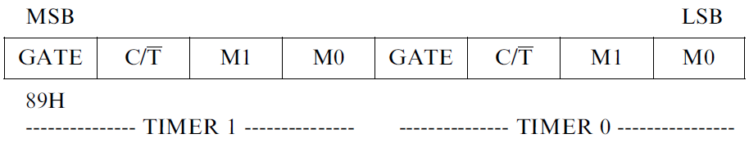
TMOD – Timer Mode Register
Lower 4 bits for Timer 0
Higher 4 bits for Timer 1
M0/ M1 – mode of operations of timer are decided
Gate and C/T(bar) – decides the control of operation either by software or hardware (interrupt)

Slide 18
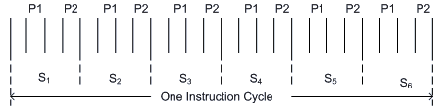
8051 Clock and Instruction Cycle
In 8051, one instruction cycle consists of twelve (12) clock cycles. Instruction cycle is sometimes called as Machine cycle by some authors.
In the "timer" function mode, the counter is incremented in every machine cycle.
Thus, one can think of it as counting machine cycles. Hence the clock rate is 1/12 th of the oscillator frequency.

Slide 19
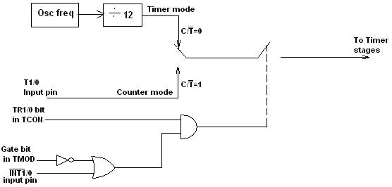

Slide 20
TMOD-
C/T – to define the source of input
1 – source is from external
0 – source is internal
GATE – defines the activation - enabling and disabling of count operation – by software or hardware means
Enabling and disabling by software and hardware means
Software control – GATE = 0
Hardware control GATE – 1 – interrupt will control the operation of timer

Slide 21
8051 Timer Modes
8051 TIMERS
Timer 0
Timer 1
Mode 0
Mode 0
Mode 1
Mode 1
Mode 2
Mode 2
Mode 3
*
TE IT SEM-V
21

Slide 22







TIMER 0
OSC
÷12
TL0
TH0
TF0
INTERRUPT
*
TE IT SEM-V
22

Slide 23








TIMER 0 – Mode 0
13 Bit Timer / Counter
OSC
÷12
TL0
(5 Bit)
TH0
(8 Bit)
TF0
INTERRUPT
Maximum Count = 1FFFh (0001111111111111)
The lower 5 bits of TLX and 8 bits of THX are used for the 13 bit count.
Upper 3 bits of TLX are ignored.
When the counter rolls over from all 0's to all 1's, TFX flag is set and an interrupt is generated.
*
TE IT SEM-V
23

Slide 24
TIMER 0 – Mode 1
16 Bit Timer / Counter
OSC
÷12
TL0
(8 Bit)
TH0
(8 Bit)
TF0
INTERRUPT
Maximum Count = FFFFh (1111111111111111)
This mode is similar to mode-0 except for the fact that the Timer operates in 16-bit mode.
*
TE IT SEM-V
24

Slide 25
TIMER 0 – Mode 2
8 Bit Timer / Counter with AUTORELOAD
OSC
÷12
TL0
(8 Bit)
TH0
(8 Bit)
TF0
INTERRUPT
Reload
TH0
(8 Bit)
Maximum Count = FFh (11111111)
*
TE IT SEM-V
25

Slide 26


TIMER 0 – Mode 3
Two - 8 Bit Timer / Counter
OSC
÷12
TL0
(8 Bit)
TF0
INTERRUPT
Control bits TR1 and TF1 are used by Timer-0 (higher 8 bits)
(TH0) in Mode-3
while TR0 and TF0 are available to Timer-0 lower 8 bits(TL0).
OSC
÷12
TH0
(8 Bit)
TF1
INTERRUPT
Separate 2 8-bit counters
Timer 1 can be used only in mode 2 where TF1 and TR1 are not required
*
TE IT SEM-V

Slide 27


TIMER 1
OSC
÷12
TL1
TH1
TF1
INTERRUPT
*
TE IT SEM-V
27

Slide 28



TIMER 1 – Mode 0
13 Bit Timer / Counter
OSC
÷12
TL1
(5 Bit)
TH1
(8 Bit)
TF1
INTERRUPT
Maximum Count = 1FFFh (0001111111111111)
*
TE IT SEM-V
28

Slide 29
TIMER 1 – Mode 1
16 Bit Timer / Counter
OSC
÷12
TL1
(8 Bit)
TH1
(8 Bit)
TF1
INTERRUPT
Maximum Count = FFFFh (1111111111111111)
*
TE IT SEM-V
29

Slide 30
TIMER 1 – Mode 2
8 Bit Timer / Counter with AUTORELOAD
OSC
÷12
TL1
(8 Bit)
TH1
(8 Bit)
TF1
INTERRUPT
Reload
TH1
(8 Bit)
Maximum Count = FFh (11111111)
*
TE IT SEM-V
30

Slide 31
8051 Instruction set
8051 has about 111 instructions. These can be grouped into the following categories
Arithmetic Instructions Logical Instructions Data Transfer instructions Boolean Variable Instructions Program Branching Instructions

Slide 32
Mnemonics | Description | Bytes | Instruction Cycles
ADD A, Rn | A = (A + Rn) | 1 | 1
ADD A, direct | A A + (direct) | 2 | 1
ADD A, @Ri | A A + @Ri | 1 | 1
ADD A, #data | A A + data | 2 | 1
ADDC A, Rn | A A + Rn + C | 1 | 1
ADDC A, direct | A A + (direct) + C | 2 | 1
ADDC A, @Ri | A A + @Ri + C | 1 | 1
ADDC A, #data | A A + data + C | 2 | 1
DA A | Decimal adjust accumulator | 1 | 1
DIV AB | Divide A by B A quotient B remainder | 1 | 4
Arithmetic instruction
DEC A | A A -1 | 1 | 1
DEC Rn | Rn Rn - 1 | 1 | 1
DEC direct | (direct) (direct) - 1 | 2 | 1
DEC @Ri | @Ri @Ri - 1 | 1 | 1
INC A | A A+1 | 1 | 1
INC Rn | Rn Rn + 1 | 1 | 1
INC direct | (direct) (direct) + 1 | 2 | 1
INC @Ri | @Ri @Ri +1 | 1 | 1
INC DPTR | DPTR DPTR +1 | 1 | 2
MUL AB | Multiply A by B A low byte (A*B) B high byte (A* B) | 1 | 4
SUBB A, Rn | A A - Rn - C | 1 | 1
SUBB A, direct | A A - (direct) - C | 2 | 1
SUBB A, @Ri | A A - @Ri - C | 1 | 1
SUBB A, #data | A A - data - C | 2 | 1

Slide 33
Logical instructions
Mnemonics | Description | Bytes | Instruction Cycles
ANL A, Rn | A A AND Rn | 1 | 1
ANL A, direct | A A AND (direct) | 2 | 1
ANL A, @Ri | A A AND @Ri | 1 | 1
ANL A, #data | A A AND data | 2 | 1
ANL direct, A | (direct) (direct) AND A | 2 | 1
ANL direct, #data | (direct) (direct) AND data | 3 | 2
CLR A | A 00H | 1 | 1
CPL A | AA | 1 | 1
ORL A, Rn | A A OR Rn | 1 | 1
ORL A, direct | A A OR (direct) | 1 | 1
ORL A, @Ri | A A OR @Ri | 2 | 1
ORL A, #data | A A OR data | 1 | 1
ORL direct, A | (direct) (direct) OR A | 2 | 1
ORL direct, #data | (direct) (direct) OR data | 3 | 2
RL A | Rotate accumulator left | 1 | 1
RLC A | Rotate accumulator left through carry | 1 | 1
RR A | Rotate accumulator right | 1 | 1
RRC A | Rotate accumulator right through carry | 1 | 1
SWAP A | Swap nibbles within Acumulator | 1 | 1
XRL A, Rn | A A EXOR Rn | 1 | 1
XRL A, direct | A A EXOR (direct) | 1 | 1
XRL A, @Ri | A A EXOR @Ri | 2 | 1
XRL A, #data | A A EXOR data | 1 | 1
XRL direct, A | (direct) (direct) EXOR A | 2 | 1
XRL direct, #data | (direct) (direct) EXOR data | 3 | 2

Slide 34
MOV A, Rn | A Rn | 1 | 1
MOV A, direct | A (direct) | 2 | 1
MOV A, @Ri | A @Ri | 1 | 1
MOV A, #data | A data | 2 | 1
MOV Rn, A | Rn A | 1 | 1
MOV Rn, direct | Rn (direct) | 2 | 2
MOV Rn, #data | Rn data | 2 | 1
MOV @Ri, direct | @Ri (direct) | 2 | 2
MOV @Ri, #data | @Ri data | 2 | 1
MOV DPTR, #data16 | DPTR data16 | 3 | 2
MOVC A, @A+DPTR | A Code byte pointed by A + DPTR | 1 | 2
MOVC A, @A+PC | A Code byte pointed by A + PC | 1 | 2
MOVC A, @Ri | A Code byte pointed by Ri 8-bit address) | 1 | 2
MOVX A, @DPTR | A External data pointed by DPTR | 1 | 2
MOVX @Ri, A | @Ri A (External data - 8bit address) | 1 | 2
MOVX @DPTR, A | @DPTR A(External data - 16bit address) | 1 | 2
PUSH direct | (SP) (direct) | 2 | 2
POP direct | (direct) (SP) | 2 | 2
XCH Rn | Exchange A with Rn | 1 | 1
XCH direct | Exchange A with direct byte | 2 | 1
XCH @Ri | Exchange A with indirect RAM | 1 | 1
XCHD A, @Ri | Exchange least significant nibble of A with that of indirect RAM | 1 | 1
MOV direct, A | (direct) A | 2 | 1
MOV direct, Rn | (direct) Rn | 2 | 2
MOV direct1, direct2 | (direct1) (direct2) | 3 | 2
MOV direct, @Ri | (direct) @Ri | 2 | 2
MOV direct, #data | (direct) #data | 3 | 2
MOV @Ri, A | @Ri A | 1 | 1
MOV @Ri, direct | @Ri (direct) | 2 | 2
MOV @Ri, #data | @Ri data | 2 | 1
Data transfer instructions

Slide 35
Boolean variable instructions
Mnemonics | Description | Bytes | Instruction Cycles
CLR C | C-bit 0 | 1 | 1
CLR bit | bit 0 | 2 | 1
SET C | C 1 | 1 | 1
SET bit | bit 1 | 2 | 1
CPL C | C | 1 | 1
CPL bit | bit | 2 | 1
ANL C, /bit | C C . | 2 | 1
ANL C, bit | C C. bit | 2 | 1
ORL C, /bit | C C + | 2 | 1
ORL C, bit | C C + bit | 2 | 1
MOV C, bit | C bit | 2 | 1
MOV bit, C | bit C | 2 | 2

Slide 36
Program branching instruction
AJMP for Absolute jump within 2k memory
SJMP for short jump within +/-128 bytes from the SJMP Command and
LJMP for Long jump
ACALL addr11 | PC + 2 (SP) ; addr 11 PC (7FF) | 2 | 2
AJMP addr11 | Addr11 PC | 2 | 2
CJNE A, direct, rel | Compare with A, jump (PC + rel) if not equal | 3 | 2
CJNE A, #data, rel | Compare with A, jump (PC + rel) if not equal | 3 | 2
CJNE Rn, #data, rel | Compare with Rn, jump (PC + rel) if not equal | 3 | 2
CJNE @Ri, #data, rel | Compare with @Ri A, jump (PC + rel) if not equal | 3 | 2
DJNZ Rn, rel | Decrement Rn, jump if not zero | 2 | 2
DJNZ direct, rel | Decrement (direct), jump if not zero | 3 | 2
JC rel | Jump (PC + rel) if C bit = 1 | 2 | 2
JNC rel | Jump (PC + rel) if C bit = 0 | 2 | 2
JB bit, rel | Jump (PC + rel) if bit = 1 | 3 | 2
JNB bit, rel | Jump (PC + rel) if bit = 0 | 3 | 2
JBC bit, rel | Jump (PC + rel) if bit = 1 | 3 | 2
JMP @A+DPTR | A+DPTR PC | 1 | 2
ACALL allows you to jump to a subroutine within the same 2K page while
LCALL allows you to jump to a subroutine anywhere in the 64K code space.
JZ rel | If A=0, jump to PC + rel | 2 | 2
JNZ rel | If A ≠ 0 , jump to PC + rel | 2 | 2
LCALL addr16 | PC + 3 (SP), addr16 PC | 3 | 2
LJMP addr 16 | Addr16 PC | 3 | 2
NOP | No operation | 1 | 1
RET | (SP) PC | 1 | 2
RETI | (SP) PC, Enable Interrupt | 1 | 2
SJMP rel | PC + 2 + rel PC | 2 | 2
JMP @A+DPTR | A+DPTR PC | 1 | 2
JZ rel | If A = 0. jump PC+ rel | 2 | 2
JNZ rel | If A ≠ 0, jump PC + rel | 2 | 2
NOP | No operation | 1 | 1

Slide 38
Generate square wave on pin P1.0 using timer0 – IS A SOFTWARE APPROACH
MOV TMOD, #01H; SET MODE
LOOP MOV TL0, # 0EEH ; INITIALIZE THE TIMER - 2
MOV TH0, #0FFH; -2
CPL P1.0 – COMPLIMENT BIT - 1
ACALL DELAY – 2
SJMP LOOP - 2
DELAY SET B TR0 ; COUNTING IS ENABLED HERE - 1
AGAIN JNB TF0 AGAIN; LOOKS FOR THE FLAG BIT TF0 - 17
CLR TR0; DISABLE THE COUNTING - 1
CLR TF0 – READY FOR NEXT CYCLE 1
RET 1

Slide 39
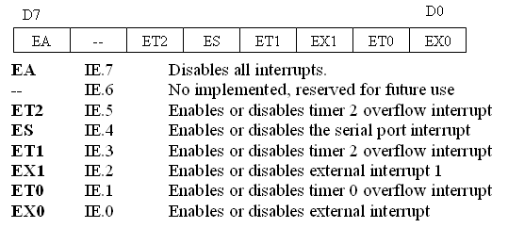
Using Timer 0 interrupt- (keil)
Assembler directives
ORG: defines the starting address for the program in program memory
EQU : assigns a numeric value to a symbol identifier
DB: Define a byte. Puts a byte constant at the memory location specified
DW define a word (16 bit data)
DBIT: define a BIT
END: directive to the assembler to stop the assembly process.
ORG 0000H
LJMP MAIN
ORG 000BH
LJMP SERVICE
ORG 30H
MAIN: MOV TMOD, #00000001B ; initialization of Timer 0 in mode 1
MOV TL0, #00H
MOV TH0, #0DCH
MOV IE, #82H; enable timer 0 interrupt
SETB TR0 ; start timer 0
HERE: SJMP HERE
SERVICE: CPL P1.2
MOV TL0, #00H
MOV TH0, #0DCH ; there is no CLR TF0 , because it is
automatically reset when program jumps to the service routine
RETI
END
Interrupt Enable IE (SFR)

Slide 40
Time Delay Generation and Calculation

Slide 41
Machine Cycle
For the CPU to execute an instruction takes a certain number of clock cycles.
In the 8051 family, these clock cycles are referred to as machine cycles.
Ex：RET needs 2 machine cycles
The 8051 has an on-chip oscillator which generates machine cycles.
The 8051 requires an external clock（a quartz crystal oscillator）to run the on-chip oscillator.
Notes:
quartz 石英
crystal 水晶
oscillator:振盪器
The pin of 8051 for external clock => look Chapter 4.

Slide 42
Machine Cycle
The relationship between two oscillators：
The length of the machine cycle is 12 of the oscillator period.
The frequency of the machine cycle is 1/12 of the crystal frequency.
The frequency of the external crystal can be vary from 4 MHz to 30MHz.
Very often the 11.0592MHz crystal oscillator is used to make the 8051-based system compatible with the serial port of the IBM PC（See Chapter 10）.

Slide 43
Example 1
The following shows crystal frequency for three different 8051-
based systems. Find the period of the machine cycle in each case.
11.0592 MHz (b) 16 MHz (C) 20 MHz
Solution:
11.0592/12 = 921.6 KHz
machine cycle is 1/921.6 KHz = 1.085 μs (microsecond)
(b) oscillator period = 1/16 MHz = 0.625 μs
machine cycle (MC) = 0.625 μs ×12 = 0.75 μs
(c) 20 MHz/12 = 1.66 MHz
MC = 1/1.66 MHz = 0.60 μs

Slide 44
Example 2
For an 8051 system of 11.0592 MHz, find how long it takes to
execute each of the following instructions.
(a) MOV R3,#55 (b) DEC R3 (c) DJNZ R2, target
(d) LJMP (e) SJMP (f) NOP (g) MUL AB
Solution:
The machine cycle for a system of 11.0952 MHz is 1.085 μs.
Table A-1 shows machine cycles for each instructions.
Instruct Machine cycles Time to execute
(a) MOV R3,#55 1 1×1.085 μs = 1.085 μs
(b) DEC R3 1 1×1.085 μs = 1.085 μs
(c) DJNZ R2,target 2 2×1.085 μs = 2.17 μs
(d) LJMP 2 2×1.085 μs = 2.17 μs
(e) SJMP 2 2×1.085 μs = 2.17 μs
(f) NOP 1 1×1.085 μs = 1.085 μs
(g) MUL AB 4 4×1.085 μs = 4.34 μs

Slide 45
Example 3
Find the size of the delay in the following program, if the crystal
frequency is 11.0592 MHz.
MOV A,#55H
AGAIN: MOV P1,A
ACALL DELAY
CPL A
SJMP AGAIN
;－－－Time delay Machine Cycle
DELAY: MOV R3,#200 1
HERE: DJNZ R3,HERE 2
RET 2
Solution: Table A-1
The time delay is
[(200 × 2)+1+2] × 1.085 μs = 437.252 μs.

Slide 46
Delay Calculation
A delay subroutine consists of two parts
setting a counter（initialization）
a loop
Very often we calculate the time delay based on the instructions inside the loop and ignore the clock cycles associated with the instructions outside the loop.
Two way to get a large delay is
to use NOP（Example 4）
to use a loop inside a loop（nested loop）（Example 5）

Slide 47
Example 4
Find the time delay for the following subroutine, assuming a
crystal frequency of 11.0592 MHz.
Machine Cycle
DELAY: MOV R3,#250 1
HERE: NOP 1
NOP 1
NOP 1
NOP 1
DJNZ R3,HERE 2
RET 2
Solution:
the HERE loop ＆ the two instructions outside the loop
{ [250 (1+1+1+1+2)] + 3 } × 1.085 μs
= (1500+3) × 1.085 μs = 1769.36 μs.

Slide 48
Example 5
For a machine cycle of 1.085 μs, find the time delay in the
following subroutine.
DELAY: Machine Cycle
MOV R2,#200 1
AGAIN: MOV R3,#250 1
HERE: NOP 1
NOP 1
DJNZ R3,HERE 2
DJNZ R2,AGAIN 2
RET 2
Solution:
the HERE loop = 250 (1+1+2)=1000 MCs
the AGAIN loop = 200(1000+1+2) =200600 MCs
the whole program = 200600+1+2 = 2006003 MCs
= 200603 × 1.085 μs = 217654.255 μs

Slide 49
Square wave of 50% duty cycle
MOV TMOD, #01H; ;SET MODE
LOOP MOV TL0, # 0F2H ; INITIALIZE THE TIMER - 2
MOV TH0, #0FFH; -2
CPL P1.0 – COMPLIMENT BIT - 1
ACALL DELAY – 2
SJMP LOOP - 2
DELAY
SET B TR0 ; COUNTING IS ENABLED HERE - 1
AGAIN JNB TF0 AGAIN ; LOOKS FOR THE FLAG BIT TF0 - 14
CLR TR0 ; DISABLE THE COUNTING - 1
CLR TF0 – READY FOR NEXT CYCLE 1
RET 1
27
T= 2*27*1.085 = 58.59 microsec
F= 1/58.59 microsec = 17067.75 Hz
FFF2…FFF3….FFF4…FFFF…0000 TF=0
0 0 0 1
To find the delay:
F=11.0592/12 = 921.6KHz timer freq
T = 1/F = 1/(921.6 *10^3) = 1.085microsec
FFFF-FFF2 = 0DH =(13)D
FOR ROLL OVER 13+1 = 14
14* 1.085 MICROSEC = 15.19 MICROSEC FOR HALF PULSE
T= 2*15.19 = 30.38 microsec
Delay = no.of counts* 1.085 microsec

Slide 50
Using Timer 0 interrupt- (keil)
Assembler directives
ORG: defines the starting address for the program in program memory
EQU : assigns a numeric value to a symbol identifier
DB: Define a byte. Puts a byte constant at the memory location specified
DW define a word (16 bit data)
DBIT: define a BIT
END: directive to the assembler to stop the assembly process.
ORG 0000H
LJMP MAIN
ORG 000BH
LJMP SERVICE
ORG 30H
MAIN: MOV TMOD, #00000001B ; initialization of Timer 0 in mode 1
MOV TL0, #00H
MOV TH0, #0DCH
MOV IE, #82H; enable timer 0 interrupt
SETB TR0 ; start timer 0
HERE: SJMP HERE
SERVICE: CPL P1.2
MOV TL0, #00H
MOV TH0, #0DCH ; there is no CLR TF0 , because it is
automatically reset when program jumps to the service routine
RETI
END
Interrupt Enable IE (SFR)

Slide 51
Delay calculations
To get the maximum delay we make TL0, TH0 = 00
Delay = (65536 – 0) *1.085 microsec = 71.1065 ms
To generate a pulse width of 5ms on P2.3
XTAL = 11.0592MHz
5ms/1.085 microsec = 4608 clocks
65536 – 4608 = EE00H = 60928
TL= 00h, TH= EEh
Generate a square wave of 2KHz
T=2KHz, F = 1/2KHz = 500microsec , half pulse = 1/500 = 250 microsec
Clocks = 250microsec/1.085microsec = 230
65536-230 = 65306 = FF1A h
TL = 1A, TH = FF

Slide 52
Problems
Generate a square wave (with 50% duty cycle) of frequency 1, 2, 5, 8, 10, 15, 20 KHz using timer/counter – hardware/ software approach. Assume clock frequency to be 11.0592MHz.
First get the count corresponding to each frequency.
Load the registers and verify the frequency/time
Generate a square wave (with 25% duty cycle) of frequency 1, 2, 5, 8, 10, 15, 20 KHz using timer/counter – hardware/ software approach. Assume clock frequency to be 11.0592MHz.
Get the count corresponding to 25% and 75% duty cycle
Load the registers and verify the frequency/time
Generate a square wave (with 50% duty cycle) of frequency 2 and 4 KHz using Delay. Assume clock frequency to be 11.0592MHz.
Generate a square wave (with 25% duty cycle) of frequency 2, 4 KHz using Delay. Assume clock frequency to be 11.0592MHz.

Slide 53
Assignments
Generation of Square, Sine and Triangular Waves using i. hardware (interrupt) and ii. software approaches
To perform 8-bit and 16-bit addition, subtraction, multiplication and division using 8051 Assembly Language
Sorting of numbers in ascending and descending form
To perform Block Transfer and Block Exchange of given data.
Transmit the message serially using i. hardware and ii. software approach.

Slide 55
TCON
TF1 – Timer 1 over flow flag bit
8051 it is down counter – FFFF -> 0000 - TF1 will be set to 1
and will be reset to 0 when the program jumps to the ISS - @ 001BH
TR1 – timer 1 run control bit
Counting operation can be controlled by software by setting or resetting this bit
1 – enable counter
0 – disable counter
TF0 – Timer 1 over flow flag bit
In 8051 it is down counter – FFFF -> 0000 - TF0 will be set to 1
and will be reset to 0 when the program jumps to the ISS - @ 000BH
TR0 – timer 0 run control bit
Counting operation can be controlled by software
1 – enable counter
0 – disable counter

Slide 56
USING HARDWARE APPROACH
ORG 0
LJMP MAIN
ORG 000BH ; ISS
CPL P2.0 ; A CLOCK ON PORT 2
RET 1
ORG 0040H
MAIN MOV TMOD, # 02H ; MODE 2
MOV TH0, #92; INITIALIZATION
MOV IE, #82H; INTERRUPT ENABLE
SETB TR0 ; START TIMER
AGAIN MOV A, P1 ; P1 TO A AND SENDING TO PORT 0
MOV P0, A
SJMP AGAIN

Slide 57

C= 1 – Counter
C= 0 - timer
OSC
÷12
TLx
(8 Bit)
THx
(8 Bit)
TFx
(1 Bit)
T Input pin
TR
Gate
INT pin

