Slide 1
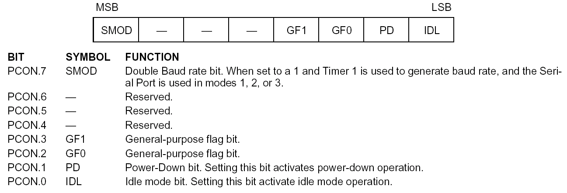
Power control register

Slide 2
Power control
A standard for applications where power consumption is critical
two power reducing modes
Idle
Power down

Slide 3
Idle mode
An instruction that sets PCON.0 causes Idle mode
Last instruction executed before going into the Idle mode
the internal CPU clock is gated off
the microcontroller turns off the greatest power consumer- CPU unit while peripheral units such as serial port, timers and interrupt system continue operating normally consuming 6.5mA.
In Idle mode, the state of all registers and I/O ports remains unchanged.
Interrupt, Timer, and Serial Port functions act normally.
All of registers , ports and internal RAM maintain their data during Idle
ALE and PSEN hold at logic high levels
Any interrupt
will cause PCON.0 to be cleared by HW (terminate Idle mode)
then execute ISR
with RETI return and execute next instruction after Idle instruction.
RST signal clears the IDL bit directly

Slide 4
Power-Down Mode
An instruction that sets PCON.1 causes power down mode
Last instruction executed before going into the power down mode
the on-chip oscillator is stopped.
thus turning off its internal oscillator and reduces power consumption enormously.
The microcontroller can operate using only 2V power supply in power- down mode, while a total power consumption is less than 40uA.
The only way to get the micro controller back to normal mode is by reset.
While the microcontroller is in Power Down mode, the state of all SFR registers and I/O ports remains unchanged.
all functions are stopped, the contents of the on-chip RAM and Special Function Registers are maintained.
The ALE and PSEN output are held low
The reset that terminates Power Down

Slide 5
8051
Interrupts

Slide 6
Interrupts Programming
An interrupt is an external or internal event that interrupts the microcontroller to inform it that a device needs its service.
Interrupts vs. Polling
A single microcontroller can serve several devices.
There are two ways to do that:
interrupts
polling.
The program which is associated with the interrupt is called the interrupt service routine (ISR) or interrupt handler.

Slide 7
Steps in executing an interrupt
Finish current instruction and saves the PC on stack.
Jumps to a fixed location in memory depend on type of interrupt
Starts to execute the interrupt service routine until RETI (return from interrupt)
Upon executing the RETI the microcontroller returns to the place where it was interrupted. Get pop PC from stack

Slide 8
Interrupt Sources
Original 8051 has 6 sources of interrupts
Reset
Timer 0 overflow
Timer 1 overflow
External Interrupt 0
External Interrupt 1
Serial Port events (buffer full, buffer empty, etc)
Enhanced version has 22 sources
More timers, programmable counter array, ADC, more external interrupts, another serial port (UART)

Slide 9
Interrupt Vectors
Each interrupt has a specific place in code memory where program execution (interrupt service routine) begins.
External Interrupt 0: 0003h
Timer 0 overflow: 000Bh
External Interrupt 1: 0013h
Timer 1 overflow: 001Bh
Serial : 0023h
Timer 2 overflow(8052+) 002bh
Note: that there are only 8 memory locations between vectors.

Slide 10
ISRs and Main Program in 8051
SJMP main
ORG 03H
ljmp int0sr
ORG 0BH
ljmp t0sr
ORG 13H
ljmp int1sr
ORG 1BH
ljmp t1sr
ORG 23H
ljmp serialsr
ORG 30H
main:
…
END

Slide 11
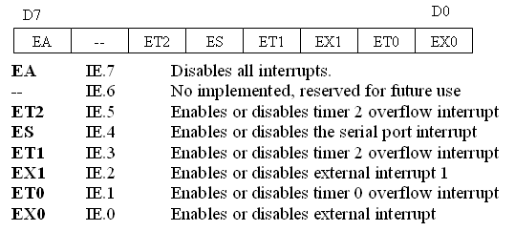
Interrupt Enable (IE) register
All interrupt are disabled after reset
We can enable and disable them bye IE

Slide 12
Enabling and disabling an interrupt
by bit operation
Recommended in the middle of program
SETB EA ;Enable All
SETB ET0 ;Enable Timer0 ovrf
SETB ET1 ;Enable Timer1 ovrf
SETB EX0 ;Enable INT0
SETB EX1 ;Enable INT1
SETB ES ;Enable Serial port
by mov instruction
Recommended in the first of program
MOV IE, #10010110B
SETB IE.7
SETB IE.1
SETB IE.3
SETB IE.0
SETB IE.2 SETB IE.4

Slide 13
Example
A 10khz square wave with 50% duty cycle
ORG 0 ;Reset entry poit
LJMP MAIN ;Jump above interrupt
ORG 000BH ;Timer 0 interrupt vector
T0ISR:CPL P1.0 ;Toggle port bit
RETI ;Return from ISR to Main program
ORG 0030H ;Main Program entry point
MAIN: MOV TMOD,#02H ;Timer 0, mode 2
MOV TH0,#-50 ;50 us delay
SETB TR0 ;Start timer
MOV IE,#82H ;Enable timer 0 interrupt
SJMP $ ;Do nothing just wait
END

Slide 14
Example
Write a program using interrupts to simultaneously create 7 kHz and 500 Hz square waves on P1.7 and P1.6.
8051
143μs
71μs
P1.7
2ms
P1.6
1ms

Slide 15
Solution
ORG 0
LJMP MAIN
ORG 000BH
LJMP T0ISR
ORG 001BH
LJMP T1ISR
ORG 0030H
MAIN: MOV TMOD,#12H
MOV TH0,#-71
SETB TR0
SETB TF1
MOV IE,#8AH
MOV IE,#8AH
SJMP $
T0ISR: CPL P1.7
RETI
T1ISR: CLR TR1
MOV TH1,#HIGH(-1000)
MOV TL1,#LOW(-1000)
SETB TR1
CPL P1.6
RETI
END
8051
143μs
71μs
P1.7
2ms
P1.6
1ms

Slide 16
Timer ISR
Notice that
There is no need for a “CLR TFx” instruction in timer ISR
8051 clears the TF internally upon jumping to ISR
Notice that
We must reload timer in mode 1
There is no need on mode 2 (timer auto reload)

Slide 17
External interrupt type control
By low nibble of Timer control register TCON
IE0 (IE1): External interrupt 0(1) edge flag.
set by CPU when external interrupt edge (H-to-L) is detected.
Does not affected by H-to-L while ISR is executed(no int on int)
Cleared by CPU when RETI executed.
does not latch low-level triggered interrupt
IT0 (IT1): interrupt 0 (1) type control bit.
Set/cleared by software
IT=1 edge trigger
IT=0 low-level trigger
(MSB)
(LSB)
TF1
TR1
TF0
TR0
IE1
IT1
IE0
IT0
Timer 1 Timer0
for Interrupt

Slide 18
External Interrupts
Level-triggered (default)
INT0
(Pin 3.2)
0
0003
12
IT0
IE0 (TCON.3)
Edge-triggered
Level-triggered (default)
INT0
(Pin 3.3)
0
0013
12
IT1
IE1 (TCON.3)
Edge-triggered

Slide 19
Example of external interuupt
ORG 0000H
LJMP MAIN
;
;interrupt service routine (ISR)
;for hardware external interrupt INT1
;
ORG 0013H
SETB P1.1
MOV R0,200
WAIT: DJNZ R0,WAIT
CLR P1.1
RETI
;
;main program for initialization
;
ORG 30H
MAIN: SETB IT1 ;on negative edge of INT1
MOV IE,#10000100B
WAIT2: SJMP WAIT2
END

Slide 20
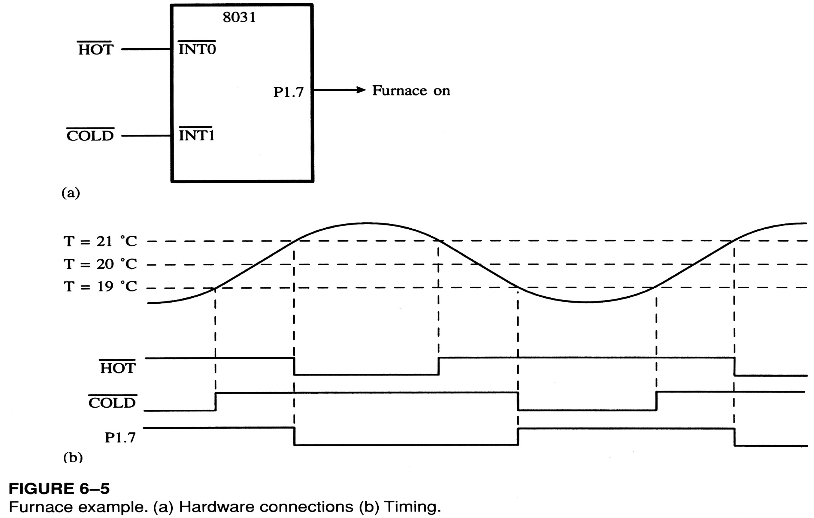
Example of external interuupt

Slide 21
Example of external interuupt
Org 0000h
Ljmp main
Org 0003h
x0isr: clr p1.7
Reti
Org 0013h
x1isr: setb p1.7
Reti
Org 0030h
Main: mov ie,#85h
Setb it0
Setb it1
Setb p1.7
Jb p3.2,skip
Clr p1.7
Skip: Sjmp $
end

Slide 22
Interrupt Priorities
What if two interrupt sources interrupt at the same time?
The interrupt with the highest PRIORITY gets serviced first.
All interrupts have a power on default priority order.
External interrupt 0 (INT0)
Timer interrupt0 (TF0)
External interrupt 1 (INT1)
Timer interrupt1 (TF1)
Serial communication (RI+TI)
Priority can also be set to “high” or “low” by IP reg.

Slide 23
Interrupt Priorities (IP) Register
---
---
PT2
PS
PT1
PX1
PT0
PX0
IP.7: reserved
IP.6: reserved
IP.5: timer 2 interrupt priority bit(8052 only)
IP.4: serial port interrupt priority bit
IP.3: timer 1 interrupt priority bit
IP.2: external interrupt 1 priority bit
IP.1: timer 0 interrupt priority bit
IP.0: external interrupt 0 priority bit

Slide 24
Interrupt Priorities Example
---
---
PT2
PS
PT1
PX1
PT0
PX0
MOV IP , #00000100B or SETB IP.2 gives priority order
Int1
Int0
Timer0
Timer1
Serial
MOV IP , #00001100B gives priority order
Int1
Timer1
Int0
Timer0
Serial
External interrupt 0 (INT0)
Timer interrupt0 (TF0)
External interrupt 1 (INT1)
Timer interrupt1 (TF1)
Serial communication (RI+TI)

Slide 25
Interrupt inside an interrupt
---
---
PT2
PS
PT1
PX1
PT0
PX0
A high-priority interrupt can interrupt a low-priority interrupy
All interrupt are latched internally
Low-priority interrupt wait until 8051 has finished servicing the high-priority interrupt

