Slide 1
8051 - Serial Communication

Slide 2
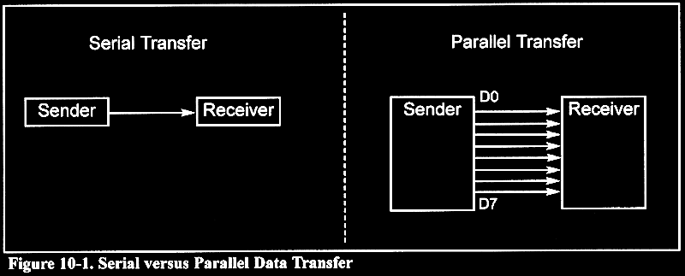
Basics of serial communication
Parallel: expensive - short distance – fast Serial :cheaper– long (two different cities by modem)-slow

Slide 3
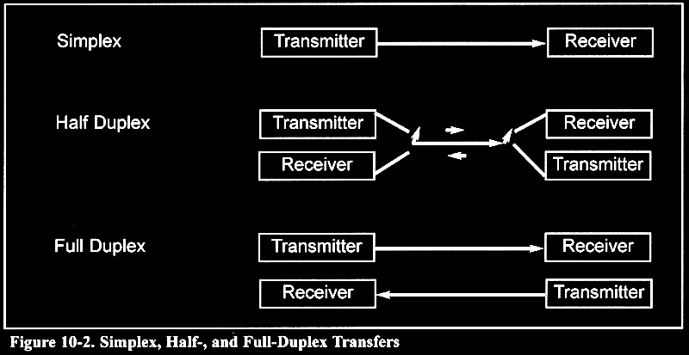
Basics of serial communication

Slide 4
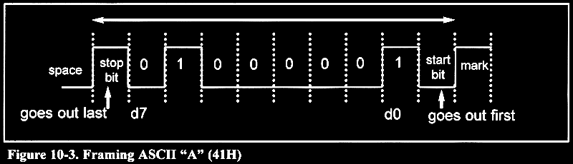
Start and stop bits
When there is no transfer the signal is high Transmission begins with a start (low) bit LSB first Finally 1 stop bit (high) Data transfer rate (baud rate) is stated in bps bps: bit per second

Slide 5
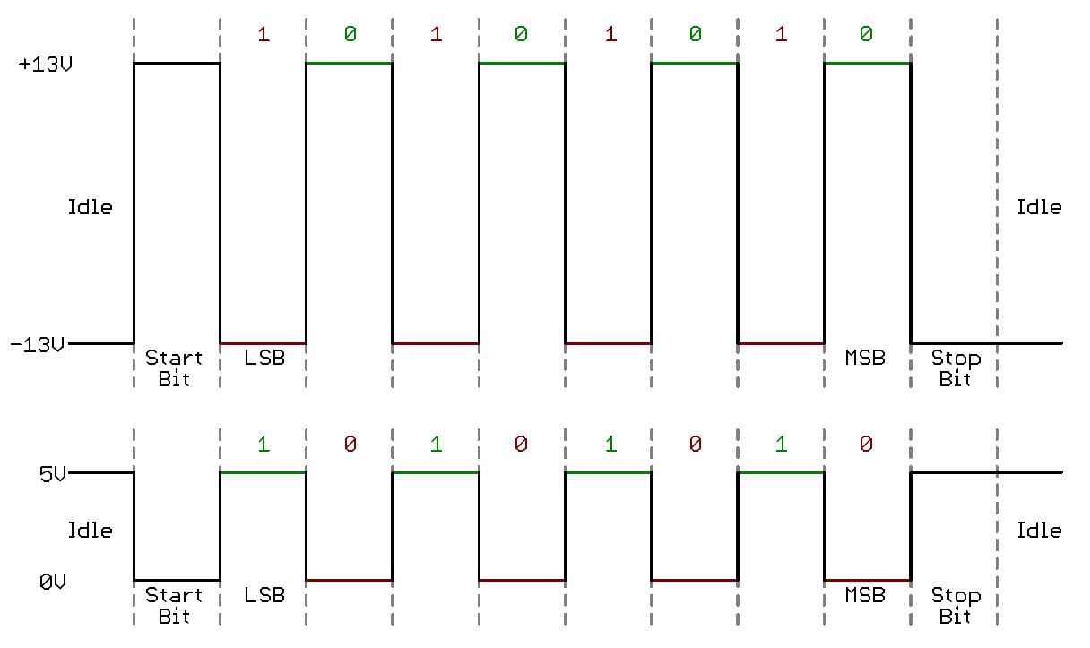
How to communicate 8051 to PC
Connect TXD to RXD and RXD to TXD from pc to 8051
Use max232 to transform signal from TTL level to RS232 level
The baud rate of the 8051 must matched the baud rate of the pc
PC standard baud rate
2400-4800-9600-14400-19200-28800-33600-57600
Serial mode 1 is used
Timer 1 is used
The 8051 UART divides the machine cycle frequency by 32
Machine cycle is 1/12 XTAL frequency
We use timer1 in mode 2 (auto reload)
See example 10-1
RS232 level signal
TTL logic signal

Slide 6
RxD and TxD pins in the 8051
TxD pin 11 of the 8051 (P3.1)
RxD pin 10 of the 8051 (P3.0)
SBUF register
MOV SBUF,#’D’ ;load SBUF=44H, ASCII for ‘D’
MOV SBUF,A ;copy accumulator into SBUF
MOV A,SBUF ;copy SBUF into accumulator

Slide 7
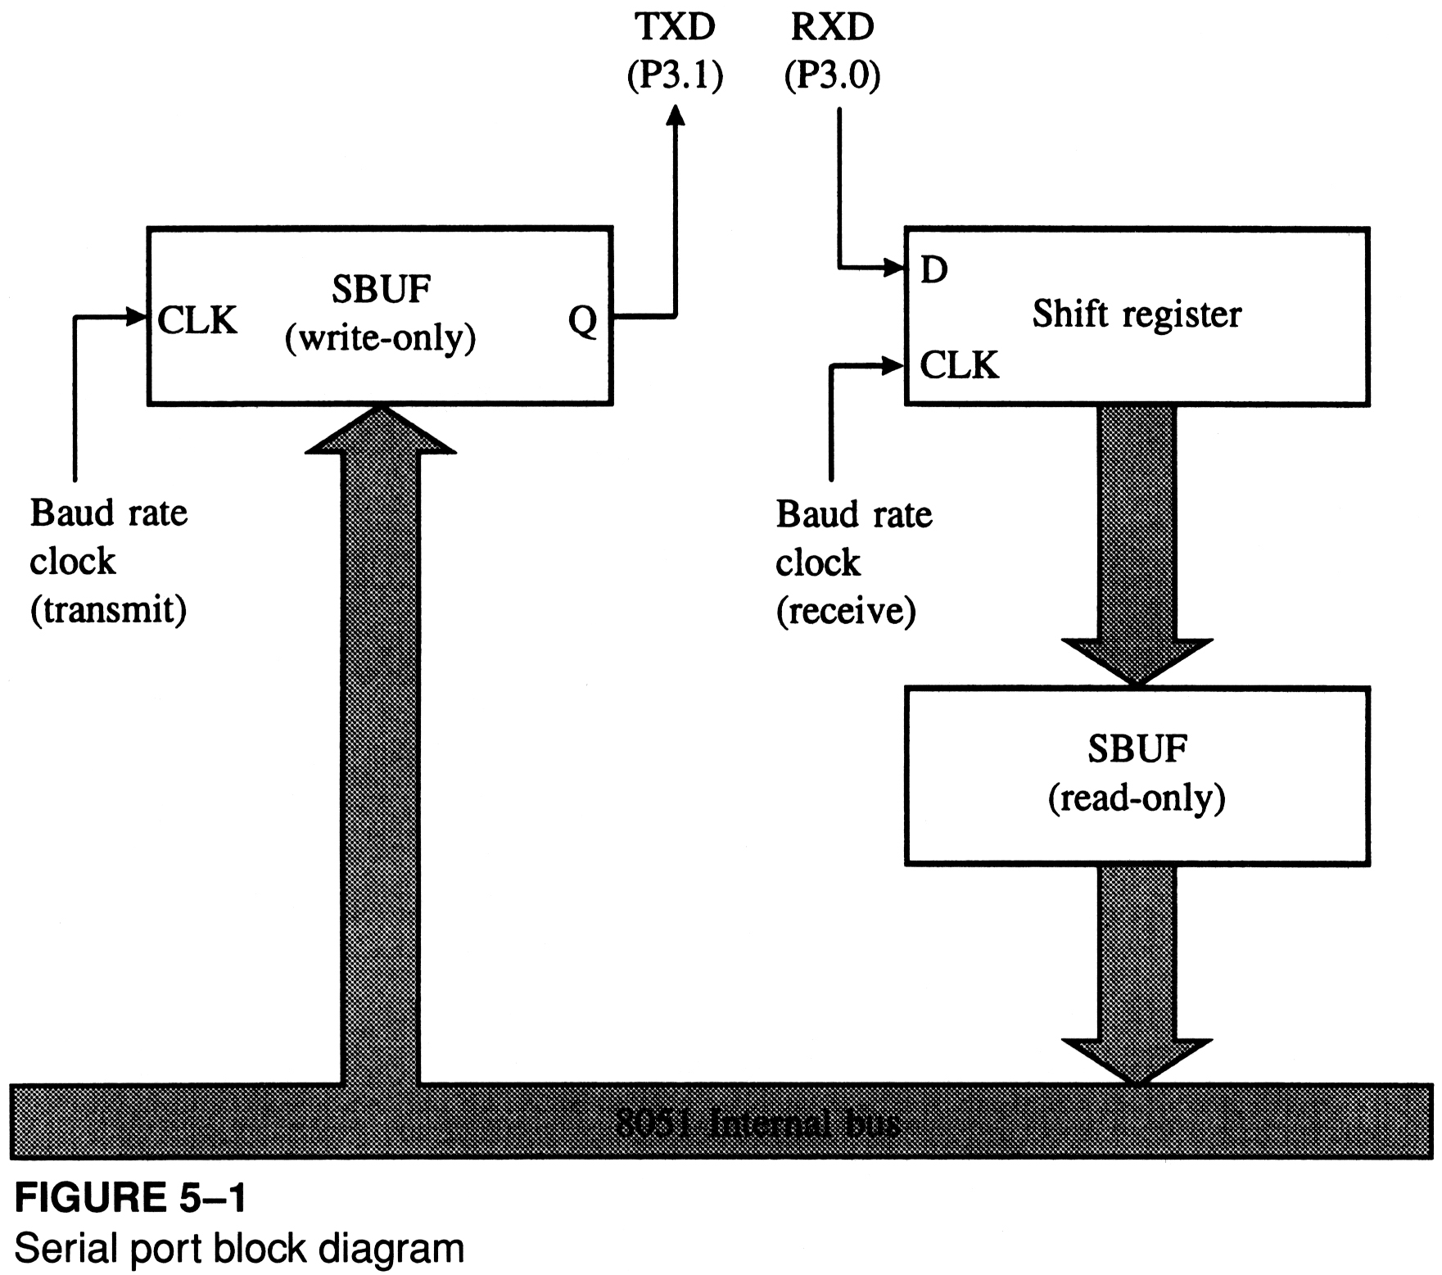
Serial port block diagram

Slide 8
Why 11.0592 MHz?
m/c frequency = 11.0592/12 = 921600 = 0.9216 MHz
UART frequency = 921600/32 = 28800 Hz
Timer overflow clock = 28800 Hz
Clock/3 = 28800/3 = 9600
Clock/6 = 28800/6 = 4800
Clock/12 = 28800/12 = 2400
m/c frequency = 12/12 = 1 MHz
UART frequency = 1000000/32 = 31250 Hz
Timer overflow clock = 31250 Hz
Clock/3 = 31250/3 =10416.66666
Clock/6 = 31250/6 = 5208.3333
2400-4800-9600-14400-19200-28800-33600-57600

Slide 9
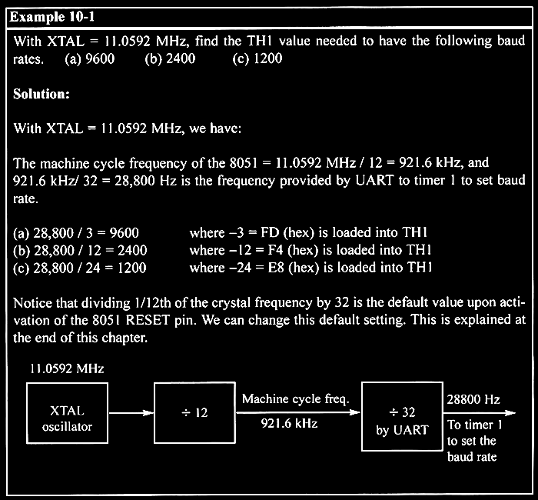

Slide 10
Sixteen’s complement-Representing signed decimal into Hex
The hexadecimal equivalent of two's complement in binary.
Generally, sixteen's complement hexadecimal is used as a "shorthand notation" for two's complement signed binary numbers,
To find the sixteen's complement hexadecimal value,
First convert the number to two's complement signed binary,
Then convert that binary value to hexadecimal.
For example: (-3)
2’s compliment of -3D
0000 0011 B (IGNORE SIGN)
1111 1100 (flip the bit and add 1)
1111 1101 (after adding 1)
Convert this into hex = FD
(-6) – 0000 0110 B
1111 1001 (flip the bits)
1111 1010 – FA
(-12) – 0000 1100 B
1111 0011 (add 1)
1111 0100 B= F4

Slide 11
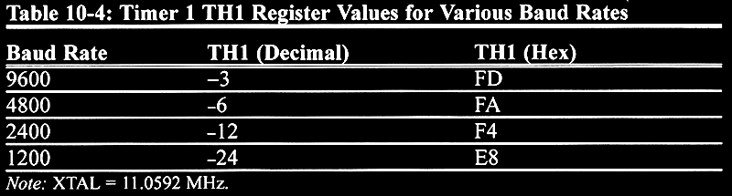
SMOD=0
SMOD=1
19200
9600
4800
2400
28800 TH1 = -2 FE

Slide 12
Serial control (SCON) Register
SM0
SM1
SM2
REN
TB8
RB8
TI
RI
SM0 (SCON.7) : mode specifier
SM1 (SCON.6) : mode specifier
SM2 (SCON.5) : used for multi processor communication
REN (SCON.4) : receive enable (by software enable/disable)
TB8 (SCON.3) : transmit bit8
RB8 (SCON.2) : receive bit 8
TI (SCON.1) : transmit interrupt flag set by HW clear by SW
RI (SCON.0) : receive interrupt flag set by HW clear by SW

Slide 13
SM0
SM1
SM2
REN
TB8
RB8
TI
RI
SCON
Bit | Symbol | Address | Description
7 | SM0 | 9FH | serial port mode bit 0
6 | SM1 | 9EH | serial port mode bit 1
5 | SM2 | 9DH | serial port mode bit 2 - will be dealt with at a later date
4 | REN | 9CH | receiver enable - this bit must be set to receive data
3 | TB8 | 9BH | transmit bit 8 - this is the ninth bit transmitted in the 9-bit UART modes
2 | RB8 | 9AH | receive bit 8 - this is the ninth bit received in the 9-bit UART modes
1 | TI | 99H | transmit interrupt flag - this bit is set by hardware when an entire byte has been transmitted - it must be cleared by software
0 | RI | 98H | receive interrupt flag - this bit is set by hardware when an entire byte has been received - it must be cleared by software

Slide 14
TI/RI BIT
MOV SBUF, #23H ; send the first byte down the serial line $ JNB TI, $ ; wait for the entire byte to be sent CLR TI ; the transmit interrupt flag is set by hardware but must be cleared by software MOV SBUF, #56H ; send the second byte down the serial line
RI BIT
$ JNB RI, $ ; wait for an entire byte to be received CLR RI ; the receive interrupt flag is set by hardware but must be cleared by software MOV A, SBUF ; move the data stored in the read-only buffer to the accumulator

Slide 15
Mode of operation
SM0 SM1 MODE operation transmit rate
0 0 0 shift register fixed (xtal/12)
0 1 1 8 bit UART variable (timer1)
1 0 2 9 bit UART fixed (xtal/32 or xtal/64)
1 1 3 9 bit UART variable (timer1)

Slide 16
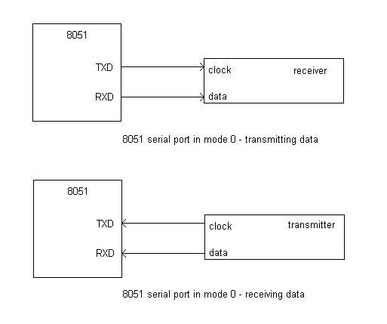
Mode of operation
Mode 0 :
Serial data enters and exits through RxD
TxD outputs the shift clock.
8 bits are transmitted/received(LSB first)
The baud rate is fixed a 1/12 the oscillator frequency.

Slide 17
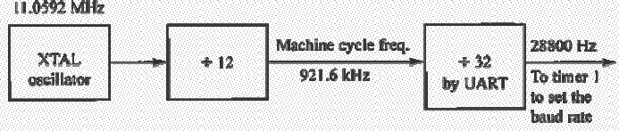
Mode of operation
Mode 1
Ten bits are transmitted (through TxD) or received (through RxD)
A start bit (0), 8 data bits (LSB first), and a stop bit (1)
On receive, the stop bit goes into RB8 in SCON
the baud rate is determined by the Timer 1 overflow rate.
Timer1 clock is 1/32 machine cycle (MC=1/12 XTAL)
Timer clock can be programmed as 1/16 of machine cycle
Transmission is initiated by any instruction that uses SBUF as a destination register.

Slide 18
In mode 1, the baud rate is determined by the overflow of timer 1.
However, since the timer operates at a relatively high frequency (compared to serial port baud rates) the timer 1 overflow frequency is divided by either 32 or 16, as shown in the diagram below.
On Reset SMOD is set to 0

Slide 19
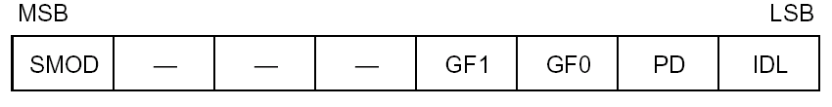
What is SMOD
Bit 7 of PCON register
If SMOD=1 double baud rate
PCON is not bit addressable
How to set SMOD
Mov a, pcon
Setb acc.7
Mov pcon,a

Slide 20
Why does SMOD exist?
The SMOD bit effectively doubles the baud rate by causing the timer 1 overflow frequency to be divided by 16 rather than 32.
But why would such a feature be required when we could double the baud rate by changing the value in TH1
One of the standard baud rates is 19200. To achieve this we calculate
TH1 = 256 - ((system frequency / (12 * 32)) / baud) TH1 = 256 - ((12MHz / (12 * 32)) / 19200) TH1 = 256 - 1.6 TH1 = 256 - 2 (rounding up => error of 0.4) TH1 = 254 a value for TH1 with a system frequency of 12MHz and SMOD = 0.
However, if we set SMOD the calculation becomes:
TH1 = 256 - ((system frequency / (12 * 16)) / baud) TH1 = 256 - ((12MHz / (12 * 16)) / 19200) TH1 = 256 - 3.25 TH1 = 256 - 3 (rounding down => error of 0.25) TH1 = 253
In the first case the error was 0.4 while in the second case, with SMOD set, the error was only 0.25. Therefore, when calculating the value for TH1 to obtain a particular baud rate we need to try both cases (SMOD = 0 and SMOD = 1) and then pick the case with the least error.

Slide 21
RB8
On Receive -
The stop bit is copied to RB8 in SCON.
The data in the shift register is moved (in parallel) into SBUF (read-only).
RI is set.
Why is the stop bit copied into RB8?
the programmer may first wish to test the stop bit to ensure it is a logic 1.
If the stop bit is not a logic 1 then something went wrong in the transmission of the data and the program can be written to ignore the erroneous data

Slide 22
CLR SM0 SETB SM1 ;clear SM0 and set SM1 to put the serial port in mode 1 MOV TMOD, #20H ;put timer 1 in mode 2 interval timing MOV TH1, #230 ;put the reload value in TH1 - this results in a baud rate of 1200 SETB TR1 ;start timer 1 MOV SBUF, A ;send data in the accumulator down the serial line

Slide 24
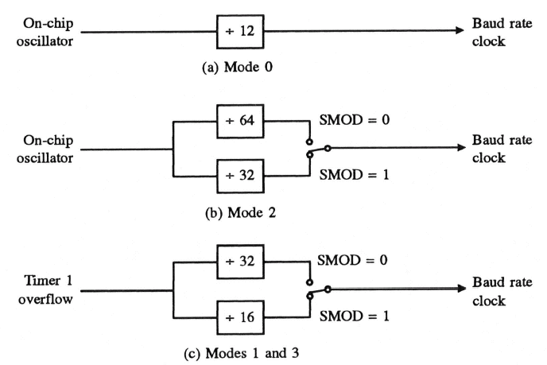
Mode of operation

Slide 25
Mode of operation
Mode 2 :
Eleven bits are transmitted (through TxD), received (through RxD)
A start bit (0)
8 data bits (LSB first)
A programmable 9th data bit
and a stop bit (1)
On transmit, the 9th bit (TB8) can be assigned 0 or 1.
On receive, the 9the data bit goes into RB8 in SCON.
the 9th can be parity bit
The baud rate is programmable to 1/32 or 1/64 the oscillator frequency in Mode 2 by SMOD bit in PCON register
Mode 3
Same as mode 2
But may have a variable baud rate generated from Timer 1.

Slide 26
Adding a Parity Bit to ASCII Data
If you look at the ASCII table you will notice the codes go from 0 to 7FH.
Only seven bits are needed to code the basic ASCII characters.
This leaves the 8th bit free - we can use this spare bit as a parity bit.
The 8051 maintains even parity with the accumulator, ie; the number of ones in the accumulator together with the parity bit (in the program status word) is always even
Before we send data, we can move it to the accumulator and then copy the parity bit into the accumulator MSB.
Now the data in the accumulator has an even number of ones.
Let's say we wish to transmit the character Q - by looking in the ASCII table we see the code for Q is 51H. If we move this to the accumulator its status, together with the parity bit will be as shown below
ACC | 0 | 1 | 0 | 1 | 0 | 0 | 0 | 1
P | 1

Slide 27
Adding parity bit
The code below shows how to transmit and receive ASCII characters with even parity.
MOV A, 30H ; move the ASCII character stored in location 30H to the ACC MOV C, P ;copy the parity bit to the carry bit MOV ACC.7, C ;then move it from the carry bit to the ACC MSB MOV SBUF, A ;transmit the character along with the parity bit down the serial line JNB TI, $ ; wait for the byte to be sent CLR TI

Slide 28
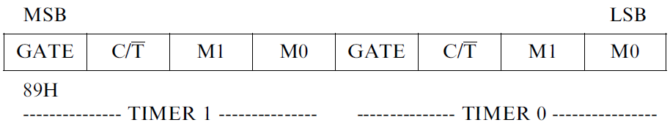
Serial example(1)
An example of sending a message.
;initialization
MOV TMOD,#20H
MOV TH1,#-12
MOV SCON,#50H
;begin to trnasmit
SETB TR1
AGAIN1: MOV A,#'B'
CALL TRANSS
MOV A,#'A'
CALL TRANSS
MOV A,#'L'
CALL TRANSS
MOV A,#'E'
CALL TRANSS
SJMP AGAIN1
;seial transmiting subroutine
TRANSS: MOV SBUF,A
AGAIN2: JNB TI,AGAIN2
CLR TI
RET
END
;-------------------------------------------------------------
; PROGRAM -1 TO TRANSFER "A" SERIALLY AT 4800 BAUD RATE
;-------------------------------------------------------------
MOV TMOD, #20H ; TIMER 1 MODE 2, BAUD RATE GENRATOR
MOV TH1, #-6 ; BAUD RATE 4800, -3 FOR 9600, -12 FOR 2400, -24 FOR 1200
MOV SCON, #50H ; SELECT MODE 1 - 8-BIT UART AND REN = 1, 0101 0000
SETB TR1 ; START TIMER 1
AGAIN: MOV SBUF, # "A" ; LOAD SBUF WITH "A"
HERE: JNB TI, HERE ;LOOK FOR TRANSMIT INT BIT,SET WHEN STOP BIT TRANSMITTED
CLR TI ; CLEAR BIT BY SOFTWARE
SJMP AGAIN ; REPEAT
END
SM0
SM1
SM2
REN
TB8
RB8
TI
RI

Slide 29
;--------------------
; PROGRAM TO READ DATA FROM UART1 AND TRANSFER - RECEIVE / TRANSMIT
;--------------------
MOV TMOD, #20H ; SET TIMER 1 IN 16 BIT TIMER MODE
MOV SCON, #40H ; INITIALIZE SERIAL COMMUNICATION
MOV TL0, #0FDH ;LOAD TIMER TO GENERATE BAUD RATE
MOV TH0, #0FDH
SETB TR1 ; START TIMER1
LOOP: SETB REN ; ENABLE RECEPTION
HERE: JNB RI,HERE ; WAIT UNTIL DATA IS RECEIVED
CLR RI ; CLEAR RECEIVE FLAG
MOV A, SBUF ;GET DATA INTO ACC
CLR REN ; DISABLE RECEPTION
MOV SBUF, A GET DATA INTO SBUF FOR TRANSMISSION
HERE1: JNB TI, HERE1 ; WAIT UNTIL DATA TRANSMITTED
CLR TI ; CLEAR FLAG TI
SJMP LOOP ;CONTINUE THE CYCLE
END
SM0
SM1
SM2
REN
TB8
RB8
TI
RI

Slide 30
;------------------------------------------------------------------
; PROGRAM 3 - TO RECEIVE BYTES OF DATA SERIALLY WITH BAUD RATE 4800
; 8-BIT DATA, 1 STOP BIT
;;------------------------------------------------------------------
MOV TMOD, #20H ; TIMER 1 MODE 2
MOV TH1, #-6
MOV SCON, #50H
SETB TR1
HERE: JNB RI, HERE ; LOOK FOR RI FLAG BIT, SET ON RECEIVE
MOV A, SBUF ; TRANSFER RECEVIED DATA IN A
MOV P1, A ; OUTPUT THE DATA TO PORT 1
CLR RI
MOV SBUF, A
HERE1: JNB TI, HERE1
CLR TI ; CLEAR FLAG
SJMP HERE ; LOOP
END
SM0
SM1
SM2
REN
TB8
RB8
TI
RI

Slide 31
;---------------------------------------------------------------
;PROGRAM - USING INTERRUPT
;---------------------------------------------------------------
ORG 0000H
LJMP MAIN
;jump to serial ISR
ORG 0023H
LJMP ISR
;main program
ORG 30H
MOV P1,#0FFH
MOV TMOD,#20H
MOV TH1,#-3
MOV SCON,#50H
MOV IE,#10010000B
SETB TR1
MAIN: MOV A, P1
MOV P2, A
MOV SBUF, A;
SJMP MAIN
ORG 100H
ISR: JB TI,TRANSM
MOV A,SBUF
mov P0,A
CLR RI
RETI
TRANSM: MOV A,P1
MOV SBUF,A
CLR TI
RETI
END

Slide 32
;-------------------------------------------------------------
; PROGRAM -1 TO TRANSFER "A" SERIALLY AT 4800 BAUD RATE
;-------------------------------------------------------------
;MOV TMOD, #20H; TIMER 1 MODE 2, BAUD RATE GENRATOR
;MOV TH1, #-6 ; BAUD RATE 4800, -3 FOR 9600, -12 FOR 2400, -24 FOR 1200
;MOV SCON, #50H ; SELECT MODE 1 - 8-BIT UART AND REN = 1, 0101 0000
;SETB TR1 ; START TIMER 1
;AGAIN: MOV SBUF, # "A" ; LOAD SBUF WITH "A"
;HERE: JNB TI, HERE ;LOOK FOR TRANSMIT INT BIT,SET WHEN STOP BIT TRANSMITTED
;CLR TI ; CLEAR BIT BY SOFTWARE
;SJMP AGAIN ; REPEAT
;END
SM0
SM1
SM2
REN
TB8
RB8
TI
RI

Slide 33
;---------------------------------------------------------------
;PROGRAM 2 PROGRAM TO TRANSFER "YES" SERIALLY AT BAUD RATE 9600
;---------------------------------------------------------------
;MOV TMOD, #20H ; TIMER 1 MODE 2
;MOV TH1, #-3
;MOV SCON, #50H
;SETB TR1
;AGAIN: MOV A, # "Y"
;ACALL TRANS
;MOV A, # "E"
;ACALL TRANS
;MOV A, # "S"
;ACALL TRANS
;MOV A, # "-"
;ACALL TRANS
;SJMP AGAIN
;TRANS: MOV SBUF, A
;HERE: JNB TI, HERE
;CLR TI
;RET
;END

Slide 34
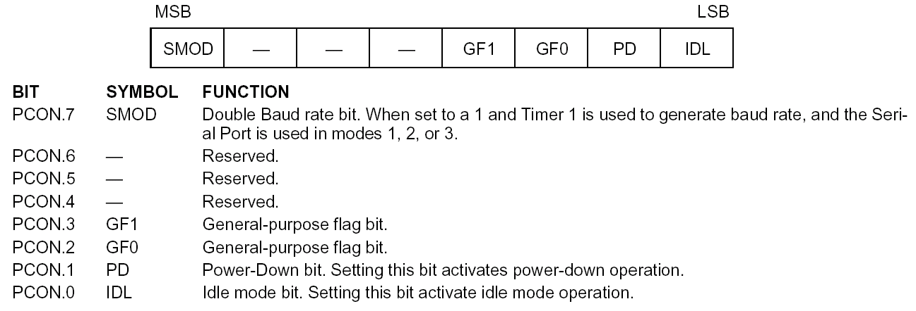
Power control register

Slide 35
Power control
A standard for applications where power consumption is critical
two power reducing modes
Idle
Power down

Slide 36
Idle mode
An instruction that sets PCON.0 causes Idle mode
Last instruction executed before going into the Idle mode
the internal CPU clock is gated off
Interrupt, Timer, and Serial Port functions act normally.
All of registers , ports and internal RAM maintain their data during Idle
ALE and PSEN hold at logic high levels
Any interrupt
will cause PCON.0 to be cleared by HW (terminate Idle mode)
then execute ISR
with RETI return and execute next instruction after Idle instruction.
RST signal clears the IDL bit directly

Slide 37
Power-Down Mode
An instruction that sets PCON.1 causes power down mode
Last instruction executed before going into the power down mode
the on-chip oscillator is stopped.
all functions are stopped, the contents of the on-chip RAM and Special Function Registers are maintained.
The ALE and PSEN output are held low
The reset that terminates Power Down

Slide 39
Serial example(2)
An example for serial port interrupt
ORG 0000H
LJMP MAIN
;jump to serial ISR
ORG 23H
LJMP ISR
;main program
ORG 30H
;1-initializtion
MAIN: MOV P0,#0FFH
MOV TMOD,#20H
MOV TH1,#-13
MOV SCON,#50H
MOV IE,#90H
;2-begin
SETB TR1
AGAIN: MOV A,P0
MOV P1,A
SJMP AGAIN
;
;ISR for reading from serial port
ISR: PUSH ACC
JB TI,TRANSM
MOV A,SBUF
MOV P2,A
CLR RI
SJMP ISREND
TRANSM: CLR TI
ISREND: POP ACC
RETI
END

Slide 40
Serial example(3)
an example for serial port interrupt
;for transmitting
ORG 0000H
LJMP MAIN
;jump to serial ISR
ORG 23H
LJMP ISR
;main program
ORG 30H
;initializtion
MAIN: MOV P0,#0FFH
MOV TMOD,#20H
MOV TH1,#-13
MOV SCON,#50H
MOV IE,#90H
;2-begin
SETB TR1
AGAIN: SJMP AGAIN
;ISR for receive from serial to p0
;transmitting to serial from p1
ISR: JB TI,TRANSM
MOV A,SBUF
mov P0,A
CLR RI
RETI
TRANSM: MOV A,P1
MOV SBUF,A
CLR TI
RETI
END

Slide 41
Serial example(4)
ORG 0000
;Initialize serial port & timer
INIT: MOV SCON,#52H ;Serial port mode 1
MOV TMOD,#20H ;Timer 1, mode 2
MOV TH1,#-13 ;Reload count for 2400 baud
SETB TR1 ;Start timer 1
;move character 'B' to accumulator for transmitting
MOV A,#'B'
;Transmit characters by serial port
OUTCHR: MOV C,P ;Put parity bit in C flag
CPL C ;Change to odd parity
MOV ACC.7,C ;Add to character code
AGAIN: JNB TI,AGAIN ;Buffer empty? no:check again
CLR TI ;Yes:clear falg and
MOV SBUF,A ;send character
CLR ACC.7 ;Strip off parity bit
JMP $
END

Slide 42
Power control register

Slide 43
Power control
A standard for applications where power consumption is critical
two power reducing modes
Idle
Power down

Slide 44
Idle mode
An instruction that sets PCON.0 causes Idle mode
Last instruction executed before going into the Idle mode
the internal CPU clock is gated off
Interrupt, Timer, and Serial Port functions act normally.
All of registers , ports and internal RAM maintain their data during Idle
ALE and PSEN hold at logic high levels
Any interrupt
will cause PCON.0 to be cleared by HW (terminate Idle mode)
then execute ISR
with RETI return and execute next instruction after Idle instruction.
RST signal clears the IDL bit directly

Slide 45
Power-Down Mode
An instruction that sets PCON.1 causes power dowm mode
Last instruction executed before going into the power down mode
the on-chip oscillator is stopped.
all functions are stopped,the contents of the on-chip RAM and Special Function Registers are maintained.
The ALE and PSEN output are held low
The reset that terminates Power Down

Slide 46
Power control example
Org 0000h
Ljmp main
Org 0003h
Orl pcon,#02h ;power down mode
Reti
Org 0030h
Main:
……
……
……
Orl pcon,#01h ;Idle mode
end

Slide 47
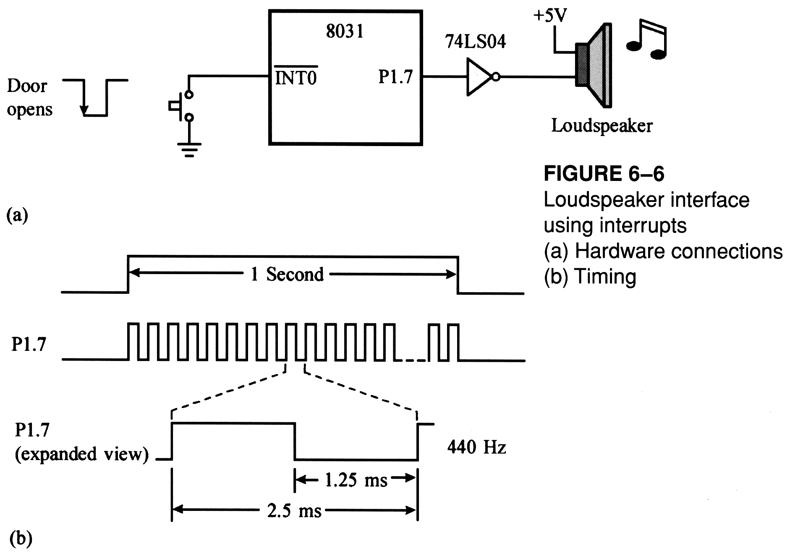
example

Slide 75
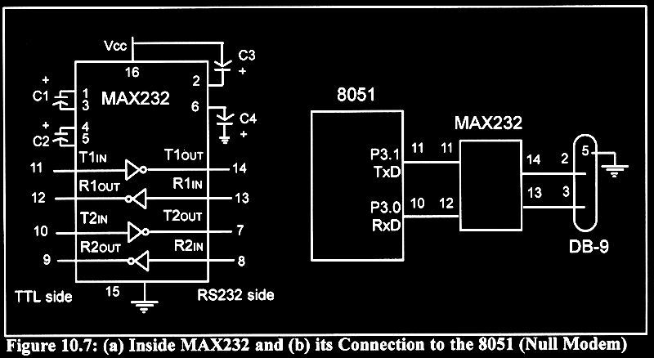
MAX232

