Slide 1
DAY 2 : Hands-On IoT Training
Pre-requisites :
Register FREE with FRED : https://fred.sensetecnic.com/
Register FREE with Dioty : http://www.dioty.co/
Register FREE with TTN : https://www.thethingsnetwork.org/

Slide 2
My background - Zaki
Sekolah Sultan Mohamad Jiwa, Sg. Petani, Kedah. (88-92)
B.Eng (Hons) Electronics & Electrical Engineering, University of Salford, UK.
Prestigious Discovery Sdn Bhd, KL (1998-1999) – Firmware Engineer
Motorola Technology Sdn Bhd, Penang (1999-2009) – Firmware Architect
MIMOS Berhad (2009-Now) – Firmware/Product Architect
Holds 11 patents (2 granted, 9 filed – Author and Co-Author)

Slide 3

A brief history of SCADA
What is SCADA
Stands for Supervisory, Control and Data Acquisition
Famous is 1960s
It works like a supervisor who supervises and control the entire plant area.
SCADA is not a 100% controller. It is just a software which has to be linked with controllers. Ultimately it is to be connected to PLC / RTU systems which in turn are connected to field instruments.

Slide 4
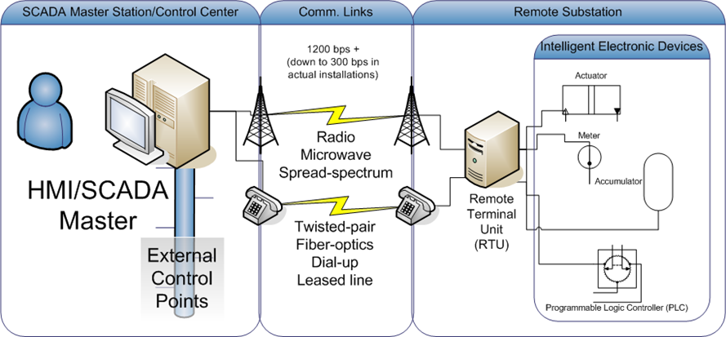
Building blocks of a SCADA system

Slide 5
SCADA vs IoT
SCADA and IoT could share the same meaning, maybe some parameters differ them, in my opinion :
IoT extends SCADA usage in terms of analytics and prediction.
Data Collection - IoT is much more related to long time data storage for analysis and comparison with different solutions than to the day-by-day operation of the plant which is the main SCADA usage.
Traditional SCADA normally is a closed system, no worry about external attack.

Slide 6
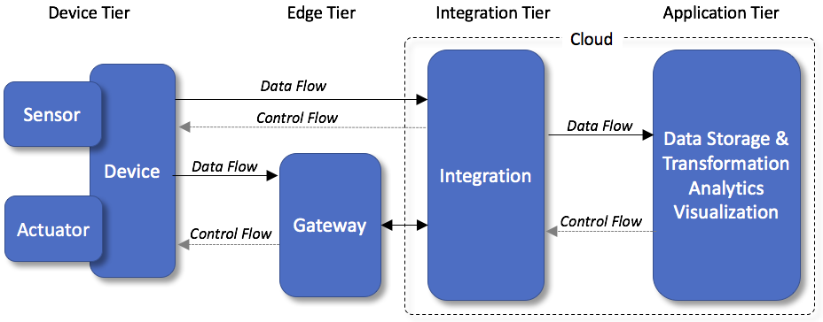
IoT building blocks
Full-Stack Engineer / Developer
(Expertise in all segments)

Slide 7

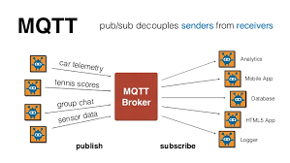
Some basics for IoT – we will use this
JSON
JSON is not a protocol, but an encoding format
Used widely in IoT
MQTT
A lightweight messaging protocol for small sensors and mobile devices, optimized for high-latency or unreliable networks
Client – Server - Client
Publish – Broker – Subscribe
Needs a Topic

Slide 8
JSON vs XML Example
JSON Example | XML
{"employees":[ { "firstName":"John", "lastName":"Doe" }, { "firstName":"Anna", "lastName":"Smith" }, { "firstName":"Peter", "lastName":"Jones" } ]} | <employees> <employee> <firstName>John</firstName> <lastName>Doe</lastName> </employee> <employee> <firstName>Anna</firstName> <lastName>Smith</lastName> </employee> <employee> <firstName>Peter</firstName> <lastName>Jones</lastName> </employee> </employees>
Note :
- XML has to be parsed with an XML parser. JSON can be parsed by a standard JavaScript function.
- XML is much more difficult to parse than JSON. - JSON is parsed into a ready-to-use JavaScript object.

Slide 9
MQTT
Message Queuing Telemetry Transport is an ISO standard (ISO/IEC PRF 20922)[2] publish-subscribe-based messaging protocol.
It works on top of the TCP/IP protocol.
It is designed for connections with remote locations where a "small code footprint" is required or the network bandwidth is limited.
The publish-subscribe messaging pattern requires a message broker.
FREE, open source Mosquitto MQTT. You can install on your PC
Cloud-based MQTT broker also available, example is Dioty, HiveMQ, CloudMQTT

Slide 10
MQTT (continue)
Register FREE with DIOTY
http://www.dioty.co/
The password will be sent to your email
Register now so that we can proceed to the next exciting exercise

Slide 11
IoT – the sequence of thoughts
Hardware and sensor
Make sure you can get the sensor data locally
Push the data to the cloud :
Why?.... Because we can access it anywhere
Where? …. Any cloud-based MQTT broker
Get the data and manipulate it :
How?.... Use MQTT subscriber
Manipulate?.... Yes, using tools, example is Node-Red

Slide 12
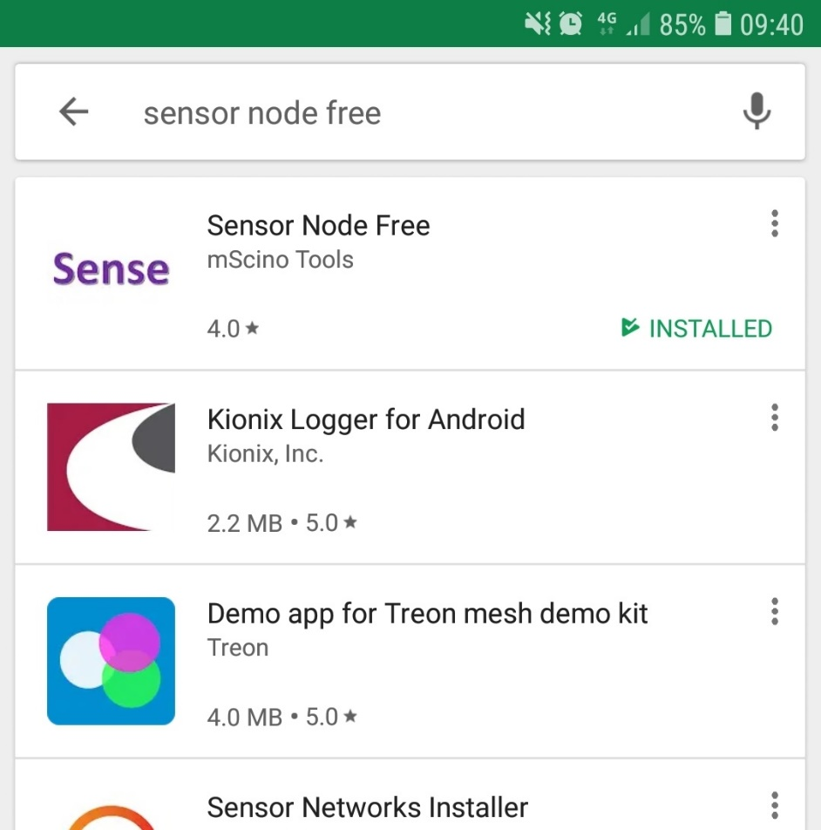
Hardware and Sensor
Our closest friend : Handphone. This App is for Android only.

Slide 13
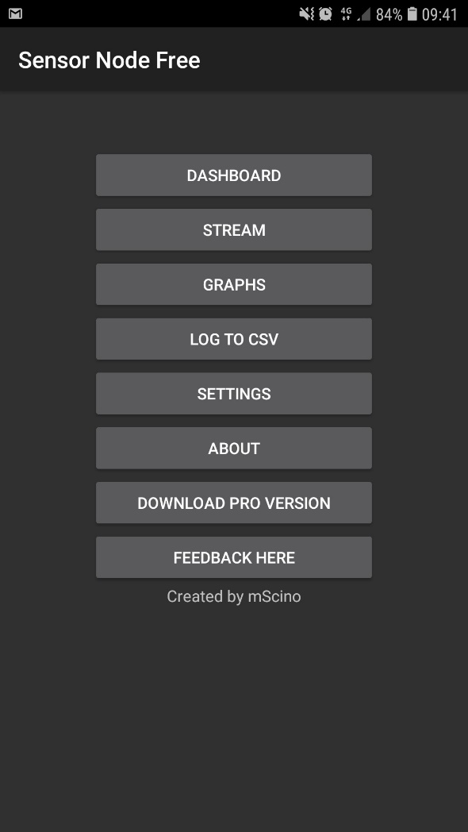
Step 1: Open the App

Slide 14
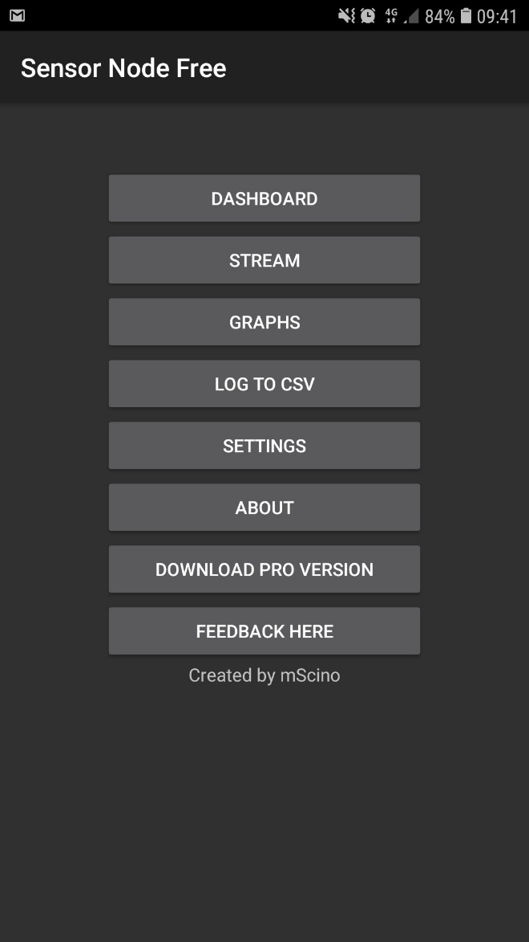
Step 2: See the dashboard
Click at Dashboard

Slide 15
Make sure you can get the sensor data locally
In the dashboard, you can see all your phone’s sensors in action
It means you are now already have the sensor data…

Slide 16
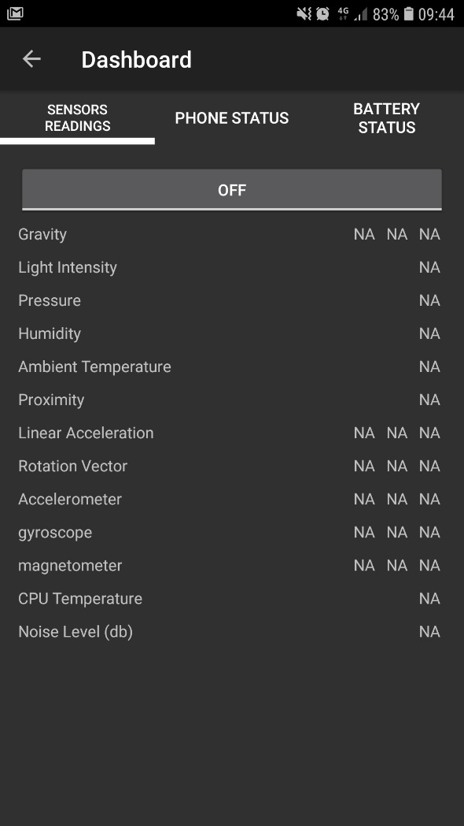
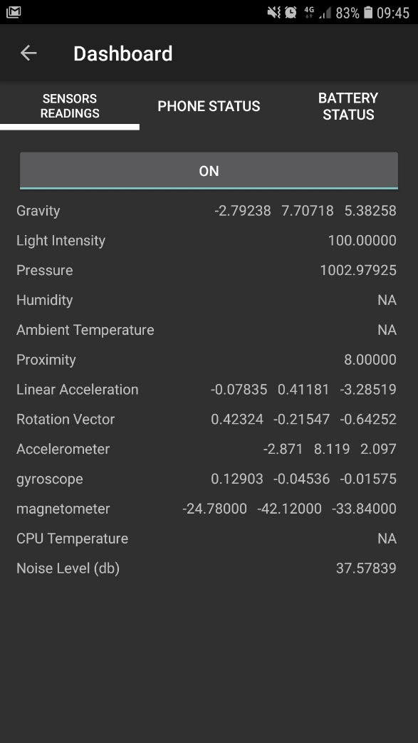
Step 2 : See the dashboard (continue)
Toggle OFF to ON

Slide 17
Push the data to cloud
Release the data
Let it go somewhere other than just trapped inside your phone
We will use MQTT service to do the work
Select any sensors you like to publish

Slide 18

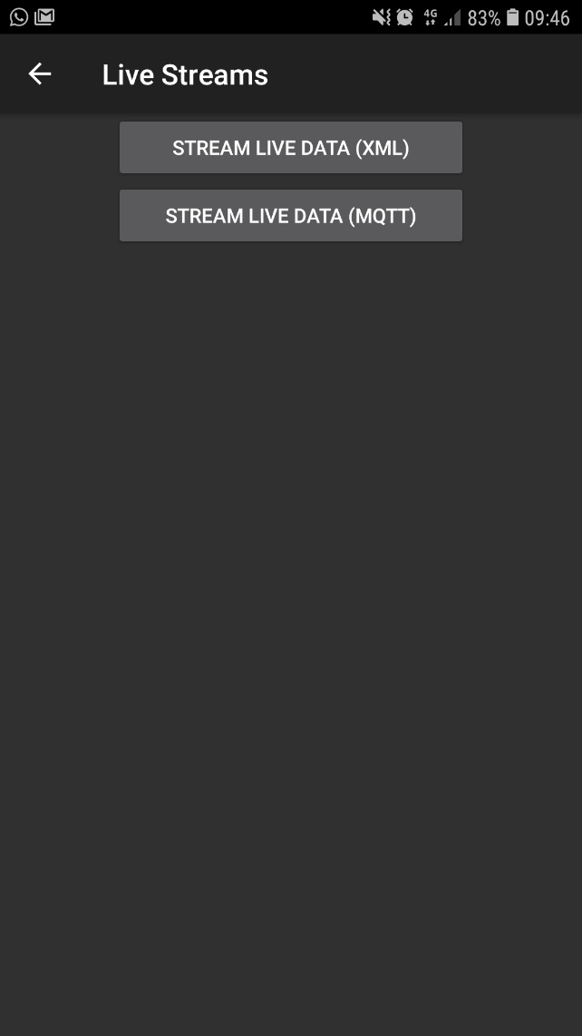
Step 3 : Stream it !
Click at “Stream”

Slide 19
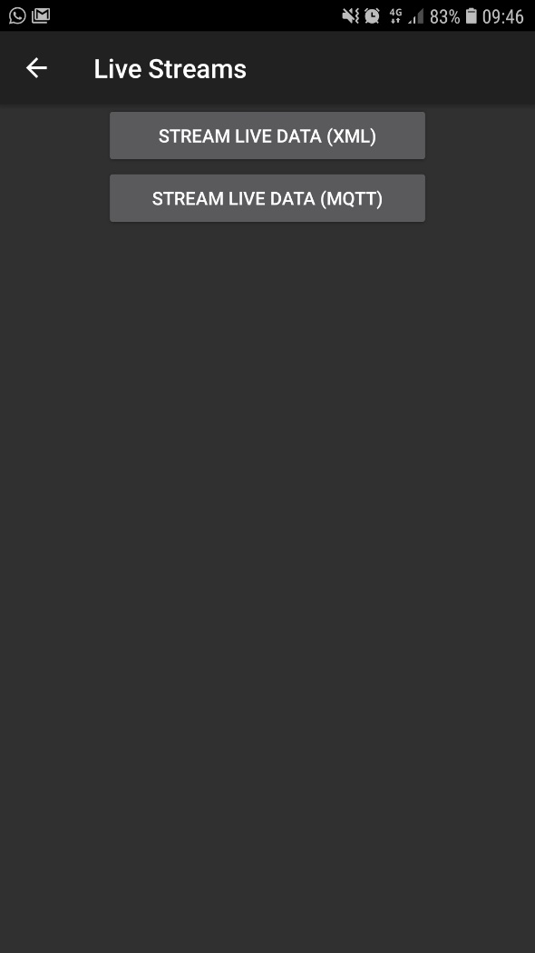
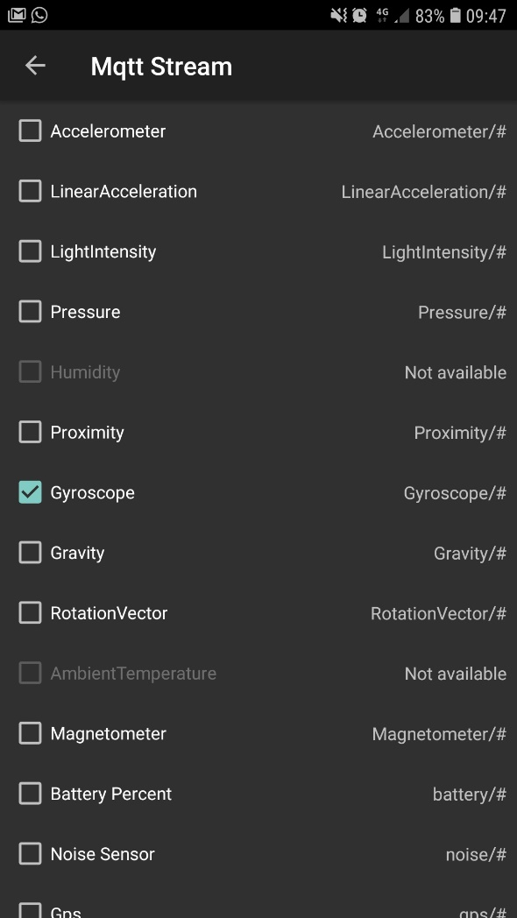
Step 3: Stream It ! (continue)
Click at MQTT stream

Slide 20
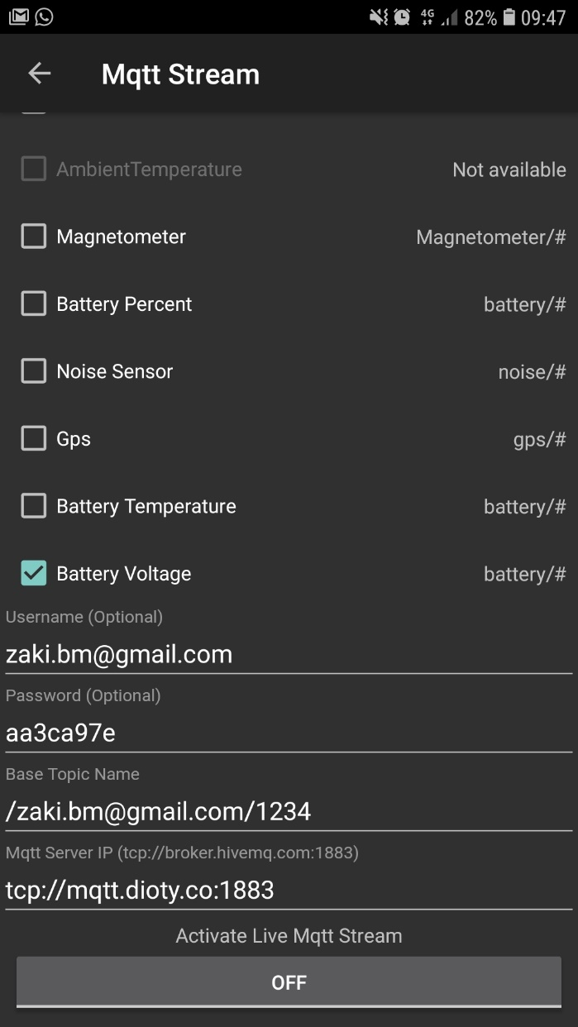
Step 4: Fill in MQTT info
Scroll down at the same screen

Slide 21
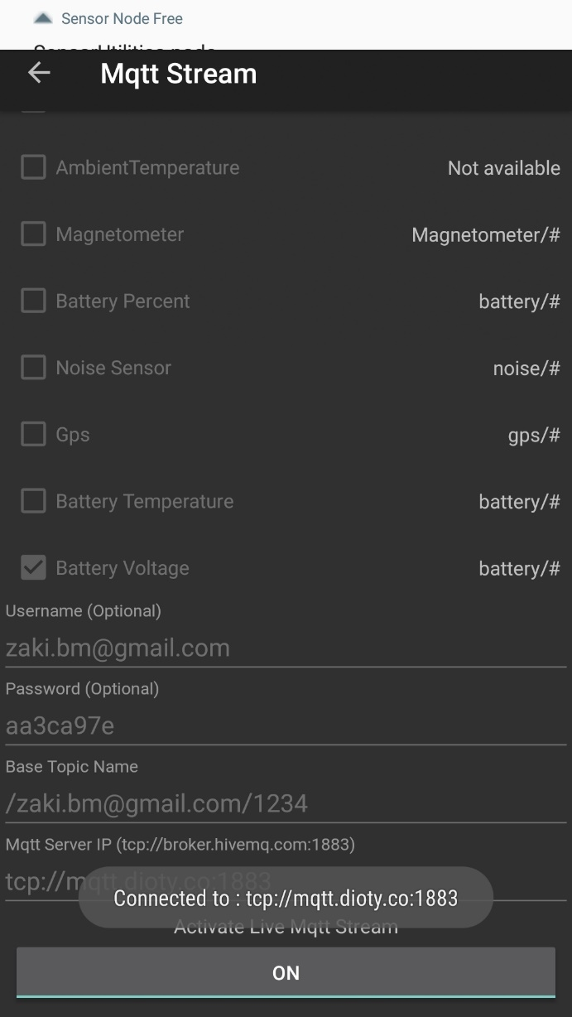
Step 4 : Press ON to publish the data
Data is now sent to DioTY MQTT broker

Slide 22
Get the data and manipulate it
Subscribe to the data
Need to use MQTT subscriber software
Once you get the data, pass it to your SW Tool.
Show chart of the data history
Automate action
Send to analytics module
Example of SW Tool to do manipulation : Node-Red (open source)

Slide 23
Sensor Node Source Code - sequence
Header Files Needed | Instantiation | MQTT & WiFi info | MQTT connection
#include "DHT.h" #include "WiFiEsp.h" #include <PubSubClient.h> #include <stdio.h> #include <stdlib.h> #include <string.h> #include <ArduinoJson.h> | DHT dht; WiFiEspClient client; PubSubClient mqttClient(client); | const char* server = "mqtt.dioty.co"; char ssid[] = “wifiSSID"; char pass[] = “wifiPasswd"; | if (mqttClient.connect(NULL, “user@name", “passwd")) { Serial.println("connected");
Read VCC | Read T&H | Format as JSON | Send to Cloud
averageVcc = averageVcc + (float) readVcc(); int16_t averageVccInt = round(averageVcc); dtostrf( averageVccInt, 3, 2, temp ); | dtostrf( dht.getHumidity(), 3, 2, temp2 ); dtostrf( dht.getTemperature(), 3, 2, temp3 ); | root["Voltage"] = temp; root["Humidity"] = temp2; root["Temperature"] = temp3; root.printTo(msg); | mqttClient.publish("/zaki.bm@gmail.com/1234", msg);

Slide 24
See if the data goes to Cloud Server

Slide 25
Did MQTT broker receive the data?
I assume Dioty (MQTT broker) received the Data we just sent.
Can check, go to Dioty.co

Slide 26
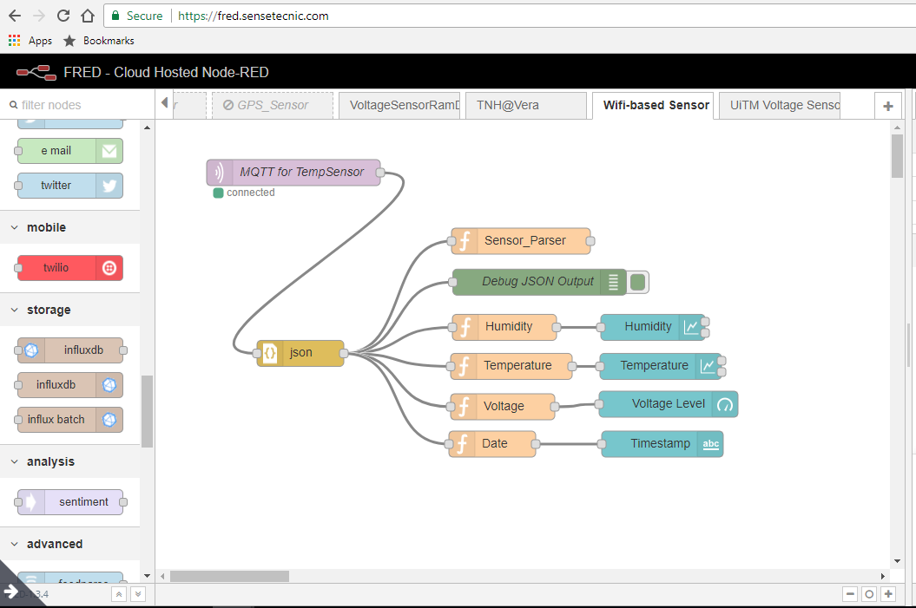
Node-Red as a middleware
MQTT Client. We get the data from Dioty.co
Dashboard setup. We put the data in dashboard style that we want
Logic Processing using Javascript

Slide 27
What is Node Red ?
Node-RED is a programming tool for wiring together hardware devices, APIs and online services in new and interesting ways.
It provides a browser-based editor that makes it easy to wire together flows using the wide range of nodes in the palette that can be deployed to its runtime in a single-click.

Slide 28
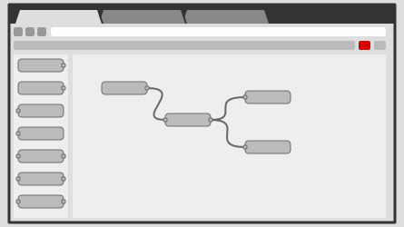
Browser-based flow editing
Node-RED provides a browser-based flow editor that makes it easy to wire together flows using the wide range of nodes in the palette. Flows can be then deployed to the runtime in a single-click.
JavaScript functions can be created within the editor using a rich text editor.
A built-in library allows you to save useful functions, templates or flows for re-use.

Slide 29
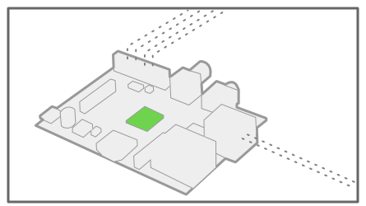
Built on Node.js
The light-weight runtime is built on Node.js, taking full advantage of its event-driven, non-blocking model. This makes it ideal to run at the edge of the network on low-cost hardware such as the Raspberry Pi as well as in the cloud.
With over 225,000 modules in Node's package repository, it is easy to extend the range of palette nodes to add new capabilities.

Slide 30
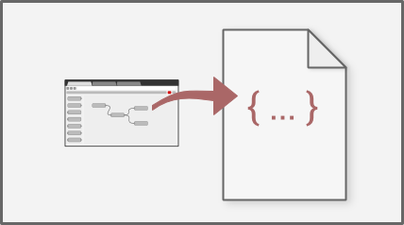
Social Development
The flows created in Node-RED are stored using JSON which can be easily imported and exported for sharing with others.
An online flow library allows you to share your best flows with the world.

Slide 31
FRED – online Node Red
Now, for Node-Red, you can choose to install it on your PC or just use the cloud-based.
Cloud-based is at https://fred.sensetecnic.com/
Node-RED provides a browser-based flow editor, which can be used to create JavaScript functions. The runtime is built on Node.js. The flows created in Node-RED are stored using JSON.
Front End for Node-RED (FRED) manages instances of Node-RED for multiple users in the cloud. To instantly create your own Node-RED instance, register for a free (limited) account, or check out the pricing for hosting your instance of Node-RED.

Slide 32
FRED example
Make sure you have your FRED running, add a New Flow
https://github.com/orenonline/LoRaWAN_WiFi_IoT_Training/
Click at “FRED_Diagram_WiFi”
Click at “SensorNode.txt”
Click at “Raw”
Copy the whole text
Now go to your New Flow page, select Import->Clipboard
Position it nicely on the page

Slide 33
Edit FRED node
Each items in the FRED is called a “node”
If you do a copy and paste, all logics are copied and pasted
But credentials are not copied and pasted.
Double-click at “MQTT for TempSensor” node
Double-click at “MyDioty MQTT Broker” node
Click at the small pencil
Click at the Security Tab
Fill in the Username and Password.
Can be found at my github : click here : UnPwd_WiFi_Node
Click “Deploy”

Slide 34
See the Debug and Dashboard
On the right hand side, click at the Debug tab
You can see the incoming data
For Dashboard, you can click at the Dashboard tab
All the dashboard item has been populated
All you need is just to press the small arrow underneath the Dashboard tab

Slide 35
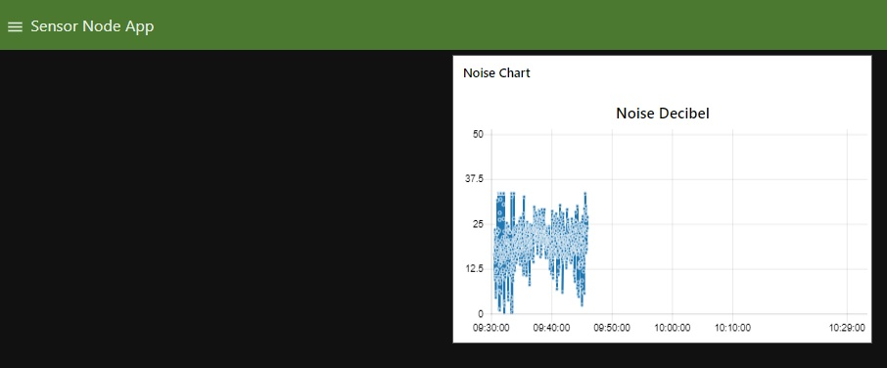
The Visualization

Slide 36
WiFi-based Sensor Node

Slide 37
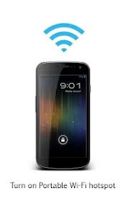
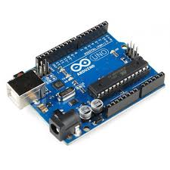
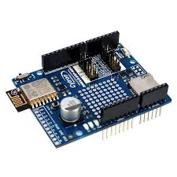
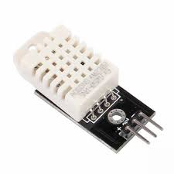






Voltage, T&H Sensor - IoT using WiFi
50m
JSON Format
MQTT Client + Logic Process + Dashboard

Slide 38
Sensor Node Source Code
In my github repository :
https://github.com/orenonline/LoRaWAN_WiFi_IoT_Training
Libraries :
PubSubClient : https://github.com/knolleary/pubsubclient
WiFiESP : https://github.com/bportaluri/WiFiEsp

Slide 39
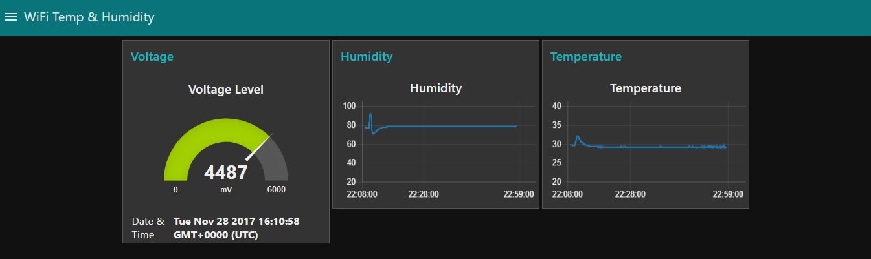
The dashboard generated

Slide 40
LoRaWAN-based Sensor Node

Slide 41



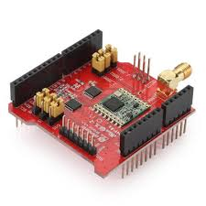



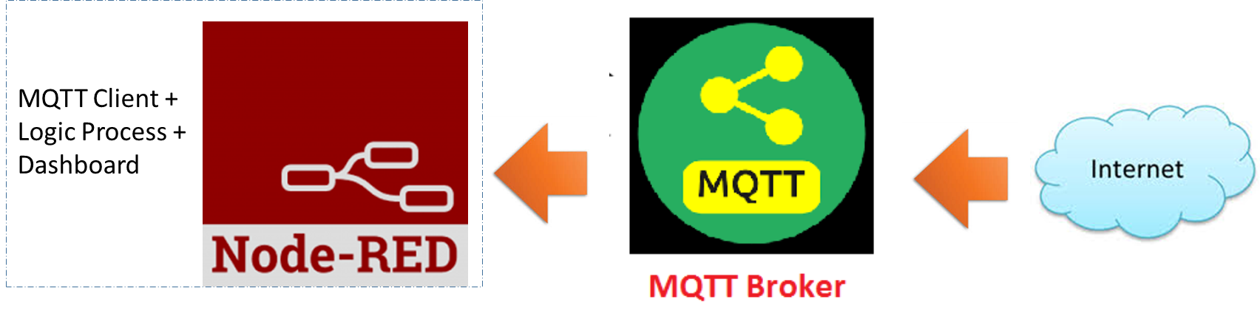
LoRaWAN IoT Example
LoRaWAN Gateway
10km
JSON Format
Using UDP
LoRaWAN Protocol
MQTT Protocol
TTN Server

Slide 42
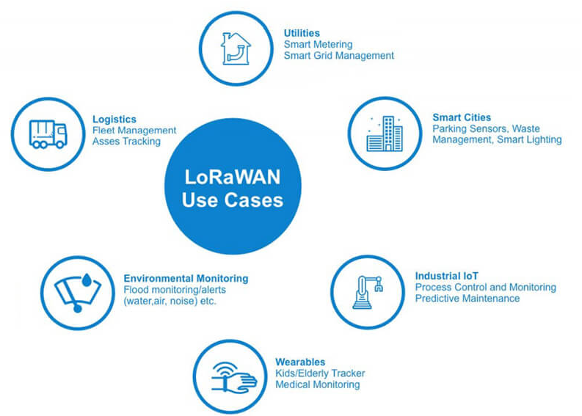
LoRaWAN use cases

Slide 43
Gateway for LoRaWAN
For LoRaWAN, you will need a LoRaWAN-compliant Gateway in order for your sensor data gets through to the Cloud Server.
A fully compliant-LoRaWAN gateway must have a mandatory 8 channels LoRaWAN frequencies.
Normally, one Gateway can cover a distance of 15km radius in an open space environment.

Slide 44
Source Code for LoRaWAN node
https://github.com/orenonline/LoRaWAN_WiFi_IoT_Training/blob/master/Arduino_LoRaWAN_IoT_Demo.ino
You will need to install the library needed first, link as below :
https://github.com/orenonline/arduino-lmic-as923
Compile and flash inside the Arduino

Slide 45
See if the data goes to Cloud Server

Slide 46
LoRaWAN Server
We will use TheThingsNetwork (TTN) as our LoRaWAN server.
We can see from here if the data arrives.

Slide 47
Pass the data to middleware

Slide 48
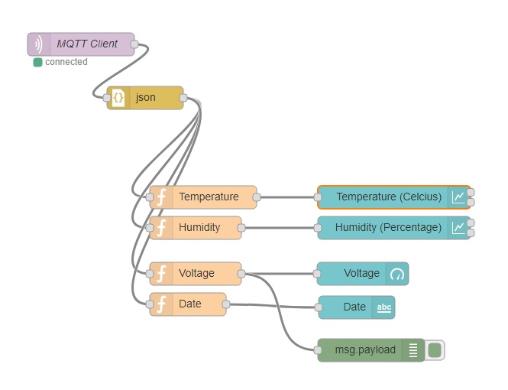
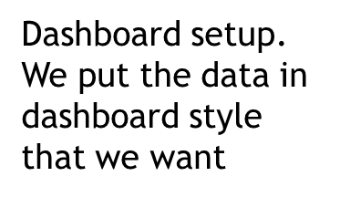
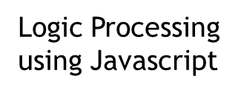
Node-Red for LoRaWAN sensor
MQTT client. Subscribes with TTN’s MQTT Server to get Data

Slide 49
FRED example
Make sure you have your FRED running, add a New Flow
https://github.com/orenonline/LoRaWAN_WiFi_IoT_Training/
Click at “FRED_Diagram_LoRaWAN”
Click at “Raw”
Copy the whole text
Now go to your New Flow page, select Import->Clipboard
Position it nicely on the page

Slide 50
Edit FRED node
Each items in the FRED is called a “node”
If you do a copy and paste, all logics are copied and pasted
But credentials are not copied and pasted.
Double-click at “MQTT Client” node
Click at the small pencil
Click at the Security Tab
Fill in the Username and Password.
Can be found at my github : click here : UnPwd_LoRaWAN_Node

Slide 51
See the Debug and Dashboard
On the right hand side, click at the Debug tab
You can see the incoming data
For Dashboard, you can click at the Dashboard tab
All the dashboard item has been populated
All you need is just to press the small arrow underneath the Dashboard tab

Slide 52
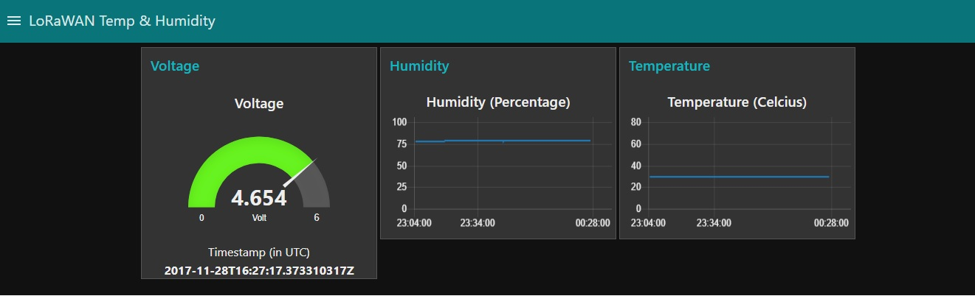
Dashboard - can be designed to come out with the same look and feel

