Slide 1
BISONIAM Astronomia

Slide 2
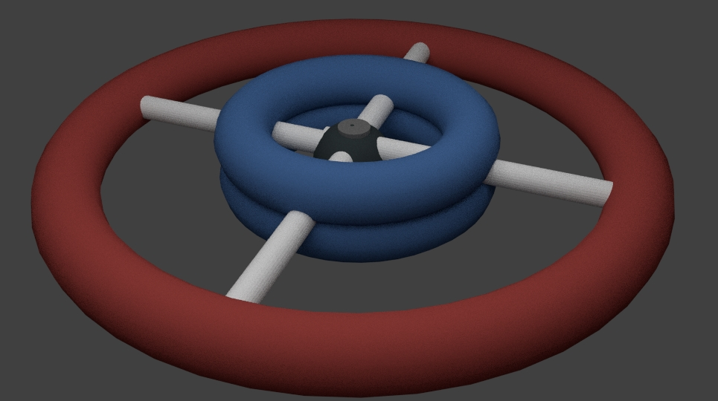
STRUCTURAL DESIGN

Slide 3
Materials
Material | Source | Product | Usage
Silica | Moon regolith | Silicon Nitride and Silicon Carbide | Base Mesh, Radiation Protection
Ammonia | Urine purification | Silicon Nitride | Radiation Protection
Alumina | From Moon regolith | Aluminum oxinitride. | Transparent hull, Radiation Protector
Carbon | Moon Regolith | Graphene, Silicon Cardbide | External Protection, Radiation protection
Titanium Di-oxide | Ilmenite (From Moon regolith) | Titanium Foam | Hull panelling

Slide 4
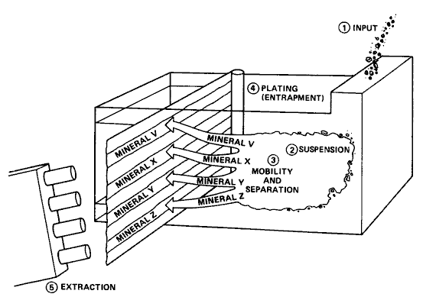
Machines and Materials
Collected regolith tested for materials.
Process of electrophoresis used to separate different minerals.
Gel electrophoresis works by using an electric current to pass DNA samples through a gel.
The gel acts like a sieve allowing smaller DNA molecules to migrate through the gel quicker than larger molecules.

Slide 5
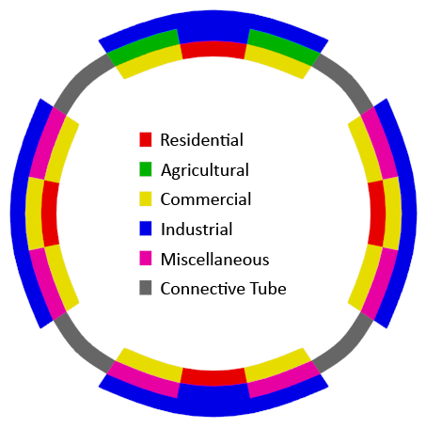
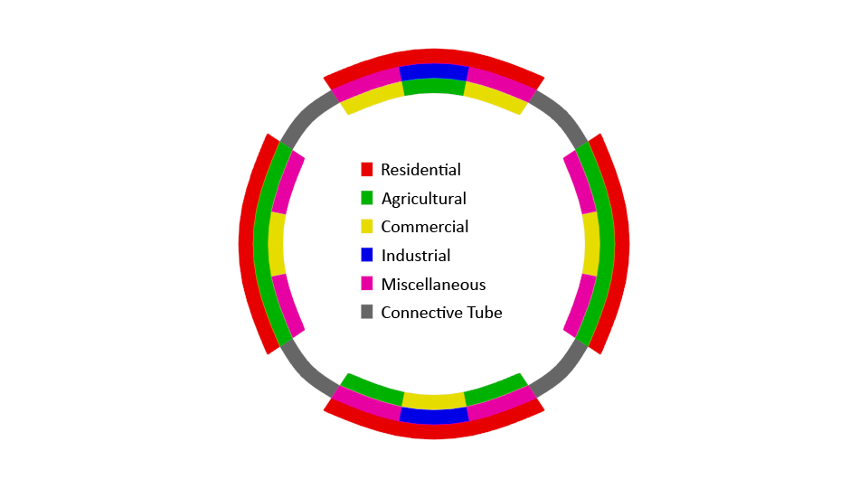
Interior Layout
Usage Type
Area Allocation
Percentage
Residential
210,600m²
24.7%
Agricultural
243,000m²
28.5%
Commercial
129,600m²
15.2%
Industrial
48,600m²
5.7%
Other
220,200m²
25.9%
Total
852,000m²
100.0%
TOROID SET B
Set B has both a lower area (768,000m²) and lower simulated gravitational acceleration (8.83 m/s², 0.9g) than Set A. This toroid shall be the industrial and commercial hub of the settlement, with its 0.9g environment providing a comfortable area for adults to live and work in. Set B shall have lesser agricultural area than Set A, due to the presence of industrial areas which have the potential to contaminate the food. However, Set B will boast apartment housing, hotels, shopping centers, banks and many other adult-

Slide 6
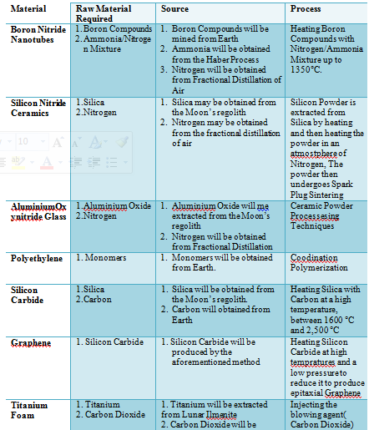

Slide 7
Operations

Slide 8
3.1 Construction Materials and their Sources
Material | Raw Material Required | Source | Process
Boron Nitride Nanotubes | Boron Compounds Ammonia/Nitrogen Mixture | Boron Compounds will be mined from Earth Ammonia will be obtained from the Haber Process Nitrogen will be obtained from Fractional Distillation of Air | Heating Boron Compounds with Nitrogen/Ammonia Mixture up to 1350°C.
Silicon Nitride Ceramics | Silica Nitrogen | Silica may be obtained from the Moon’s regolith Nitrogen may be obtained from the fractional distillation of air | Silicon Powder is extracted from Silica by heating and then heating the powder in an atmostphere of Nitrogen, The powder then undergoes Spark Plug Sintering
Aluminium Oxynitride Glass | Aluminium Oxide Nitrogen | Aluminium Oxide will me extracted from the Moon’s regolith Nitrogen will be obtained from Fractional Distillation | Ceramic Powder Processesing Techniques
Polyethylene | 1. Monomers | 1. Monomers will be obtained from Earth. | Coodination Polymerization
Silicon Carbide | Silica Carbon | Silica will be obtained from the Moon’s regolith. Carbon will obtained from Earth | Heating Silica with Carbon at a high temperature, between 1600 °C and 2,500 °C
Graphene | 1. Silicon Carbide | 1. Silicon Carbide will be produced by the aforementioned method | Heating Silicon Carbide at high tempratures and a low pressure to reduce it to produce epitaxial Graphene
Titanium Foam | 1. Titanium 2. Carbon Dioxide | 1. Titanium will be extracted from Lunar Ilmenite 2. Carbon Dioxide will be be obtained by reacting methane with water. | Injecting the blowing agent( Carbon Dioxide) into Liquid Titanium
Inconel X-750 Alloy | Nickel Chromium Iron Niobium Cobalt Manganese Copper Aluminium Titanium Silicon Carbon Sulphur | Nickel, Chromium, Niobium, Cobalt, Manganese and Copper will be mined from Earth Aluminium, Iron, Titanium and Silicon will be extracted from the Moon’s regolith. Carbon and Sulphur will be taken from the Earth | Heating and Combining all the metals to form the superalloy
Hydrogen | 1. Methane 2. Water | 1. Methane and Water will be extracted from Earth | Steam reforming of Natural Gas
Oxygen | 1. Ilmenite 2. Hydrogen 3. Carbon Monoxide | 1. Ilmeite will be extracted from the Moon 2. Hydrogen will be produced as said above. 3. Carbon Monoxide will be obtained from | Reduction of Ilmenite by Hydrogen and Carbon Monoxide
Lithium Hydoxide | 1. Lithium Carbonate 2. Calcium Hydroxide | 1. Lithium will mined from Earth and will then react with a certain amount of carbonate to form Lithium Carbonate 2.Reacting Lime with Water will form Calcium Hydroxide | A Metathesis Reaction between Lithium Carbonate and Calcium Hydroxide

Slide 9
3.2 The Infrastructure
3.2.1 Atmosphere Control
In Residential Torus, the air composition will mimic that of Earth and will be at atmospheric pressure
In the Industry and Research Torus, there entire torus will be non-pressurized as to reduce obstructions caused on Earth
In the Agricultural torus, the atmosphere will have a higher CO2 concentration than that of Earth to optimize plant growth, it will however have the same pressure
Gas | Percentage
Nitrogen | 78%
Oxygen | 21%
Carbon Dioxide | 0.04%
Water vapor | 0.95%
Other | 0.01%
Residential Torus Air Composition

Slide 10
3.2.2 Food Production
Meat via Stem-Cell Reproduction
Aeroponics and Hydroponics
3.2.3 Electrical Power Production
Photovoltaic Solar Cells
Nuclear Reactors

Slide 11
3.3: Transport of Materials to Settlement
Transport from Moon: Magnetic Sails
Transport from Earth:

Slide 12
Human Factors

Slide 13
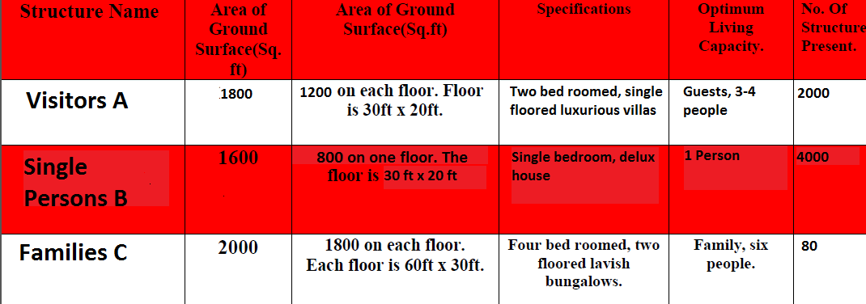
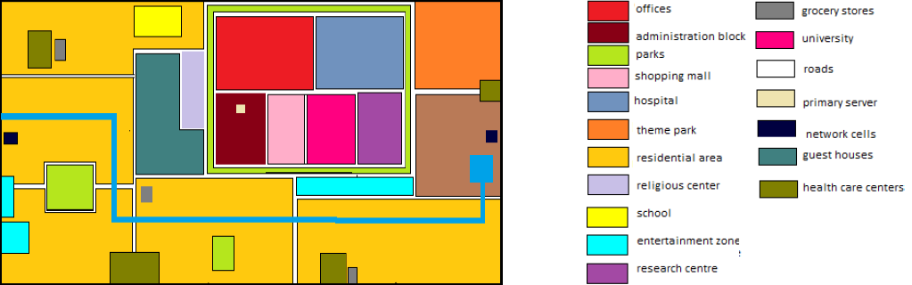
House Distribution

Slide 14
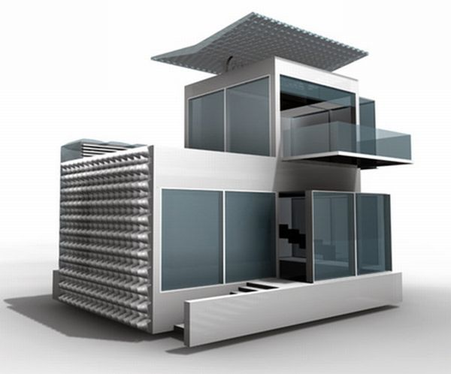
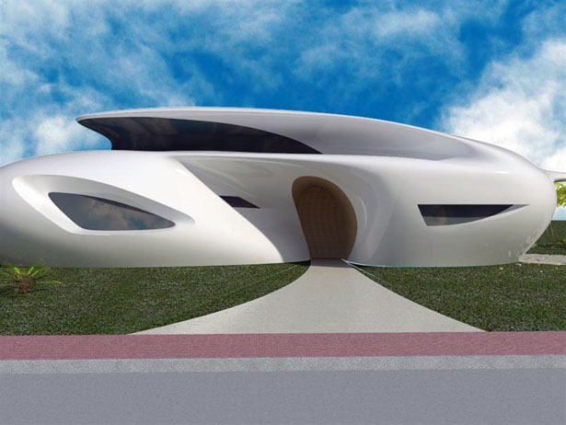
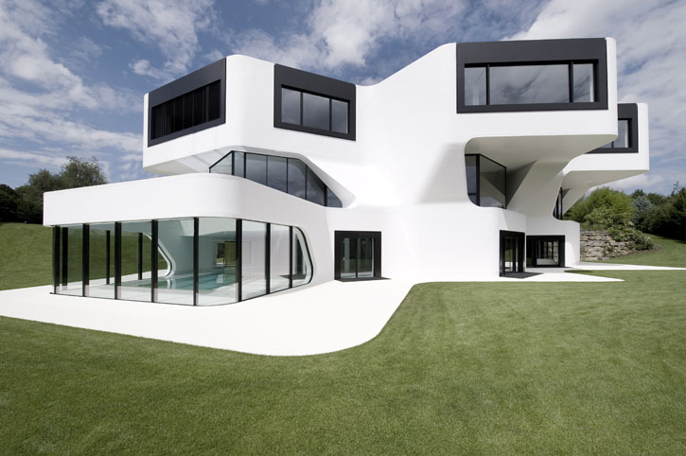
Visitors A
Single Person B
Families C

Slide 15
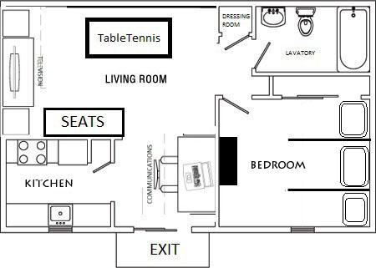
(1) The communications systems present in every house. It shall send the radio signals to and from Earth, which in turn will forward the information to the hotel. (2) The houses will be provided with a DVD player as well as a table tennis table. (3) The houses shall have cabins accommodating the guests (4) The kitchen shall provide fresh foods in tins as well as a mini stove. (5) The elevator shall have a lavatory which will deposit its waste in the plastic bags into the waste area that shall be empted into space.

Slide 16
Human Factors

Slide 17
Food production
Aeroponics
Hydroponics
Vitro meat
Mycoprotein
For milk, we will use composite of Nutrose, Lactose and water.

Slide 18
Recreation Facilities
Virtual Heavens, a place with large amount of trees planted and a view of space from a glass covering.
The Half-g experience
Sports ground in Half-g environment, new types of games like flying football or “quiditch”.
Virtual Skydiving in Half-g
Amusement Parks which utilize Half-g.
Malls would be spread all over
“5-D Cinemas” with zero gravity effects.

Slide 19
Education
The education sector will be divided into three levels: Elementary level, Secondary level and Higher level
For elementary level there would be human teachers, so as to groom the children.
For secondary level we will have human teachers as well as recorded and live broadcast of lectures.
For higher level the primary teaching source would be live broadcasting lectures. There would be lectures by on-board personnel once in a week.

Slide 20
Health Care Services
5 Hospitals
Ambulances
Pharmaceutical Companies
Sensors to monitor every residents health
Hospitals to be fully stocked with aid and medicinal drugs especially military quarantine

Slide 21
Automation

Slide 22
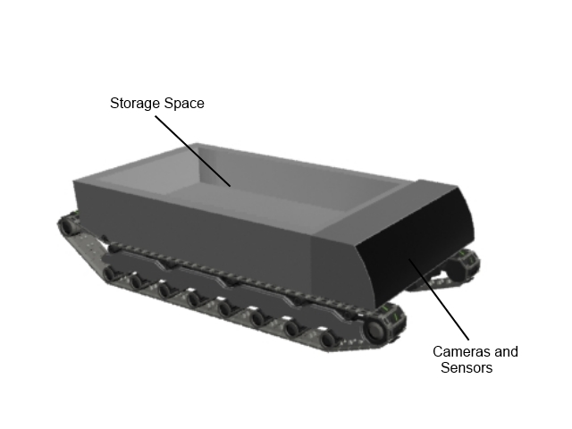
MAIN ROBOTS
Secure It
Automated security guard
Connected to
the central mainframe for detection of a malfunction
Transporter
MaidBot
Large container for carrying cargo up to 2000 tones
Will be used for transportation of bulk material around the settlement
Programmed to clean the houses and facilities on the settlement
Programmed by each household’s
residence’s head
Hydraulic arms to pick things up and
organize them.

Slide 23
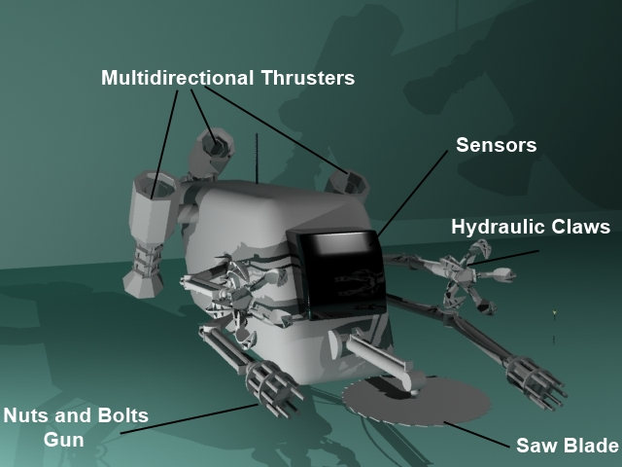
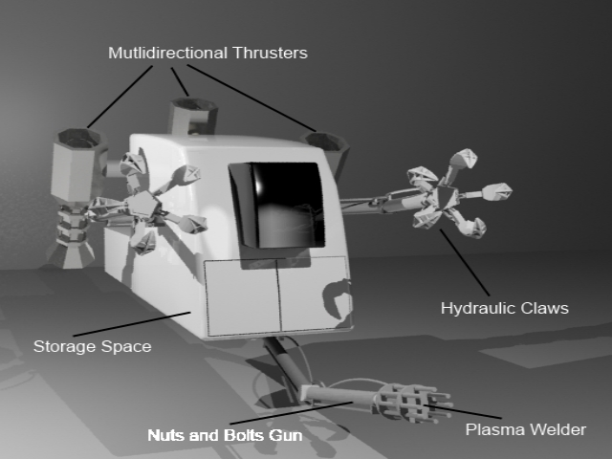
Ambulance
Will carry all critical care patients to the hospital.
Installed with
proper health care facilities like drips, medicines, oxygen masks .
Builder 800
Crane 3000
External construction of Bisoniam.
Electromagnetic capability to improve the robots ability to pick up metal objects
Will use cold welding to weld materials together.
Will also transport all required materials for external construction

Slide 24
Conitngency | Safety Measure | Response Time
Solar Flare | -Polyethylene will be used in the construction of the outer wall. | --------------------------
Internal Fire | -Smoke detecters shall detect fire - Everyone in the affected area will be evacuated -The area will be sealed off | < 15 minutes
Disease Outbreak | -Everyone in the affected area will be quarantined and if the need arises, evacuated. | < 15 minutes
Incoming Asteroid | -The thrusters shall move the settlement out of the path of the asteroid | < 45 minutes
Lack of Provisions | -The Provision Reserve will be used and the required provisions will be ordered | < 7 days
Virus attack on server | -Antivirus software will constantly monitor for any malicious code | < 5 minutes
Server Breakdown | -All operations will be continued by backup servers until primary servers are working again | < 1 minute
Power failure | -Energy consumption will be reduced to the minimum | < 5 minutes
Contingency Plans

Slide 25
Costing and Schedule
BISONIAM

Slide 26
Scheduling
The construction of BISONIAM Space Settlement will be spread across a period of twelve years.
The first year will be spent for the initial research for the construction of BISONIAM and the second and third year for construction of the automated construction machinery.
The next three years will be spent for the construction of the Residential, Industrial and Agricultural Torii.
The next years will be spent for the construction and implementation of other essential features such as artificial gravity, power stations, communication networks etc.

Slide 27
Task Name | Start | End | Duration
Initial Studies | 2052 | 2053 | 1 Year
Automated Machine Construction. | 2053 | 2055 | 2 Years
Construction of Main Sphere | 2055 | 2056 | 1 Year
Construction of Spokes | 2056 | 2057 | 1 Year
Construction of Industrial Torus | 2057 | 2058 | 1 Year
Construction of Residential and Agricultural Torus | 2057 | 2059 | 2 Years
Construction of Communication Networks | 2059 | 2060 | 1 Year
Final Construction and Establishment of BISONIAM | 2060 | 2064 | 4 Years End = 2054 (12 Years)

Slide 28
COSTING : Main Costs
Item Name | Cost Per Unit ($) | Quantity | Total Cost
Central Sphere | - | - | US$ 20 Billion
Spokes | 250 Million | 4 | US$ 1 Billion
Residential Torus | - | - | US$ 20 Billion
Industrial Torus | - | - | US$ 20 Billion
Agricultural Torus | - | - | US$ 20 Billion
Waste Management Unit | 45 Million | 1 | US$ 45 Million
Temperature Control | 1 Million | 10 | US$ 10 Million
Pressurization | - | - | US$ 28 Million
 |  |  | US$ 156 Billion

Slide 29
Costing : Automation
Name of Machinery | Quantity | Cost
Builder 800 | 30 | 5,000,000 * 30 = US $150 Million
MaidBot 023 | 10,000 | 200,000 * 10,000 = US$2 Billion
Ambulance | 100 | 500,000 * 100 = US$ 50 Million
Crane 3000 | 3000 | 2500000 *3000 = US$750 Million
Transporter | 200 | 450,000 * 200 = US$90 Million
SECURE IT | 5000 | 500,000 * 5000 = US$ 250 Million
 | Total = 18330 | Total = US$ 3,290,000,000

Slide 30
Costing : Human Factors
Units | Number of Units | Total Cost
Housing Unit A : Visitors | 2000 | 2000*20000000 =US$4,000,000,000
Housing Unit B : Single Resident | 4000 | 4000*1000000=US$400,000,000
Housing Unit C : Family | 80 | 80*10000000= US$80,000,000
Hospitals | 10 | 10*1000000 = US$10,000,000
Recreational Facilities | 10 | 10*1000000 = US$ 10,000,000
 | 6800 | Total = US$ 4,500,000,000

Slide 31
Total Costs = US$168,290,000

