Slide 1
BIG DATA ANALYTICS · ASSIGNMENTS 2 & 3
NYC Yellow Taxi
Ingestion, ETL & Analytics on HDFS + Spark
COURSE & CLASS
GROUP 17 · CONTRIBUTIONS
Course — Big Data Analytics
Class — BSCS-13A
Course Group — Group 3 (BDA, BSCS-13A)
Project Group # — 17
Institution — NUST SEECS
Malik Muhammad Hassaan — CMS 460233 · Ingestion · Validation · Profiling · Cleaning strategy
Muhammad Ahmed — CMS 456679 · Spark ETL · Dimensional model · Analytics · Optimizations
End-to-end pipeline · 2.96M trips · HDFS warehouse · Spark SQL · automated reporting

Slide 2
SLIDE 2
Dataset Overview, Rationale & Business Value
DATASET FACTS
WHY THIS DATASET
Source — NYC TLC Yellow Taxi (Jan 2024)
File — yellow_tripdata_2024-01.parquet
Volume — 2,964,624 trips · 19 columns
Format — Parquet — binary, columnar
• Volume > 500K rows justifies HDFS + Spark
• Each row is a trip — natural fact table
• Clear dimensions: time, location, payment, vendor
• Real DQ issues — perfect ETL teaching dataset
WHY ANALYTICS ON THIS DATA MATTERS
BUSINESS BENEFITS DELIVERED
• Reveals when and where demand spikes
• Quantifies how riders pay and tip
• Identifies highest-revenue origin–destination pairs
• Surfaces driver / vendor performance differences
• Surge / dispatch windows → higher revenue
• Vehicle repositioning to hot OD pairs
• Card-payment investment justified by share data
• Tip insights → driver coaching & retention
Dataset
2 / 11
Presenter: Hassaan
Group 17 · BSCS-13A · BDA

Slide 3
SLIDE 3
Data Quality Issues & Cleaning Methods
Identified in profile_data.py · Resolved in etl.py · 0 nulls in keys after ETL.
ISSUE → ACTION
ISSUE → ACTION
• Negative fares — median per distance bin (etl.py 84–93)
• Zero passenger count — round + clip min 1 (etl.py 96–99)
• Non-integer passenger — round to integer (etl.py 96–99)
• Duplicate rows — dropDuplicates (etl.py 71)
• Distance outliers — cap at 99th percentile (etl.py 110–114)
• Tip > fare — cap tip at fare (etl.py 102–107)
• Missing numerics — median imputation (etl.py 117–125)
• Missing categorical — fallback to 0 / mode (etl.py 128–131)
• Datetime inconsistencies — to_timestamp + duration (etl.py 74–81)
• Future timestamps — median by hour/weekday (profile 86–88)
Data Quality
3 / 11
Presenter: Hassaan
Group 17 · BSCS-13A · BDA

Slide 4
SLIDE 4
End-to-End Pipeline Architecture
Ingest
Profile
ETL
Analytics
Report
ingest.py
profile_data.py
etl.py (Spark)
analytics.py
build_final_report
Download · validate ≥ 500K rows · upload to HDFS
Schema · missing · stats · DQ issues
Clean · derive · star schema · partition
5 Spark SQL queries · 4 charts
Bundle CSVs + charts → PDF
Storage: HDFS /warehouse/raw/... → /warehouse/processed/...
Compute: Apache Spark 3.5.8 · PySpark · Spark SQL · HDFS NameNode + DataNode local cluster
Validation: etl_summary.json · raw row count = fact_trips row count = 2,964,624 · zero nulls in keys
Architecture
4 / 11
Presenter: Hassaan
Group 17 · BSCS-13A · BDA

Slide 5
SLIDE 5
Dimensional Model — Star Schema
dim_datetime
dim_payment
749 rows · etl.py 164–169
5 rows · etl.py 171–184
fact_trips
2,964,624 rows
distance · fare · tip · revenue · IDs
dim_trip_category
3 rows · etl.py 186–195
Joined on natural keys: datetime_key · payment_type · distance_bucket · small dims → broadcast joins.
Warehouse Model
5 / 11
Presenter: Ahmed
Group 17 · BSCS-13A · BDA

Slide 6
SLIDE 6
Five Business Questions (analytics.py)
Q1 — Trip volume & average fare by hour and day of week (lines 43–65)
Q2 — Correlation between trip distance and fare amount (lines 66–77)
Q3 — Payment-type preference by time and pickup location (lines 78–96)
Q4 — Average tip by payment type, distance, and vendor (lines 97–111)
Q5 — Top pickup → dropoff pairs by volume and revenue (lines 112–126)
Source of questions: Dataset_Justification.pdf · Implemented as Spark SQL views over fact_trips and dims.
Analytics
6 / 11
Presenter: Ahmed
Group 17 · BSCS-13A · BDA

Slide 7
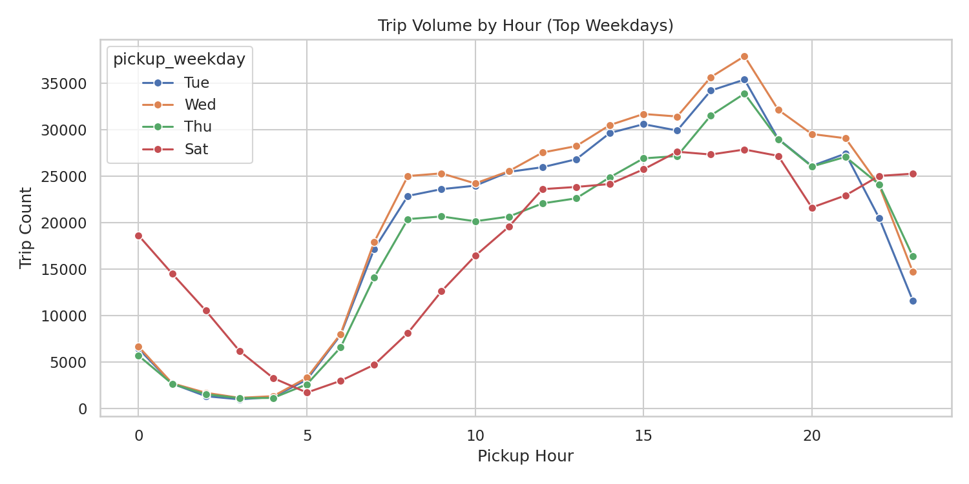
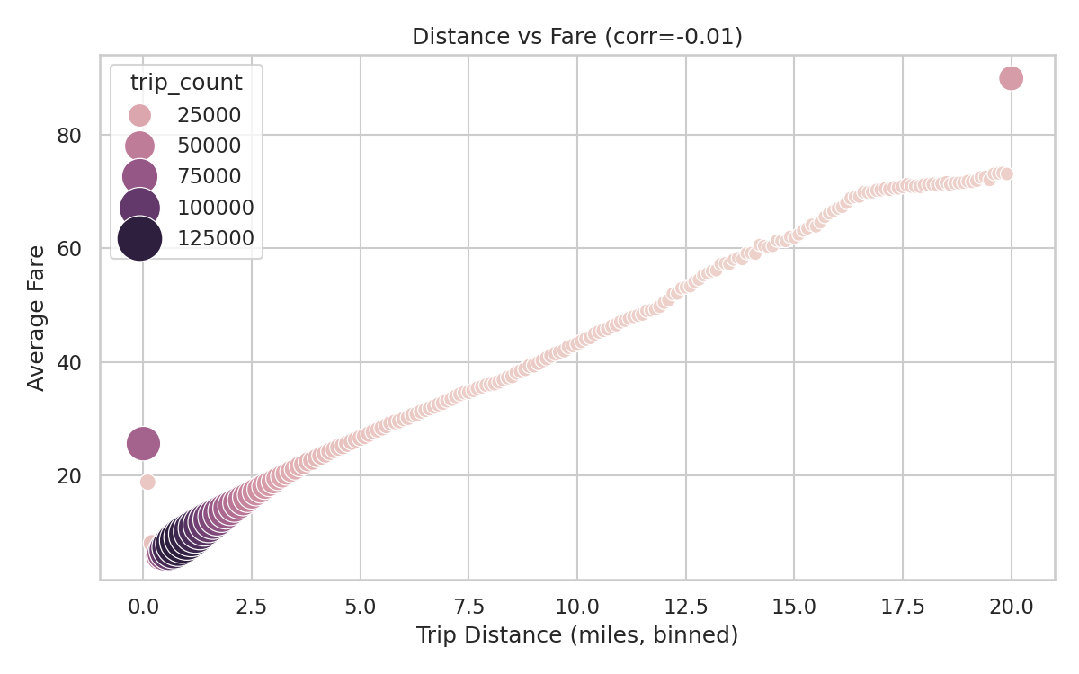
FINDINGS
Q1 — Hourly Demand · Q2 — Distance vs Fare
• Demand peaks 5–7 PM on weekdays.
• Fri/Sat sustain volume late at night.
• Lowest volume in the 3–5 AM window.
• Strong positive distance ↔ fare relationship.
• Within-bin correlation low → time/traffic noise.
• Distance is the dominant fare driver.
Findings — Q1 & Q2
7 / 11
Presenter: Ahmed
Group 17 · BSCS-13A · BDA

Slide 8
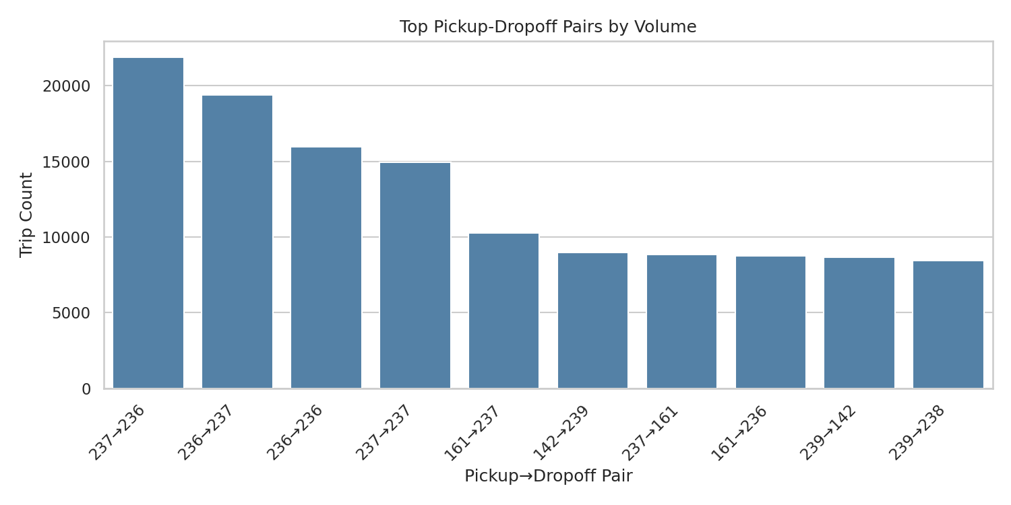
FINDINGS
Q3 Payment · Q4 Tipping · Q5 Top OD Pairs
KEY NUMBERS FROM CSVs
• Q3 Payment — Credit card 80–84% in zones 161/236/237
• Q4 Tip CC long — $11.58 · 21.2% of fare
• Q4 Tip CC short — $2.71 · 27.9% of fare
• Q4 Cash / dispute — ≈ $0 (no-charge $0.11)
• Q5 Top volume — 237 → 236 · 21,883 trips
• Q5 Top revenue — 132 → 132 · $246,050 (JFK)
• Credit card dominates payment in core Manhattan during peak hours.
• Tip $ highest on long trips; tip % highest on short trips.
• A handful of OD pairs (Manhattan core + JFK) drive most revenue.
Findings — Q3, Q4, Q5
8 / 11
Presenter: Ahmed
Group 17 · BSCS-13A · BDA

Slide 9
BONUS
Pipeline Optimizations
• Broadcast joins — small dims wrapped in F.broadcast(...) (etl.py 198–200)
• Cache reused DF — transformed.cache() before deriving fact + dims (etl.py 161)
• Partitioned Parquet — fact_trips & dim_datetime partitioned by year, month (etl.py 370, 373)
• Approx percentile — percentile_approx for distance cap & medians (etl.py 110, 117–122)
• Dynamic partition overwrite — partitionOverwriteMode=dynamic (etl.py 60)
• Tuned shuffle partitions — spark.sql.shuffle.partitions = 16 (etl.py 59)
Engineering
9 / 11
Presenter: Ahmed
Group 17 · BSCS-13A · BDA

Slide 10
SLIDE 5
Business Insights & Conclusion
• Demand is time-bound — Peak 5–7 PM, dawn lull → dynamic dispatch / surge windows.
• Distance dominates fare — Strong positive trend → predictable distance-based pricing.
• NYC taxis are cashless — Credit card 80%+ in busiest zones → invest in card UX.
• Tipping is payment-driven — Card riders tip materially; cash / disputes ≈ 0.
• Revenue concentrated — Manhattan core (161/236/237) + JFK (132) drive most revenue.
• Data quality discipline — All 2.96M rows preserved · 0 nulls in keys (etl_summary.json).
Insights
10 / 11
Presenter: Ahmed
Group 17 · BSCS-13A · BDA

Slide 11
SLIDE 6
Dataset & GitHub Repository
DATASET
NYC TLC Yellow Taxi Trip Records (Jan 2024)
https://www.nyc.gov/site/tlc/about/tlc-trip-record-data.page
File: yellow_tripdata_2024-01.parquet
GITHUB REPOSITORY
NYC-Taxi-Ingestion-Pipeline
https://github.com/hassaanawan48/NYC-Taxi-Ingestion-Pipeline
Includes ingest.py · profile_data.py · etl.py · analytics.py · build_final_report.py
Thank you · Questions are welcome.
References
11 / 11
Presenter: Ahmed
Group 17 · BSCS-13A · BDA

