Slide 1
Identity-based
policies
IAM Identities
(users, groups, roles)
AWS Resources
(S3, EC2, Lambda)
IAM Identities
(users, groups, roles)
AWS Resources
(S3, EC2, Lambda)
Resource-based policies

Slide 2
Top Level Domain
(TLD)
Sub Domain
https://www.example.com
Protocol
(Hyper Text Transfer)
Domain
Uniform Resource Locator (URL)

Slide 3

AWS CloudFormation

Slide 4
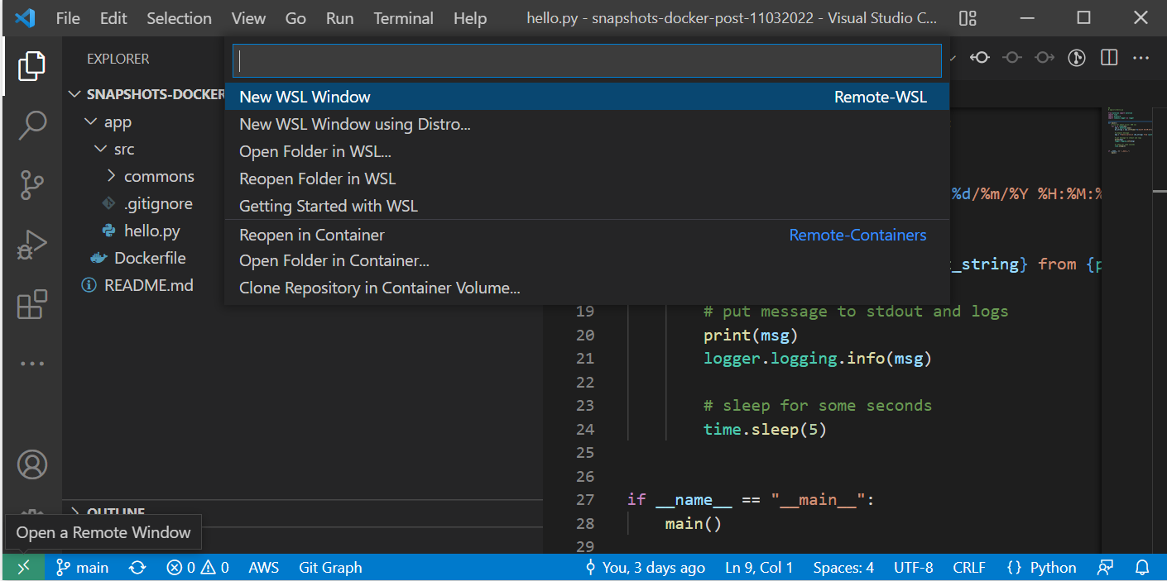
New Icon

Slide 5



Sync
Trigger
Amazon Elastic File System
(Amazon EFS)
AWS Lambda
Amazon Simple Storage Service (Amazon S3)

Slide 6

Amazon Simple Storage Service (Amazon S3)
1. Event Notification Trigger
2. Invoke DataSync task
AWS DataSync
AWS Lambda
3. Sync EFS with S3
Amazon Elastic File System
(Amazon EFS)

Slide 7

Amazon Simple Storage Service (Amazon S3)
2. Invoke DataSync task
1. Scheduled trigger
AWS DataSync
AWS Lambda
Amazon EventBridge
3. Sync EFS with S3
Amazon Elastic File System
(Amazon EFS)

