Slide 1
Identity-based
policies
IAM Identities
(users, groups, roles)
AWS Resources
(S3, EC2, Lambda)
IAM Identities
(users, groups, roles)
AWS Resources
(S3, EC2, Lambda)
Resource-based policies

Slide 2
Top Level Domain
(TLD)
Sub Domain
https://www.example.com
Protocol
(Hyper Text Transfer)
Domain
Uniform Resource Locator (URL)

Slide 3

AWS CloudFormation

Slide 4
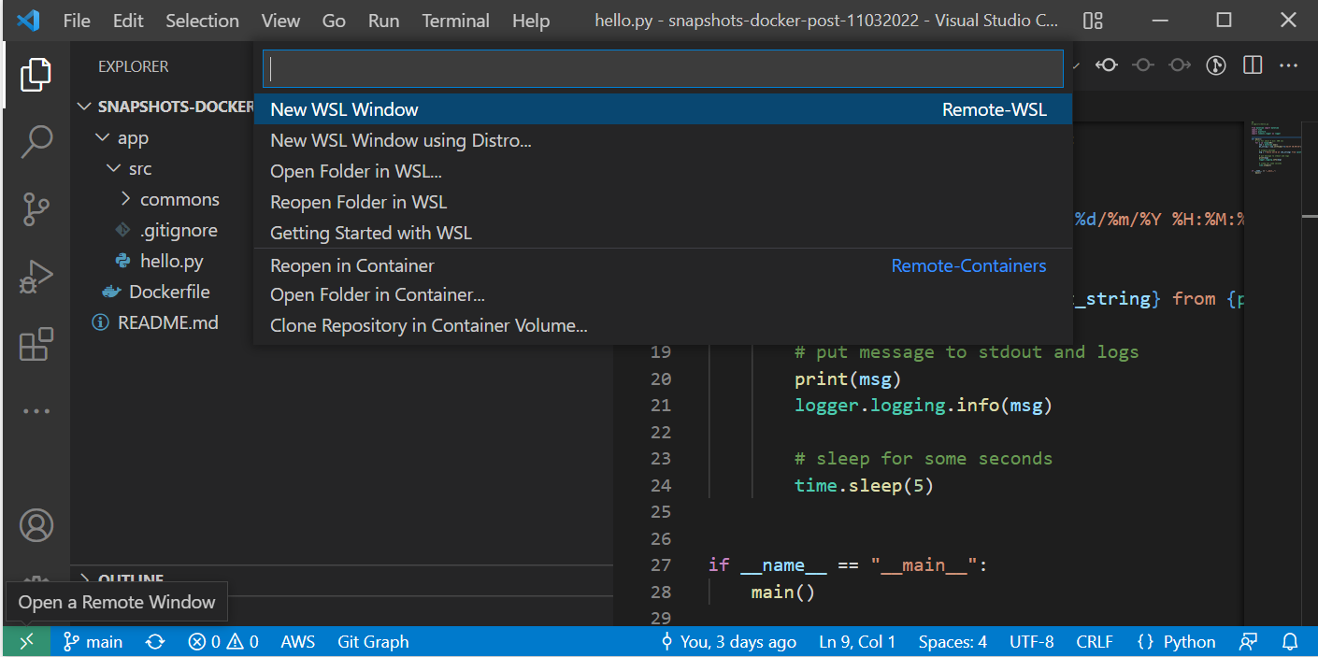
New Icon

Slide 5



Sync
Trigger
Amazon Elastic File System
(Amazon EFS)
AWS Lambda
Amazon Simple Storage Service (Amazon S3)

Slide 6

Amazon Simple Storage Service (Amazon S3)
1. Event Notification Trigger
2. Invoke DataSync task
AWS DataSync
AWS Lambda
3. Sync EFS with S3
Amazon Elastic File System
(Amazon EFS)

Slide 7

Amazon Simple Storage Service (Amazon S3)
2. Invoke DataSync task
1. Scheduled trigger
AWS DataSync
AWS Lambda
Amazon EventBridge
3. Sync EFS with S3
Amazon Elastic File System
(Amazon EFS)

Slide 8



Client
Web Browser
AWS Lambda
Function URL
Amazon SageMaker
Model Endpoint
Notes:
2022-06-17-sagemaker-endpoint

