Slide 1


Slide 2
University Recommender website

Slide 3
INTRODUCTION OF PROJECT
This website will helps students to know about all the details of different universities according to the locations and preferences. Moreover, it will also let them know about the aggregate, fees, admission criteria and other facilities of various universities etc.

Slide 4
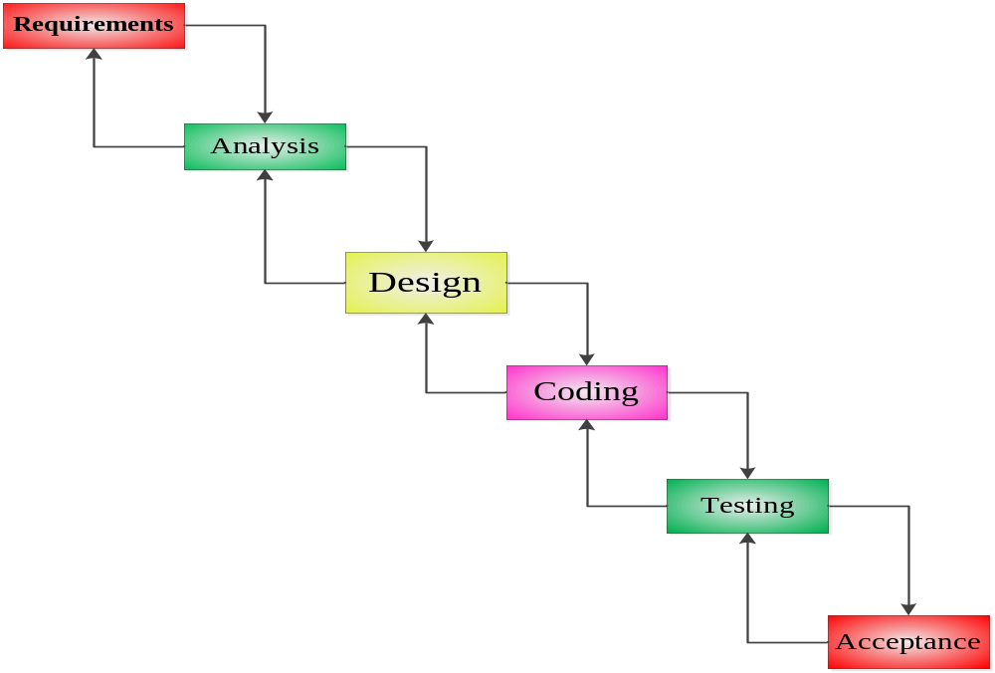
Diagram of Process Model.

Slide 5
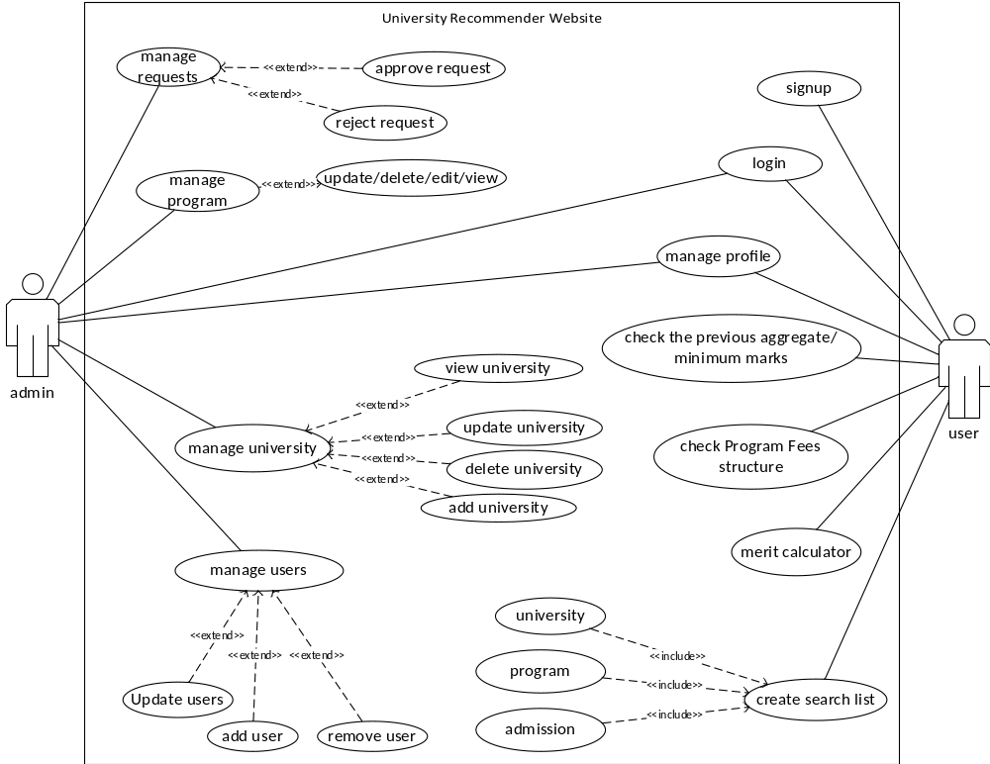
Use Case Diagram

Slide 6
Business Rules Catalog
Functional Requirements:
Admin can:
User management. Create user, Delete user, Update user, View user and can accept or reject the user signup requests.
Can add, update admission criteria periodically to ensure the data authenticity.
Admin should add/update university admission deadlines in the system.
Registered Users can:
Can check admission requirements of all universities.
System should show previous aggregate/minimum marks for each domain/program.
Can create predefined search list that can be used in future to easily search for same parameters.
A merit calculator should be added to check which domain/program can be taken by student.
Student(s) would be able to check Program Fees structure of all universities.
Non-registered students/users can:
Any unregistered users /Student(s) will be able to see or search all the information on the website; however, to create the search list, they must have to register on the website.

Slide 7
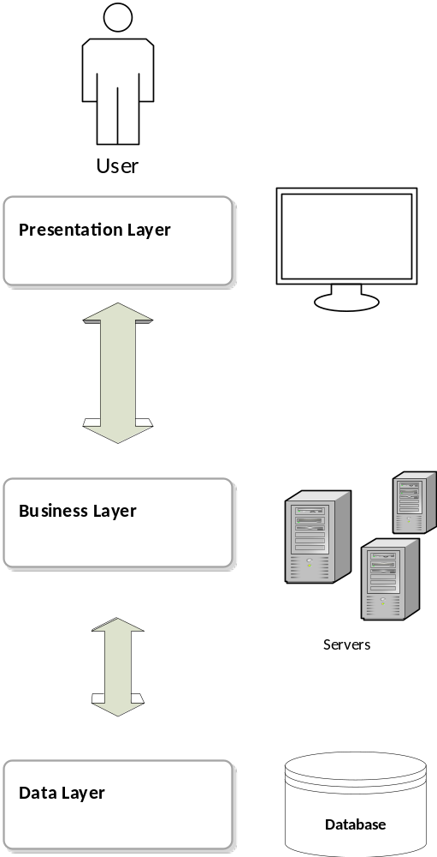
Architectural Design

Slide 8
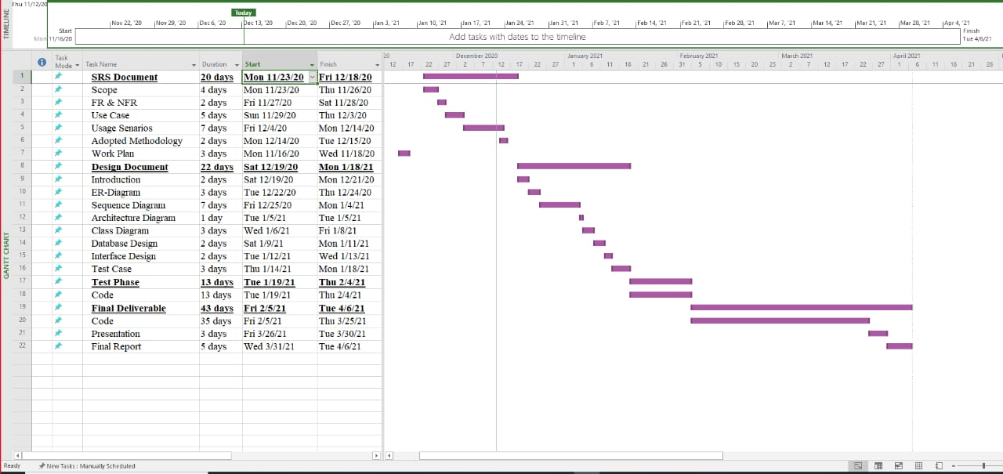
Project Schedule

Slide 9
Sequence Diagrams

Slide 10
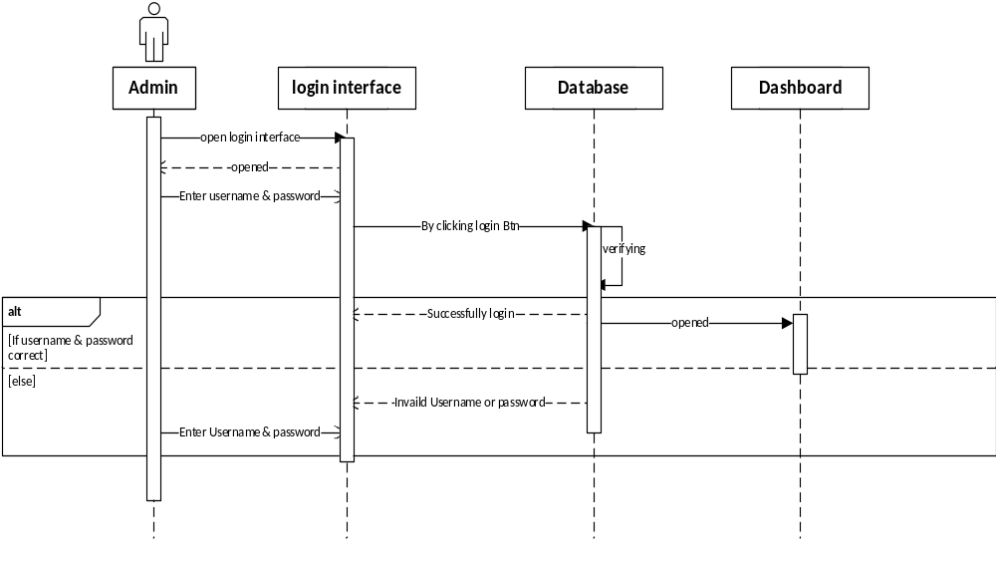
Admin Login

Slide 11
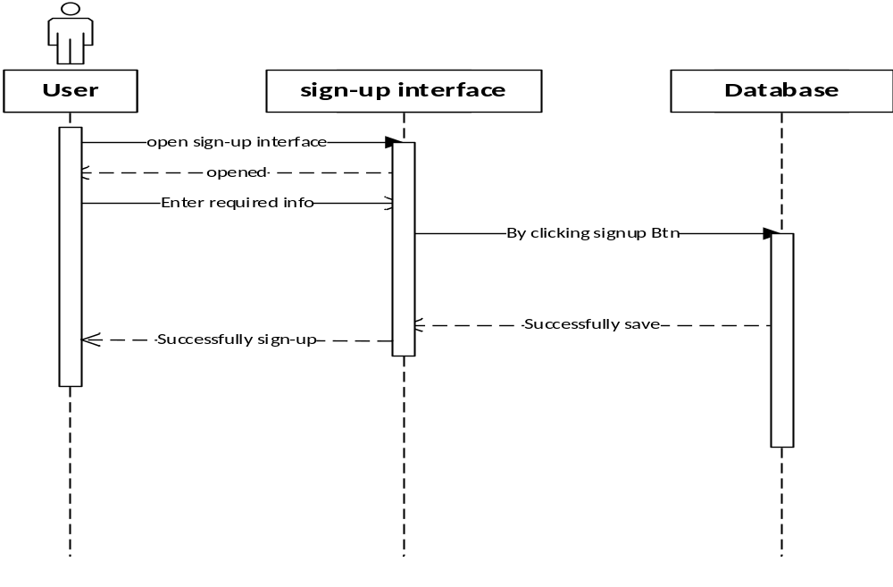
User Sign-Up

Slide 12

User Login

Slide 13
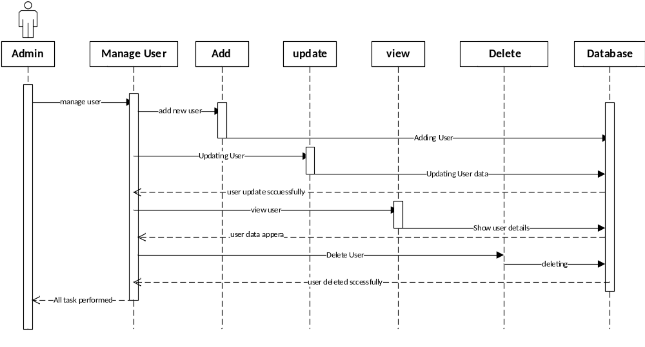
Admin Manage User

Slide 14
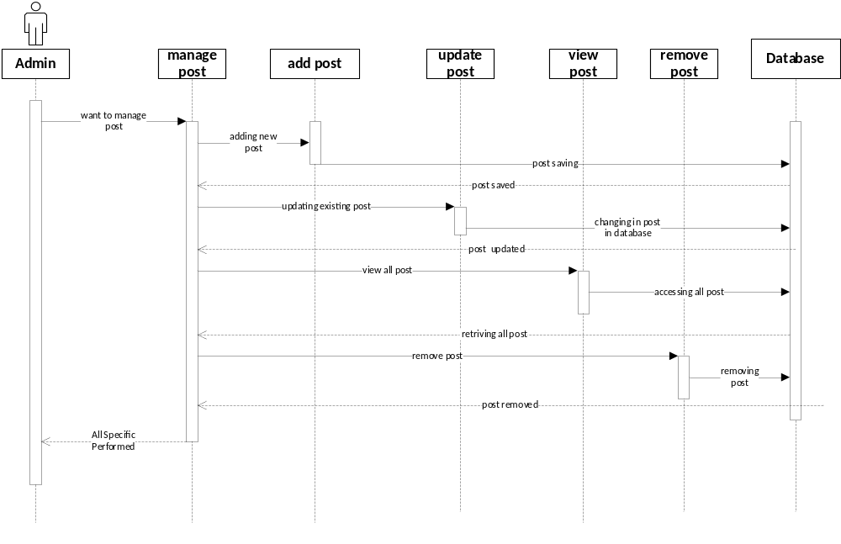
Manage Post

Slide 15
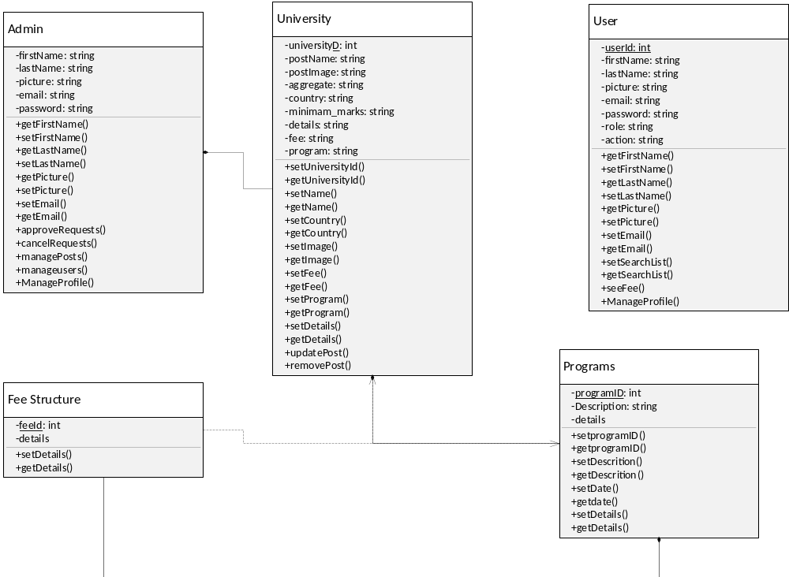
Logical Model/Class Diagram

Slide 16
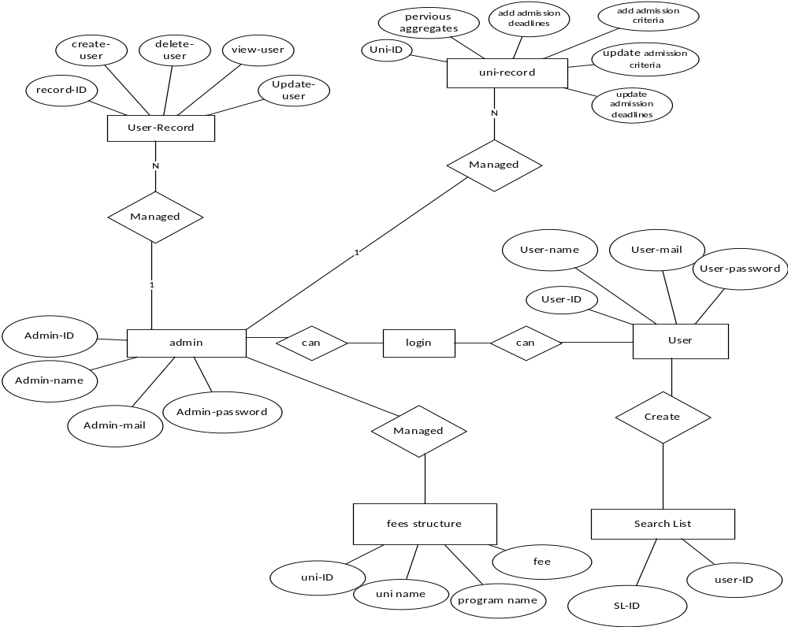
Entity-Relationship Diagram

Slide 17
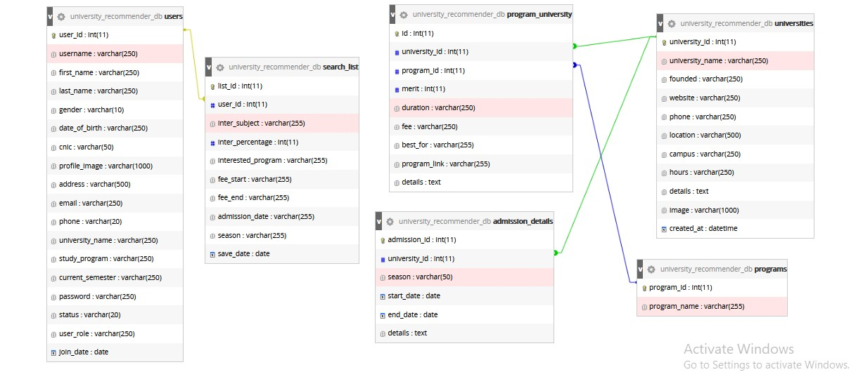
Database Diagram

Slide 18
User Interfaces

Slide 19
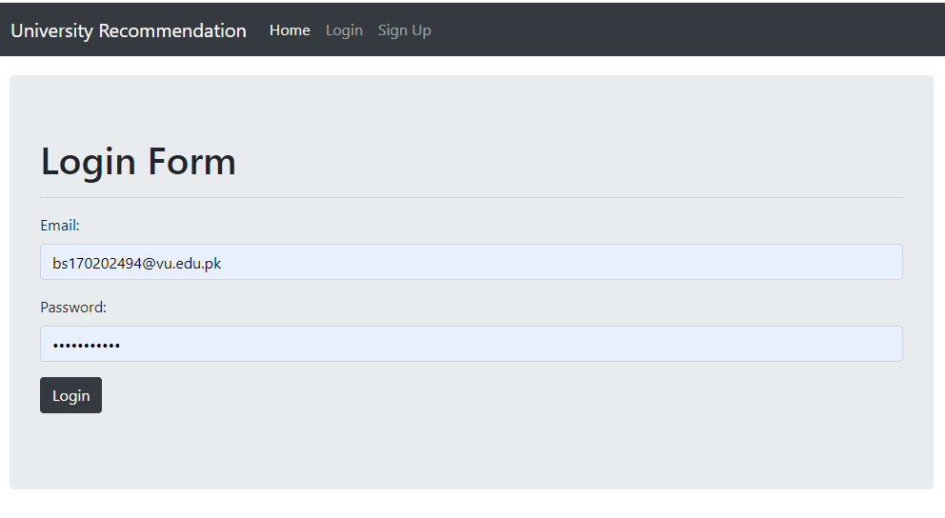
Login Form

Slide 20
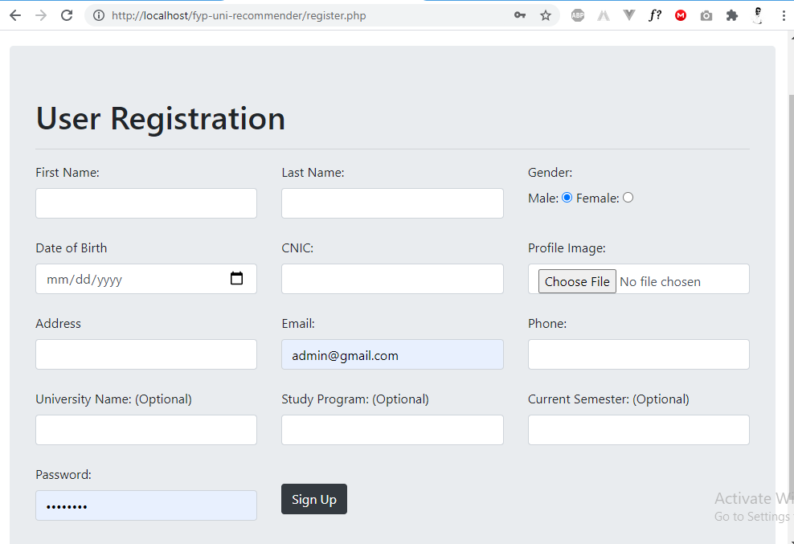
Registration Form

Slide 21
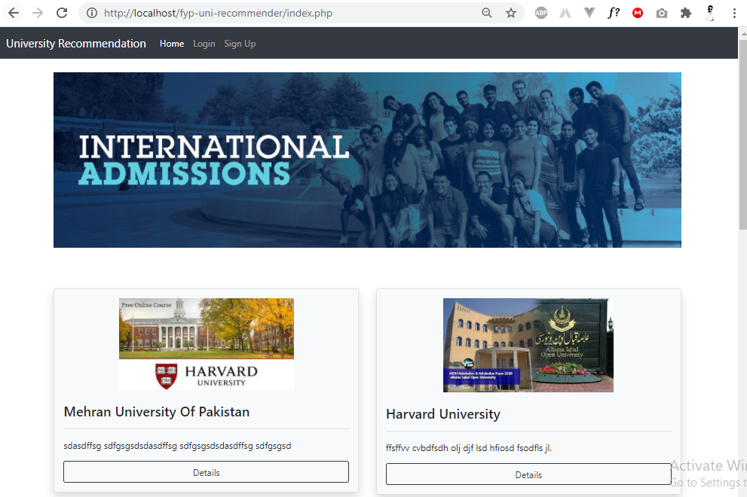
Homepage

Slide 22
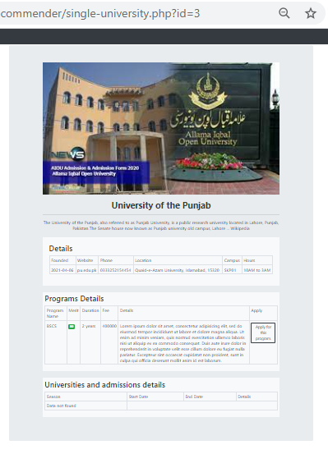
Single Post

Slide 23
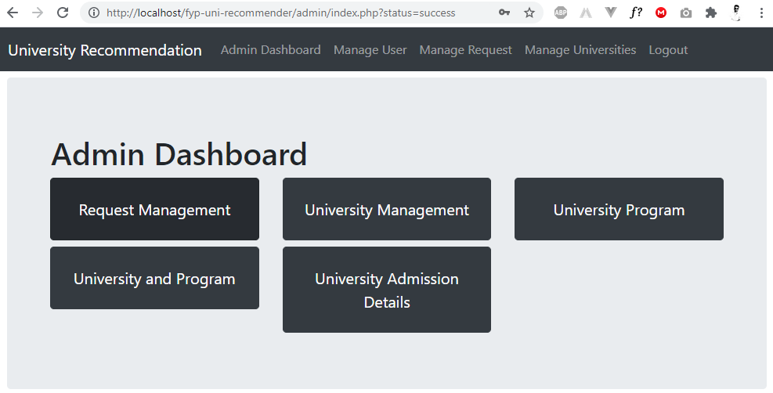
Admin Dashboard

Slide 24
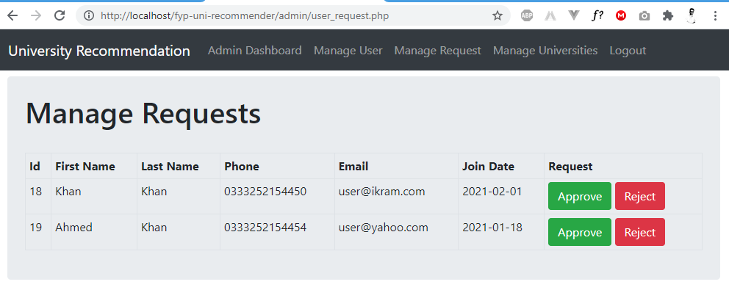
Admin (User Request Manage)

Slide 25
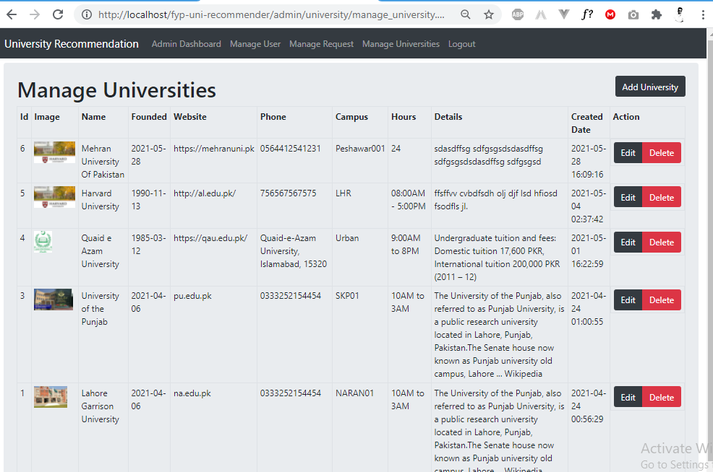
Admin (Manage Universities)

Slide 26
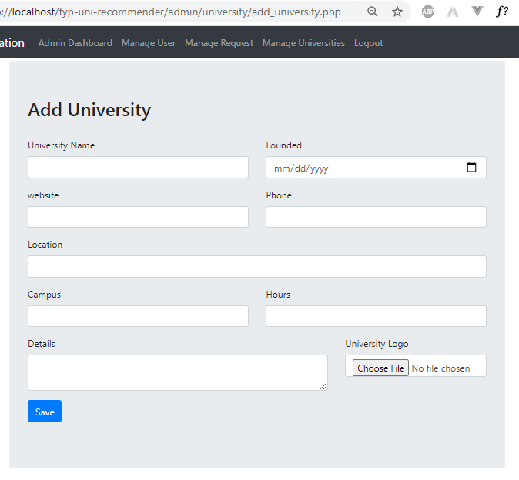
Admin (Add University)

Slide 27
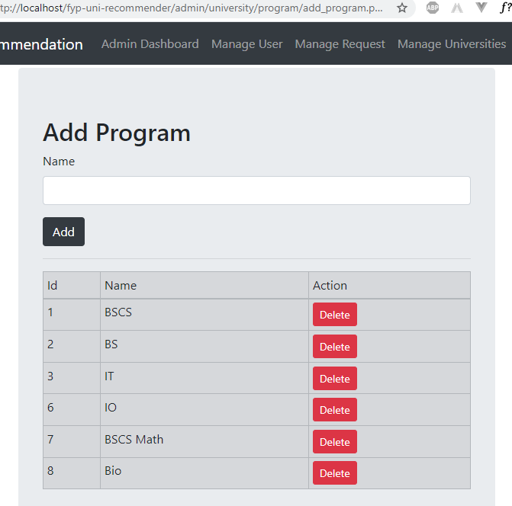
Admin (Add Program)

Slide 28
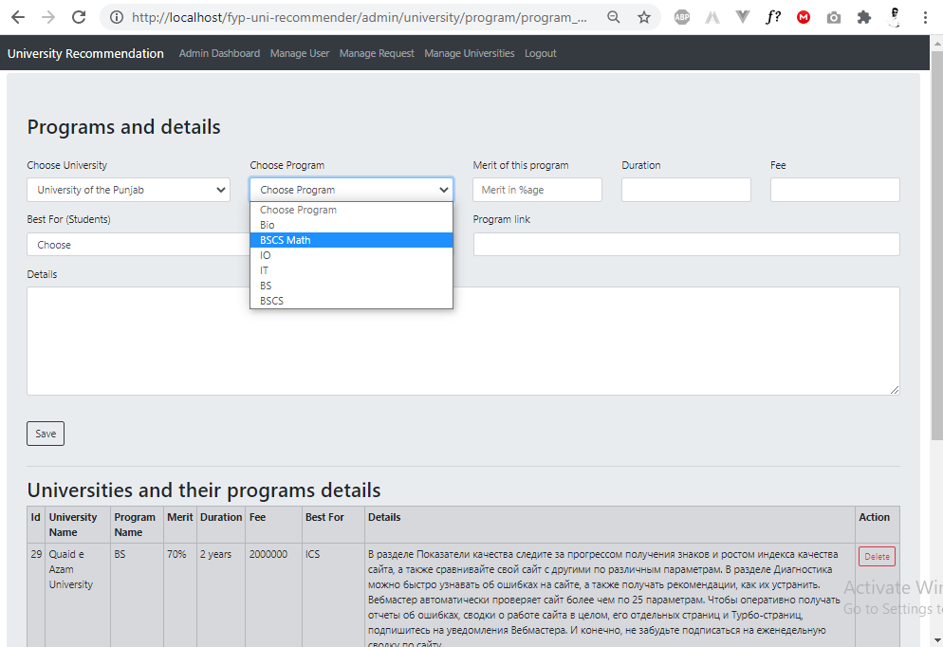
Admin (Assign Program & details)

Slide 29
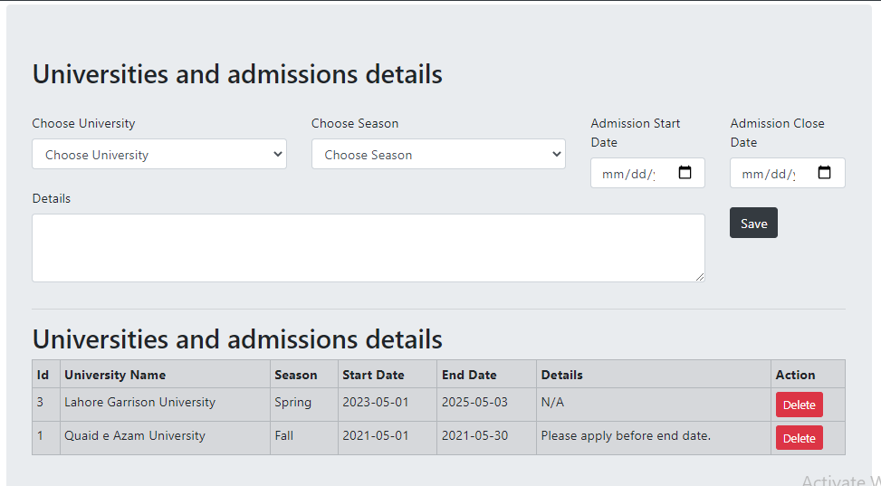
Admin (Add admission details)

Slide 30
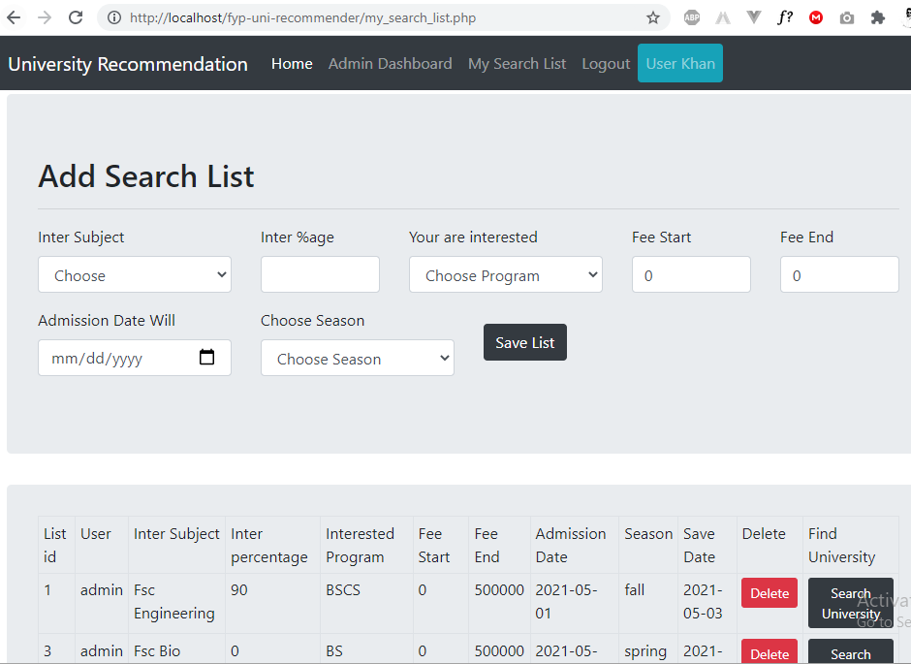
Pre defined List

Slide 31
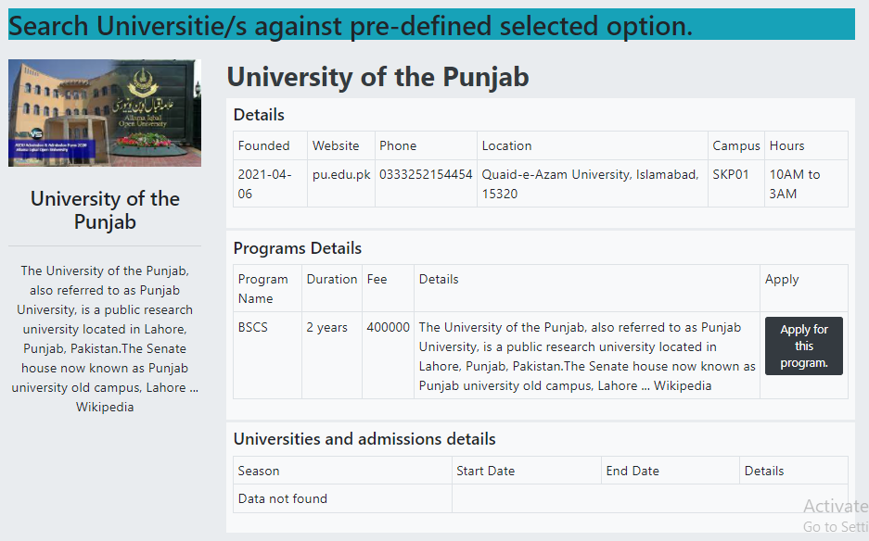
Pre defined selected results

Slide 32
Tools
PHP
MySQL
Bootstrap
Laragon (Local Server)
PHPSTORM

