Slide 1

A Project Report
PRESENTATION
AI4Sustain: Predicting the Environmental and Socio-Economic Impact of AI Expansion Using Machine Learning
SUBMITTED BY SUPERVISED BY
Mohd Hassan Dr. Aaina
2023-310-158
B.Tech CSE
SUBMITTED TO
Department of Computer Science & Engineering
School of Engineering Sciences & Technology
JAMIA HAMDARD

Slide 2
Objective
• Develop a full‑stack web application to quantify, visualise, and forecast the sustainability impact of AI infrastructure expansion.
• Collect real‑world data (energy, CO₂, water, GDP, renewables, population) from World Bank API for 261 countries.
• Engineer a synthetic AI Expansion Index as a proxy for AI infrastructure intensity.
• Train an XGBoost model for current sustainability score; an LSTM network for 2024‑2040 trajectory.
• Deploy an interactive world‑map dashboard for researchers, policymakers, and general public.

Slide 3
Problem Statement
• Rapid AI & data centre growth places unprecedented, uneven demands on global resources.
• No existing unified framework:
– Quantifies per‑country sustainability impact of AI expansion.
– Forecasts impact over a 15‑year horizon.
– Provides an intuitive, non‑technical visual interface.
– Integrates energy, water, carbon, socio‑economic, and renewable dimensions into a single risk score.
• AI4Sustain addresses this gap with a data‑driven, ML‑powered platform.

Slide 4
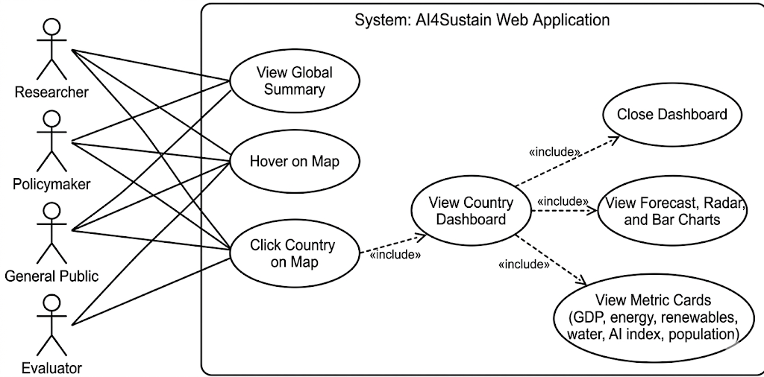
Use Case Diagram

Slide 5
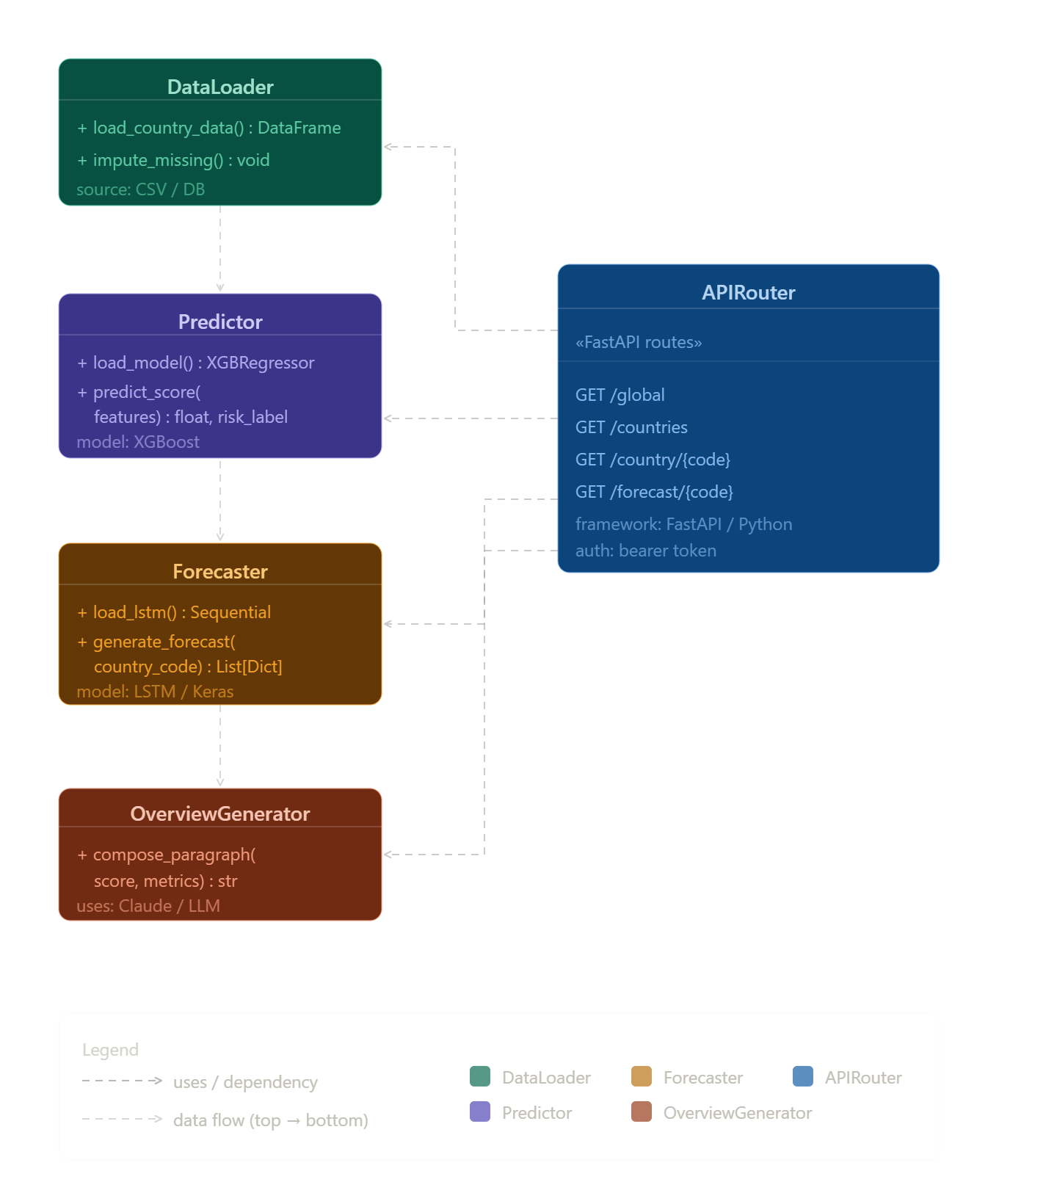
Class Diagram–Backend (FastAPI / Python)

Slide 6
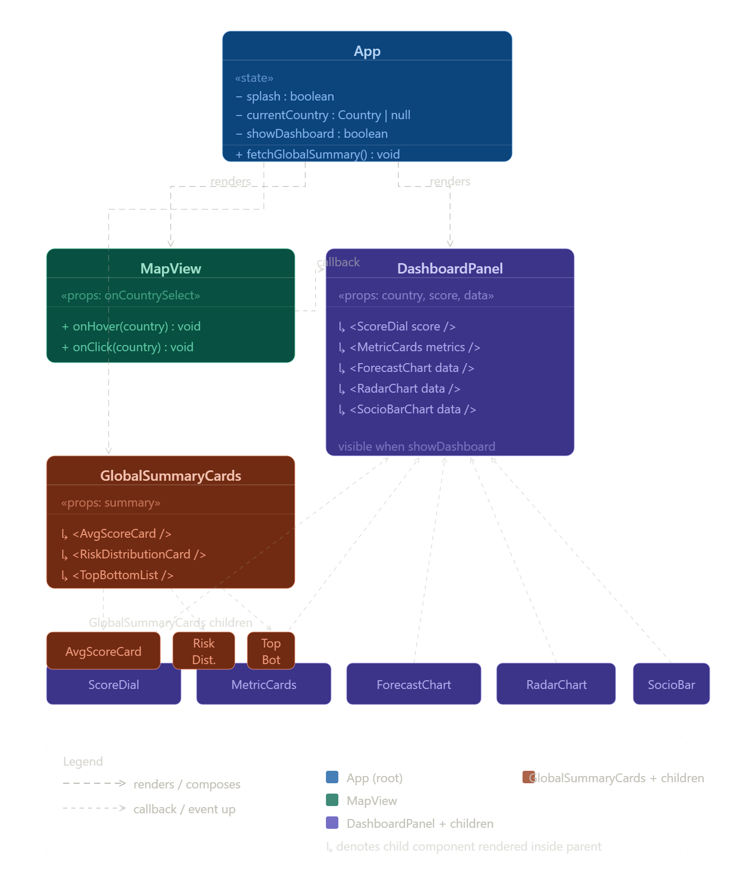
Class Diagram – Frontend (React)

Slide 7
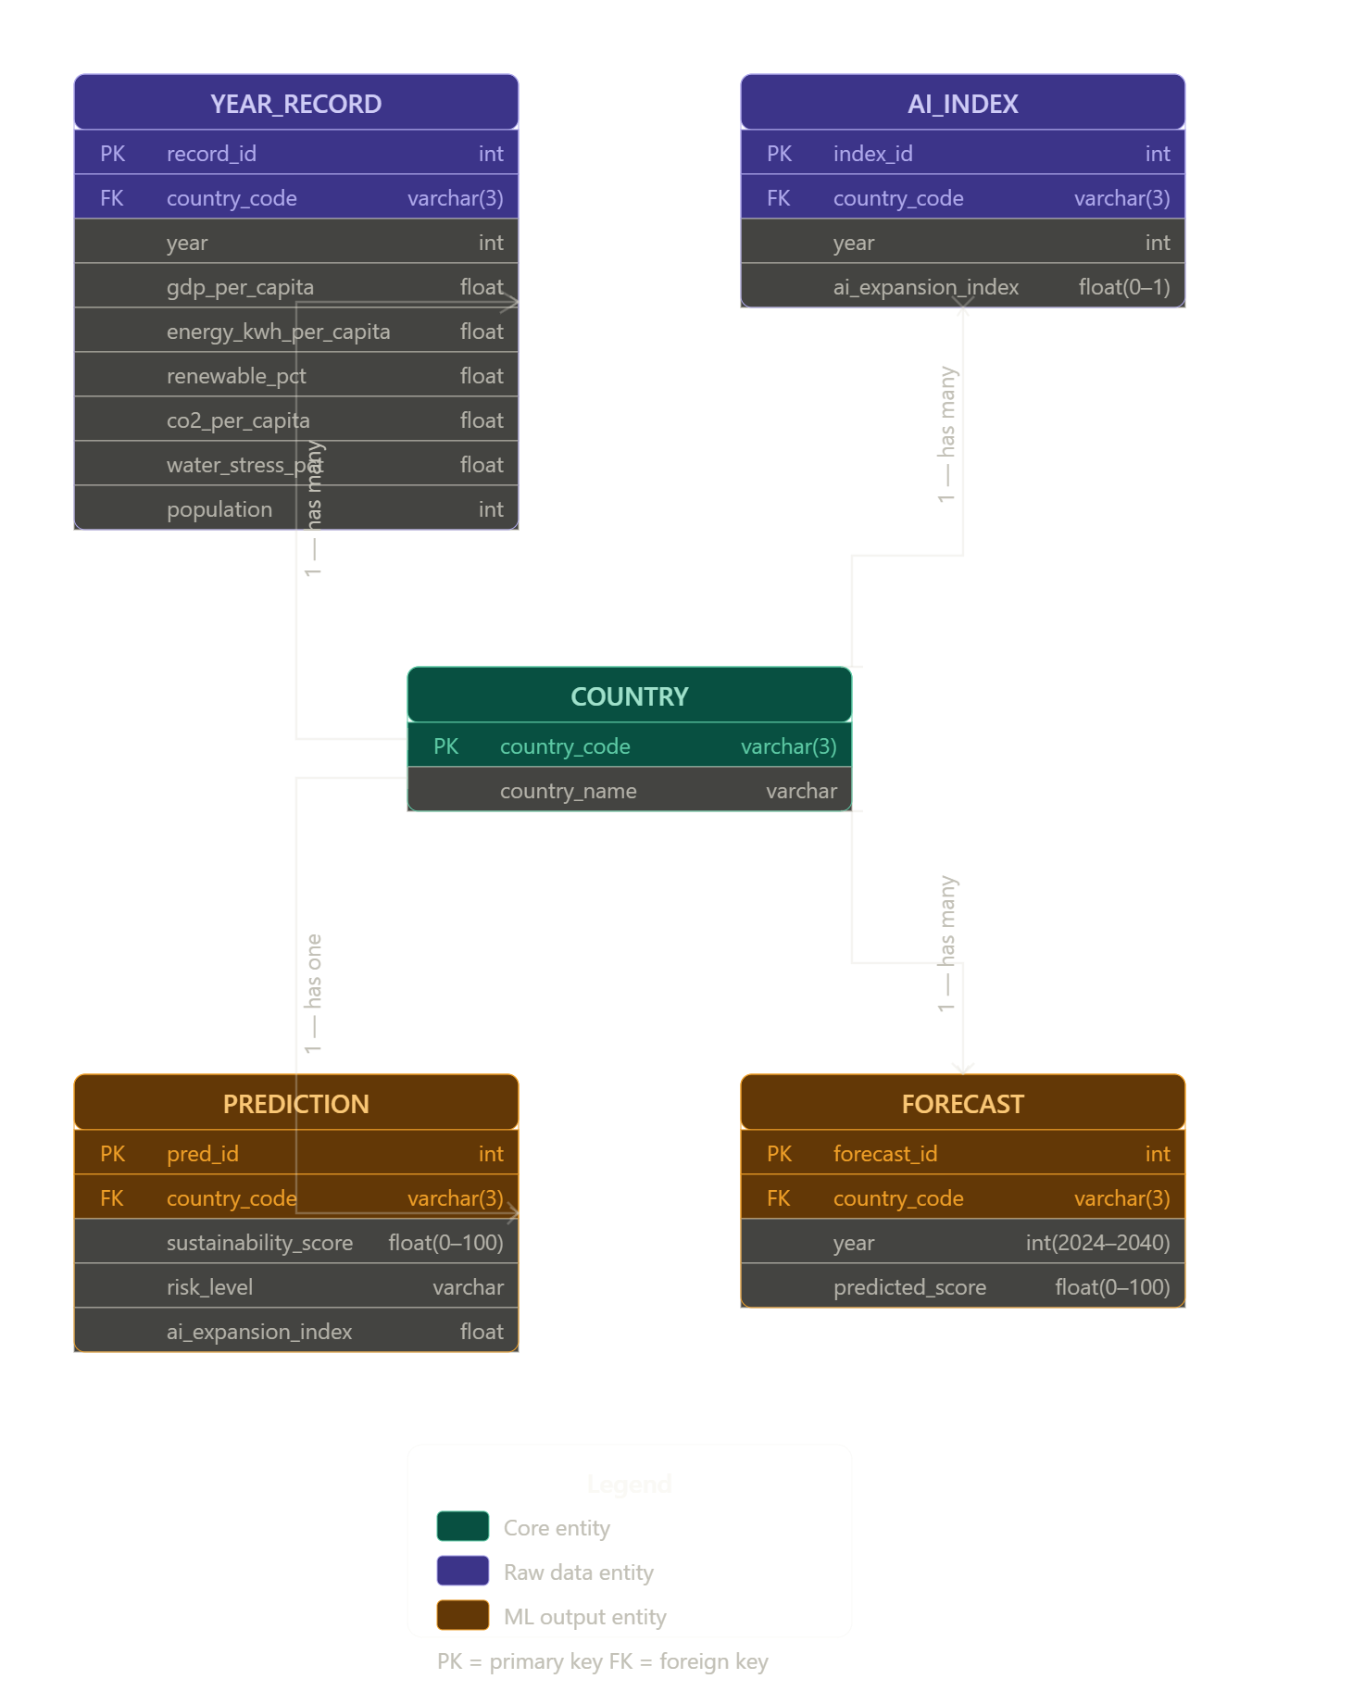
Entity Relationship Diagram

Slide 8
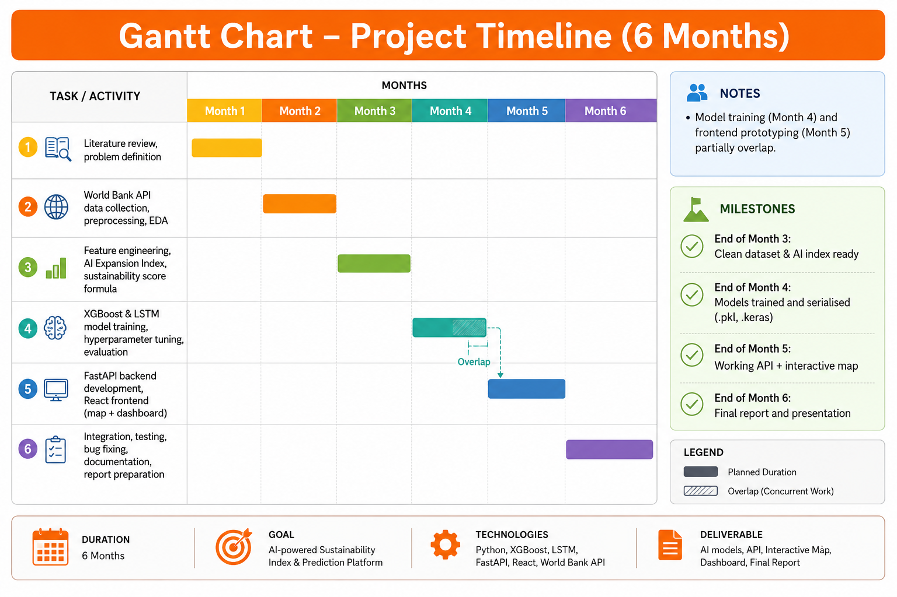
Gantt Chart-Project Timeline(6 months)
• Month 1: Literature review, problem definition
• Month 2: World Bank API data collection, preprocessing, EDA
• Month 3: Feature engineering, AI Expansion Index, sustainability score formula
• Month 4: XGBoost & LSTM model training, hyperparameter tuning, evaluation
• Month 5: FastAPI backend development, React frontend (map + dashboard)
• Month 6: Integration, testing, bug fixing, documentation, report preparation
• Model training (Month 4) and frontend prototyping (Month 5) partially overlap.
• Milestones:
– End of Month 3: Clean dataset & AI index ready
– End of Month 4: Models trained and serialised (.pkl, .keras)
– End of Month 5: Working API + interactive map
– End of Month 6: Final report and presentation

Slide 9
Conclusion
• AI4Sustain successfully delivers country‑level sustainability intelligence via ML.
• XGBoost captures current sustainability score with interpretable features; LSTM projects 15‑year trajectories.
• Interactive React dashboard makes complex multi‑indicator data accessible to broad audiences.
• Key insight: High‑income, fossil‑fuel‑dependent economies (e.g., Bahrain, Qatar, Kuwait) face the highest risk under unchecked AI expansion.
• The system is modular, replicable, and can be extended with new indicators or finer spatial resolution.
• Replace synthetic AI Expansion Index with real‑world data when available.
• Incorporate policy scenarios (carbon taxes, renewable mandates) into forecasts.
• Upgrade from national to sub‑national (city/state) granularity.
• Deploy as a public‑facing web service with authentication and rate limiting.
• Integrate real‑time energy/carbon APIs for live monitoring.

Slide 10
Bibliography (IEEE Format)
[1] T. Chen and C. Guestrin, "XGBoost: A scalable tree boosting system," KDD, 2016.
[2] S. Hochreiter and J. Schmidhuber, "Long short‑term memory," Neural Computation, 1997.
[3] World Bank Open Data, "World Development Indicators," data.worldbank.org.
[4] F. Chollet et al., "Keras: Deep Learning for Humans," GitHub, 2015.
[5] E. Strubell, A. Ganesh, and A. McCallum, "Energy and Policy Considerations for Deep Learning in NLP," ACL, 2019.
[6] A. Li et al., "Making AI Less Thirsty," arXiv:2304.03271, 2023.
[7] F. Pedregosa et al., "Scikit‑learn: Machine Learning in Python," JMLR, 2011.
[8] FastAPI Documentation, S. Ramirez, fastapi.tiangolo.com.
[9] React Documentation, Meta, react.dev.
[10] Leaflet.js, V. Agafonkin, leafletjs.com.
[11] International Energy Agency, "Electricity 2024," iea.org.
[12] Recharts, recharts.org.
[13] Vite, vitejs.dev.
[14] A. Vaswani et al., "Attention is all you need," NeurIPS, 2017.

