Slide 1
PROJECT PRESENTATION
AI Interview Preparation Assistant
An Intelligent Platform for Resume ATS Optimization, Adaptive Mock Interviews & Real-Time Fluency Analytics
PRESENTED BY
Syed Hasan Abbas
UUCMS ID: U18IW24S0186
Dept. of Computer Science & Engineering
PRESENTED BY
Srujan Shetty
UUCMS ID: U18IW24S0181
Dept. of Computer Science & Engineering
Technology Stack
Next.js 14 (App Router) • PostgreSQL & Prisma ORM • Google Gemini AI • Web Speech API • Tailwind CSS • NextAuth.js

Slide 2
1. INTRODUCTION
Background, Problem Statement & Proposed Solution
Understanding the challenges in interview preparation and our integrated AI approach
⚠ The Problem Landscape
• Fragmented Preparation: Candidates jump across disconnected portals: static PDF question banks, uncalibrated resume checkers, and isolated quizzes with zero unified feedback.
• Static & Robotic Question Banks: Conventional tools follow rigid, predetermined scripts. They do not listen, probe deeper into candidate replies, or ask dynamic follow-ups.
• No Behavioral & Speech Feedback: Interviews test communication pacing, pause duration, and filler word frequency, yet standard preparation platforms completely ignore vocal delivery.
• High Cost & Low Availability of Human Mocks: Scheduling live 1-on-1 human mock interviews is cost-prohibitive, stressful, and impossible to scale on-demand.
✓ Our Intelligent Solution
• End-to-End Preparation Lifecycle: Bridges resume ATS screening, tailored mock interviews, and automated post-session feedback in a single unified dashboard.
• Multi-Modal Adaptive AI Engine: Supports real-time voice streaming and text chat. Dynamically branches conversation, probes trade-offs, and scales question difficulty.
• Granular Speech & Fluency Metrics: Measures speaking rate (WPM), latency before speaking, pause frequency, and filler words (um, uh, like) to enhance candidate poise.
• Rubric Evaluation & Synthesis: Evaluates every response against industry competencies and delivers a quantitative report with YouTube video learning links.
AI Interview Preparation Assistant • Syed Hasan Abbas & Srujan Shetty
2 / 12

Slide 3
2. OBJECTIVES
Core Project Objectives & Engineering Goals
Key technical objectives driving the architectural design and system implementation
1
Conversational Mock Interviews
Develop an adaptive conversation engine across 4 interview tracks (Technical, HR, Managerial, and Aptitude) with real-time SSE token streaming and contextual follow-up probing.
2
Multi-Modal Voice & Text Support
Implement real-time Speech-to-Text (STT) and Text-to-Speech (TTS) integration with voice activity detection (VAD) to replicate natural dialogue flow with human interviewer personas.
3
Speech & Fluency Analytics
Track and quantify real-time communication metrics including words-per-minute (WPM), response latency, silent pause duration, and linguistic filler words to provide actionable delivery critique.
4
Rubric-Based Evaluation Pipeline
Implement an asynchronous background evaluation worker that scores candidate answers against structured competency pillars and scales interview difficulty (Junior to Lead).
5
Resume ATS Screening & Optimization
Provide intelligent resume parsing with keyword gap analysis, format validation, and ATS score computation against targeted job descriptions.
6
Security, Privacy & Decoupled Architecture
Deliver enterprise security with TOTP 2FA, zero-IP logging, isolated admin dashboards, and a provider-agnostic LLM interface allowing hot-swapping between Gemini and Groq.
AI Interview Preparation Assistant • Syed Hasan Abbas & Srujan Shetty
3 / 12

Slide 4
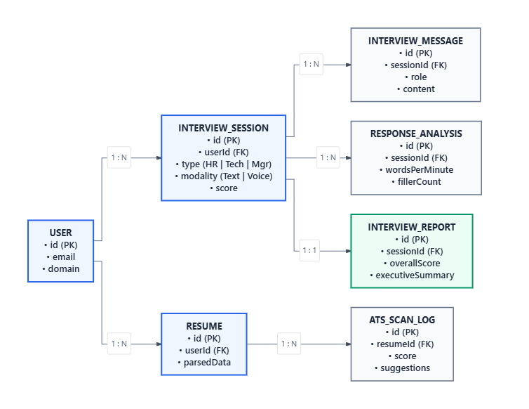
3. ER DIAGRAM
Entity-Relationship Data Model
Relational database schema representing users, interview sessions, turns, metrics, and reports
Database Entities & Cardinalities
• USER: Stores account credentials, profile settings, domain track, and TOTP 2FA secret (1:N with Session & Resume).
• INTERVIEW_SESSION: Core session state tracking interview type (HR | Tech | Mgr), modality (Text | Voice), and aggregate score.
• INTERVIEW_MESSAGE: Maintains ordered conversational turn history between candidate (role: user) and interviewer (role: assistant).
• RESPONSE_ANALYSIS: Captures per-turn vocal metrics including wordsPerMinute, fillerCount, latency, and pause frequency.
• INTERVIEW_REPORT: 1:1 relation with completed session containing final overallScore, executive summary, and rubric pillar breakdowns.
• RESUME & ATS_SCAN_LOG: Stores parsed resume data, targeted job description matching scores, and keyword recommendation logs.
AI Interview Preparation Assistant • Syed Hasan Abbas & Srujan Shetty
4 / 12

Slide 5
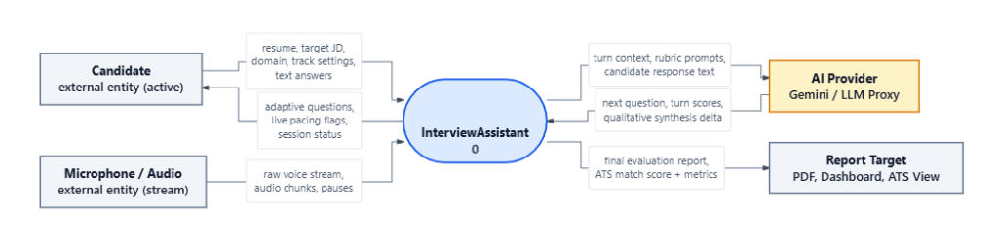
4. DATA FLOW DIAGRAM (DFD)
DFD Level 0 — Context Level Diagram
High-level boundary model illustrating interactions between external entities and InterviewAssistant
Candidate
ACTIVE EXTERNAL ENTITY
Inputs resume, target job description, domain track settings, and voice/text answers. Receives adaptive questions, pacing flags, and session status.
Microphone / Audio
STREAMING EXTERNAL ENTITY
Captures raw voice stream, audio frames, and silent pause intervals, providing raw signals for transcription and fluency computation.
AI Provider (Gemini / LLM)
COGNITIVE EXTERNAL ENTITY
Processes conversation turn context, rubric criteria, and candidate responses. Returns generated questions, rubric scores, and synthesis deltas.
Report Target
OUTPUT SINKS
Delivers finalized structured evaluations, ATS match percentage, performance dashboards, and exportable PDF interview diagnostic reports.
AI Interview Preparation Assistant • Syed Hasan Abbas & Srujan Shetty
5 / 12

Slide 6
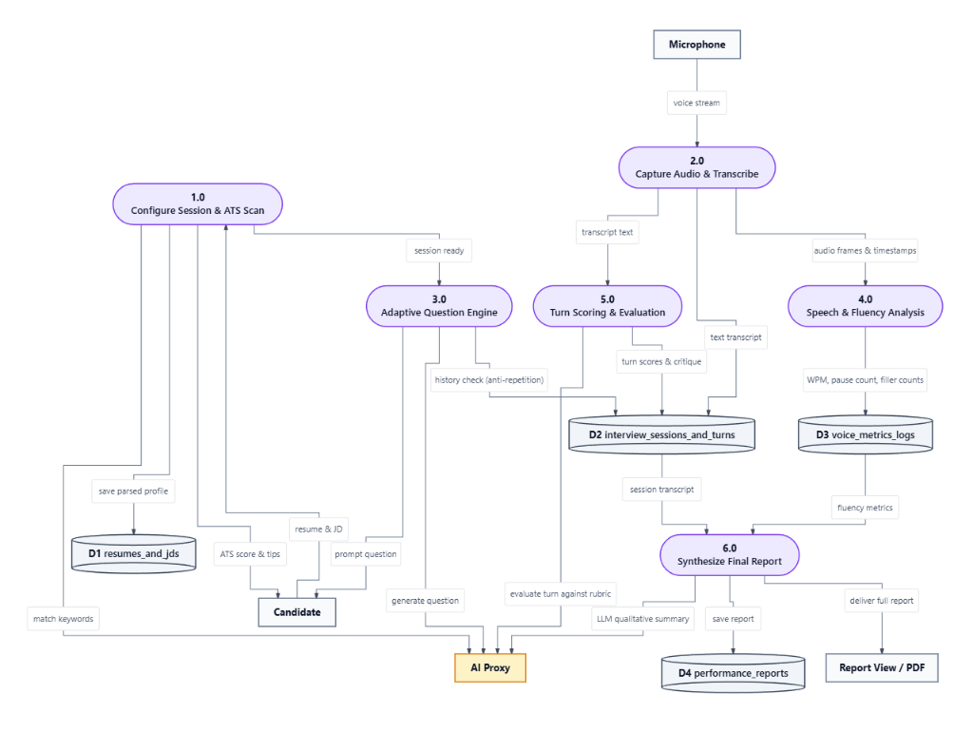
4. DATA FLOW DIAGRAM (DFD)
DFD Level 1 — Process Decomposition & Data Stores
Detailed data flow between system processes, data stores (D1–D4), candidate, and AI Proxy
Decomposition of Processes & Stores
• 1.0 Configure Session & ATS Scan: Parses candidate resume/JD, runs keyword gap analysis, and populates data store D1 (resumes_and_jds).
• 2.0 Capture Audio & Transcribe: Ingests voice stream from microphone, generates text transcript, and extracts audio frames with timestamps.
• 3.0 Adaptive Question Engine: Consults candidate history to prevent repetition and queries AI Proxy to formulate the next contextual interview question.
• 4.0 Speech & Fluency Analysis: Calculates words-per-minute (WPM), pause count, and filler frequencies, writing to D3 (voice_metrics_logs).
• 5.0 Turn Scoring & Evaluation: Evaluates candidate answer against rubric benchmarks and writes turn scores to D2 (interview_sessions_and_turns).
• 6.0 Synthesize Final Report: Combines transcripts and fluency logs to synthesize performance reports in D4 and generate PDF/dashboards.
AI Interview Preparation Assistant • Syed Hasan Abbas & Srujan Shetty
6 / 12

Slide 7
5. MODULE DESCRIPTION (WORKING CODE)
Module 1: Adaptive Interview Engine & Intent Orchestrator
State-driven conversation engine that classifies candidate intent and adapts dialogue dynamically
Engine Logic & State Machine
• Intent Classification: Detects greetings, introductions, meta-instructions (e.g. 'can you speak faster?'), requests to end, or substantive answers.
• Contextual Action Branching: Executes actions like DRILL_DOWN, CHALLENGE_TRADEOFF, or ADVANCE_PILLAR based on candidate response quality.
• Anti-Repetition History: Checks conversation transcripts against previously covered concepts to ensure fresh, progressive inquiry.
• Streaming AI Delivery: Server-Sent Events (SSE) stream the AI's tokens word-by-word with realistic human interviewer personas (Alex Chen, Sarah Martinez).
TypeScript • services/interview-engine.ts
export type InterviewAction =
| "OPEN_INTERVIEW" | "HANDLE_GREETING"
| "DRILL_DOWN" | "CHALLENGE_TRADEOFF"
| "ADVANCE_PILLAR" | "CONCLUDE_ROUND";
export function determineNextAction(
state: InterviewState,
candidateMessage: string
): { action: InterviewAction; reason: string } {
const classification = classifyCandidateMessage(candidateMessage);
if (classification.isGreeting) {
return { action: "HANDLE_GREETING", reason: "GREETING_DETECTED" };
}
if (classification.isSubstantive) {
// Check pillar progression depth
if (state.turnsInCurrentPillar >= 2) {
return { action: "ADVANCE_PILLAR", reason: "PILLAR_PROGRESSION_ADVANCE" };
}
return { action: "DRILL_DOWN", reason: "SUBSTANTIVE_PROBE_DEPTH" };
}
return { action: "PROMPT_FOR_SUBSTANCE", reason: "NON_SUBSTANTIVE_REPROMPT" };
}
AI Interview Preparation Assistant • Syed Hasan Abbas & Srujan Shetty
7 / 12

Slide 8
5. MODULE DESCRIPTION (WORKING CODE)
Module 2: Speech & Fluency Analysis
Real-time acoustic and linguistic analysis measuring pace, pauses, and disfluency
Fluency Metrics Computation
• Words Per Minute (WPM): Calculates speaking speed against standard conversational targets (ideal: 130–160 WPM). Flags rushing or hesitant delivery.
• Response Latency: Measures the silent hesitation window between interviewer question completion and candidate's first speech utterance.
• Filler Word Tracking: Regex scanning for verbal crutches ('um', 'uh', 'like', 'you know', 'basically') and computes fillers-per-100-words rate.
• Disfluency & Structure: Detects repeated words, false starts, and categorizes overall communication structure (Minimal, Concise, Balanced, Verbose).
TypeScript • services/response-analyzer.ts
export function calculateSpeakingRate(
wordCount: number,
speakingDurationSec: number
): SpeakingRateMetrics {
const wordsPerMinute = speakingDurationSec > 0
? Math.round((wordCount / speakingDurationSec) * 60)
: null;
return { wordCount, speakingDurationSec, wordsPerMinute };
}
const FILLER_PATTERNS = [
/\b(um|uh|er|ah)\b/gi,
/\b(like|you know|basically|actually)\b/gi
];
export function analyzeFillers(text: string, wordCount: number): FillerMetrics {
let count = 0;
FILLER_PATTERNS.forEach(regex => {
const matches = text.match(regex);
if (matches) count += matches.length;
});
const fillerRate = wordCount > 0
? Number(((count / wordCount) * 100).toFixed(2))
: 0;
return { fillerCount: count, fillerRate };
}
AI Interview Preparation Assistant • Syed Hasan Abbas & Srujan Shetty
8 / 12

Slide 9
5. MODULE DESCRIPTION (WORKING CODE)
Module 3: Turn Evaluation & Performance Synthesis
Asynchronous rubric evaluation worker and LLM qualitative report synthesizer
Evaluation Pipeline & Reporting
• Zod Rubric Validation: Enforces strict mathematical evaluation schemas (0–100 score, weight, evidence snippet, constructive feedback) per evaluated turn.
• Transactional Outbox Pattern: Decouples real-time conversation from LLM scoring using background `EvaluationJob` queue with automatic retry workers.
• Adaptive Difficulty Scaling: Evaluates candidate performance signals to dynamically adjust difficulty tier (Junior → Mid → Senior → Lead).
• Holistic Final Report: Synthesizes competency scores, speech metrics, executive summary, cited quote evidence, and YouTube learning recommendations.
TypeScript • services/evaluator.ts
export const RubricScoreSchema = z.object({
dimension: z.string().min(1),
score: z.number().int().min(0).max(100),
weight: z.number().min(0).max(1).default(1),
evidenceSnippet: z.string().default(""),
feedback: z.string().default(""),
});
export async function evaluateTurn(
sessionContext: SessionContext,
turn: TurnInput
): Promise<TurnEvaluationResult> {
const prompt = buildRubricPrompt(sessionContext, turn);
const rawResponse = await llmProvider.generate(prompt);
const parsed = TurnEvaluationSchema.parse(JSON.parse(rawResponse));
// Update pillar mastery & adaptive difficulty
const nextTier = computeAdaptiveDifficulty(parsed.overallScore);
return { ...parsed, nextDifficulty: nextTier };
}
AI Interview Preparation Assistant • Syed Hasan Abbas & Srujan Shetty
9 / 12

Slide 10
6. CONCLUSION
Project Summary & Key Engineering Milestones
Review of accomplishments, technical highlights, and system impact
✓ Conversational Realism
Replaced rigid question forms with genuine, thread-woven AI conversations that listen, probe edge cases, and adapt dynamically to candidate input.
✓ Multi-Modal Speech Intelligence
Integrated real-time speech recognition, latency tracking, and pause analysis, providing vital behavioral feedback absent in typical platforms.
✓ Enterprise Architecture & Security
Engineered provider-agnostic LLM orchestration, PostgreSQL persistence via Prisma, TOTP 2FA, zero-IP logging, and isolated admin dashboards.
✓ Complete End-to-End Value
Successfully connected resume ATS scanning, 4 interview tracks (Tech, HR, Mgr, Aptitude), automated scoring, and curated YouTube learning resources.
Deployment & Live Production
Deployed live on Vercel at https://ai-intweview-preparation-assistant.vercel.app/ backed by Supabase PostgreSQL and Google Gemini AI.
AI Interview Preparation Assistant • Syed Hasan Abbas & Srujan Shetty
10 / 12

Slide 11
7. FUTURE ENHANCEMENTS
System Evolution & Feature Roadmap
Strategic roadmap for scaling functionality, AI intelligence, and institutional adoption
SHORT TERM
Video & Computer Vision Analysis
Integrate WebRTC video capture with facial expression, gaze stability, and posture analysis to simulate full video panel interviews.
SHORT TERM
Acoustic Vocal Prosody Scoring
Upgrade from text-based silence checks to acoustic neural models measuring vocal tremor, pitch variation, and genuine spoken confidence.
MEDIUM TERM
Multi-Language Mock Interviews
Extend the NLP prompts and STT/TTS pipeline to support mock interviews in regional Indian languages (Hindi, Kannada) and international tongues.
MEDIUM TERM
AI-Powered Resume Transformation
Move from ATS diagnostics to automated resume rewriting, generating bullet points tailored to target job descriptions with quantifiable impacts.
LONG TERM
Embedded Code Execution (Judge0)
Expand the Monaco code editor into a full-fledged sandboxed IDE with Judge0 supporting multi-language compilation and automated test cases.
LONG TERM
Campus Placement Cell Portal
White-label portal for college placement drives with student cohort management, placement readiness scores, and recruiter analytics.
AI Interview Preparation Assistant • Syed Hasan Abbas & Srujan Shetty
11 / 12

Slide 12
Thank You!
AI Interview Preparation Assistant • Questions & Answers
Syed Hasan Abbas
UUCMS ID: U18IW24S0186
abbassyedhassa786@gmail.com
Srujan Shetty
UUCMS ID: U18IW24S0181
Dept. of Computer Science & Engineering
PROJECT LINKS & DEPLOYMENT
Live Web Application: https://ai-intweview-preparation-assistant.vercel.app/
GitHub: hassan-abbas06 • Database: Supabase PostgreSQL • AI: Google Gemini API

