Slide 1
Understanding Cyclomatic Complexity
Measuring Code Complexity in Software Development

Slide 2
What is Cyclomatic Complexity?
Cyclomatic Complexity is a metric used in software engineering to measure the complexity of a program. It indicates the number of linearly independent paths through a program's source code.

Slide 3
Why Measure Cyclomatic Complexity?
Helps in identifying complex code that may be error-prone.
Assists in simplifying code to improve maintainability and readability.
Useful in determining the number of test cases needed for thorough testing.

Slide 4
How to Calculate Cyclomatic Complexity
If the source code contained no control flow statements (conditionals or decision points) the complexity would be 1, since there would be only a single path through the code.
If the code had one single-condition IF statement, there would be two paths through the code: one where the IF statement is TRUE and another one where it is FALSE. Here, the complexity would be 2.
Two nested single-condition IFs, or one IF with two conditions, would produce a complexity of 3.

Slide 5
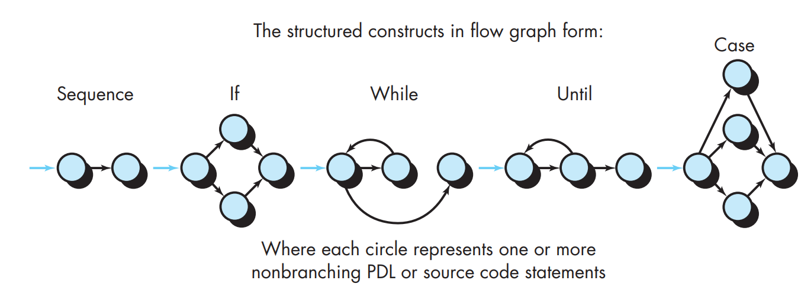
Flow Graph Notation
Before the basis path method can be introduced, a simple notation for the representation of control flow, called a flow graph (or program graph) must be introduced:

Slide 6
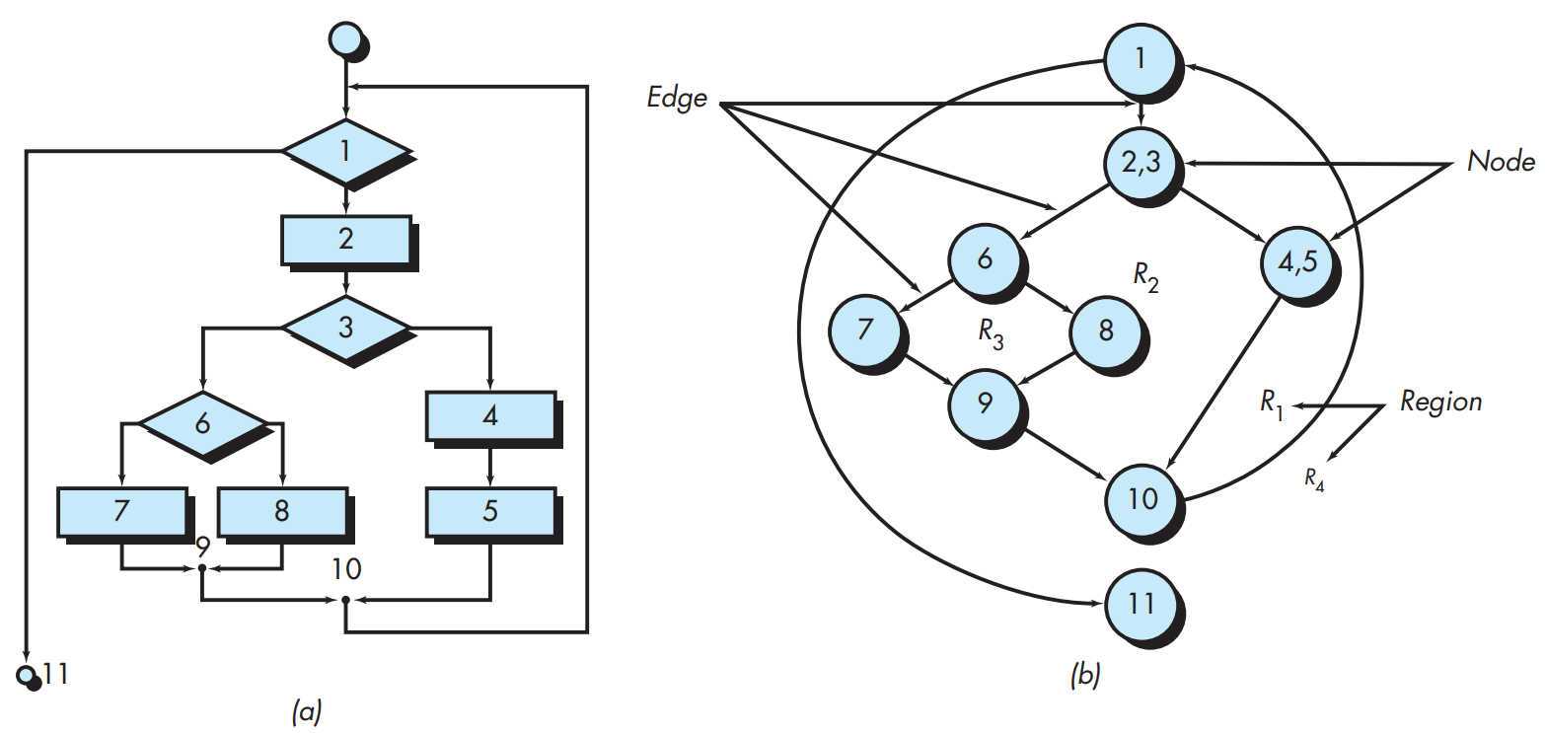
Figure 23.2

Slide 7
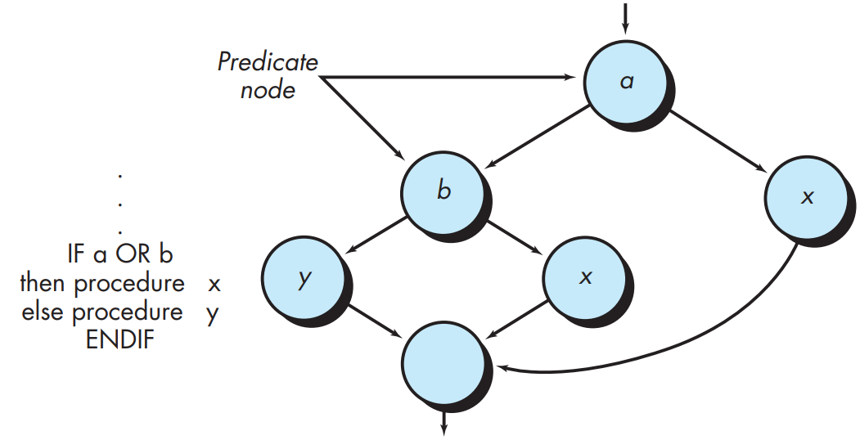

Slide 8
Independent Program Paths
Path 1: 1-11
Path 2: 1-2-3-4-5-10-1-11
Path 3: 1-2-3-6-8-9-10-1-11
Path 4: 1-2-3-6-7-9-10-1-11
Note that each new path introduces a new edge. The path 1-2-3-4-5-10-1-2-3-6-8-9-10-1-11

Slide 9
Independent Program Paths
1. The number of regions of the flow graph corresponds to the cyclomatic complexity.
2. Cyclomatic complexity V(G) for a flow graph G is defined as
V(G)= E-N+2 where E is the number of flow graph edges and N is the number of flow graph nodes.
3. Cyclomatic complexity V(G) for a flow graph G is also defined as
V(G)=P+1 where P is the number of predicate nodes contained in the flow graph G.

Slide 10
Independent Program Paths
Referring once more to the flow graph in Figure 23.2b, the cyclomatic complexity can be computed using each of the algorithms just noted:
The flow graph has four regions.
V(G)=11 edges - 9 nodes + 2 = 4.
V(G)= 3 predicate nodes + 1 = 4.

Slide 11
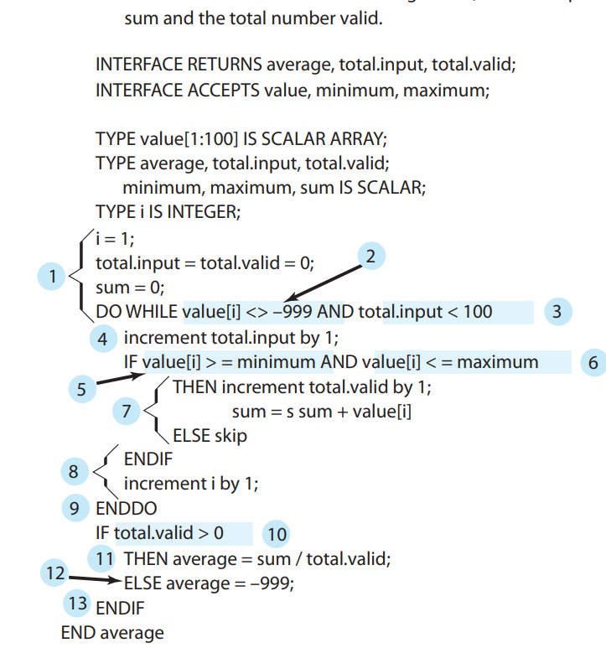

Slide 12
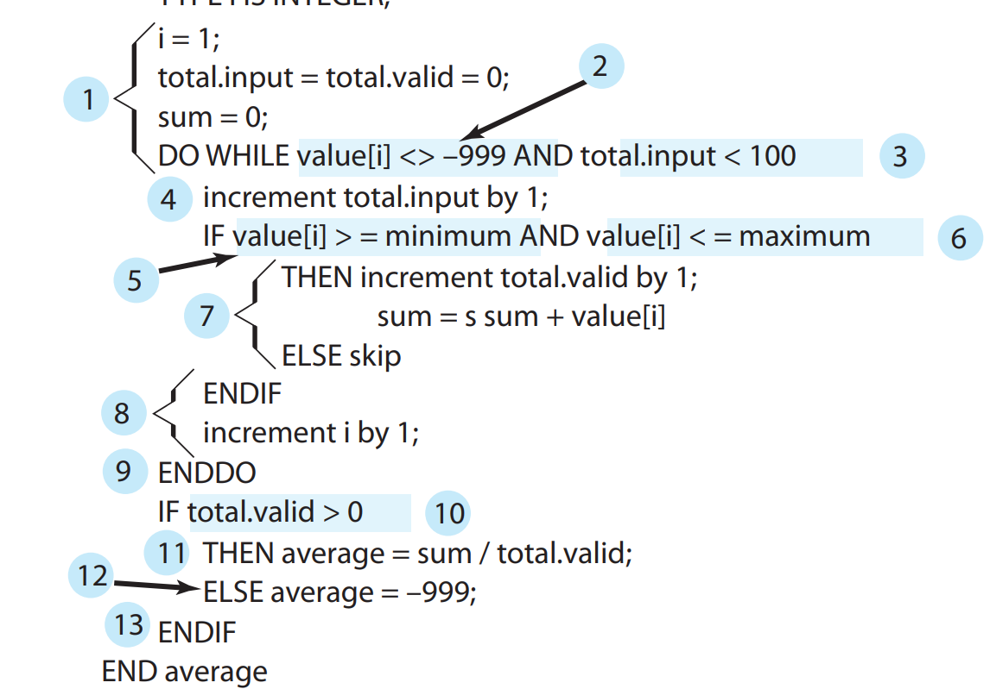

Slide 13
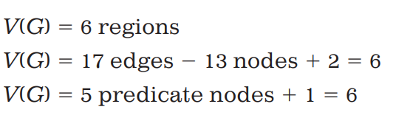
Six paths:
Path 1: 1-2-10-11-13
Path 2: 1-2-10-12-13
Path 3: 1-2-3-10-11-13
Path 4: 1-2-3-4-5-8-9-2-. . .
Path 5: 1-2-3-4-5-6-8-9-2-. . .
Path 6: 1-2-3-4-5-6-7-8-9-2-. . .

Slide 14
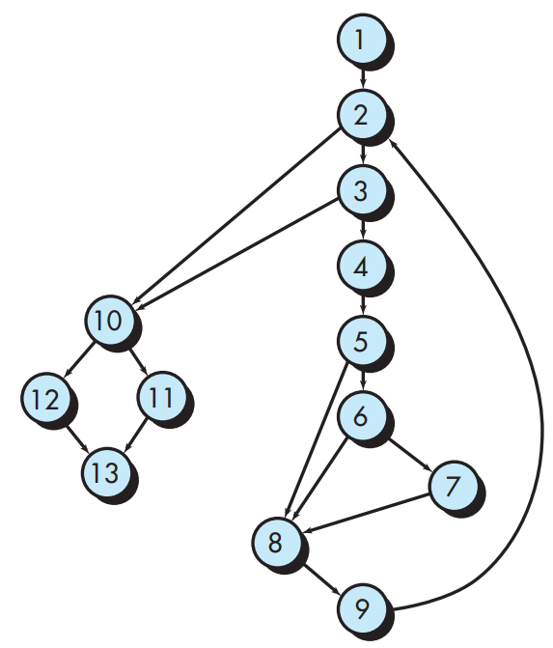

Slide 15
Example of Cyclomatic Complexity Calculation
A = 10 IF B > C THEN A = B ELSE A = C ENDIF Print A Print B Print C

Slide 16
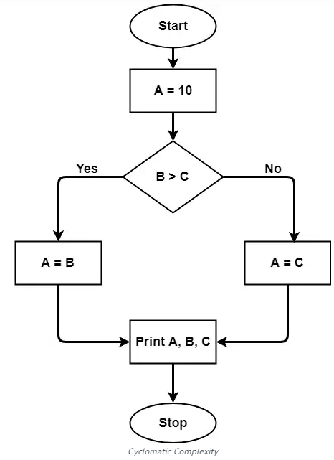
Example of Cyclomatic Complexity Calculation
The cyclomatic complexity calculated for the above code will be from the control flow graph. The graph shows seven shapes(nodes), and seven lines(edges), hence cyclomatic complexity is
M = E - N + 2P
7-7+2 = 2.

Slide 17
Example of Cyclomatic Complexity Calculation
Translating it into simpler language, it works like this: You transform your code into a graph. Each node in the graph is a statement of the code. The edges are what connects the nodes. Finally, P simply means the exit point of the program or routine.
Imagine a function with three consecutive statements and no structure or decision statement. Its graph would look like this
[ ] -> [1st statement] -> [2nd] -> [3rd] -> [exit]

Slide 18
Example of Cyclomatic Complexity Calculation
We have five nodes, four edges, and one connect component. Let’s replace all of that in the formula:
M = E - N + 2P
M= 4 - 5 + (2 * 1)

Slide 19
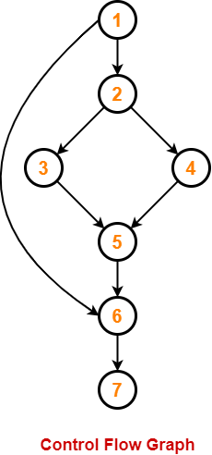
Example of Cyclomatic Complexity Calculation
1. IF A = 354
2. THEN IF B > C
3. THEN A = B
4. ELSE A = C
5. END IF
6. END IF
7. PRINT A

Slide 20
Example of Cyclomatic Complexity Calculation
Method-01:
Cyclomatic Complexity= Total number of closed regions in the control flow graph + 1 = 2 + 1
= 3
Method-02:
Cyclomatic Complexity = E – N + 2
= 8 – 7 + 2
= 3

Slide 21
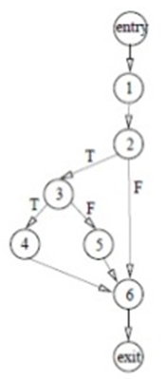
Example of Cyclomatic Complexity Calculation
0. Integer x,y,z
1. read x,y,z
2. if(x<y)
3. if(y<z)
4. x=z;
else
5. z=x;
endif
endif
6. print x,y,z
end example
V(G) = E – N + 2
=9-8+2
=3

Slide 22
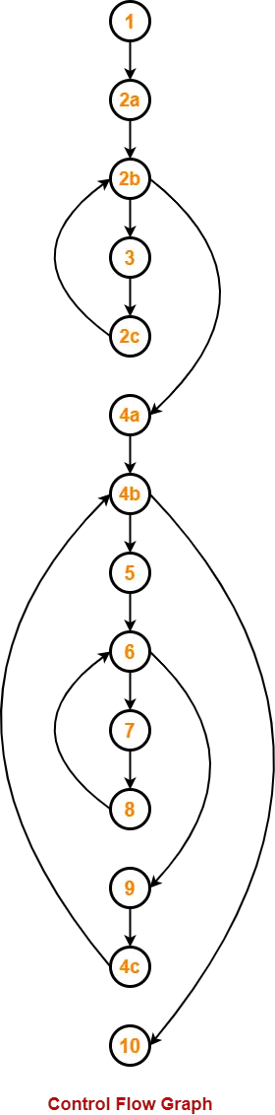
Example of Cyclomatic Complexity Calculation
1. {
1. int i, j, k;
2a,2b. for (i=0 ; i<=N ; i++)
3. p[i] = 1;
4a,4b. for (i=2 ; i<=N ; i++)
{
k = p[i]; j=1;
while (a[p[j-1]] > a[k] {
p[j] = p[j-1];
j--;
}
p[j]=k;
}

Slide 23
Example of Cyclomatic Complexity Calculation
Consider a simple program with the following control flow:
A -> B -> C (sequential statements)
B -> D (conditional statement)
Nodes (N): 4 (A, B, C, D)
Edges (E): 4 (A->B, B->C, B->D, D->C)
Complexity (M): 4 - 4 + 2*1 = 2
A
B
C
D

