Slide 1
Software Testing

Slide 2
Quality test cases, quality review and test processes

Slide 3
Software Testing
Computer programs are designed and developed by humans and hence are prone to errors.
Unchecked, they can lead to a lot of problems.
Testing the software becomes an essential part of the software development lifecycle.
Carrying out the testing activities for projects has to be practiced with proper planning and must be implemented correctly.

Slide 4
Software Testing - Definition
Software testing is a formal process carried out by a specialized testing team in which a software unit, several integrated software units or an entire software package are examined by running the programs on a computer. All the associated tests are performed according to approved test procedures on approved test cases.

Slide 5
What is Software Testing?
The process of finding evidence of defects in software systems.
Establishing confidence that a program does what it is supposed to do.
Software testing is not debugging.
Software testing is not quality assurance

Slide 6
Testing Vs Debugging
Testing is focused on identifying the problems in the product
Done by Tester
Need not to know the source code
Debugging is to make sure that the bugs are removed or fixed
Done by Developer
Need to know the source Code

Slide 7
Software Testing Vs Quality Assurance
Testing is necessary but not enough for QA process.
Testing contributes to improve quality by helping to identify problems.
QA sets standards that project team (including testers) should follow in order to build a better software.

Slide 8
What is Software Testing?
Correctness of software with respect to requirements;
Performance of software under various conditions;
Robustness of software, its ability to handle erroneous input and unanticipated conditions;
Installation and other facets of a software release.

Slide 9
Important Considerations
Detect system failures by choosing test inputs carefully.
Determine the faults leading to the failures detected.
Repair the faults leading to the failures .
Re-test the module/system.

Slide 10
Basic Questions on Testing
Why to test?
testing becomes essential to make sure the software works properly and does the work that it is meant to perform.
What to test?
Any working product which forms part of the software application has to be tested. Both data and programs must be tested.
How often to test?
When a program (source code) is modified or newly developed, it has to be tested.
Who tests?
Programmer, Tester and Customer (or third party)

Slide 11
Why do Failures Occur?

Slide 12
Software Testing Objectives
Direct objectives
To identify and reveal as many errors as possible in the tested software.
To bring the tested software, after correction of the identified errors and retesting, to an acceptable level of quality.
To perform the required tests efficiently and effectively, within the budgetary and scheduling limits.
Indirect objectives
To compile a record of software errors for use in error prevention (by corrective and preventive actions).

Slide 13
Software Testing Styles
Incremental testing strategies:
Test incrementally: Unit testing; Integration testing; System testing
Integration Testing
Bottom-up testing
Top-down testing
Big bang testing
Test entire software at one time

Slide 14
Bottom-Up Integration Testing
Lower level components are combined in clusters that perform a specific software function.
A driver (control program) is written to coordinate test case input and output.
The cluster is tested.
Drivers are removed and clusters are combined moving upward in the program structure.

Slide 15
Bottom-up Testing
M11
M9
M10
M8
M1
M2
M3
M4
M5
M6
M7

Slide 16
Bottom-up Testing
Stage 4
M11
Integration B
Integration c
Stage 3
M9
M10
Integration A
Stage 2
M8
Stage 1
M1
M2
M3
M4
M5
M6
M7

Slide 17
Top-Down Integration Testing
Main program used as a test driver and stubs are substituted for components directly subordinate to it.
Subordinate stubs are replaced one at a time with real components (following the depth-first or breadth-first approach).
Tests are conducted as each component is integrated.
On completion of each set of tests, stub is replaced with a real component.
Regression testing may be used to ensure that new errors not introduced.

Slide 18
Top-down Testing
Integration D
Integration C
Integration B
Integration A
Stage 1
M11
Stage 2
M9
M10
Stage 3
M8
Stage 4
M6
M7
Stage 5
M1
M2
Stage 6
M3
M4
M5

Slide 19
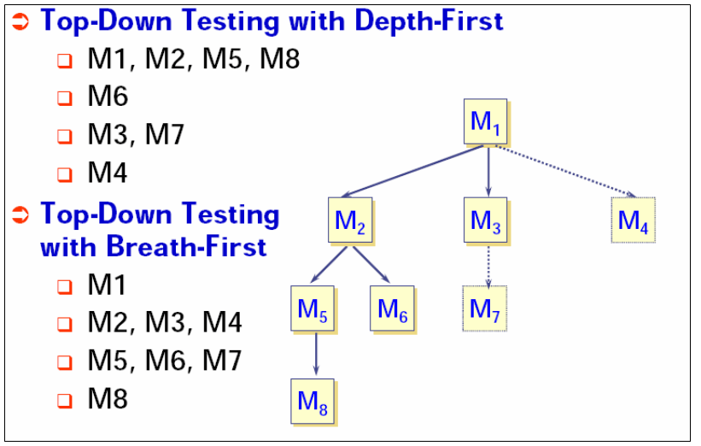
Top-down Testing

Slide 20
Stubs and Drivers: Example
Consider an example of a web application, which consists of 4 modules i.e., Module-A, Module-B, Module-C and Module-D. Each of the following modules is responsible for some specific activity or functionality, as under
Module-A ? Login page of the web application.
Module-B → Home page of the web application.
Module-C → Print Setup.
Module-D → Log out page.
modules A, B, C & D involves the interdependencies of each module over other.

Slide 21
Stubs and Drivers: Example
It is always preferable, to perform testing, in parallel, to the development process. Thus, it implies that subsequent testing must be carried out, immediately after the development of the each module.
Module-A will be tested, as soon as, it develops. However, to carry out and validate the testing procedures in respect of module-A, there urges the need of Module-B, which is not yet developed. The expected functionality of the login page (module-A) could be validated, only if it is directed to the home page (Module-B), based on the valid and correct inputs.
But, on the non-availability of the Module-B, it will not be possible to test module-A. These types of circumstances, introduces the stubs & drivers in the process of software testing.

Slide 22
Stubs and Drivers: Example
A dummy module, representing the basic functionality or feature of the module-B, is being developed, and thereafter, it is being integrated with the module-A, to perform testing, efficiently.
Similarly, stubs and drivers, are used to fulfil the requirements of other modules, such as
Log out page (Module-D), needs to be directed to the login page (Module-A), after successfully logging out from the application. In the event of unavailability of Module-A, stubs and drivers will work as a substitute for it, in order to carry out the testing of module-D.

Slide 23
Big Bang Integration Testing
All components or modules are integrated simultaneously, after which everything is tested as a whole.
Big Bang testing has the advantage that everything is finished before integration testing starts.
The major disadvantage is that, in general, it is time consuming and difficult to trace the cause of failures because of this late integration.

Slide 24
System Testing Process Test Cases

Slide 25
System Testing Process
Plan
Create master test plan (MTP) – done by test manager or test lead
Create Detailed Test Plan (what to test) – by testers – this will contain test scenarios also known as test conditions
Create Detailed Test Cases (DTC) – how to test – by testers
Execute
Regress and Analyze

Slide 26
What’s a test plan?
A software project test plan is a document that describes the objectives, scope, approach, and focus of a software testing effort
The following are some of the items that might be included in a test plan, depending on the particular project:
Title
Identification of software including version/release numbers
Revision history of document including authors, dates, approvals
Software product overview
Testing priorities and focus
Scope and limitations of testing
Test environment - hardware, operating systems, other required software, data configurations, interfaces to other systems

Slide 27
Detailed Test Plan
What is to be tested ?
Configuration – check all parts for existence
Security – how the safety measures work
Functionality – the requirements
Performance – with more users and more data
Environment – keep product same but other settings different

Slide 28
Test Plan
The goal of test planning is to establish the list of tasks to be performed
Testing will identify all of the requirements that have not been met in the software.
The main work product is the test plan.
The test plan documents the overall approach to the test. In many ways, the test plan serves as a summary of the test activities that will be performed.
It shows how the tests will be organized, and outlines all of the testers’ needs which must be met in order to properly carry out the test.
The test plan should be inspected by members of the engineering team and senior managers.

Slide 29
Test Plan…
What: a document describing the scope, approach, resources and schedule of intended testing activities; identifies test items, the features to be tested, the testing tasks, who will do each task and any risks requiring contingency planning.
Who: QA.
When: (planning)/design/coding/testing stage(s).

Slide 30
Test Plan…
Why:
Divide responsibilities between teams involved; if more than one QA team is involved
Plan for test resources / timelines.
Plan for test coverage.
Plan for OS / DB / software deployment and configuration models coverage.
QA role:
Create and maintain the document.
Analyze for completeness.
Have it reviewed and signed by Project Team leads/managers.

Slide 31
Test Planning
A Test Plan:
covers all types and phases of testing.
guides the entire testing process who, why, when, what
developed as requirements, functional specification, and high-level design are developed.
should be done before implementation starts.
A test plan includes:
test objectives
schedule and logistics
test strategies
test cases
procedure
data
expected result
procedures for handling problems

Slide 32
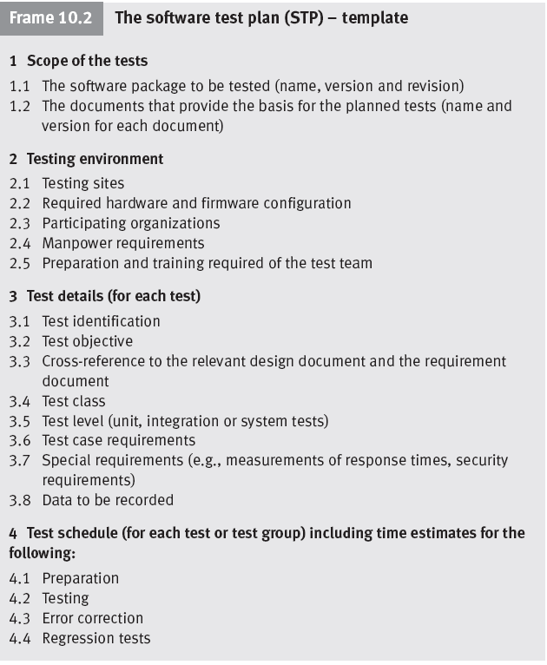
Software Test Plan - Contents

Slide 33
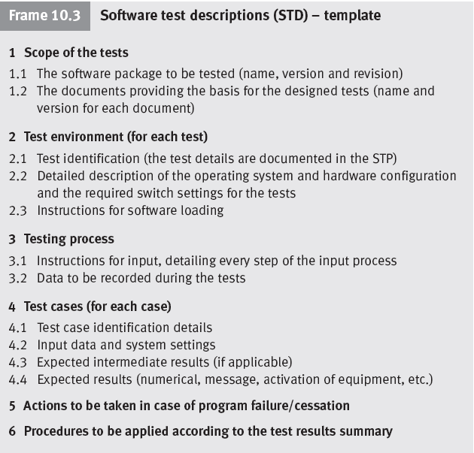
Software Test Plan - Contents

Slide 34
Test Cases

Slide 35
Testing
Testing is a process of identifying defects
Develop test cases and test data
A test case is a formal description of
A starting state
One or more events to which the software must respond
The expected response or ending state
Test data is a set of starting states and events used to test a module, group of modules, or entire system

Slide 36
Test Case
What: a set of inputs, execution preconditions and expected outcomes developed for a particular objective, such as exercising a particular program path or verifying compliance with a specific requirement;
Who: QA;
When: (planning)/(design)/coding/testing stage(s);
Why:
Plan test effort / resources / timelines;
Plan / review test coverage;
Track test execution progress;
Track defects;
Track software quality criteria / quality metrics;
Unify Pass/Fail criteria across all testers;
Planned/systematic testing vs Ad-Hoc.

Slide 37
Test Case…
A test case is a description of a specific interaction that a tester will have in order to test a single behavior of the software.
Test cases are very similar to use cases, in that they are step-by-step narratives which define a specific interaction between the user and the software.
A typical test case is laid out in a table, and includes:
ID: unique identifier of a test case, i.e. a unique name and number.
Features to be tested / steps / input values – what you need to do
A requirement which this test case is exercising.
Preconditions which describe the state of the software before the test case (which is often a previous test case that must always be run before the current test case)
Steps that describe the specific steps which make up the interaction
Expected Results / output values -what you are supposed to get from application
which describe the expected state of the software after the test case is executed.
Test cases must be repeatable.
Good test cases are data-specific, and describe each interaction necessary to repeat the test exactly.

Slide 38
Test Suite
A document specifying a sequence of actions for the execution of multiple test cases.
Purpose: to put the test cases into an executable order, although individual test cases may have an internal set of steps or procedures.
Is typically manual, if automated, typically referred to as test script (though manual procedures can also be a type of script).
Multiple Test Suites need to be organized into some sequence – this defines the order in which the test cases or scripts are to be run, what timing considerations are, who should run them etc.

Slide 39
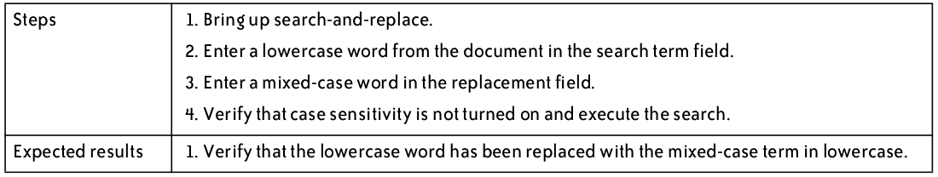
Test Cases – Bad Example

Slide 40
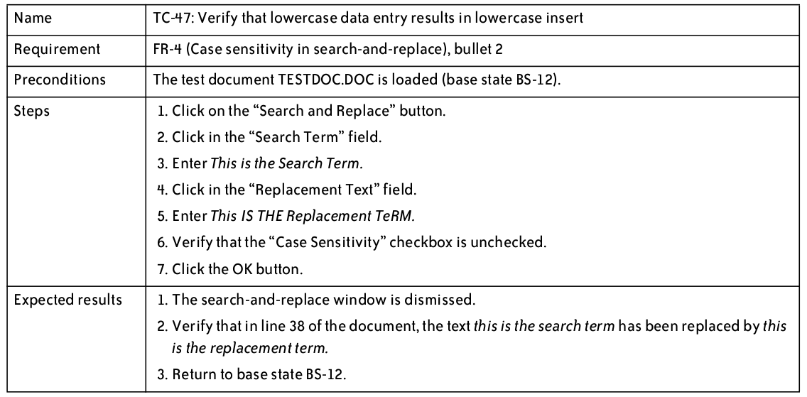
Test Cases – Good Example

Slide 41
Detailed Test Cases
The test cases will have a generic format as
below.
Test Case ID
Test Case Description
Test Prerequisite
Test Inputs
Test Steps
Expected Results

Slide 42
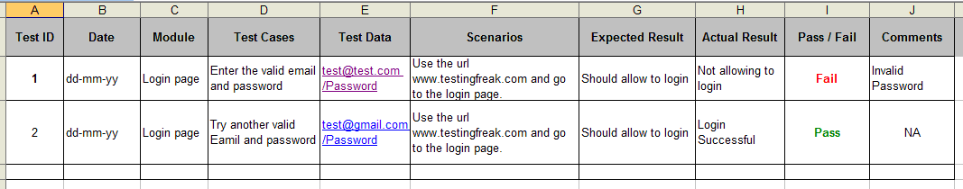
Detailed Test Cases

Slide 43
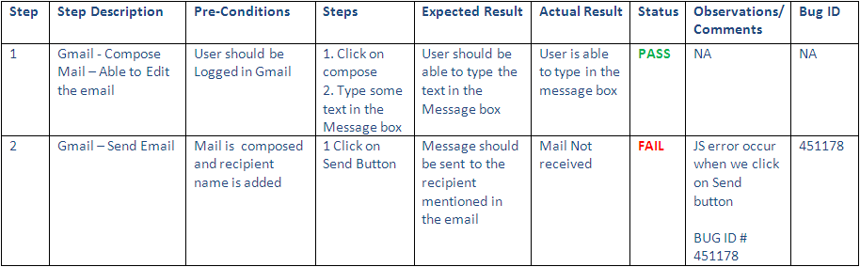
Detailed Test Cases

Slide 44
Test Problem Report or Bug Report
TPR Id | A unique identifier across the company
TPR Description | A brief description of the problem
Date | The date on which the TPR is raised
Author | The tester who raised the TPR
Test Case Id | The test case that caused this TPR to be raised
Software Version/Build | The version number of the software that was tested and found faulty
Problem Severity | Show stopper/High/Medium/Low. This will be agreed by the lead tester and the development project manager.
Priority | High/Medium/Low. How soon to fix?
Problem Detailed Description | A description of what was tested and what happened This will be filled by the tester.
Problem Resolution | After fixing the problem, the developer fills this section, with details about the fix. Developer gives this
Assigned to | To whom the TPR is assigned to be fixed
Expected Closure | When the problem to be closed Data
Actual closure data TPR status | When the problem is actually rectified and closed This is a changing field to reflect the status of the TPR.

