Slide 1

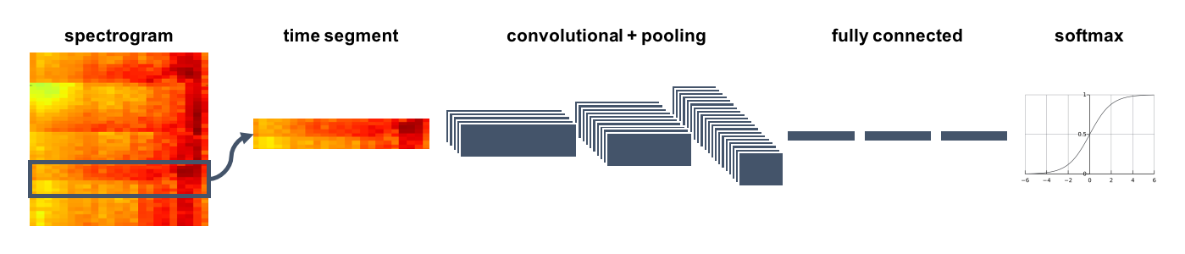
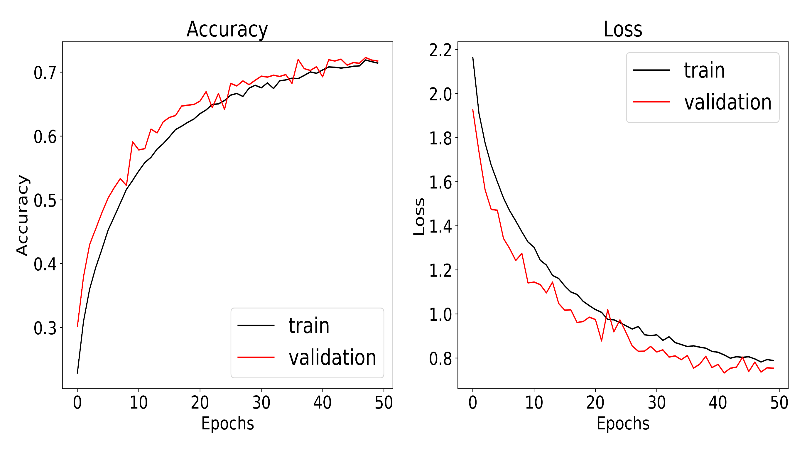
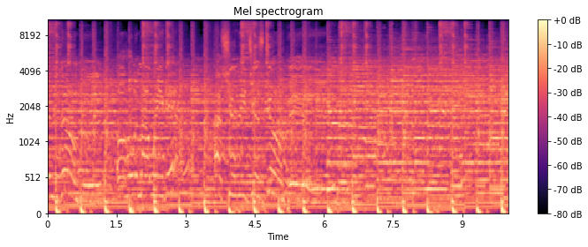
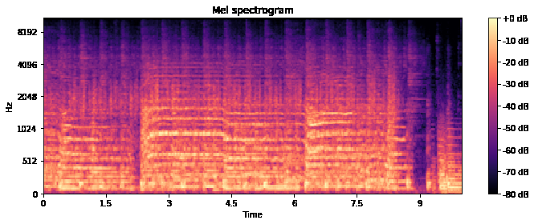
Music Genres Classification
Andrew Khalaf and Hassan Kandil
Department of Computer Science and Engineering, The American University in Cairo
Idea and Problem Statement
Architecture
Music genres are categories that have arisen through a complex interplay of cultures, artists, and market forces to characterize similarities between compositions and organize music collections. Yet the boundaries between genres remain fuzzy, making the problem of music genre recognition (MGR) a nontrivial task. In addition, The dramatic increase in the amount of published music all over the web has created a two challenges:
The need to automatically organize a collection
The need to automatically recommend new songs to a user knowing their listening habits.
Thus, we need to is to be able to group songs in semantic categories using artificial intelligence techniques. Accordingly, we proposed a solution to this problem as follows: given a music track, our aim is to classify its genre as one of 10 different genres through a deep learning model.
5 convolutional layers each followed by a max pooling layer and a dropout layer in order to prevent overfitting. Then, a fully-connected neural network of 2-hidden layers which produces the final scores of each genre.
Experimentation
- The following fine-tuning actions were conducted:
Addition of more convolutional layers with different number of filters, strides and padding. (showed no real benefit)
Addition of more Dense layers at the end of the model. (increased the number of weights but increased accuracy levels)
Different window sizes were tried out. A 3-second widow was first tried out yielding a testing accuracy of 68%. But a 1.5-second window proved to be yield better results.
Related Works
Researchers at Stanford proposed a solution to this problem in which they applied a variety of machine learning techniques to classify 16 music genres. The model with the best accuracy used SVM RBF and achieved an accuracy of 68.07%. This models were trained using a very large dataset which is composed of 25,000 30-second tracks built from the FMA dataset [4].
A different approach to the problem was using a VGG16 Convolutional Network Model, which is a very deep model with a large number of training parameters. Training was done using the popular GTZAN dataset. The best validation accuracy reached was around 86% [3].
Results
Contribution
Issues identified by researchers regarding the unreliability of the GTZAN dataset, we aimed to use the larger, more reliable and less explored FMA Medium Dataset [1]. However, due to computation resources limitation, loading the data was not feasible. Also, regarding a common issue that the dataset did not include updated tracks from recent music, we built up our own -better- dataset. The dataset is larger than the GTZAN yet within feasible size.
Mathematical background/Pre-processing
The results achieved are promising. Whereas, a CNN network of almost 240K weights can predict the correct genre out of 10 possible genres with an accuracy 72.3%. This accuracy The results out-scores the values achieved by Guo, I.et al, using their SVM RBF model that achieves 68% accuracy [4]
Each audio track is converted to an image-like format using a common signal processing technique called Mel-spectrograms. Input files are moved to Mel-spectrogram domain.
Tracks belonging to the same genre can produce similar patterns as shown in the picture
Also, each track is divided to a fixed number of windows.
Training Loss | Validation Loss | Training Accuracy | Validation Accuracy | Testing Accuracy
0.7821 | 0.7364 | 71.92% | 72.96% | 72.3%
Conclusions
Researchers should build up a proper, balanced and updated dataset.
Convolutional Networks are beneficial to extract features from musical tracks by converting the files to the Mel-spectrograms domain.
Future Work
Future researchers should try to experiment with a deeper network architecture.
Researchers should try experimenting with an ensemble network of 1D convolution and possibly with an R-CNN architecture.
The network should also be tested against more reliable data, preferably coming from FMA Datasets.
Figure 1: Pop Mel-Spectrogram
Figure 2: Rock Mel-Spectrogram
Dataset
The dataset used was a combination of GTZAN and FMA dataset[2]. It is composed in total of 2,500 tracks split into 10 different balanced genres, each track is 30 seconds.
References
The GTZAN dataset: Its contents, its faults, their effects on evaluation, and its future use Bob L. Sturm, June 10, 2013
FMA: A DATASET FOR MUSIC ANALYSIS Michaël Defferrard Kirell Benzi Pierre Vandergheynst Xavier Bresson
De Eguino, M. (2017). Deep Music Genre. Stanford University.
Guo, I., Gu,Z., and Liu,T., “Music Genre Classification via Machine Learning,” CS 299 Final Project, 2017.

