Slide 1
Information Retrieval (Lucene)
Section 1
Eng. Nesma Mahmoud

Slide 2
Section plan
Study Apache Lucene (or Lucene)
Discuss sheets
Implement some algorithms of IR in yourself
Project

Slide 3
Introduction – Search Engine & IR?
Search engine is a piece of software that helps users find the most relevant documents from big document collection (data store) in a simple and performant manner
The correct name for the process of finding right information from data store is information retrieval (IR).
By data store, we mean something that stores documents filled with information. It can be a hard disk with PDF, TXT and Word documents, or it can be a database, both relational or non relational, or some network with web pages

Slide 4
Introduction – Search Engine & IR?
IR is about getting the right document
To find the most relevant document in the document set, search engines or information retrieval engines are using some interesting data structures and algorithms.

Slide 5
Introduction – Lucene for IR
Goal: you need to build a search engine or information retrieval engine
It is not so common to build search engine from the scratch, since there are several engine libraries out there
One of the most famous one is Apache Lucene

Slide 6
Introduction – what is Lucene ?
Lucene or Apache Lucene:
is an open source Java library for Information Retrieval (IR)
Or text (Word & PDF docs, emails, webpages, tweets, etc) search engine library
allows you to add search capabilities to your application
Is not a complete search system by itself
Used by: Twitter, LinkedIn; Reddit, Zappos; CiteSeer, Eclipse, …
… and many more (see http://wiki.apache.org/lucene-java/PoweredBy)
Ports/integrations to other languages
C/C++, C#, Ruby, Perl, Python, PHP, …
Focus on indexing and searching documents (searches in text)

Slide 7
Lucene in a search system
1. indexing
Users
map the tokens into
indexes
Index document
Analyze document
convert the text into
tokens
Search UI
Index
2. Searching
Build document
Build query
Render results
Acquire content
Convert any format
(PDF, htm, …) to plain
text
Raw Content
Run query
Indexes storage: files, DB
Notes:
What is searching?
Take the user input
Create a query
Query the index
Return the results

Slide 8
Lucene Index: Inverted Index
Lucene index provides a mapping from terms (tokens) to documents.
This is called an inverted index because it reverses the usual mapping of a document to the terms it contains
aardvark
Little Red Riding Hood
0
hood
0
1
little
0
2
Robin Hood
1
Inverted
Index
red
0
riding
0
robin
1
Little Women
2
women
2
Documents
zoo
Notes:
In an inverted index, word, or terms, point to documents
The list of terms is sorted, so finding a term is very fast. From there, finding the list of documents for any term is very fast (it’s a simple list)
In reality, the terms are field specific… “red” in one field is indexed separately from “red” in another field
The “pointers” Lucene uses are document ids, internal integer identifiers for each document indexed.
Additional info is stored such as the number of times the term appeared in the field, and it’s positions in the field.

Slide 9
Lucene Implementation example
Steps of Lucene implementation: (indexing & searching)
Get Lucene jar file (library) & add it to you Java project
Write indexing code to get data and create Document objects to index with the IndexWriter
Core classes: IndexWriter, Directory, Analyzer, Document, Field
Write searching code that create query objects
Core classes: Query, QueryParser, IndexSearcher, TopDocs, ScoreDoc
Write code to use/display results

Slide 10
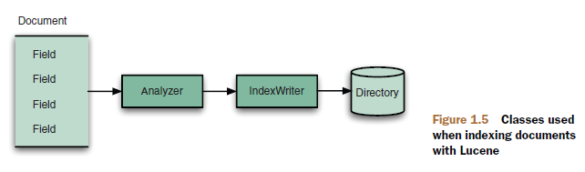
Core Indexing Classes
IndexWriter
Central component
allows to (1) create a new index, (2) open an existing one, and (3) add, remove, or update documents in an index
Built on an IndexWriterConfig and a Directory
Similar to DB table
Lucene index can be understood as a document folder
Document
Similar to a row in a relational DB or document in a document DB
Assigned a unique ID, a sequence number, (more usually called a DocId)
Field
One document is made up of one or more Fields.
The smallest definable unit of data index in Lucene
Text in these Fields are indexed
Lucene provides many different types of fields

Slide 11
Core Indexing Classes
Term
A field consists of one or more terms
A term is produced when a field put through an Analyzer (tokenizer)
The smallest unit of index and search in Lucene
Directory
Abstract class that represents the location of an index
Analyzer
Extracts tokens from a text stream
More Lucene concepts will be discussed

Slide 12
Core Searching Classes
Query
Abstract query class. Concrete subclasses represent specific types of queries, e.g., matching terms in fields, boolean queries, phrase queries, …
QueryParser
Parses a textual representation of a query into a Query instance
IndexSearcher
Central class that exposes several search methods on an index
This index is accessed via an IndexReader
TopDocs
Contains references to the top documents returned by a search
ScoreDoc
Represents a single search result
Query
IndexSearcher
TopDocs
IndexReader
Directory
Index

Slide 13
Core Searching Classes: TopDocs & ScoreDoc
TopDocs methods
totalHits: Number of top documents that matched the search
scoreDocs: Array of ScoreDoc instances containing results
getMaxScore(): Returns best score of all matches
ScoreDoc methods
doc: Document id
score: Document score

Slide 14
Lets code it ☺

Slide 15
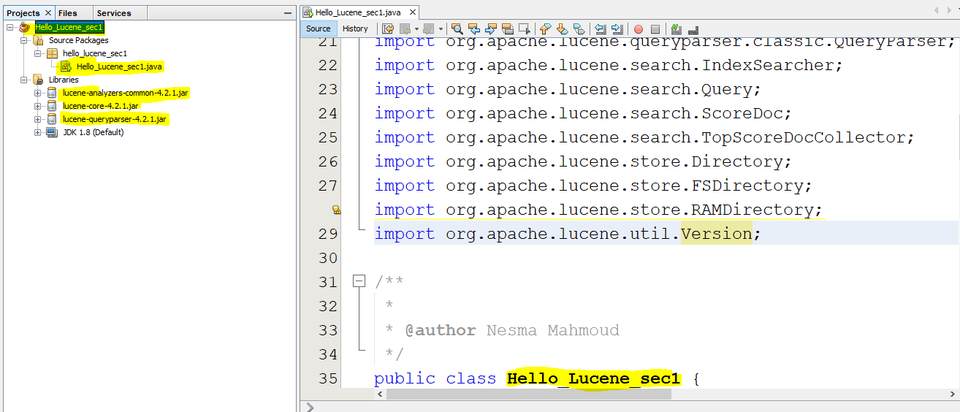
1. Create a new Java project, add Lucene Libraries to it, & create a class inside it
Don’t forgot to
import Lucene
classes
automatically

Slide 16
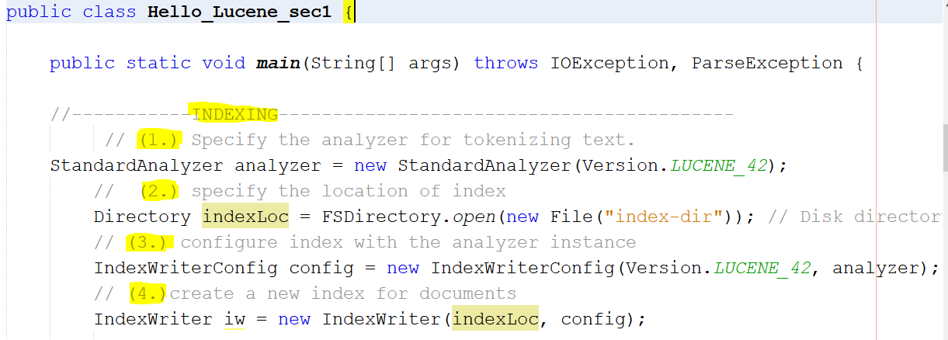
2. Create the index

Slide 17
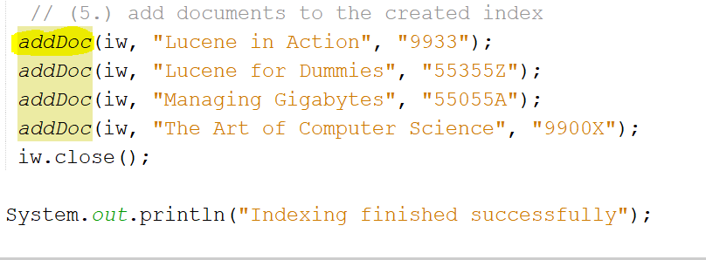
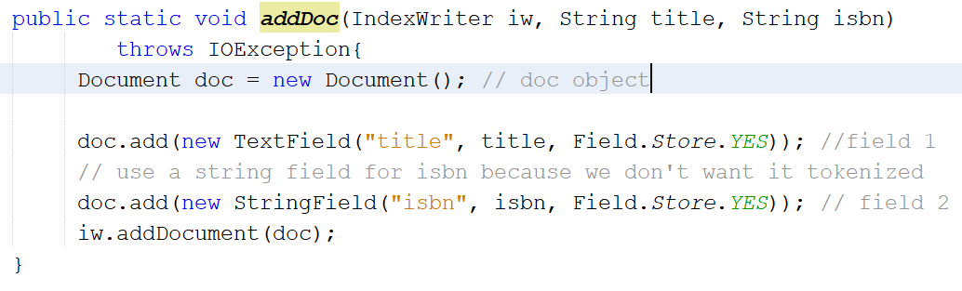
3. Add documents to the created index

Slide 18
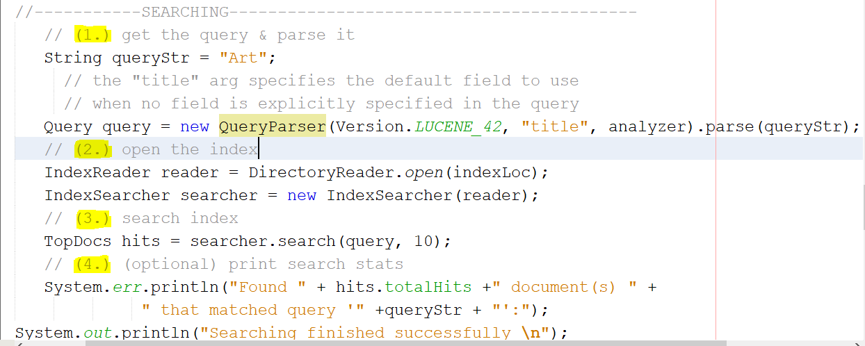
4. Search the index

Slide 19
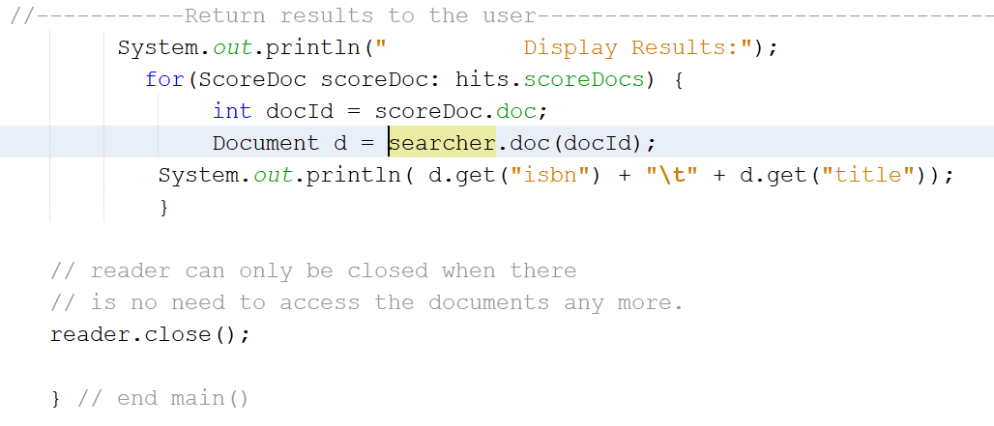
5. Display the results to the user

Slide 20
Next section
Understanding with more details of the indexing and searching in Lucene

Slide 21
Lucene Resources
Lucene: http://lucene.apache.org/core/
Lucene in Action: http://www.manning.com/hatcher3/
Code samples available for download
Ant: http://ant.apache.org/
Java build system used by “Lucene in Action” code

