Slide 1
Spelling correction

Slide 2
Spell correction
Sec. 3.3
Two principal uses
Correcting document(s) being indexed
Correcting user queries to retrieve “right” answers
Two main forms:
Isolated word
Check each word on its own for misspelling
Will not catch typos resulting in correctly spelled words
e.g., from → form
Context-sensitive(phrase check)
Look at surrounding words,
e.g., I flew form Heathrow to Narita.

Slide 3
Document correction
Sec. 3.3
Especially needed for OCR’ed documents
Correction algorithms are tuned for this: rn/m
E.g., OCR can confuse O and D more often than it would confuse O and I.
Goal: the dictionary contains fewer misspellings
But often we don’t change the documents and instead fix the query-document mapping

Slide 4
Query mis-spellings
Sec. 3.3
Our principal focus here
E.g., the query carot
We can either
Retrieve documents indexed by the correct spelling, OR
Return several suggested alternative queries with the correct spelling
Did you mean … ?

Slide 5
Isolated word correction
Sec. 3.3.2
Fundamental premise – there is a lexicon from which the correct spellings come
Two basic choices for this
A standard lexicon such as
Webster’s English Dictionary
An “industry-specific” lexicon – hand-maintained
The lexicon of the indexed corpus
E.g., all words on the web
All names, acronyms etc.

Slide 6
Isolated word correction
Sec. 3.3.2
carot
Given a lexicon and a string Q, return the words in the lexicon closest to Q
What’s “closest”?
We’ll study several alternatives
Edit distance (Levenshtein distance)
Weighted edit distance
n-gram overlap
carrot
tarot

Slide 7
Edit distance
Sec. 3.3.3
carot
carrot
tarot
Given two strings S₁ and S₂, the minimum number of operations to convert one to the other
Operations are typically character-level
Insert, Delete, Replace, (Transposition)
E.g., the edit distance from dof to dog is 1
From cat to act is 2 (Just 1 with transpose.)
from cat to dog is 3.
S₁=bouy S₂=boy edit operation “delete u” edit = 1
S₁=gun S₂=guy
-edit operation “delete n and insert y” edit = 2
-edit operation “replace n by y” edit = 1
MIN

Slide 8
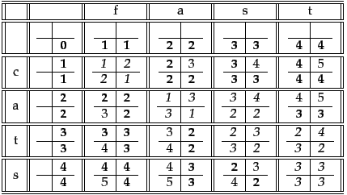
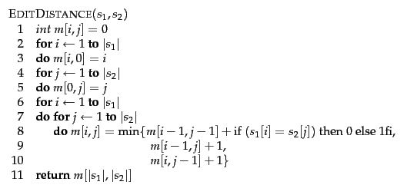
Edit distance

Slide 9
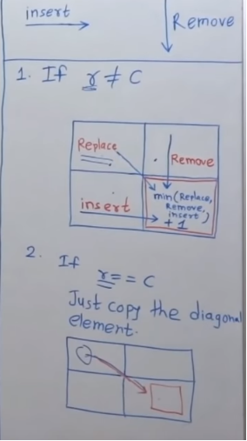
Edit distance
 |  | G | U | Y
 | 0 | 1 | 2 | 3
G | 1 | 0 | 1 | 2
U | 2 | 1 | 0 | 1
N | 3 | 2 | 1 | 1
Compute the edit distance between “paris and alice”

Slide 10
Edit distance Example
Compute the edit distance between “paris and alice”

Slide 11
Weighted edit distance
Sec. 3.3.3
As above, but the weight of an operation depends on the character(s) involved
Meant to capture OCR or keyboard errors Example: m more likely to be mis-typed as n than as q
Therefore, replacing m by n is a smaller edit distance than by q
This may be formulated as a probability model
Requires weight matrix as input
Modify dynamic programming to handle weights

Slide 12
Using edit distances
Sec. 3.3.4
Given query, first generate all strings within a preset (weighted) edit distance (e.g., 2)
Intersect this set with list of “correct” words in dictionary
Show terms you found to user as suggestions
Alternatively,
We can look up all possible corrections in our inverted index and return all docs … slow
We can run with a single most likely correction
The alternatives disempower the user, but save a round of interaction with the user

Slide 13
Edit distance to all dictionary terms?
Sec. 3.3.4
Given a (mis-spelled) query – do we compute its edit distance to every dictionary term?
Expensive and slow
Alternative?
How do we cut the set of candidate dictionary terms?
One possibility is to use n-gram overlap for this
This can also be used by itself for spelling correction.
Notes:
Alternative is to generate everything up to edit distance k and then intersect. Fine for distance 1; okay for distance 2. This is generally enough (Norvig).

Slide 14
n-gram overlap
Sec. 3.3.4
Enumerate all the n-grams in the query string as well as in the lexicon
Use the n-gram index to retrieve all lexicon terms matching any of the query n-grams
Threshold by number of matching n-grams
Variants – weight by keyboard layout, etc.

Slide 15
Example with trigrams
Sec. 3.3.4
Suppose the text is november
Trigrams are nov, ove, vem, emb, mbe, ber.
The query is december
Trigrams are dec, ece, cem, emb, mbe, ber.
So 3 trigrams overlap (of 6 in each term)
How can we turn this into a normalized measure of overlap?

Slide 16
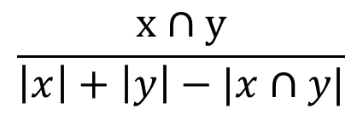
One option – Jaccard coefficient
Sec. 3.3.4
A commonly-used measure of overlap
Let X and Y be two sets; then the J.C. is
=
Equals 1 when X and Y have the same elements and zero when they are disjoint
X and Y don’t have to be of the same size
Always assigns a number between 0 and 1
Now threshold to decide if you have a match
E.g., if J.C. > 0.8, declare a match

Slide 17
Matching trigrams
Sec. 3.3.4
Consider the query lord – we wish to identify words matching 2 of its 3 bigrams (lo, or, rd)
lo
alone
lore
sloth
or
border
lore
morbid
rd
ardent
border
card
Standard postings “merge” will enumerate …
Adapt this to using Jaccard (or another) measure.

Slide 18
Context-sensitive spell correction
Sec. 3.3.5
Text: I flew from Heathrow to Narita.
Consider the phrase query “flew form Heathrow”
We’d like to respond
Did you mean “flew from Heathrow”?
because no docs matched the query phrase.

Slide 19
Context-sensitive correction
Sec. 3.3.5
Need surrounding context to catch this.
First idea: retrieve dictionary terms close (in weighted edit distance) to each query term
Now try all possible resulting phrases with one word “fixed” at a time
flew from heathrow
fled form heathrow
flea form heathrow
Hit-based spelling correction: Suggest the alternative that has lots of hits in query logs.

Slide 20
Another approach
Sec. 3.3.5
Break phrase query into a conjunction of biwords .
Look for biwords that need only one term corrected.
Enumerate only phrases containing “common” biwords.

Slide 21
Soundex

Slide 22
Soundex
Sec. 3.4
Class of heuristics to expand a query into phonetic equivalents
Language specific – mainly for names
E.g., chebyshev → tchebycheff
Invented for the U.S. census … in 1918

Slide 23
Soundex – typical algorithm
Sec. 3.4
Turn every token to be indexed into a 4-character reduced form
Do the same with query terms
Build an soundex index on the reduced forms
(when the query calls for a soundex match, search soundex index)

Slide 24
Soundex – typical algorithm
Sec. 3.4
Retain the first letter of the word.
Change all occurrences of the following letters to '0' (zero): 'A', E', 'I', 'O', 'U', 'H', 'W', 'Y'.
Change letters to digits as follows:
B, F, P, V → 1
C, G, J, K, Q, S, X, Z → 2
D,T → 3
L → 4
M, N → 5
R → 6

Slide 25
Soundex continued
Sec. 3.4
Remove all pairs of consecutive digits.
Remove all zeros from the resulting string.
Pad the resulting string with trailing zeros and return the first four positions, which will be of the form <uppercase letter> <digit> <digit> <digit>.
E.g., Herman becomes H655.
Will hermann generate the same code?
What code can be generated to “Osama”, “Osmaa”,”Mehmed”,”Mohamed”

Slide 26
Soundex
Sec. 3.4
Soundex is the classic algorithm, provided by most databases (Oracle, Microsoft, …)
How useful is soundex?
Not very – for information retrieval
Okay for “high recall” tasks (e.g., Interpol), though biased to names of certain nationalities
Zobel and Dart (1996) show that other algorithms for phonetic matching perform much better in the context of IR

