Slide 1
Game programming
Lecture 4: Lighting and shading
By Dr. Rokia Abdein

Slide 2
Lighting and shading
The term lighting or illumination is often used to describe the process by which the color and intensity of light reaching a surface is determined.
The term shading normally describes the methods used to determine the color and intensity of light reflected toward the viewer for each point on a surface.
This color depends on the properties of the light sources illuminating the surface as well as the reflective characteristics of the surface itself.

Slide 3
Lighting and shading
The interaction between light and a surface is a complex physical process. Photons can be absorbed, reflected, or transmitted when they strike the surface of a material.
To model this interaction using the whole of today’s knowledge of physics would be far too computationally time-consuming. Instead, we must settle for models that approximate the expected appearance of a surface.

Slide 4
RGB Color..
A precise model describing the reflection of light by a surface would account for every wavelength of light in the visible spectrum.
However, the cone cells in the human eye are generally sensitive to three different overlapping regions of the visible spectrum corresponding to the colors red, green, and blue.
Thus, TVs and computer displays are able to produce a wide range of colors by combining red, green, and blue light in different proportions.
For instance, yellow is produced by blending equal parts red and green. This system is commonly referred to as RGB color.
Colors that are made up of more than one wavelength of light, such as brown, can also be simulated using RGB color.

Slide 5

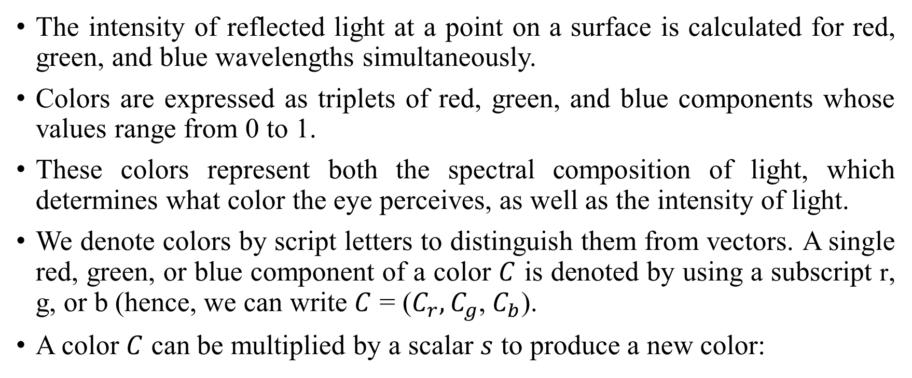
RGB Color..
The intensity of reflected light at a point on a surface is calculated for red, green, and blue wavelengths simultaneously.
Colors are expressed as triplets of red, green, and blue components whose values range from 0 to 1.
These colors represent both the spectral composition of light, which determines what color the eye perceives, as well as the intensity of light.
We denote colors by script letters to distinguish them from vectors. A single red, green, or blue component of a color $C$ is denoted by using a subscript r, g, or b (hence, we can write $C$ = ($C_{r},C_{g}$, $C_{b}$).
A color $C$ can be multiplied by a scalar $s$ to produce a new color:

Slide 6
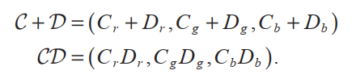
RGB Color..
Addition and multiplication of colors are performed component-wise. That is, for two colors C and D, we have:
Color multiplication, either by another color or by a scalar, is also called modulation.
The color of a pixel belonging to a rendered triangle is usually determined through some combination of colors from multiple sources.

Slide 7
RGB Color..
The color of a pixel on the face of a triangle is commonly derived from the product of a color looked up in a texture map and another color that is interpolated among the triangle’s vertices. In this case, we say that the texture color is modulated by the vertex color.

Slide 8
Light sources..
The color that we calculate for any point on a surface is the sum of contributions from all the light sources that illuminate the surface.
The standard types of light sources supported by 3D graphics systems come in four varieties: ambient, directional, point, and spot.

Slide 9
Ambient Light..
The ambient light present at a certain location is the low-intensity light that arises from the many reflections of light on all nearby surfaces in an environment.
Ambient light provides a rough approximation of the general brightness of an area and replaces the complexities of calculating all the inter-object reflections in a scene.
Ambient light appears to come from every direction with equal intensity, and thus illuminates every part of an object uniformly.

Slide 10







Directional Light Sources..
A directional light source, also known as an infinite light source, is one that radiates light in a single direction from infinitely far away. Directional lights are typically used to model light sources such as the sun, whose rays can be considered parallel.
Since they have no position in space, directional lights have infinite range, and the intensity of the light they radiate does not diminish over distance.

Slide 11
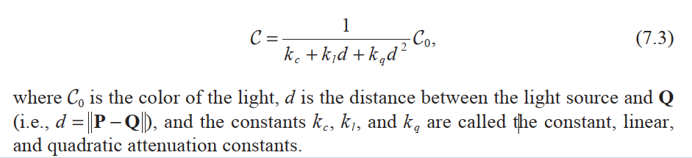






Point Light Sources..
A point light source is one that radiates light equally in every direction from a single point in space. The intensity of light naturally decreases with distance according to the inverse square law.
Suppose that a point light source has been placed at a point P. The intensity C of light reaching a point in space Q is given by :

Slide 12

Point Light Sources..
In the newer programmable shading environments provided by OpenGL and Direct3D, any kind of fall-off function can be achieved, and it’s often the case that a point light’s intensity is intentionally made to become zero beyond a certain distance from the light.
This limits the light’s volume of influence so that objects too far from the light to receive significant illumination don’t have to be rendered for that light source. This by itself helps game engines run faster .

Slide 13
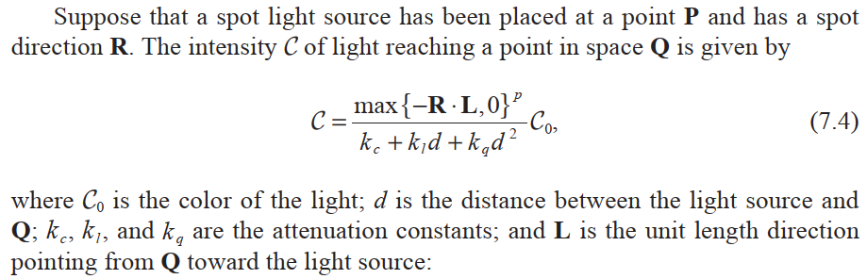
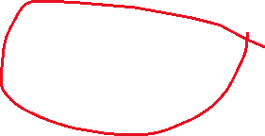




Spot Light Sources..
A spot light is similar to a point light but has a preferred direction of radiation. The intensity of a spot light is attenuated over distance in the same way that it is for a point light and is also attenuated by another factor called the spot light effect.

Slide 14







Slide 15

Spot Light Sources..
The exponent p controls how concentrated the spot light is. As shown in Figure 7.1, a large value of p corresponds to a highly focused spot light having a sharp falloff, whereas a smaller value of p corresponds to a less concentrated beam.
The spot light is most intense when R = −L and gradually falls off as the angle between R and −L increases. No radiation from a spot light reaches a point for which the angle between R and −L is greater than 90 degrees.

Slide 16
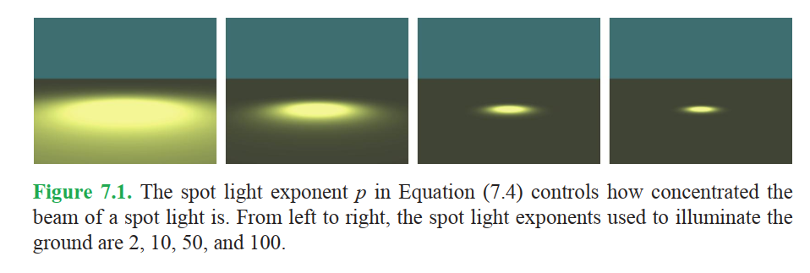

Spot Light Sources..

Slide 17











Diffuse Reflection..
A diffuse surface is one for which part of the light incident on a point on the surface is scattered in random directions. The average effect is that a certain color of light, the surface’s diffuse reflection color, is reflected uniformly in every direction.
This is called the Lambertian reflection, and because light is reflected equally in every direction, the appearance of the Lambertian reflection does not depend on the position of the observer.

Slide 18
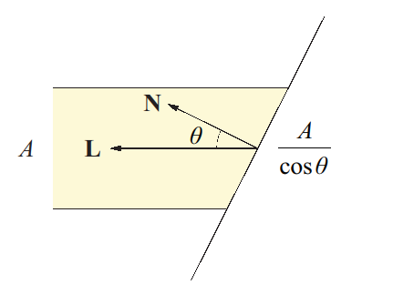







Diffuse Reflection..
As shown in Figure 7.2, a beam of light having a cross-sectional area A illuminates the same area A on a surface only if the surface is perpendicular to the direction in which the light is traveling. As the angle between the normal vector and the light direction increases, so does the surface area illuminated by the beam of light.
If the angle between the normal vector and light direction is θ, then the surface area illuminated by the beam of light is equal to A/cosθ. This results in a decrease in the intensity of the light per unit surface area by a factor of cosθ .

Slide 19
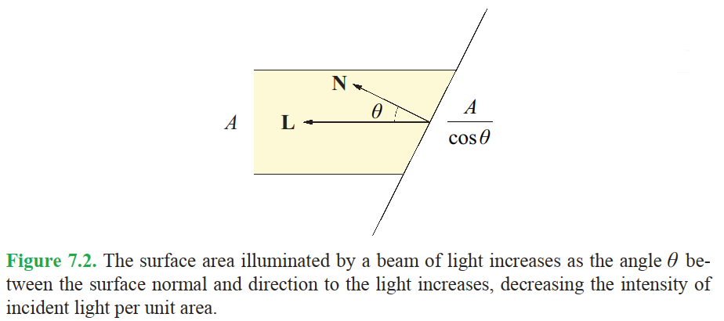

Slide 20
Diffuse Reflection..
The value of cosθ is given by the dot product between the normal vector N and the unit direction to the light source L. A negative dot product means that the surface is facing away from the light source and should not be illuminated at all. Thus, we clamp the dot product to zero in our illumination calculations.
We can now begin to construct a formula that calculates the color of light K that is reflected toward the viewer from a given point Q on a surface. This formula is written in terms of the intensity C_{i} of each of n lights illuminating the point Q, which is constant for directional light sources and is given by Equations (7.3) and (7.4) for point and spot light sources.

Slide 21
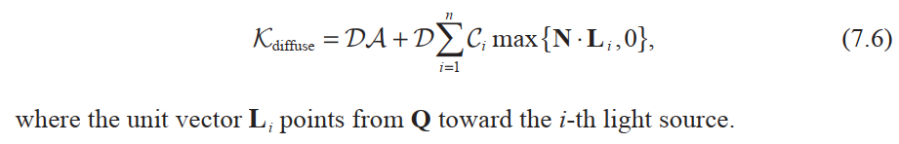

Diffuse Reflection..
The reflected light is modulated by the surface’s diffuse reflection color D. Adding the contributions from n light sources and considering the ambient intensity A, we can express the diffuse component of our lighting formula as :

Slide 22



Specular Reflection..
In addition to the uniform diffuse reflection, surfaces tend to reflect light strongly along the path given by the reflection of the incident direction across the surface normal.
This results in the appearance of a shiny highlight on a surface called a specularity.
Unlike the diffuse reflection, the specular reflection visible on a surface depends on the position of the viewer.

Slide 23
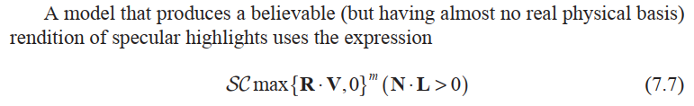




Specular Reflection..
Figure 7.3 shows the normal vector N at a point Q on a surface, the unit direction to viewer vector V, the unit direction to light vector L, and the direct reflection vector R. Specular highlights are the most intense when the reflection direction R points toward the viewer and decrease in intensity as the angle between R and the direction to the viewer V increases.

Slide 24
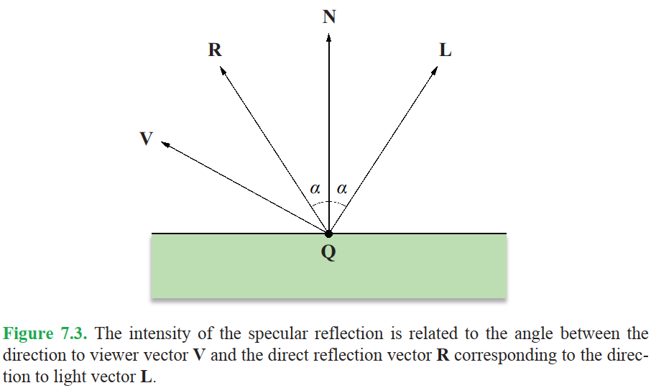






Specular Reflection..

Slide 25

Specular Reflection..
to calculate the specular contribution from a single light source, where S is the surface’s specular reflection color, C is the intensity of the incident light, and m is called the specular exponent. The expression (N . L > 0) is a Boolean expression that evaluates to 1 if true and 0 otherwise. This prevents specular highlights from showing up at points on a surface that face away from the light source.

Slide 26
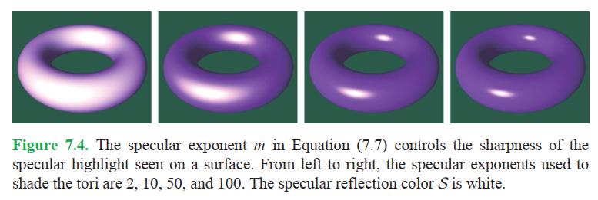


Specular Reflection..
The specular exponent m controls the sharpness of the specular highlight. As shown in Figure 7.4, a small value of m produces a dull highlight that fades out over a relatively large distance, and a large value of m produces a sharp highlight that fades out quickly as the vectors V and R diverge.

Slide 27
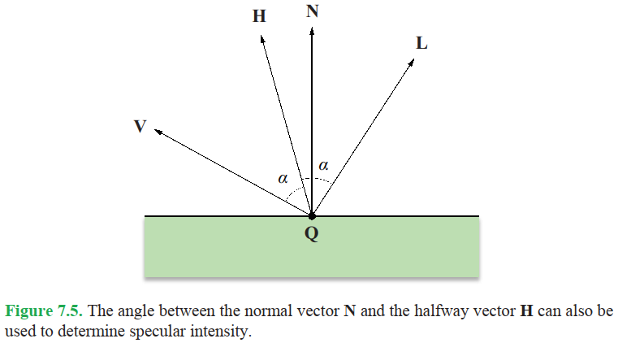


Specular Reflection..
An alternative formulation of specular highlights that requires less calculation in some cases makes use of a direction called the halfway vector. Shown in Figure 7.5, the halfway vector H is the vector lying exactly halfway between the direction to viewer vector V and the direction light vector L.

Slide 28
Specular Reflection..
Specular highlights are the most intense when H points in the direction of the normal vector N. Using this model, we replace the dot product R . V in Equation (7.7) with the dot product N . H. This produces different results in terms of the rate at which the specular highlights diminish, but still retains the general characteristics of our original model.

Slide 29
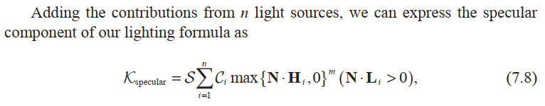


Specular Reflection..

Slide 30
Link to video
https://www.youtube.com/watch?v=U0XSsI0UDL8

