Slide 1
Normalization to terms
Token normalization is the process of canonicalizing tokens so that matches occur despite superficial differences in the character sequences of the tokens.
The most standard way to normalize is to create equivalence classes , which are normally named after one member of the set.
For Example: anti- discriminatory and antidiscriminatory are both mapped onto the term antidiscriminatory, in both the document text and queries, then searches for one term will retrieve documents that contain either.

Slide 2

Creating Equivalence Classes
We most commonly implicitly define equivalence classes of terms by, e.g.,
deleting periods to form a term
U.S.A., USA ⎝ USA
deleting hyphens to form a term
anti-discriminatory, antidiscriminatory map to antidiscriminatory
• Maintaining relations between unnormalized tokens
– Indexing unnormalized tokens and maintain a query expansion list of multiple vocabulary entries: when a query asks for “car”, search both “car” and“automobile”
– Expansion during index construction: index a document containing “car” under “car” and “automobile”
– Expansion of query terms can be asymmetric
– A more space costly but more flexible method
J. Pei: Information Retrieval and Web Search -- Tokenization
13

Slide 3
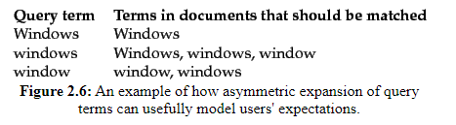
Normalization to terms
Sec. 2.2.3
An alternative to equivalence classing is to do asymmetric expansion
An example of where this may be useful
Enter: window Search: window, windows
Enter: windows Search: Windows, windows, window
Enter: Windows Search: Windows
Notes:
Why not the reverse?

Slide 4
Normalization: other languages
Sec. 2.2.3
Accents: e.g., French résumé vs. resume.
German: Tuebingen vs. Tübingen
Should be equivalent
Most important criterion:
How are your users like to write their queries for these words?
Even in languages that standardly have accents, users often may not type them
Often best to normalize to a de-accented term
Tuebingen, Tübingen, Tubingen ⎝ Tubingen

Slide 5
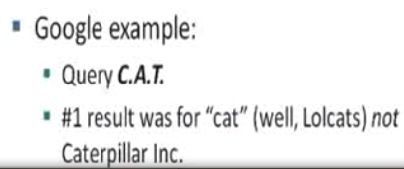
Sec. 2.2.3
Capitalization/case-folding
Reduce all letters to lower case
exception: upper case in mid-sentence?
e.g., General Motors
Fed vs. fed(governmental organization)
SAIL vs. sail
– Use some heuristics to make some tokens lowercase,
e.g., covert the first word in a sentence, all words in a
title
– Truecasing: use a machine learning sequence model to
make the decision
Often best to lower case everything, since users will use lowercase regardless of ‘correct’ capitalization…

Slide 6
Stemming and Lemmatization

Slide 7
Stemming and Lemmatization
• How can we know “organize”, “organizes”, and
“organizing” should map to the same word?
• Stemming and lemmatization: reduce inflectional
forms and sometimes derivationally related forms
of a word to a common base form
– am, are, is → be
– car, cars, car’s, cars’ → car
– “the boy’s cars are different colors” → “the boy car be
different color”
J. Pei: Information Retrieval and Web Search -- Tokenization
16

Slide 8
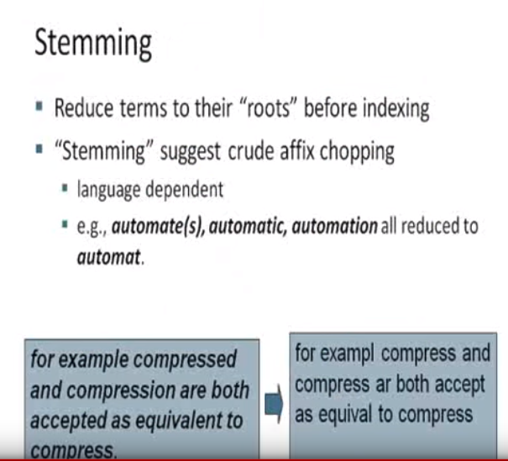

Slide 9
Stemming
• Algorithmic: a crude heuristic process that chops
off the ends of words in the hope of being correct
most of the time
– Often remove derivational affixes
• Porter’s algorithm
Conventions + 5 phases of reductions
phases applied sequentially
each phase consists of a set of rules
J. Pei: Information Retrieval and Web Search -- Tokenization
17

Slide 10
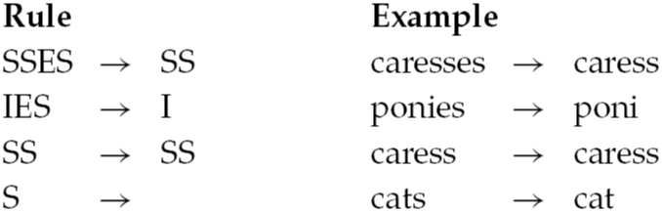
Porter’s algorithm
Sec. 2.2.4
Question:
circus canaries boss ponies
measure of a word:
which check the number of syllables to see if the word is long
enough to regard the matching portion of a rule as a suffix rather
than as part of the stem of word
Use “(m>1) EMENT → ” to map replacement to replac
Cement isn’t mapped

Slide 11
Lemmatization
• Dictionary-based stemming
• Use a vocabulary and morphological analysis of
words to remove inflectional endings only and
return the base or dictionary form of a word
(lemma)
• “saw” → “see” or “saw” depending on whether
the token is used as a verb or a noun
• Can bring very modest benefit for retrieval in
English – improving recall but may hurt accuracy
e.g: query entered “ operating and system” not good matching
operate and system
J. Pei: Information Retrieval and Web Search -- Tokenization
19

Slide 12
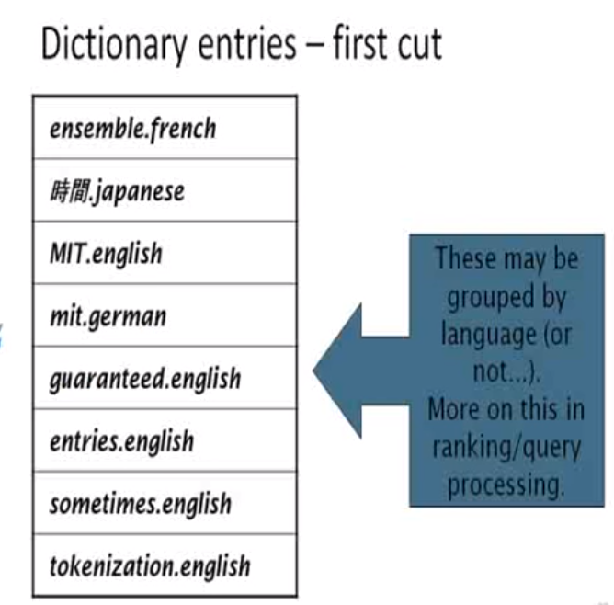

Slide 13
Faster postings merges: Skip pointers/Skip lists

Slide 14
Recall basic merge
Sec. 2.3
Walk through the two postings simultaneously, in time linear in the total number of postings entries
2
4
8
41
48
64
128
Brutus
2
8
1
2
3
8
11
17
21
31
Caesar
If the list lengths are m and n, the merge takes O(m+n)
operations.
Can we do better?
Yes (if the index isn’t changing too fast).

Slide 15
Augment postings with skip pointers (at indexing time)
Sec. 2.3
41
128
2
4
8
41
48
64
128
11
31
1
2
3
8
11
17
21
31
Why?
To skip postings that will not figure in the search results.
How?
Where do we place skip pointers?

Slide 16
Query processing with skip pointers
Sec. 2.3
41
128
2
4
8
41
48
64
128
11
31
1
2
3
8
11
17
21
31
Suppose we’ve stepped through the lists until we process 8 on each list. We match it and advance.
We then have 41 and 11 on the lower. 11 is smaller.
But the skip successor of 11 on the lower list is 31, so
we can skip ahead past the intervening postings.

Slide 17

Consider a postings intersection between this postings list, with skip pointers:
and the following intermediate result postings list (which hence has no skip pointers):
3 5 89 95 97 99 100 101
How often is a skip pointer followed?
b. How many postings comparisons will be made by this algorithm while intersecting the two lists?
c. How many postings comparisons would be made if the postings lists are intersected without the use of skip pointers?
24
75
92
115

Slide 18
Where do we place skips?
Sec. 2.3
Tradeoff:
More skips → shorter skip spans ⇒ more likely to skip. But lots of comparisons to skip pointers.
Fewer skips → few pointer comparison, but then long skip spans ⇒ few successful skips.

Slide 19
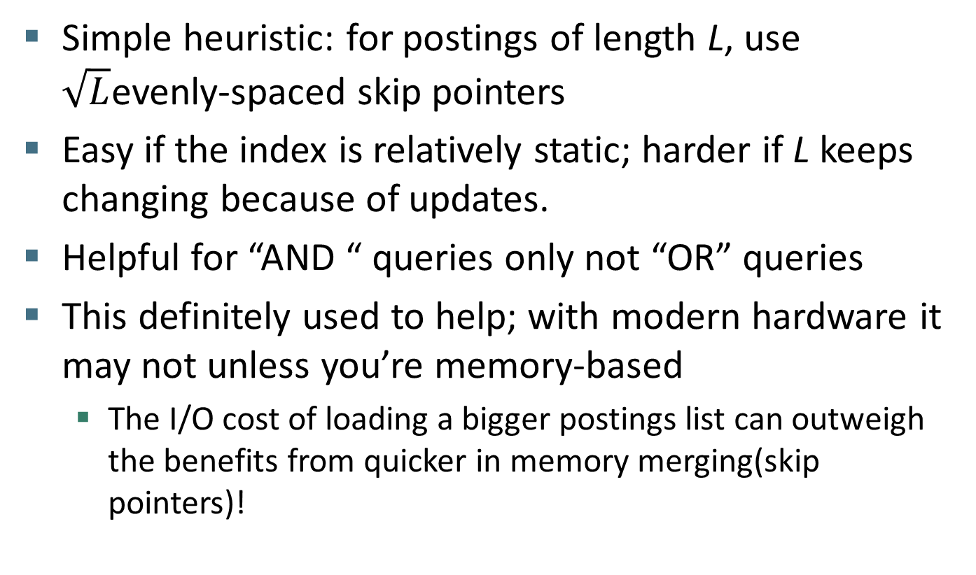
Placing skips
Sec. 2.3
Transfer time from desk will grow by adding skip pointers

Slide 20
